Slide 1
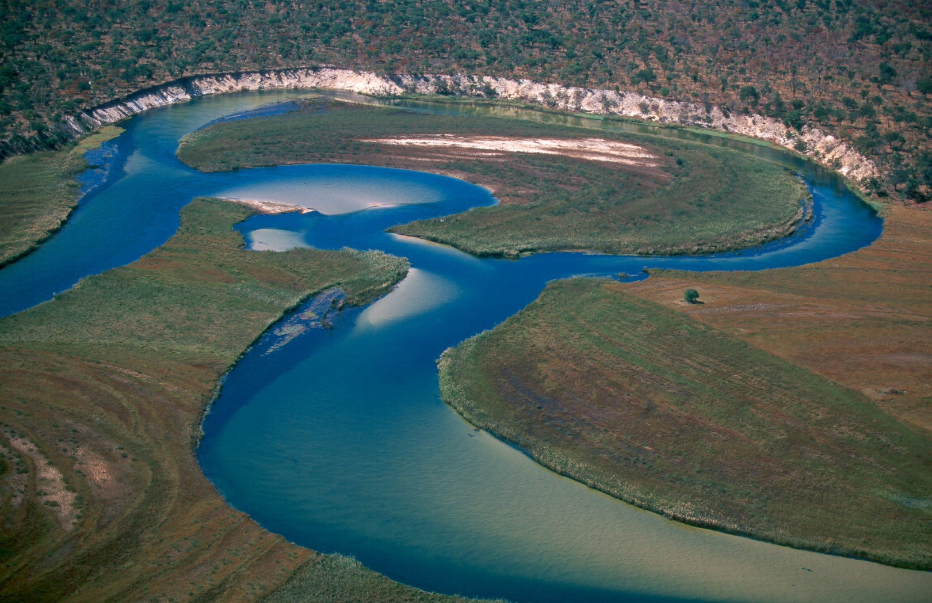
Major changes and challenges in the
Okavango Catchment
Reference report: https://the-eis.com/elibrary/search/33146

Slide 2
The Okavango/Cubango Basin is special:
Economically
Hydrologically
Environmentally

Slide 3
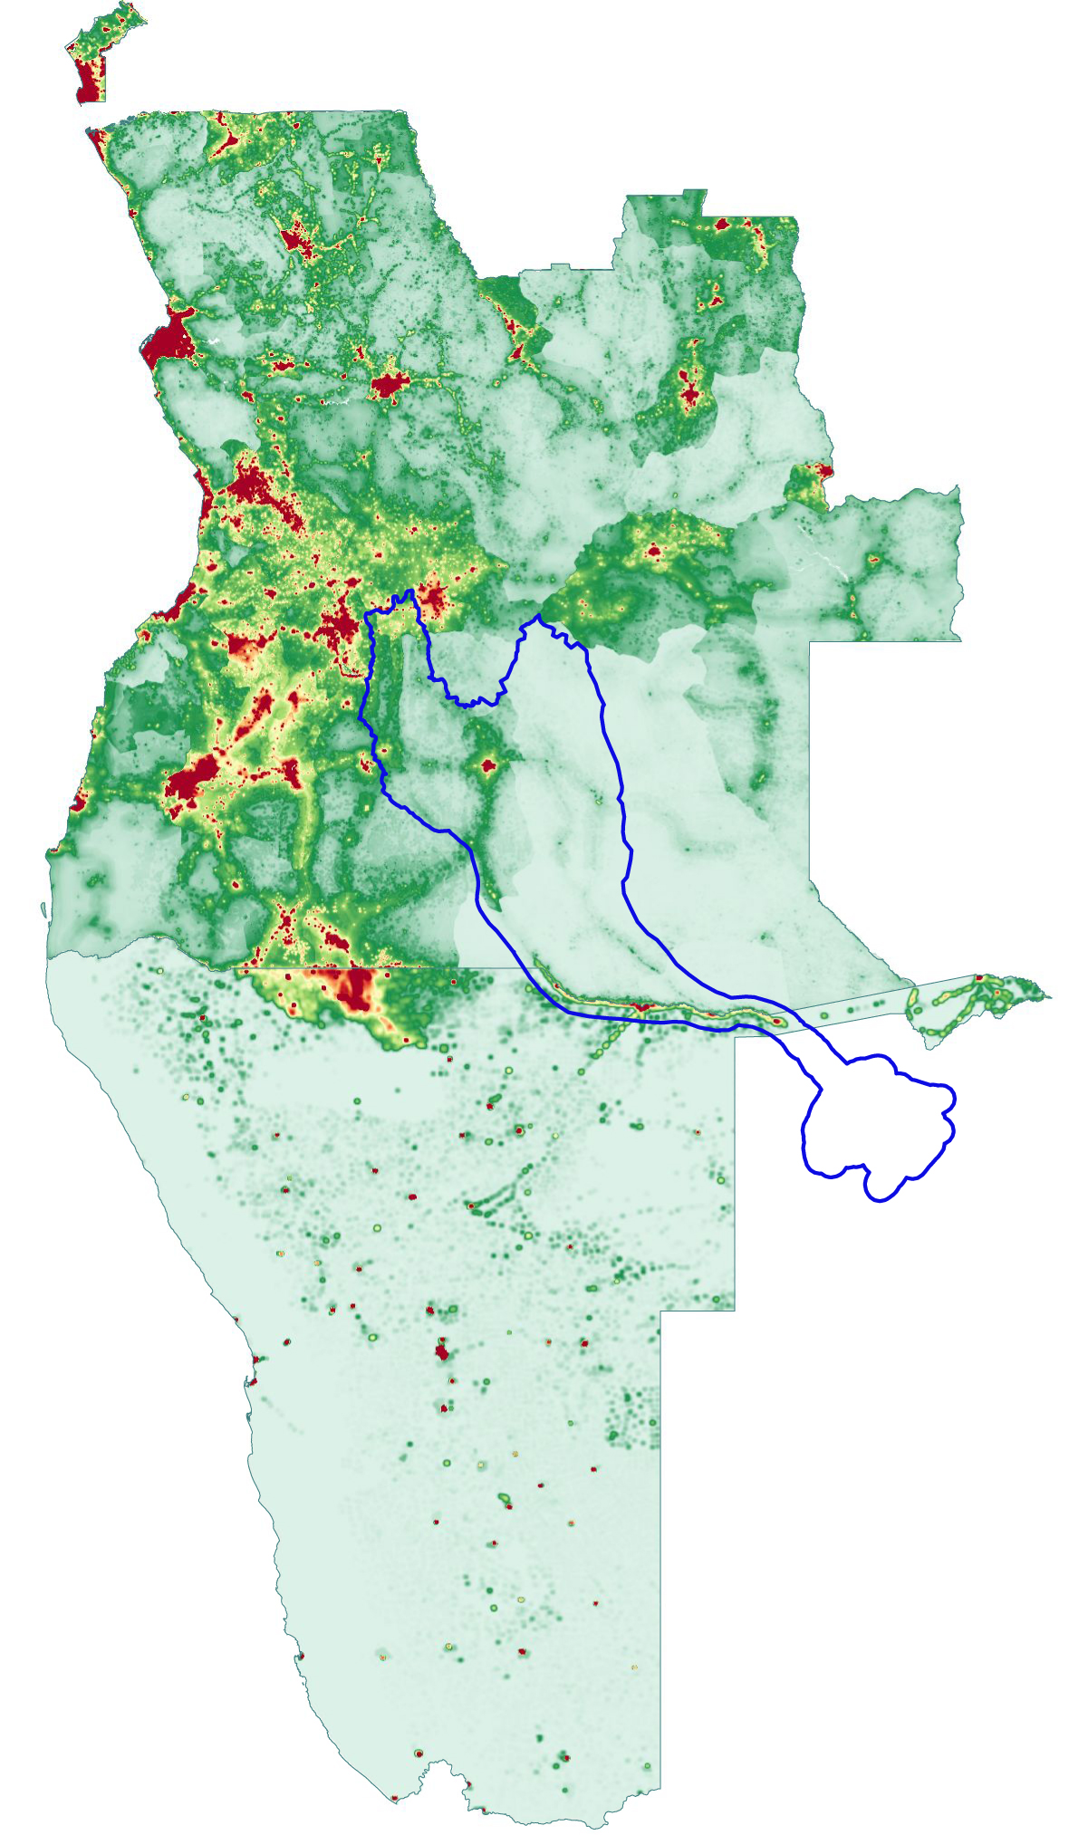
Key features
Most soils have very low fertility
Sparse rural population with very little income
Land and water are free
Minimal management of natural resources
No management of water resources

Slide 4
Major changes
Large growth of commercially run agricultural schemes
Land has gained commodity value for farming
Substantial urban migration and growth
Therefore, increased use of river water

Slide 5
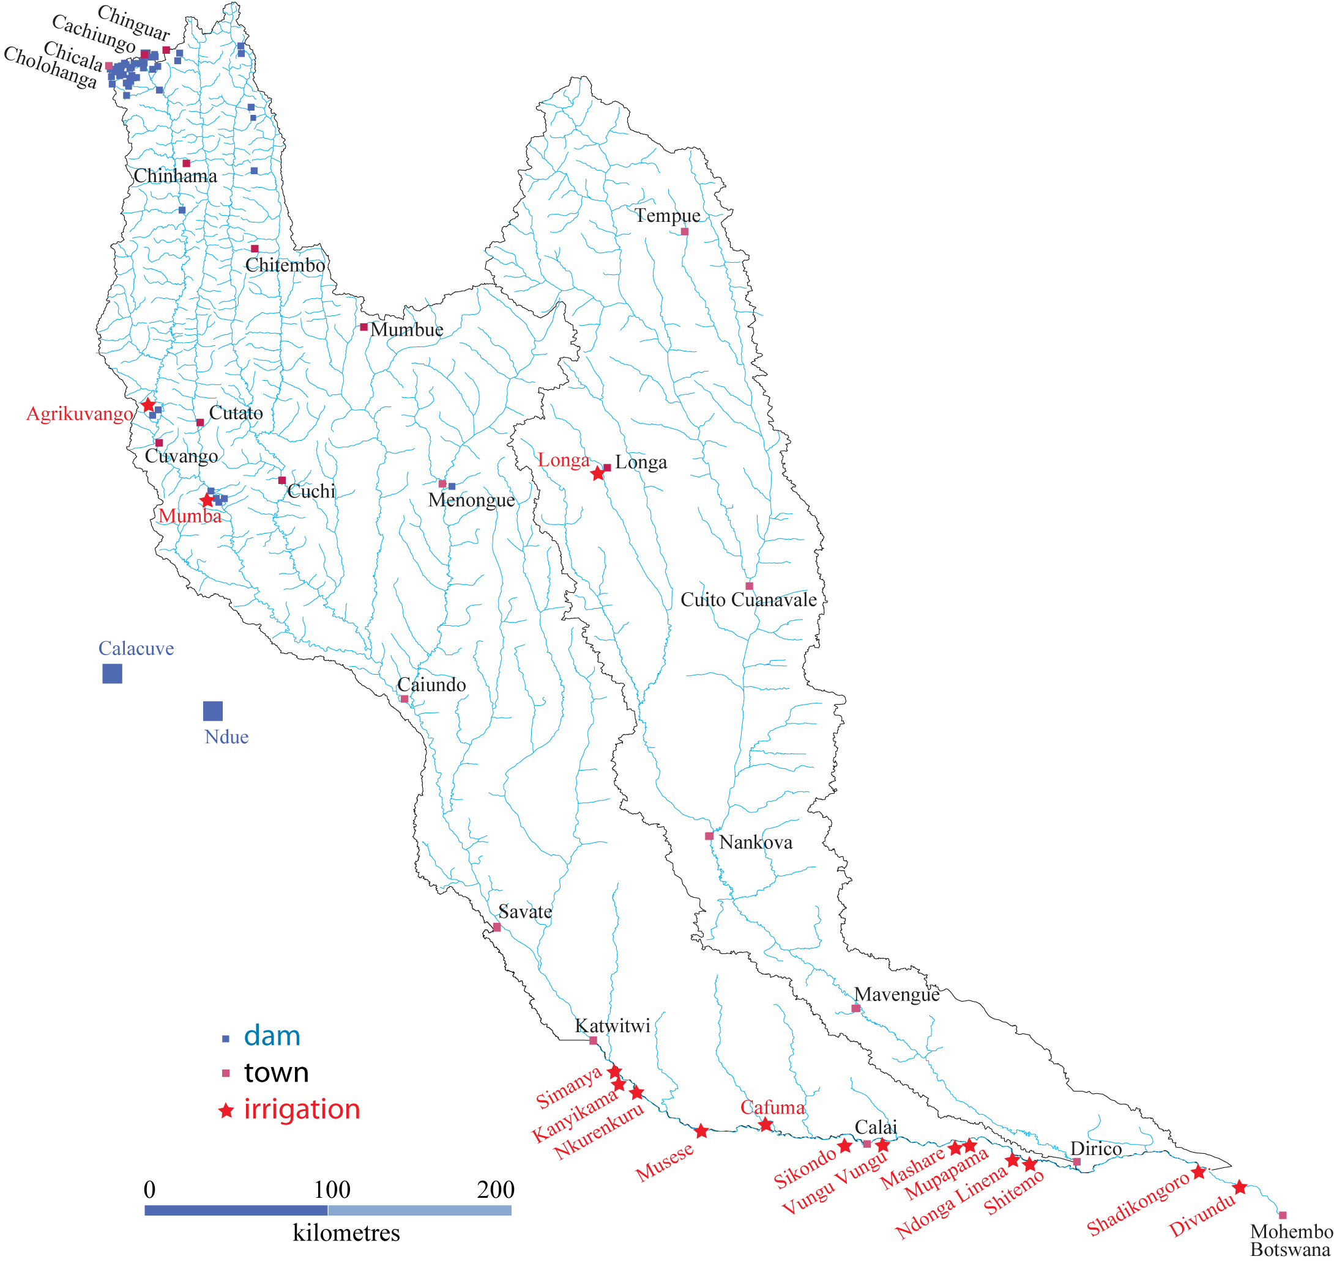
Commercial farming
and
new dams
and piped offtake
Major farms and irrigation schemes and dams
Land and water are essentially free

Slide 6
 |  |  |  |  |  | % change
 |  | Water offtakes grew from | 89 pumps | in | 2017
 |  | to | 244 pumps | in | 2023 | 274%
 |  | Private irrigated land went from | 3,220 ha | in | 2020
 |  | to | 5,320 ha | in | 2024 | 65%

Slide 7
What is happening and will continue (1)
More uncontrolled local use of river water in Angola and Namibia, for:
Growing settlement along the river and in urban areas
Greater use of river water for commercial agriculture and industrial and domestic use
Probable pumping of water into the Cuvelai of Angola and perhaps Namibia

Slide 8
What is happening and will continue (2)
Environmental quality and value of the river will decline
Tourism to Namibia will decline leading to economic job and livelihood losses
Tourism will decline in Botswana with major societal and economic impacts
Namibia will have unhappy neighbours and will suffer reputational damage

Slide 9
Looking ahead
No prospect of substantial controls of the river water
“Help yourself” attitude will prevail
Serious likelihood that the river will drop to a trickle or even dry up occasionally
Windhoek won’t be able to use Okavango water for long
It is stupid to spend alot of money on a water supply that has a short life and that will cost Namibia lots of international harm

Slide 10
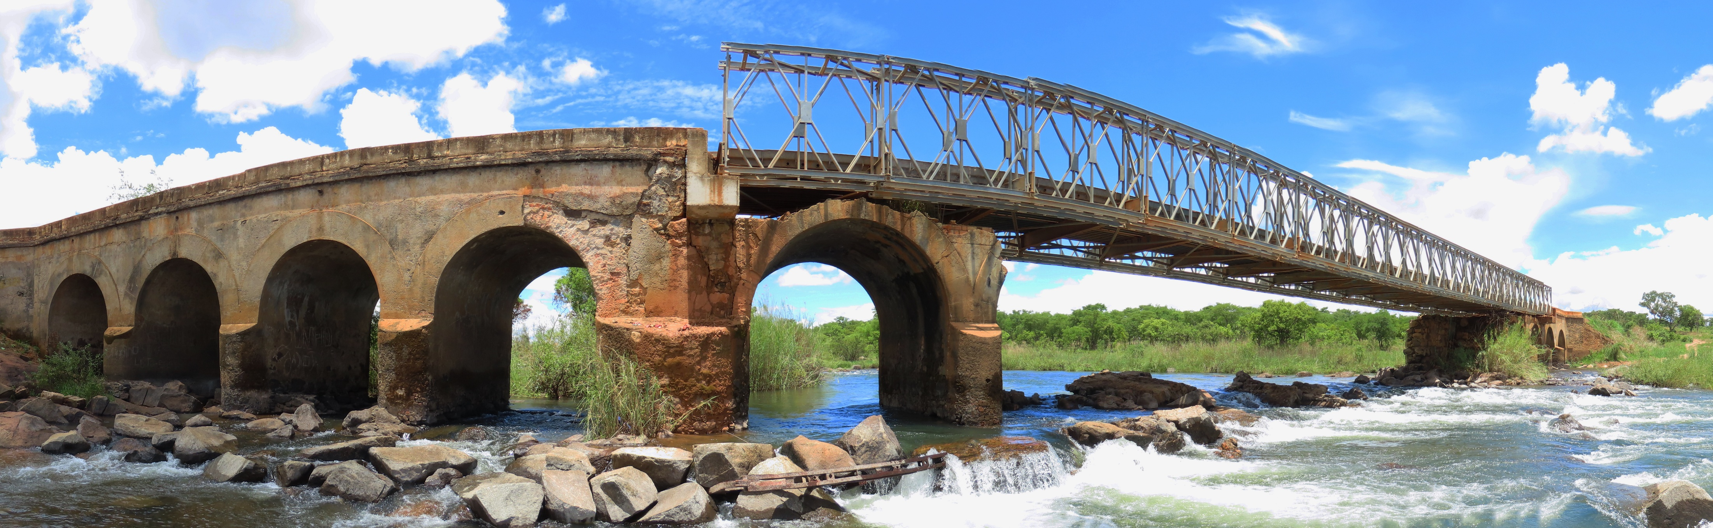
Thank you

Slide 11
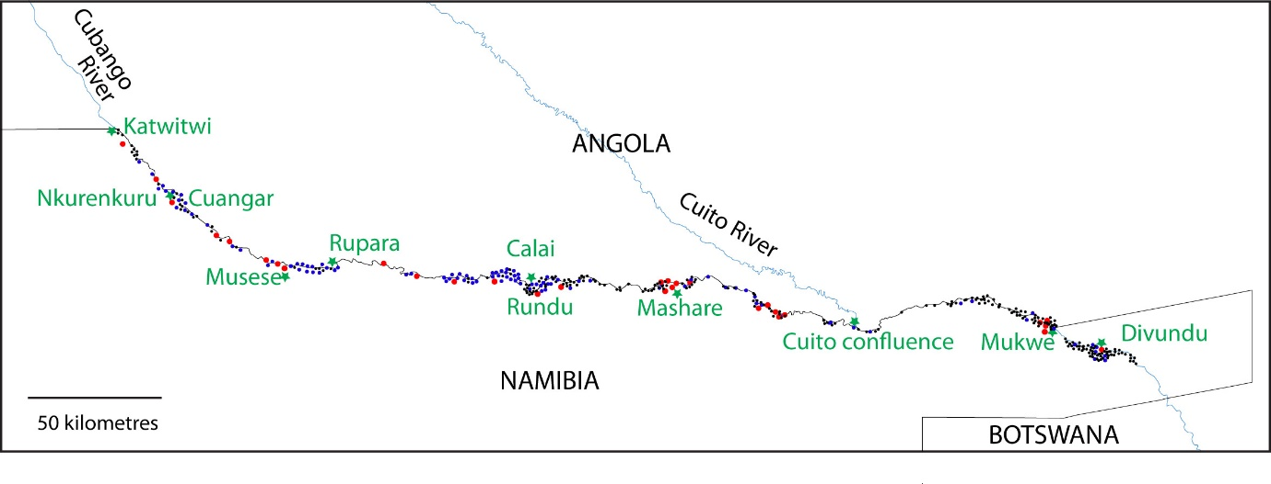
Locations of mapped offtakes in September 2023
In Angola: 9 pipes
In Namibia: 344 pipes

