Slide 1
THE PERFORMANCE, QUALITY, AND EFFECTIVENESS OF ENVIRONMENTAL IMPACT ASSESSMENT POLOCY IN NAMIBIA
Dr. Dietlinde Nakwaya-Jacobus
Senior Lecturer
Sam Nujoma Campus
University of Namibia

Slide 2

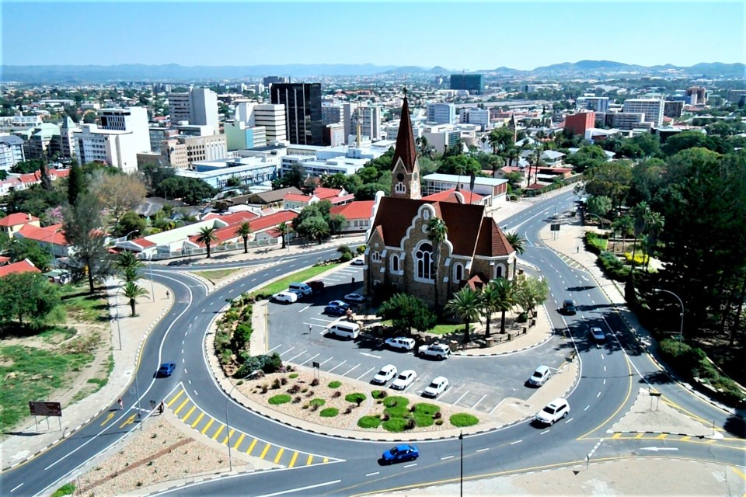



Imagine a world where
Everyone plan, design, develop wherever they wish

Slide 3
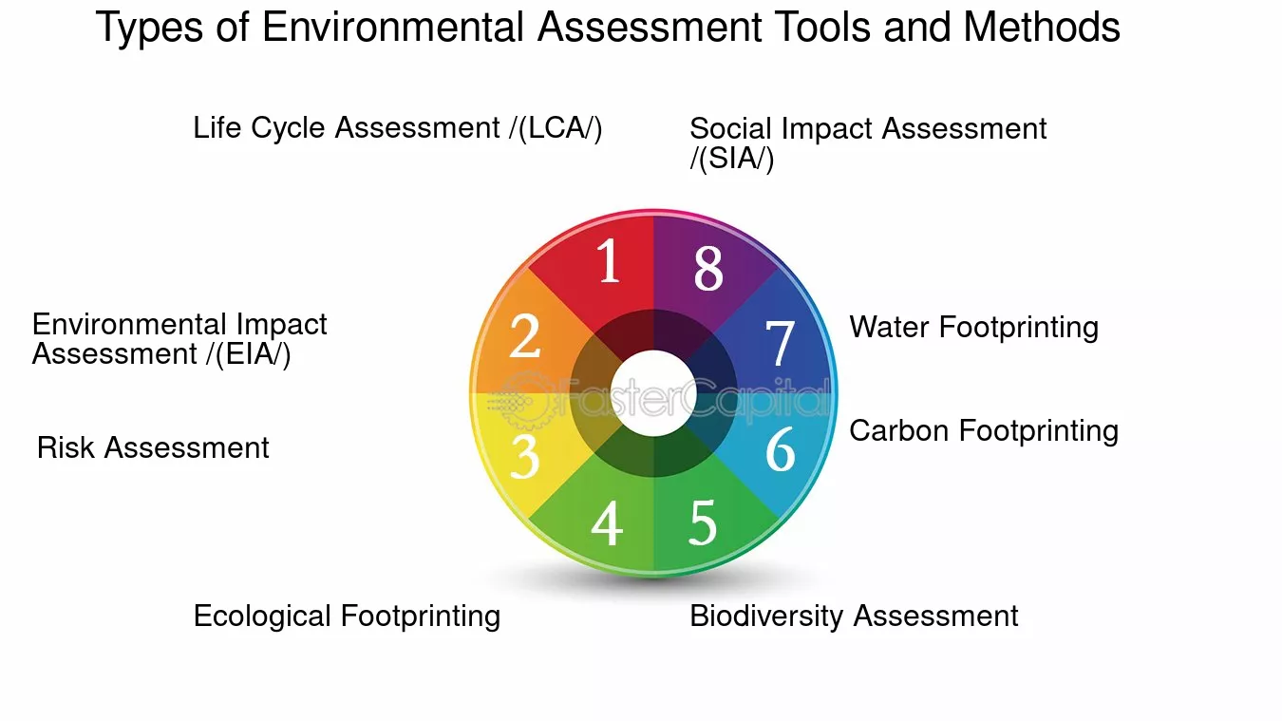

Slide 4
1. ENVIRONMENTAL IMPACT ASSESSMENT
A process that evaluates the potential environmental effects of a proposed project/development.
Dates back to 1970s:
  Nations realising the impact of human activities on the environment (Morgan, 2012).
It is the most accepted environmental governance tool (IAIA, 2009).
Now called ESIA: emphasis on the social.

Slide 5

2. What EIA does?
  Protect environment and society.
  Identify factors that may hinder the implementation of the proposed development.
  Reduce conflict between the development and environment.
  Ensure sustainable development.
Dreamtime.com

Slide 6
EIA Systems in African Countries
Country
EIA System
Quality
Regulatory
Framework
SEA
Monitoring
Egypt, Ghana, Mauritius,
South Africa, Kenya,
Ethiopia, Tanzania,
Gambia
High
In place
In place
Yes
Namibia
Medium
In place
Lacking
No
Somalia, South Sudan,
Equatorial Guinea, Central
African Republic
Low
Lacking
Lacking
No
(Ibeh & Walmsley, 2021)

Slide 7
Todays focus: Namibia EIA System Evaluation
Evaluating EIA's current
effectiveness
System Status
Assessing EIA's
governance adherence
Process Quality
Understanding actors'
views on EIA
Stakeholder
Perceptions
Learning from practical
implementations
Case Study
Lessons
Enhancing EIA for better
outcomes
EIA System
Improvement

Slide 8
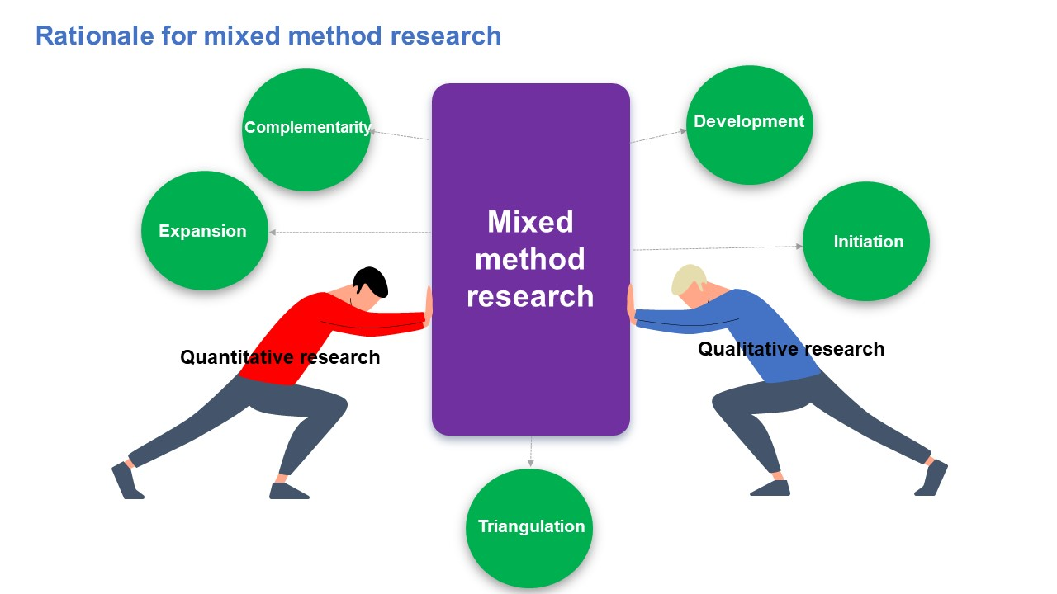
3. METHODOLOGY
Mixed method: a combination of both the quantitative and qualitative data (Denscombe, 2008).
  Suitable because of limited research.
Survey questionnaire
SPSS & Excel
Descriptive: Cross tabs
Interviews
With experts
NVIVO- Thematic analysis

Slide 9
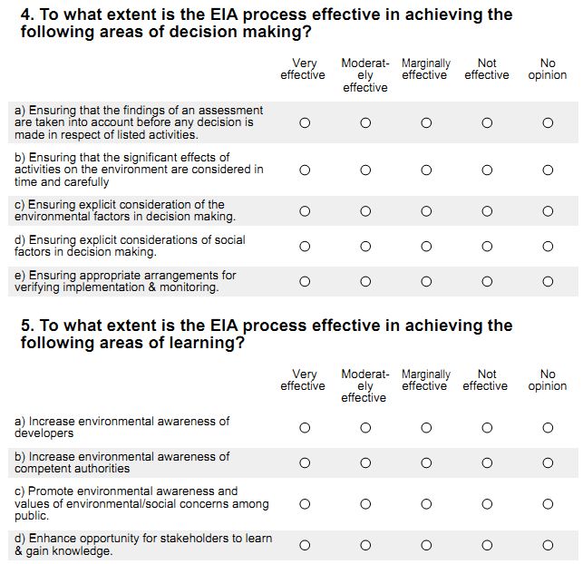
3.1 SURVEYS
Survey
Part A: Consent, contextual information institution, gender, age, years of experience, and stages of EIA involvement.
Part B: 9 sections of closed questions.
Section 1: Performance and procedural effectiveness (objective 1);
Section 2: Good governance quality in the EIA process (objective 2);
Section 3 – 9: Substantive, normative & transactive elements (objective 3).
Part C: Case study analysis

Slide 10
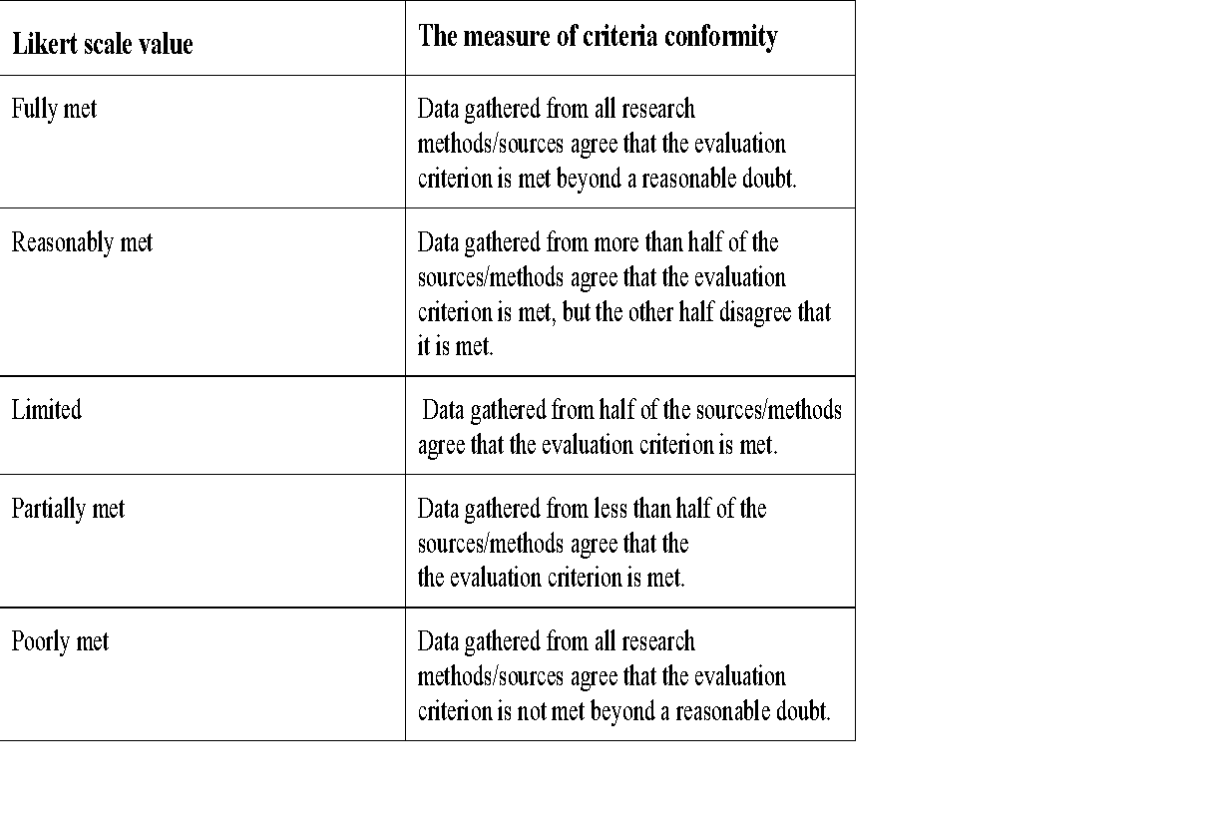
3.2 CRITERIA

Slide 11
4. RESULTS
Variable | Category | Count (n) | Percentage (%)
Gender | Female | 42 | 38%
 | Male | 68 | 62%
Highest Qualification | Grade 12 | 0 | 0%
 | Bachelor | 28 | 25%
 | Masters | 64 | 57%
 | PhD | 20 | 18%
Age category | 20-30 | 13 | 12%
 | 30-40 | 62 | 56%
 | 40-50 | 17 | 15%
 | 50+ | 19 | 17%
Years of experience in EIA | Less than 1 year | 10 | 9%
 | 1-5 years | 42 | 39%
 | 5-10 years | 31 | 28%
 | 10+ years | 26 | 24%
Number of EIAs involved in | None | 12 | 11%
 | 1-4 | 32 | 30%
 | 5-9 | 19 | 18%
 | 10+ | 43 | 41%
Table 6.1 : Contextual information of survey respondents

Slide 12
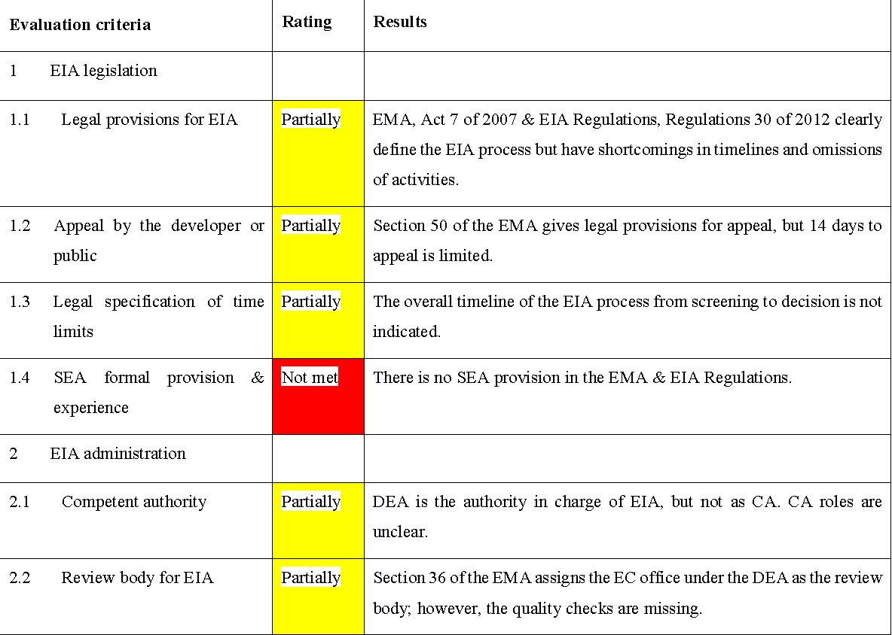
Performance
4.1 EIA system implementation and monitoring | Not met | Provisions on EIA system monitoring are not in the legislation.
4.2 EIA guidelines including sectoral authority | Not met | No sectoral guidelines or regulations exist.
4.3 Expertise in conducting EIA | Not met | No requirement exists for EIA expertise registration or certification.
4.4 Training and capacity building. | Not met | No training or capacity-building provisions exist in the legislation.
Notes:
Substantive evidence available fully met; some evidence partially met, and no evidence was classified as not met.

Slide 13
6. RESULTS : Performance
Systemic measures:
  11/12 are partially met, except SEA provisions.
Foundation measures:
  All Not met
  These are important for system performance.
  They are the actions undertaken to improve the effectiveness and successful application of the EIA system.
  The absence renders the EIA system inadequate, ineffective, and prone to manipulation and corruption.

Slide 14
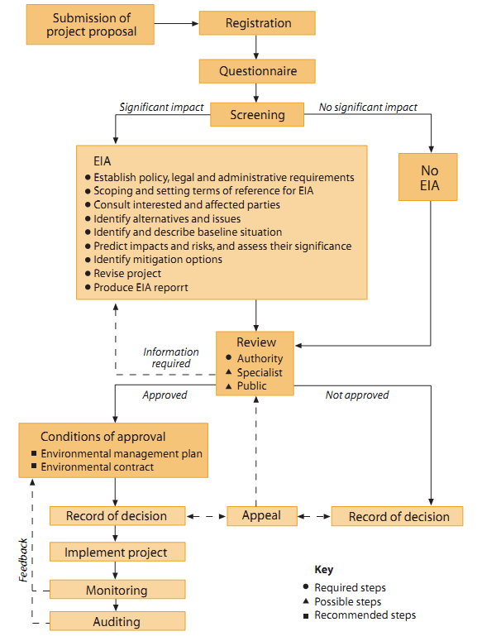
6. RESULTS : EIA Process
Rigid process
Good Institutional arrangement in place (DEA & EC office).
Partially conforming to best, ideal practices.
Lacking on PP, review and DM, monitoring, Auditing.
Consultations on EIA regulations in 2018.
EIA reform Not completed.
Figure 6. 1: Namibia EIA process

Slide 15
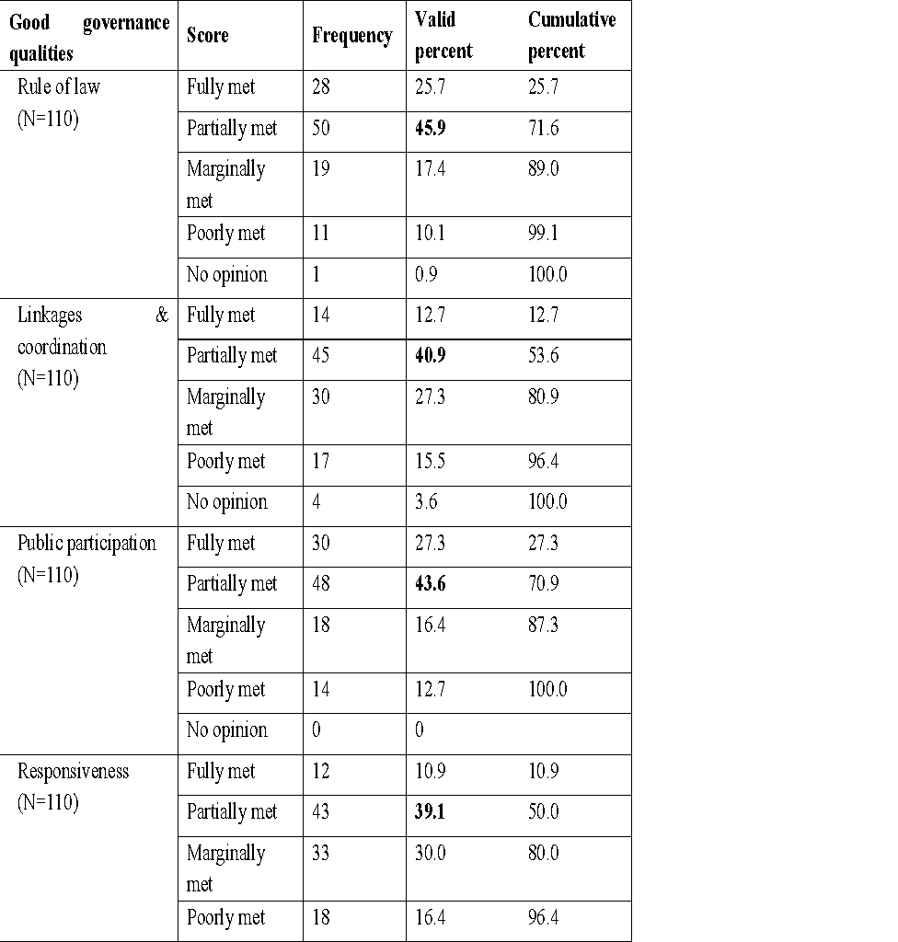
6. RESULTS : EIA Quality
Table 6.2: Actors’ Perceptions on governance qualities in Namibia EIA process (n=110)
Majority indicated: environmental laws exist, but they are not respected.
“there are multimillion-dollar coastal developments that should never have happened e.g. the Container terminal project and the Platz A-meer raft extension, environmental rules were not followed” [GovSS1].
“The EIA tool is useful, but there is hardly communication between the DEA and other organs of state & Local authority.” [LAM2].
Notes:
Fully met, Partially met, Marginally met, Poorly met, No opinion

Slide 16
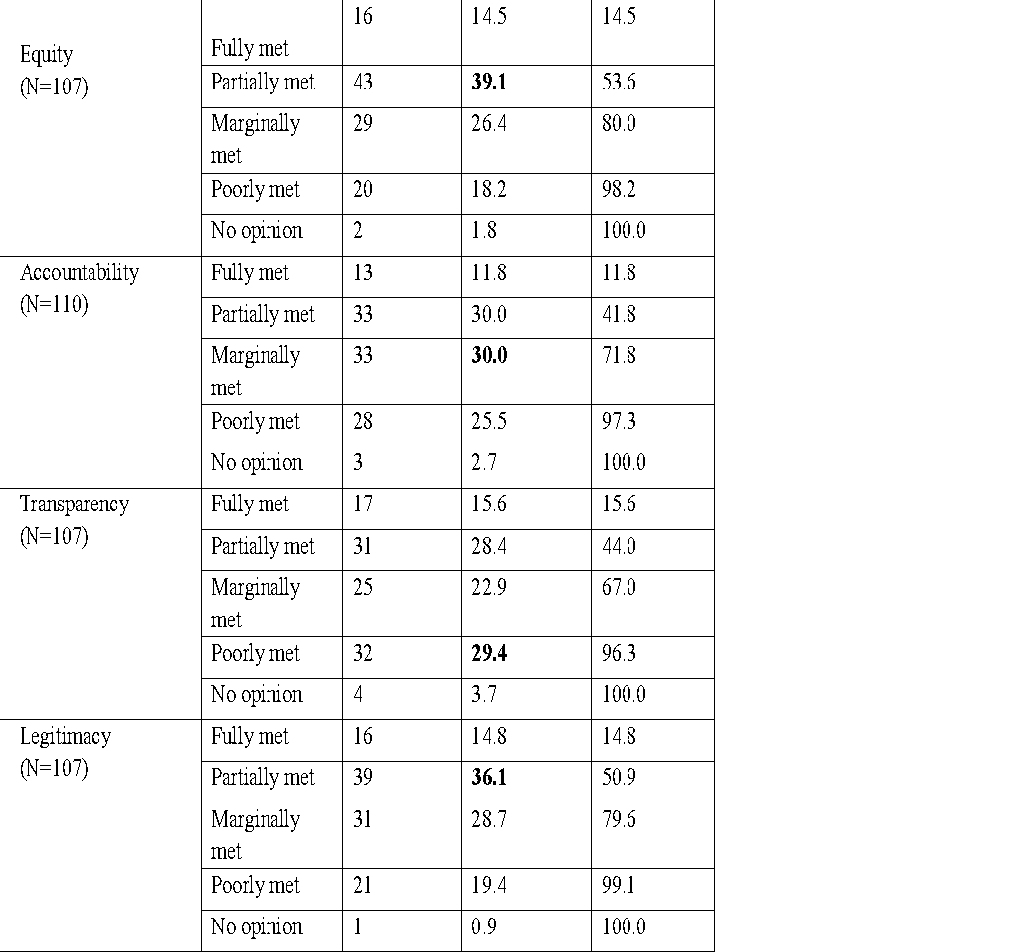
6. RESULTS : EIA Quality….
Transparency- poorly met
Accountability- Marginally met
A well-conceived EIA should reflect many of the elements of good governance qualities to produce positive governance outcomes and to ensure networks among stakeholders (Kakonge, 2006).
An EIA process that meets good governance qualities can mitigate the hazards of political conﬂicts (Monteiro et al., 2018).
Namibia's EIA process may have minimal effect on producing quality results to effect good environmental decisions.
Can be deemed inadequate.

Slide 17
6. RESULTS : EIA effectiveness - DM
EIA is moderately effective in influencing elements of decision-making.
Interviewed scientist (DEA): “EIA is helpful in DM, some developments were stopped, e.g., phosphate mining” [Gov_S1].
“There have been quite a lot of improvements in project decision making, but countrywide we need more monitoring and implementation & strategic assessment” [Gov_SS1].
Majority of experts concerned that the EIA process in Namibia is more of a “one-man show” the ultimate decision lies with the EC.
Recommending: current sustainable advisory committee be strengthened to help EC in DM on national projects.
Figure 6. 3: Actors’ Perceptions: EIA’s Effectiveness in Achieving Elements of Decision Making (n=110).

Slide 18
6. RESULTS : EIA effectiveness- Learning
EIA is moderately effective in all elements of learning.
Senior scientist:
  “It is time Namibians realize that they have a voice in EIA, but public can only learn if they are involved; projects in rural areas hardly get communities' opinion because people do not partake” [Gov_SS3]
Senior scientist: the EIA process creates an opportunity for learning and awareness:
  “Even as a reviewer, one learns a lot, public and other actors can definitely learn more” [Gov_SS2].
Majority of experts were pessimistic about EIA to enhance institutional memory, indicating that in government ministries, EIA projects are designated to only a few selected individuals, & there is no proper handover when individuals resign from the position.
Experts' recommendations:
  The need for institutions to improve the archiving and records of EIA projects.
  More people need to be trained/ aware on EIA process.
Figure 6. 6: Actors’ Perceptions: EIA’s Effectiveness in Achieving Elements of learning (n=110).

Slide 19
6. RESULTS : EIA effectiveness- Leadership
Rating: Moderately effective
Academic expert: emergency of leadership is still far-fetched for the Namibia EIA system stating that:
  “we are still in that old-fashioned approach where EIA practitioners meet the community, by way of informing and then off they go” [Ac_1].
Academic expert: emergence of leadership is more likely in urban settings as compared to rural areas, saying:
  “With developments that happen in towns, people team up and can agree to have a leader who can stand up for them, but we do not have much happening in our rural communities” [Ac_2].
Figure 6. 8: Actors’ Perceptions: EIA’s Effectiveness in contributing to emerging leadership styles (n=110).

Slide 20
6. RESULTS : transactive effectiveness
Senior government scientist: “Cost efficiency in EIA should not be mistaken with cheap, stating that investors should pay for environmental services including EIA, like other professional services” [Gov_SS3].
Government official: “the cost of EIA needs regulations, as consultants set prices on their own” [Gov_S4].
Majority experts highlighted that the ineffectiveness results from:
  Limited administrative power of DEA because of it is position in Gov.
  Translating into limited funding, human resources, expertise.
Recom: DEA to be autonomous
Figure 6.10: Actors’ Perceptions: EIA’s Effectiveness to achieving Elements of transactive (n=110)

Slide 21
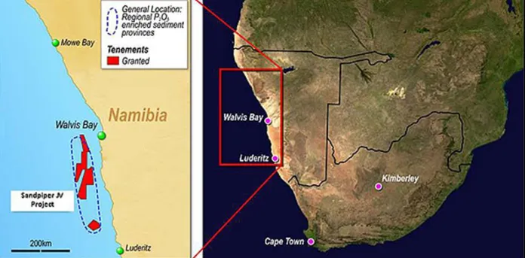
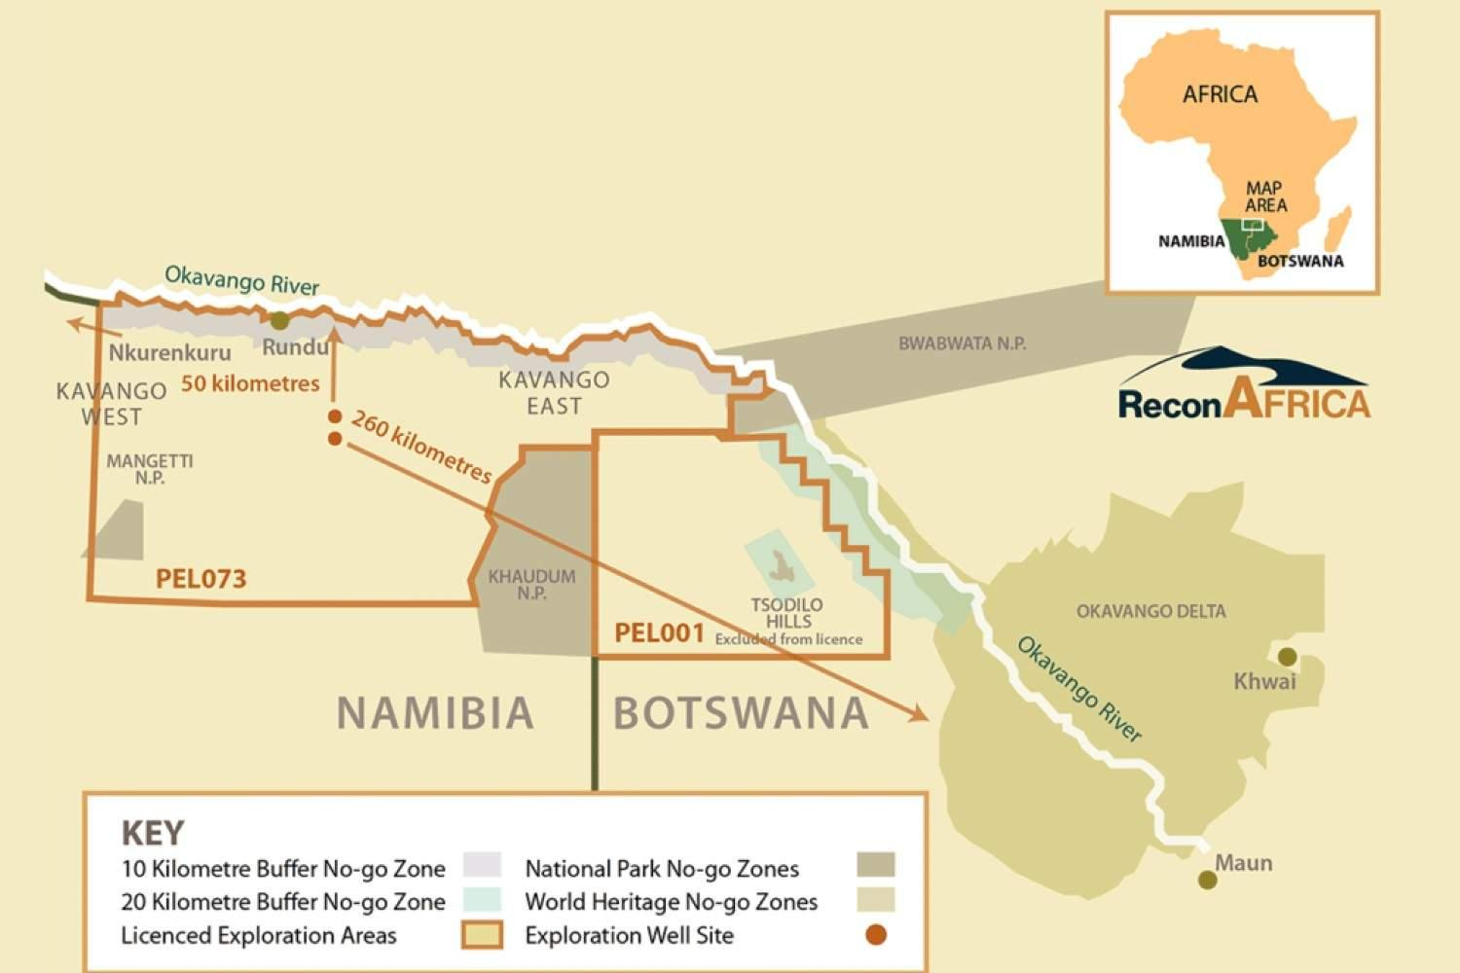
Namibia Phosphate Mining
Recon Africa oil
The NMP project is a joint venture between Mawarid Mining LLC and Havana Investments (PTY) Ltd, aimed at exploiting marine phosphate deposits in Namibia's continental shelf.
The licensed area, (ML) 170 spans 2,233 km² on Namibia's continental shelf, 60 km offshore and 120 km southwest of Walvis Bay (Benkenstein, 2014).
ECC in 2012.
The REN project, a subsidiary of Reconnaissance Energy Africa Ltd, leads the oil drilling project in Namibia’s Kavango region & within KAZA TFCA.
Their drilling program includes exploration wells, stratigraphic test wells, and a 3D seismic survey.
ECC obtained in 2019.

Slide 22
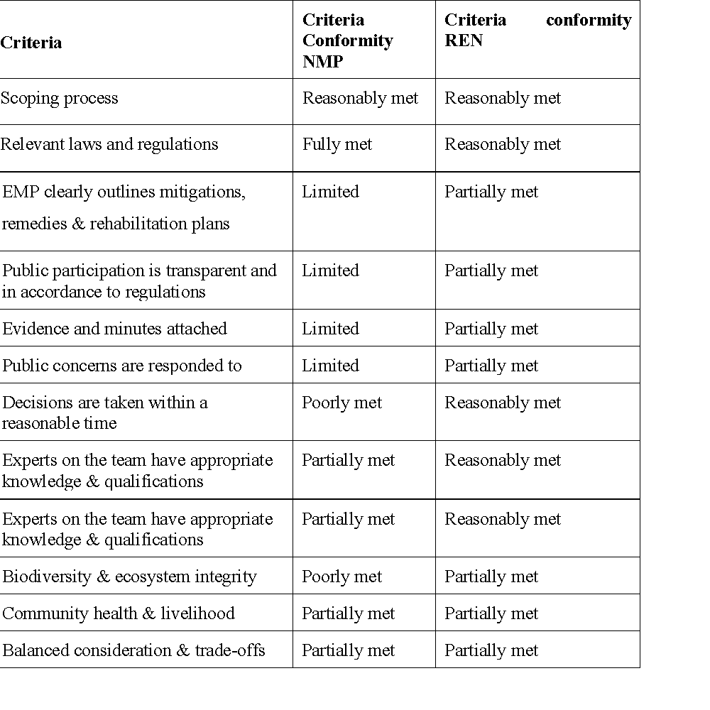
6. RESULTS : EIA reports-Case study analysis
NMP REN
4 Limited -
3 poorly met -
1 fully met -
6 partially met 9 partially
1 reasonably met 6 reasonably met

Slide 23
6. RESULTS & DISCUSSION Objective 4: Case study
REN report failed to acknowledge legislation related to forestry and communal land.
  A significant omission, considering the potential impacts that oil exploration can have on land use, biodiversity, and local communities.
NMP undertook a verification study as an additional measure in their assessment:
  good idea but without an ECC- High level of non-compliance.

Slide 24
6. RESULTS & DISCUSSION Objective 4: Case study
Failure:
Cumulative impacts not adequately addressed.
No clear information on monitoring and rehabilitation.
  For such complex projects, responsibility & funding commitments ought to be clear.
Inappropriate advertisement PP methods; language barrier:
  Newspapers -Republikein
  Radio is appropriate given the context.
Such deficiency & flawed information is a concern to Environmental governance----- treatment of marginalized community.

Slide 25
8. CONCLUSION & RECOMMENDATIONS
Status & Performance:
Namibia partially conforms to criteria of an internationally ideal system.
Has a functional EIA system based on:
  Good legal basis
  A well-established institutional arrangement, and
  a specified EIA process for new and existing development & public & private .
Namibia is committed to good environmental governance as noticed in the consistitution & efforts in NDP (Environmental sustainability).
EIA process has a preventive effect, evident from numerous projects halted due to EIA decision.
Due diligence is needed to develop foundational measures: which are key to improve performance.

Slide 26
8. CONCLUSION & RECOMMENDATIONS
Quality:
Namibia EIA process seems inadequate as it only partially satisfies good governance qualities.
Poor rating of transparency and accountability is a challenge.
EIA cannot be a good governance tool for Env. Sustainability, without it fully satisfying these principles.

Slide 27
8. CONCLUSION & RECOMMENDATIONS
Effectiveness:
Namibia EIA system is moderately effective in contributing to elements of effectiveness.
Influence of EIA on appropriate DM, Learning & emergence of leadership are core- need improvement.
The moderate rating does not imply failure because certainly, the situation could have been worse in the absence of EIA.
For an EIA system that has not been reviewed, these results are somewhat positive, and with improvements, & legislation reform -system can become effective and efficient.

Slide 28
8. CONCLUSION & RECOMMENDATIONS
Case study analysis:
Challenges:
  Lack of EIA expertise, inadequate and poor public consultations, mistrust between actors, lack of accountability in monitoring & rehabilitation, limited consideration of socio-economic impacts of projects, compromised decision making.
These limitations confronts the implementation & credibility of the EIA process, raising questions on the stewardship of environmental governance in Namibia.
EIA can help define the country’s developmental path and the betterment of its people.

Slide 29
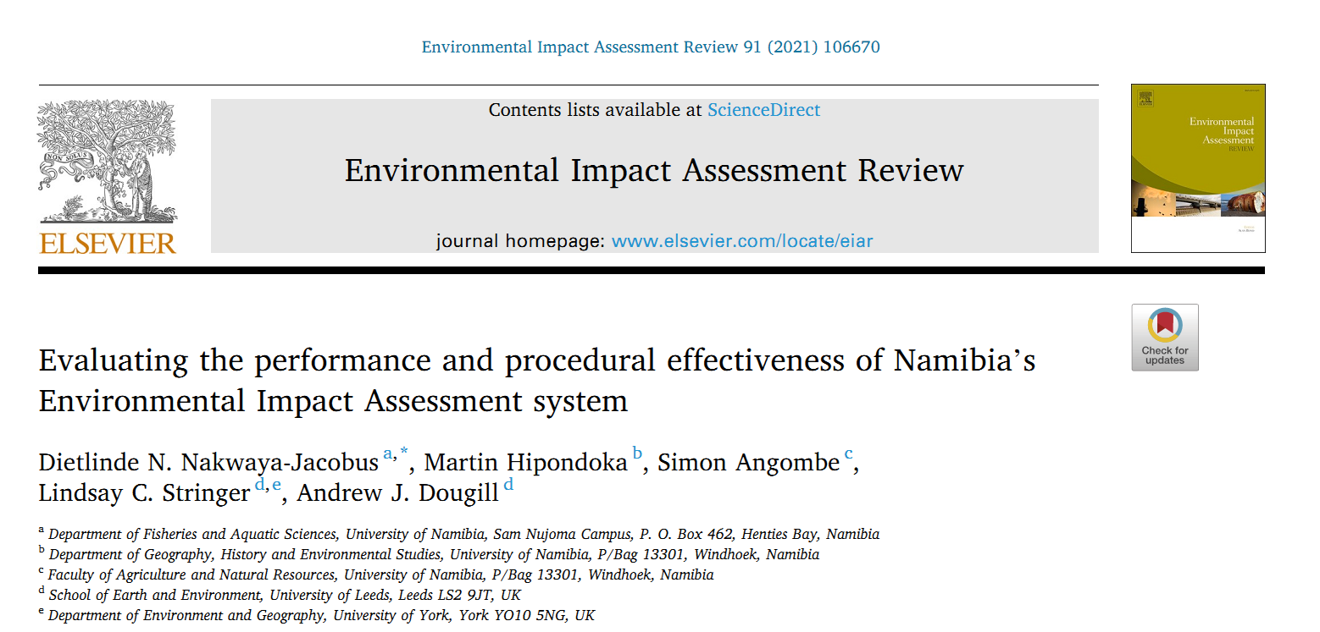
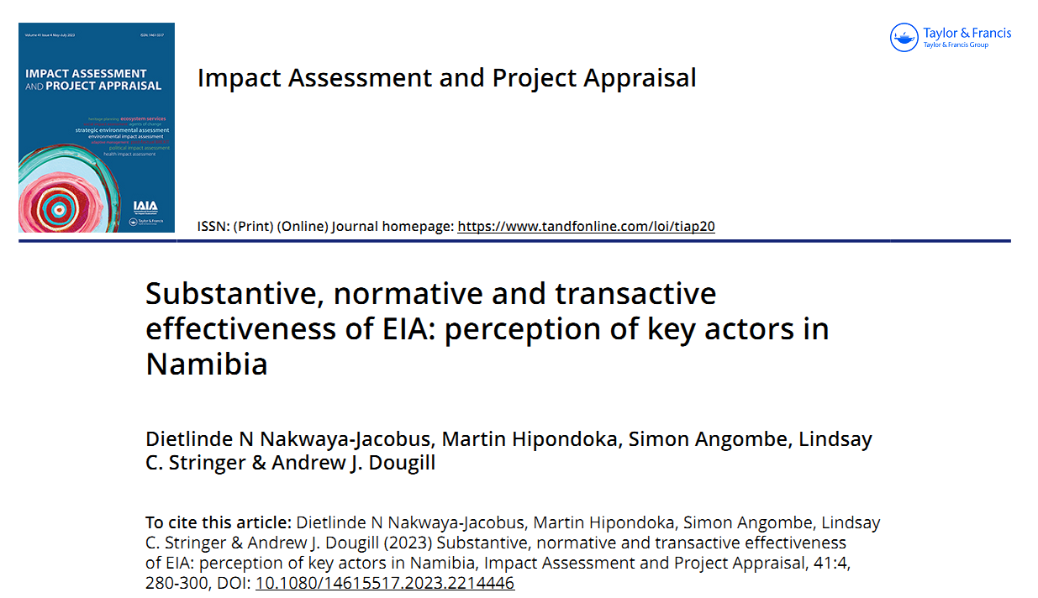
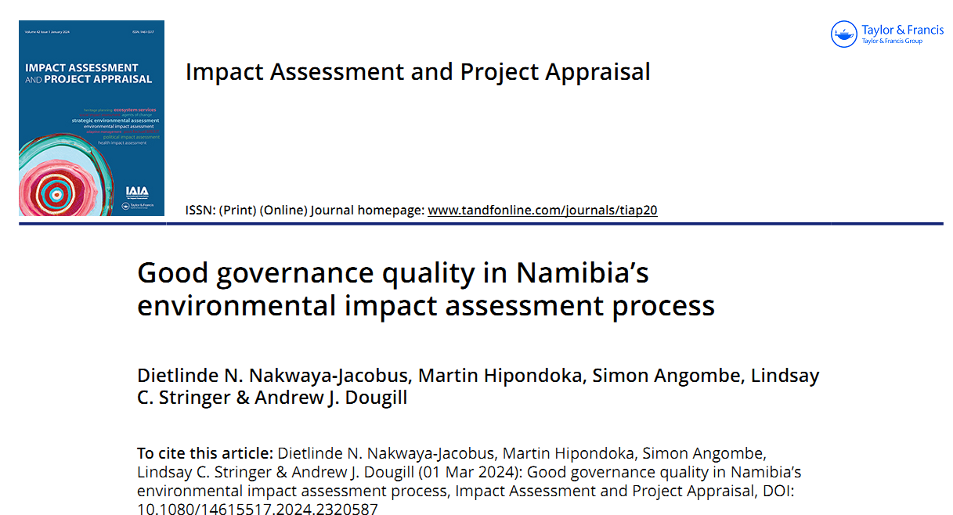
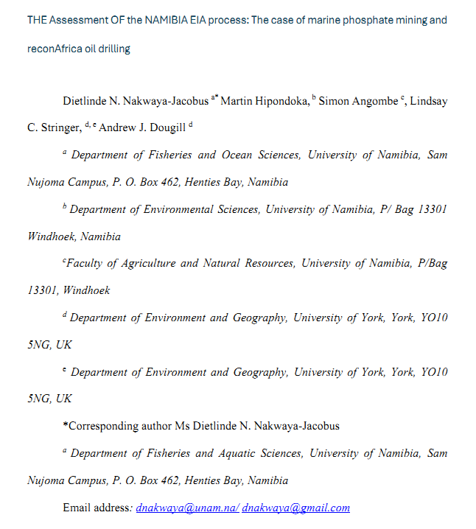
9. CONTRIBUTION TO KNOWLEDGE

Slide 30
REFERENCES
Chanchitpricha, C., & Bond, A. (2013). Conceptualising the effectiveness of impact assessment processes. Environmental Impact Assessment Review, 43, 65–72. https://doi.org/10.1016/j.eiar.2013.05.006
Enríquez-de-Salamanca, Á. (2018). Stakeholders’ manipulation of environmental impact assessment. Environmental Impact Assessment Review, 68, 10–18. https://doi.org/10.1016/j.eiar.2017.10.003
Loomis, J. J., & Dziedzic, M. (2018). Evaluating EIA systems’ effectiveness: A state of the art. Environmental Impact Assessment Review, 68, 29–37. https://doi.org/10.1016/j.eiar.2017.10.005
Marara, M., Okello, N., Kuhanwa, Z., Douven, W., Beevers, L., & Leentvaar, J. (2011). The importance of context in delivering effective EIA: Case studies from East Africa. Environmental Impact Assessment Review, 31(3), 286–296. https://doi.org/10.1016/j.eiar.2010.10.002
National Planning Commission. (2015). Policy brief. Population dynamics. https://www.npc.gov.na/wp-content/uploads/2023/06/Population-Dynamics-Policy-Brief-2015.pdf
Rathi, A. K. A. (2017). Evaluation of project-level environmental impact assessment and SWOT analysis of EIA process in India. Environmental Impact Assessment Review, 67, 31–39. https://doi.org/10.1016/j.eiar.2017.08.004
Sadler, B. (1996). International study of the effectiveness of environmental assessment. Final report. Environmental assessment in a changing world: Evaluating practice to improve performance. Canadian Environmental Assessment Agency. https://unece.org/DAM/env/eia/documents/StudyEffectivenessEA.pdf

Slide 31

THANK YOU
TANGI UNENE
DANKE SEHR!

