Slide 1

Snake Conservation Association Of Namibia
EduConservation Seminar

Slide 2
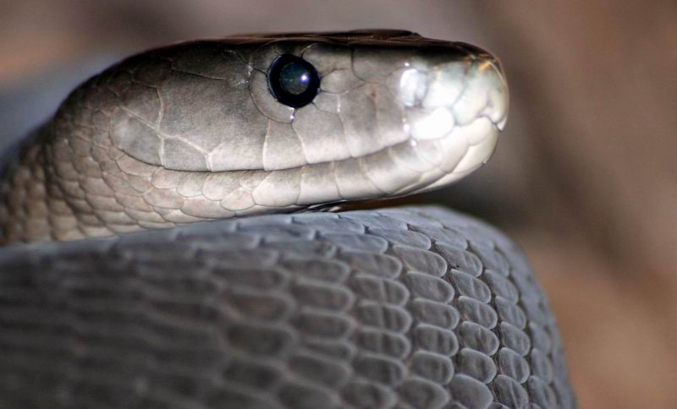
Program Index
What does SCAN do?.
Annual statistics.
Educational Sessions.
Medical Information Sessions.
Community work and Research.
“Conservation through Education”

Slide 3
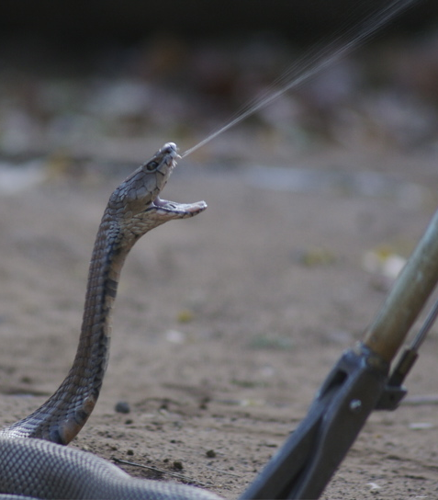
What does SCAN do?
Non-Profit, Volunteer organization. (All members have regular jobs.)
Removal and Relocation of snakes caught in the city.
Educational and Information talks to create awareness about snakes and the importance of conservation and preservation.
Professional Handling courses to the Tourism industry for lodges and guides, the mining industry and the Security industry.
Public and Educational information sessions.
Various research projects that includes relocation effectiveness, venom and DNA sequencing projects.
All of the above depend on DONATIONS and are mostly self funded.

Slide 4
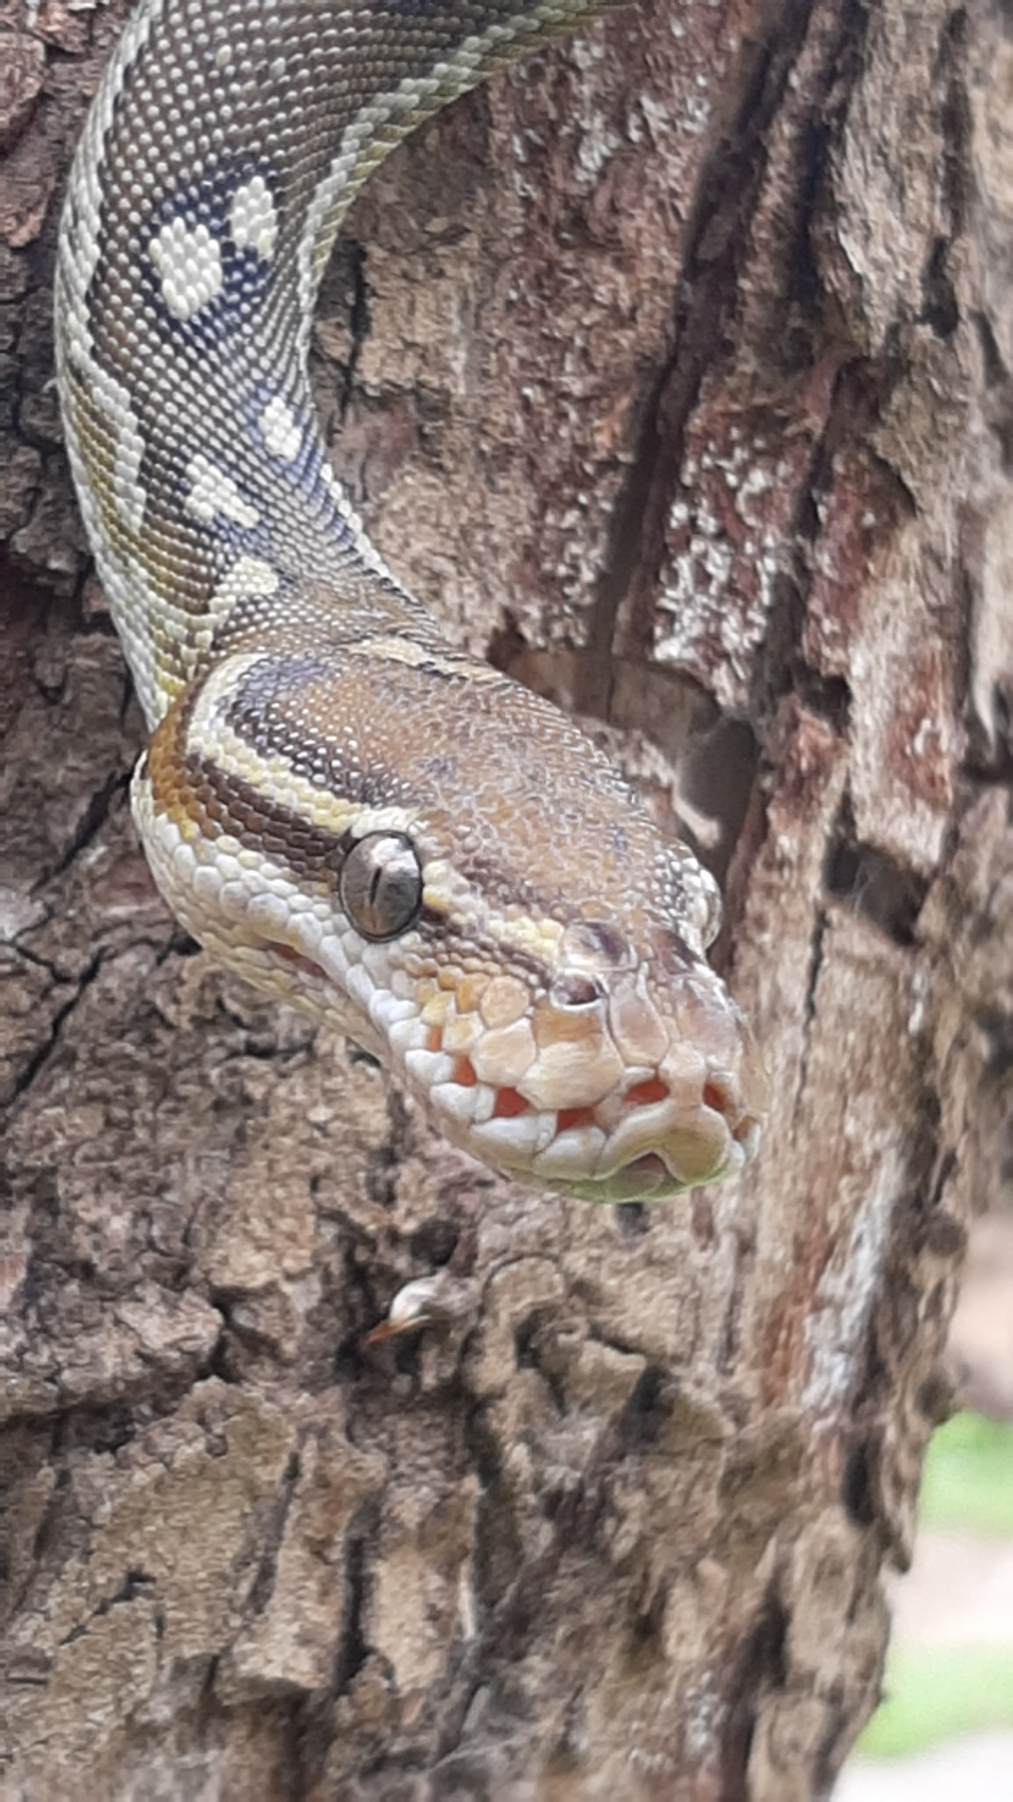
Statistics:
Call outs per season: ( From August to May) – 350 to 400. (Windhoek only)
Call outs: Countrywide: 500 calls countrywide.
Successful catches: 200 – 250. ( Depending on rainy seasons.)
Average km’s per call out: 8km – 10km
Average km’s per relocation: 10km – 60km.
Average km’s per season: ±4000 for Windhoek.
Other areas where SCAN operates: Katima/Rundu/Otavi/Grootfontein/Gobabis/Karibib/Otjivarongo/Okahandja/Rehoboth/ Swakopmund/Keertmanshoop area.
SCAN Members: 19 active snake handlers
Hours: 24/7

Slide 5
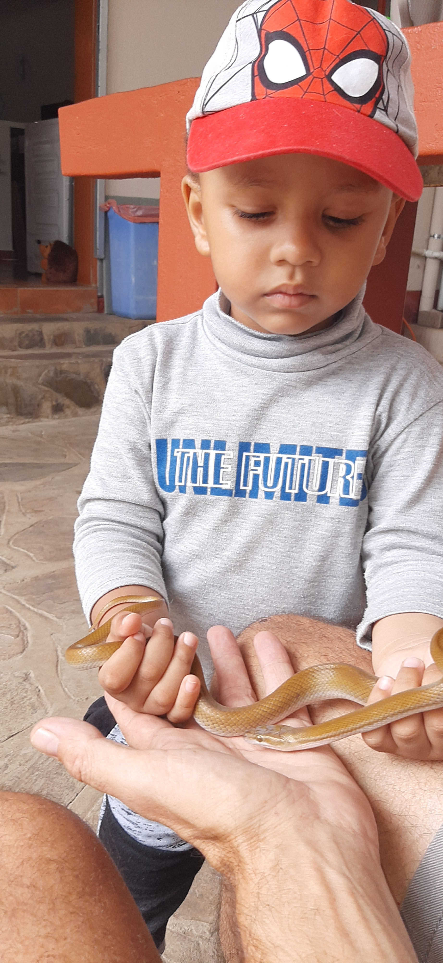
Educational Information Session:
SCAN facilitates about 10 – 15 School talks per season. (August – May)
SCAN teaches safety first! What to do and what not to do.
SCAN educates the young on the importance of nature and the important part that all animals have in the ecosystem. This includes the integral part of snakes.
Reach: ± 1000 - 1500 kids per year. From 2018 we have reached about 9000 children.
Why: To break the stigma and myths of snakes instilled by “old folks' tales”. And to give a message to respect all animals, especially snakes.
Reward: Seeing the wonder in their eyes when they can hold a snake without fear. (Kids end up educating their parents after such a talk.)

Slide 6
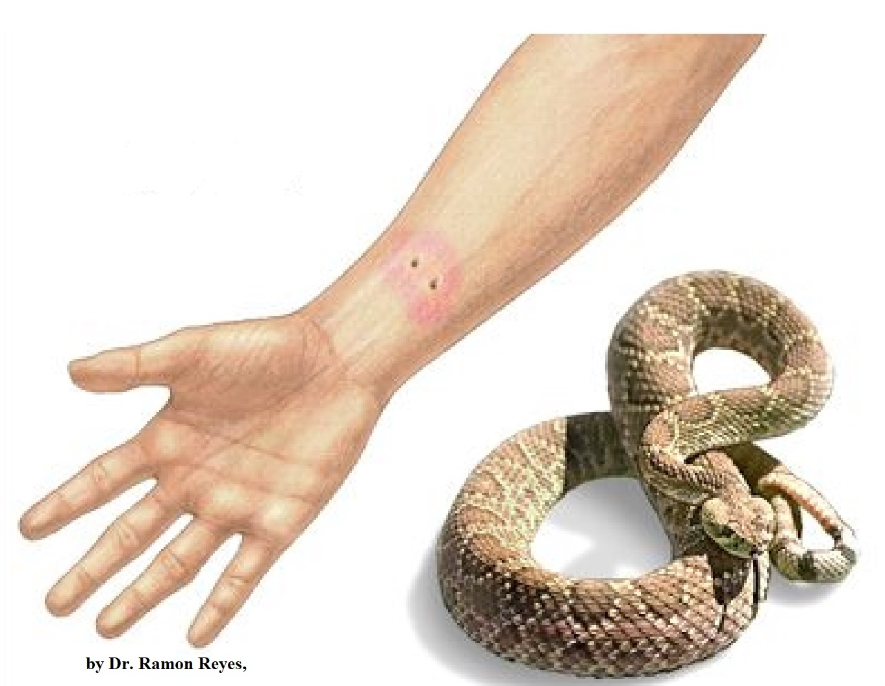
Medical Information Sessions:
SCAN facilitates Medical Information sessions along with Dr. Buys & Dr. Saayman for the medical industry.
International groups like World Extreme Medicine and others visit Namibia to receive training and information on snake bite protocols. This also includes general safety in the field where snake/human conflict is a high probability.
Veterinary segment: SCAN also provides information sessions and protocols to veterinary personal and students about snake bites and the effects thereof on pets.

Slide 7
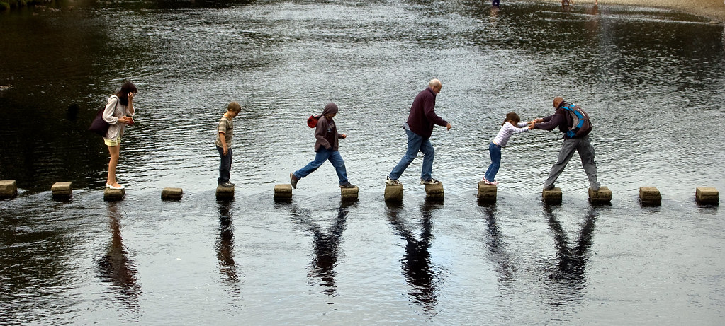
Community and Research:
SCAN provides community talks in rural areas to educate the public about snakes and what to do in conflict situations;
Public talks: Are very important to educate people from ALL walks of life.
Training people in areas that can capture, secure and relocate snakes before they are killed unnecessarily.
Social media presence: Youtube and Facebook platforms are effective, and SCAN has a significant following with over 25 000 followers. However, a lot more needs to be done as many people still kill snakes unnecessarily.
Relocation and tracking research.
Venom and DNA collection and research.
Field work including species DNA collection and sequencing.
Snake bite assistance countrywide.

Slide 8
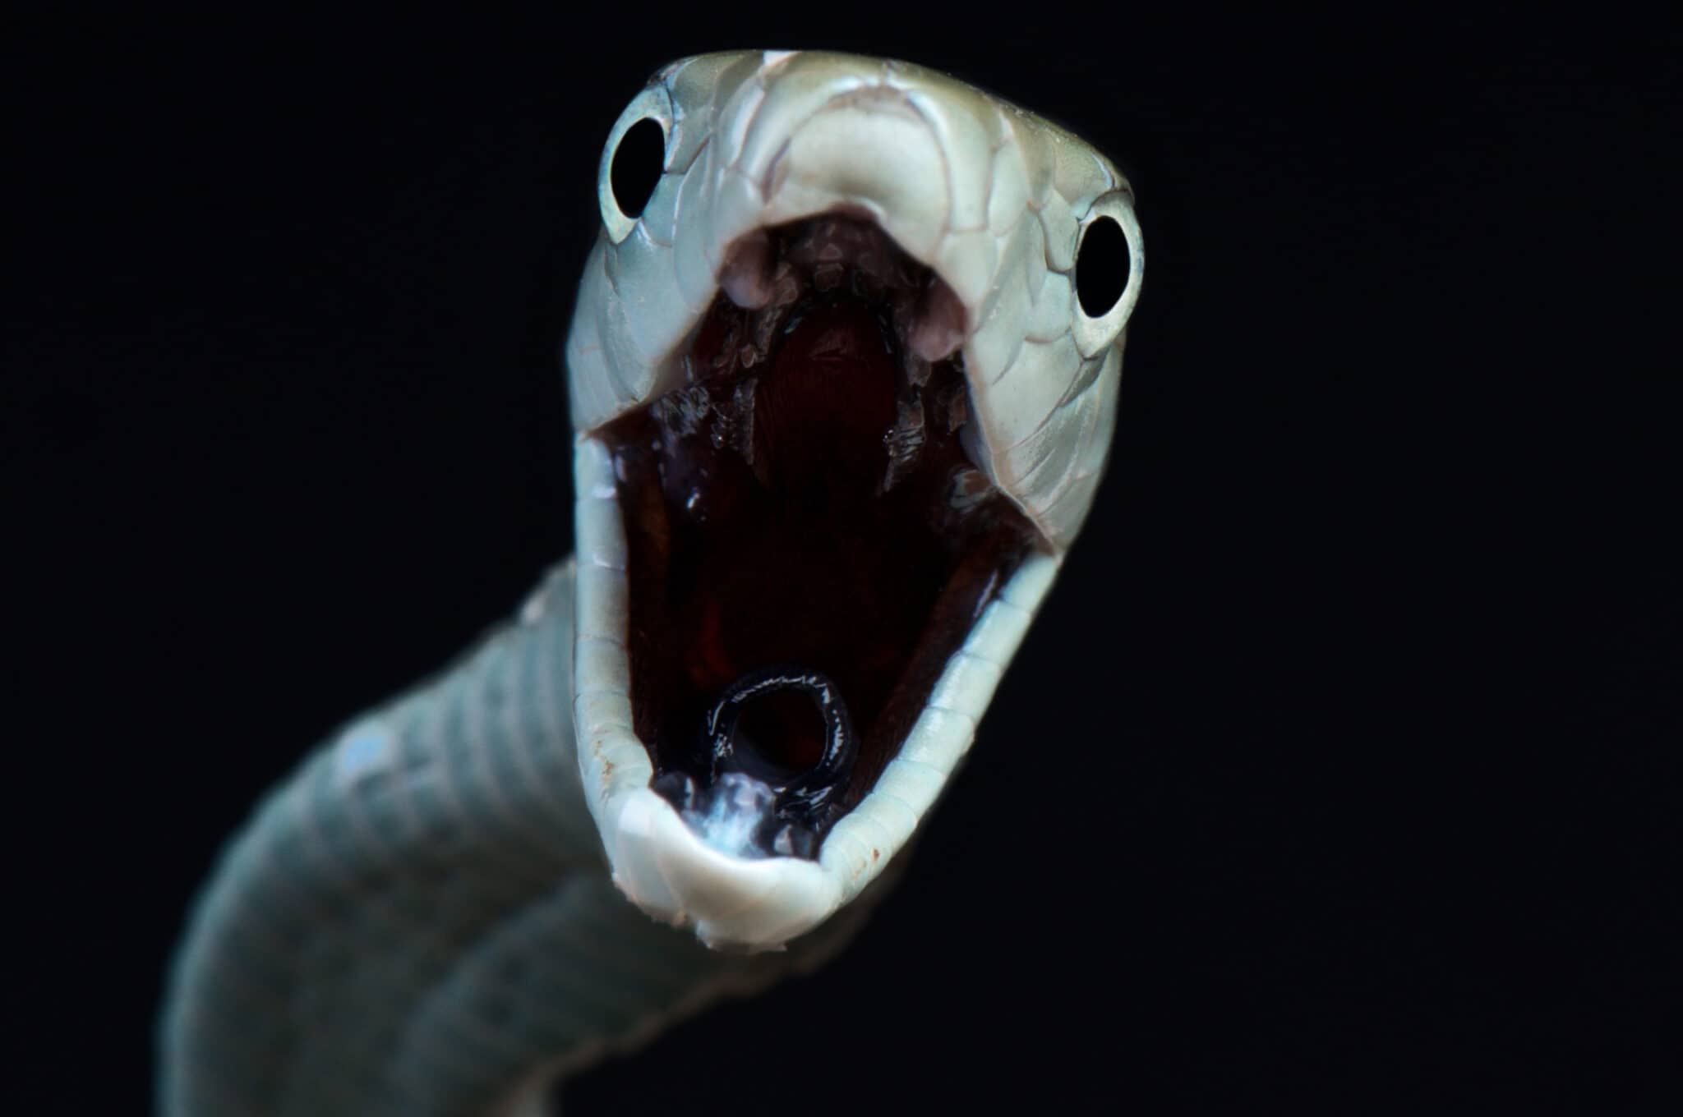
THANK YOU!
This Photo by Unknown Author is licensed under CC BY-SA

