Slide 1
The Formation of NAMCOB, Its Roles and The Seabird Rangers life on the Islands
13 March 2026

Slide 2
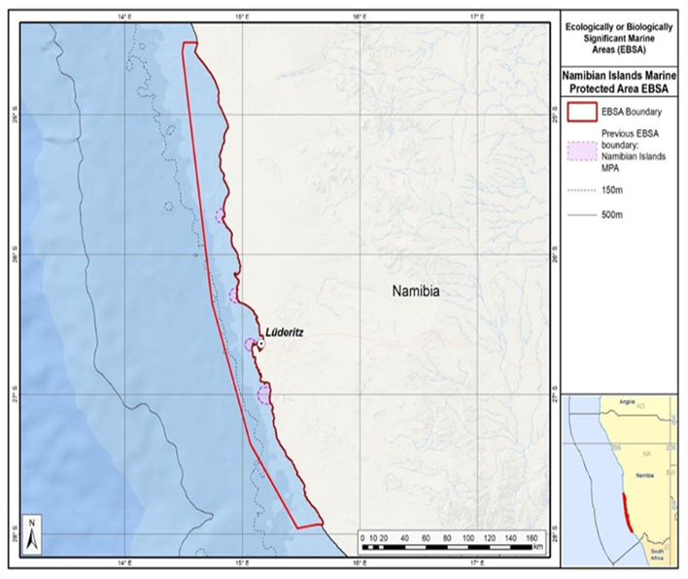
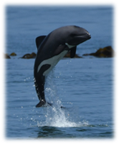
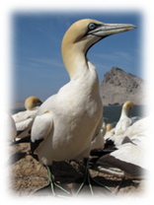
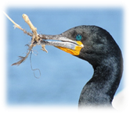
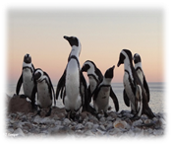
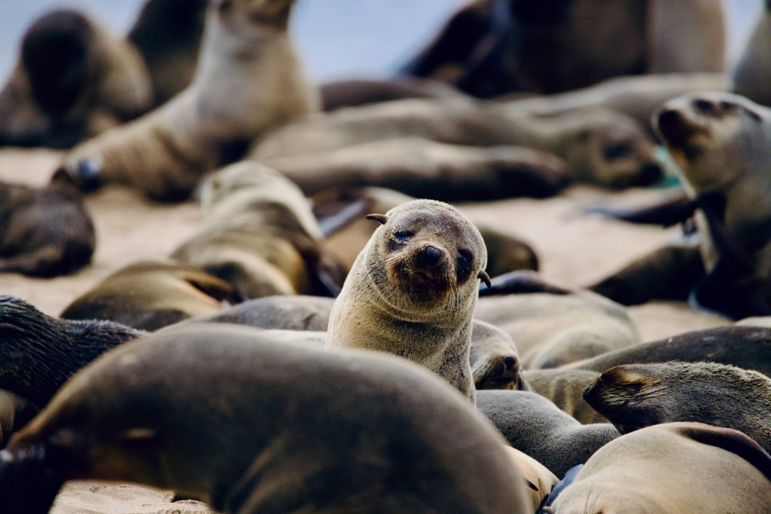
Namibia’s Marine Protected Area (NIMPA)
Coastline of Namibia: 1 572km; Exclusive Economic Zone (EEZ): 200 nm
NIMPA = Namibia’s first and only MPA, 2nd largest in Africa proclaimed in 2009
NIMPA is 9,500 km2 and is an iconic area of marine biodiversity, supporting globally significant populations of seabirds and marine mammals, and important marine industries.
NAMCOB was created to support the government in:
NIMPA’s long-term management and monitoring especially the important seabird populations
Engage the community in marine conservation, awareness activities and supporting tourism

Slide 3
About NAMCOB
The Namibian Foundation for the Conservation of Seabirds (NAMCOB) Founded in 2023.
NAMCOB is a nonprofit conservation organisation based in Lüderitz
Founded in response to a recognized need for a dedicated national entity focused on the rescue, rehabilitation, and conservation of African Penguins and other threatened seabird species in Namibia.

Slide 4
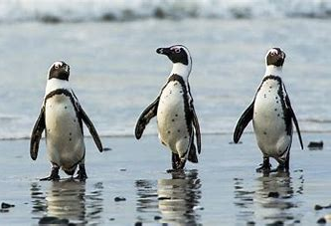
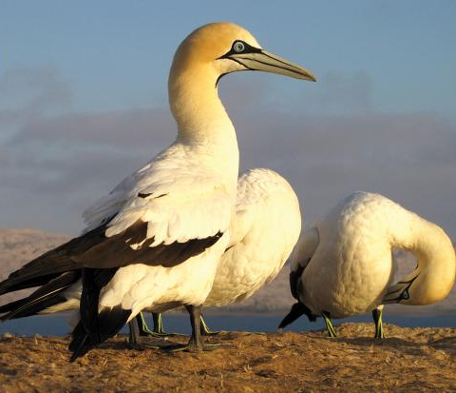
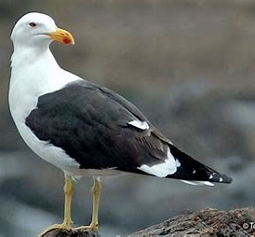
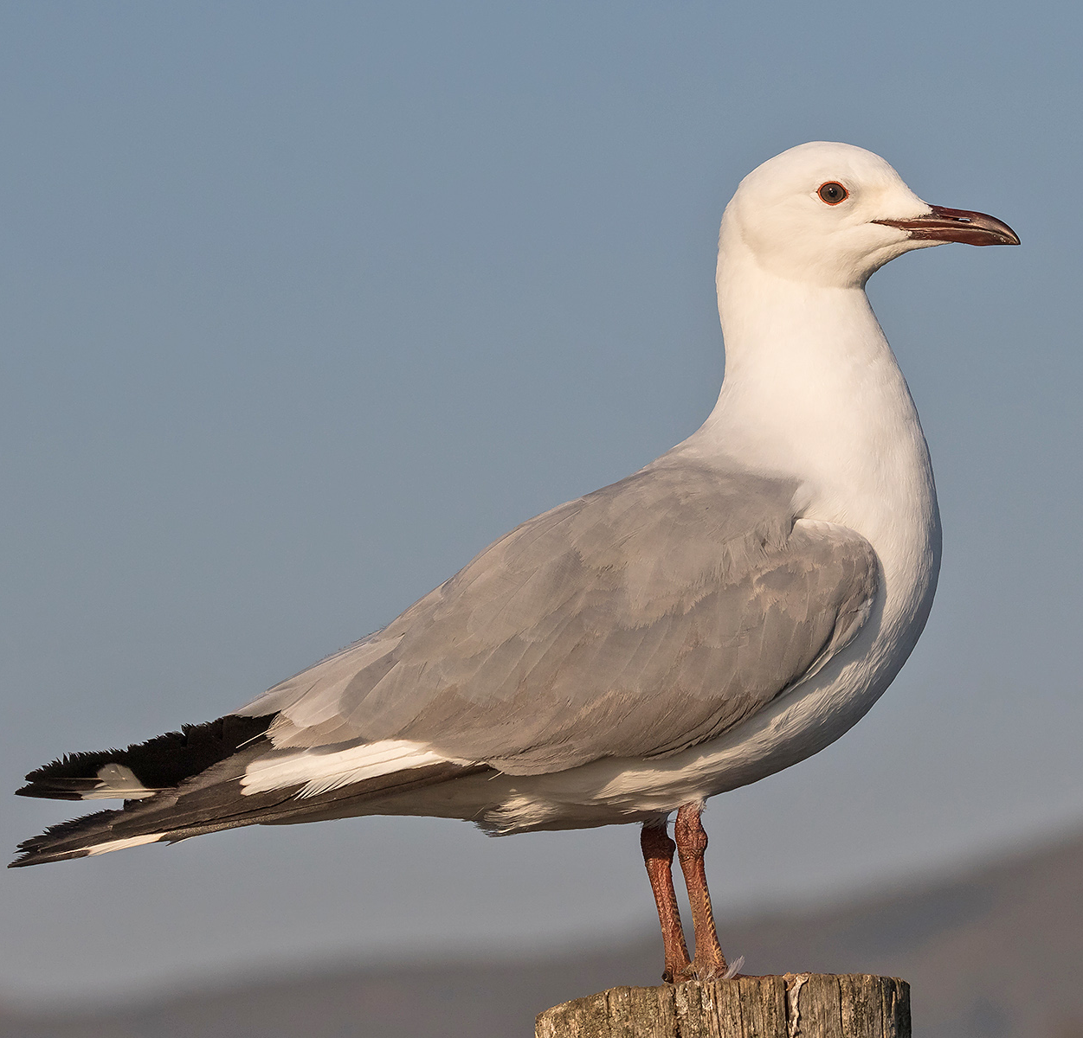
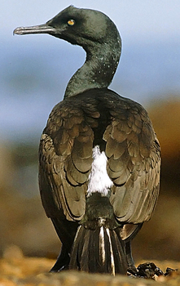
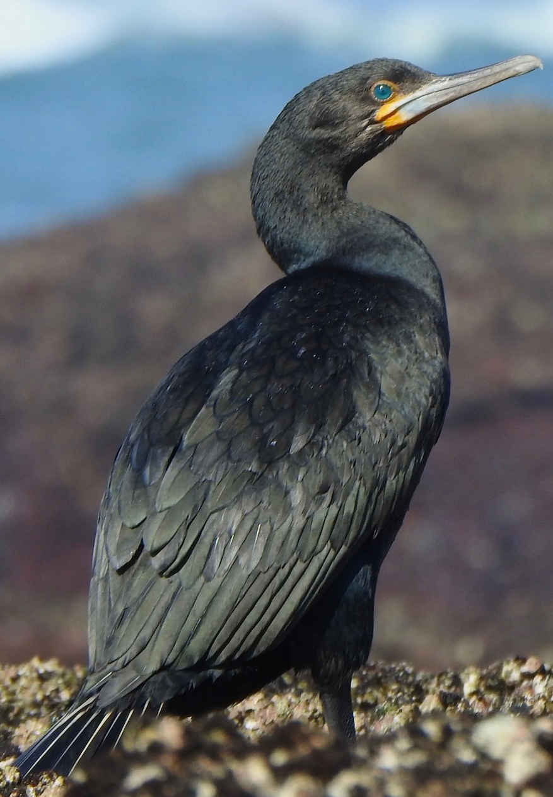
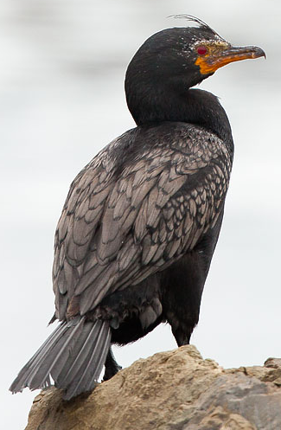
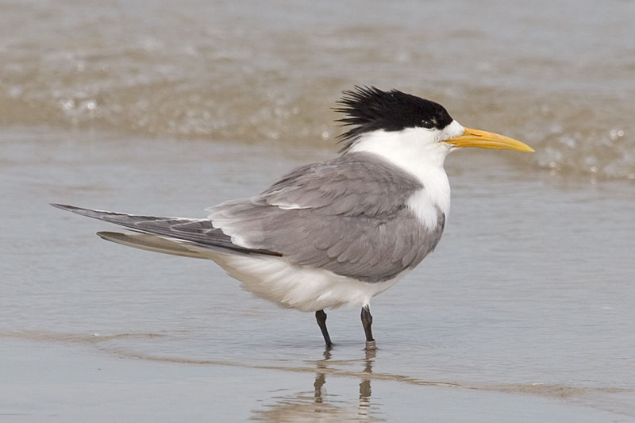
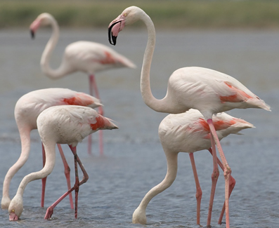
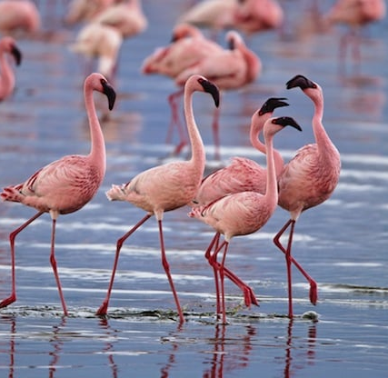
Namibia’s Seabirds:
Kelp gull & Hartlaubs gull
African penguins
Cape gannet
Greater crested tern
Greater & Lesser Flamingo
Bank Cape Crowned
Cormorant

Slide 5


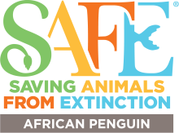



About NAMCOB
Founding Entities
Goal and Objectives
Namibia Nature Foundation
Debmarine-Namdeb Foundation
Southern African Foundation for the Conservation of Coastal Birds (SANCCOB)
Maryland Zoo
African Penguin Project
Namibia Chamber of Environment.
Our goal is to conserve seabirds on the Namibia coast and in its marine exclusive economic zone, with emphasis on the most threated species.
Strengthen seabird crisis response and rehabilitation capacity
Advance monitoring, research, and data management
Educate and build skills among local community while raising public awareness for marine conservation
Develop sustainable funding and governance strategies
Support NIMPA’s conservation and management

Slide 6
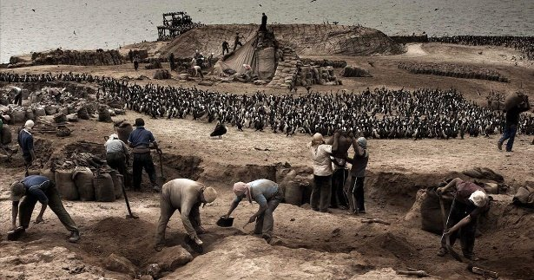
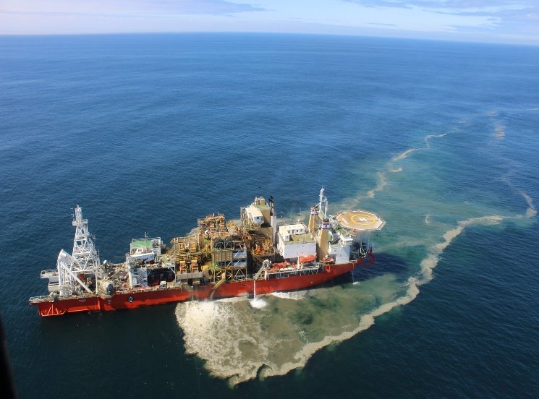
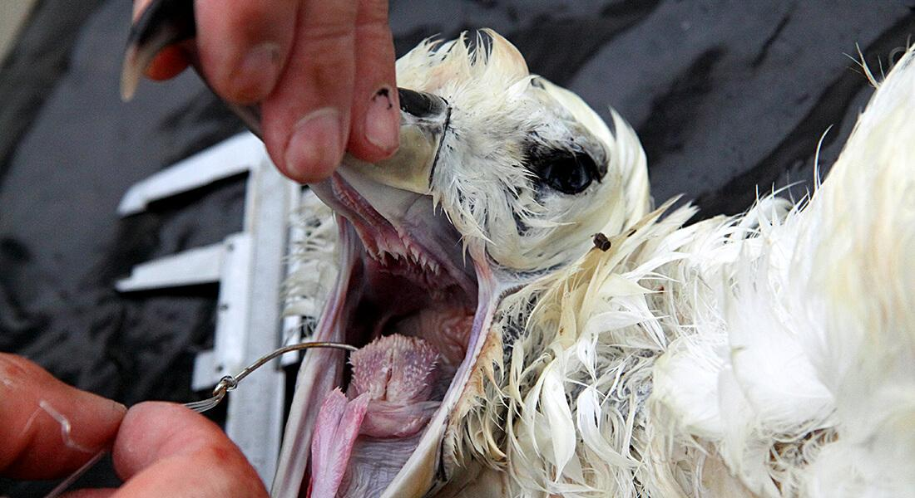
Treats to Seabirds
Overfishing (sardine – 1960s)​
Coastal and marine diamond mining (regulated)
​Oil Exploration
Guano harvesting (prohibited)
​Disease (Outbreak of Bird flue)

Slide 7
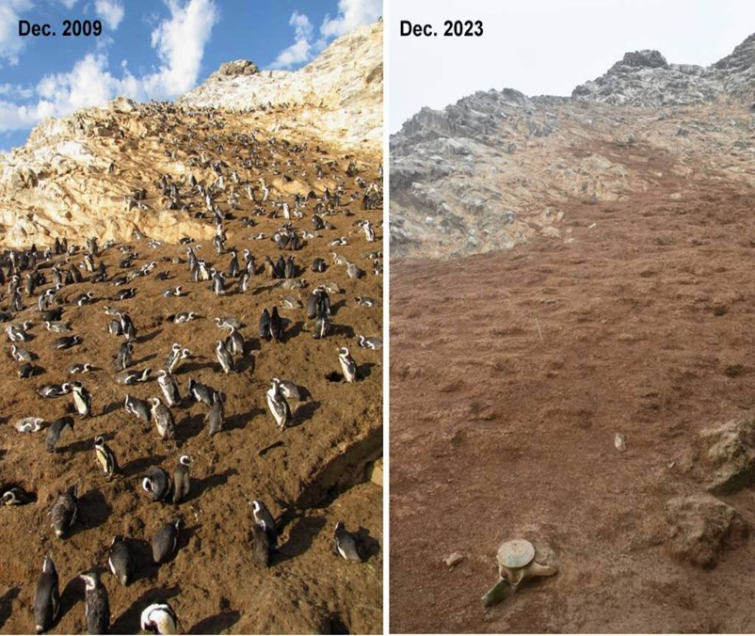
Status

Slide 8
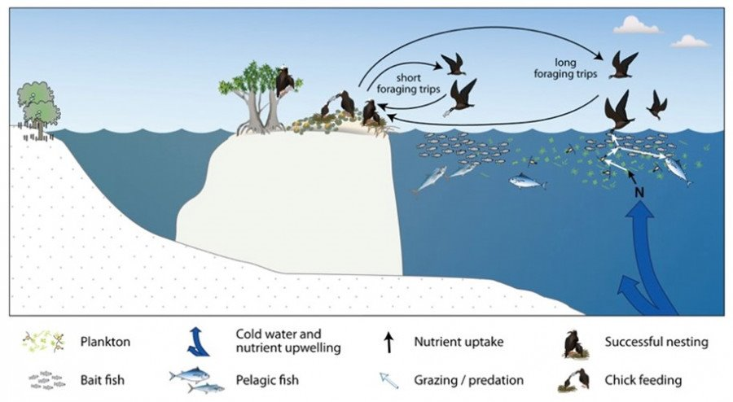
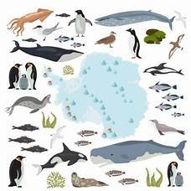
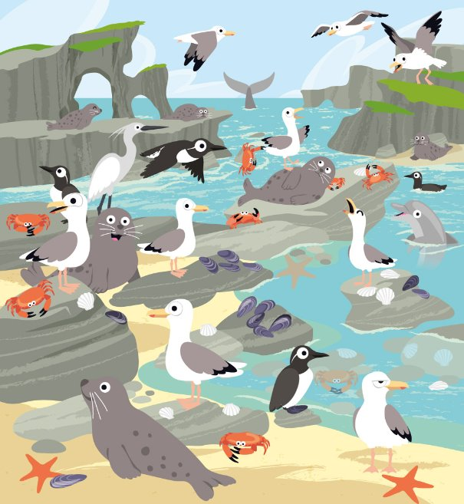
The Importance of Seabirds
Seabirds transfer minerals and nutrients from their marine food to the topsoil ecosystems as they defecate.
They can enrich the surrounding waters and contribute to the growth of marine plants & land plants which form the base of the food chain.
Play a critical role in maintaining a healthy balance in the food chain, and are essential for the survival of other marine species like fish and turtle
Are invaluable indicators of the overall health of the ocean
Changes in their population size, distribution, or diet can indicate changes in the availability and quality of the food they eat, the ocean’s physical conditions, and the presence of pollutants and contaminants in the water.

Slide 9

1. Seabird Conservation and Monitoring
Monitoring: Regularly monitor seabird populations on key islands by ranger deployment
Data Collection: Provides scientific data to inform management decisions and adaptive conservation strategies.
5. Environmental Education and Community Engagement
2. Research and Threat Mitigation
Conduct research on threats facing seabirds (e.g., predation, pollution, habitat degradation).
Support and implements mitigation measures, such as the improvement of breeding habitats.
Build awareness among coastal communities and schools on the status and importance of seabird and marine conservation.
Encourages local stewardship and supports sustainable use of marine resources.
NAMCOB
4. Field Presence and Operational Support
3. Capacity Sharing with Government
Collaborate with the Ministry to support the implementation of conservation measures within NIMPA, while continuously building the capacity and knowledge of personnel through shared learning and training initiatives
Operational base in Lüderitz, enabling direct access to NIMPA islands.
Provides logistical and field support for conservation activities (e.g., island visits, data collection, rehabilitation efforts).

Slide 10
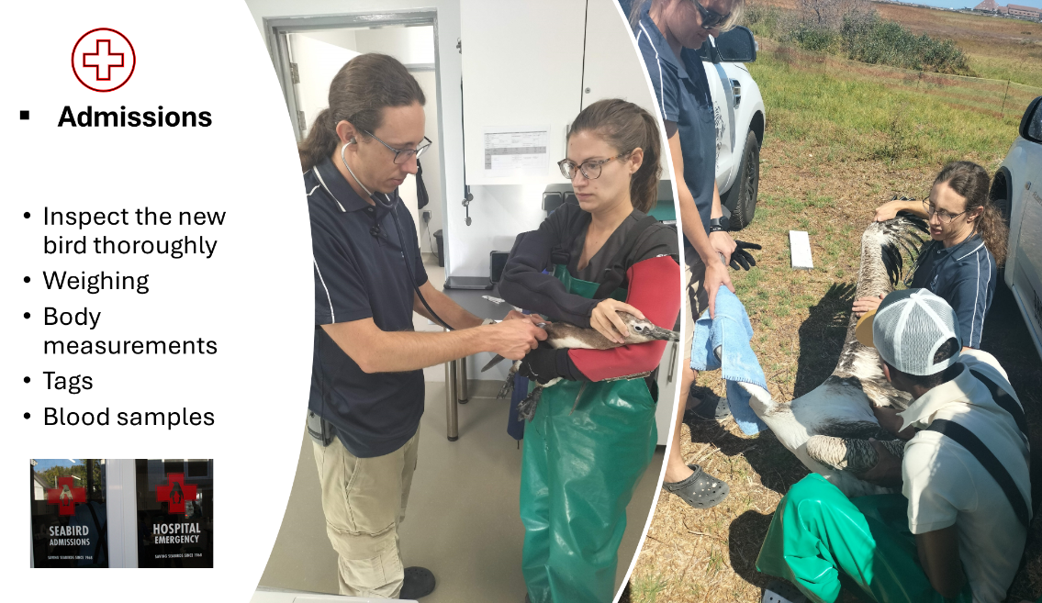
Rehabilitation Centre

Slide 11
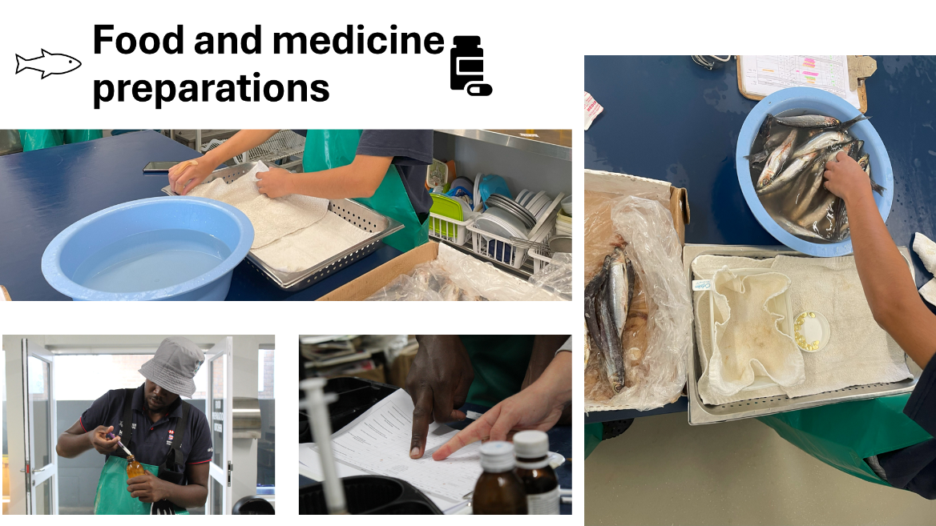

Slide 12
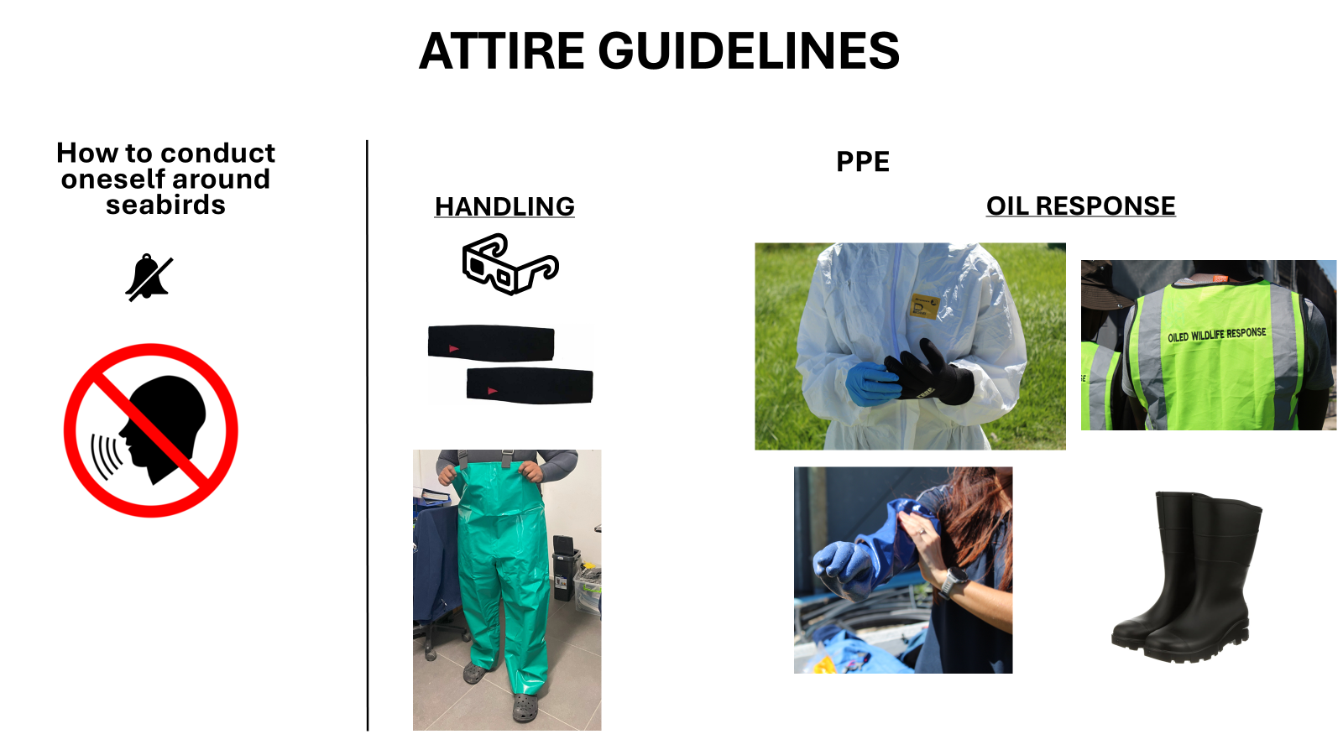
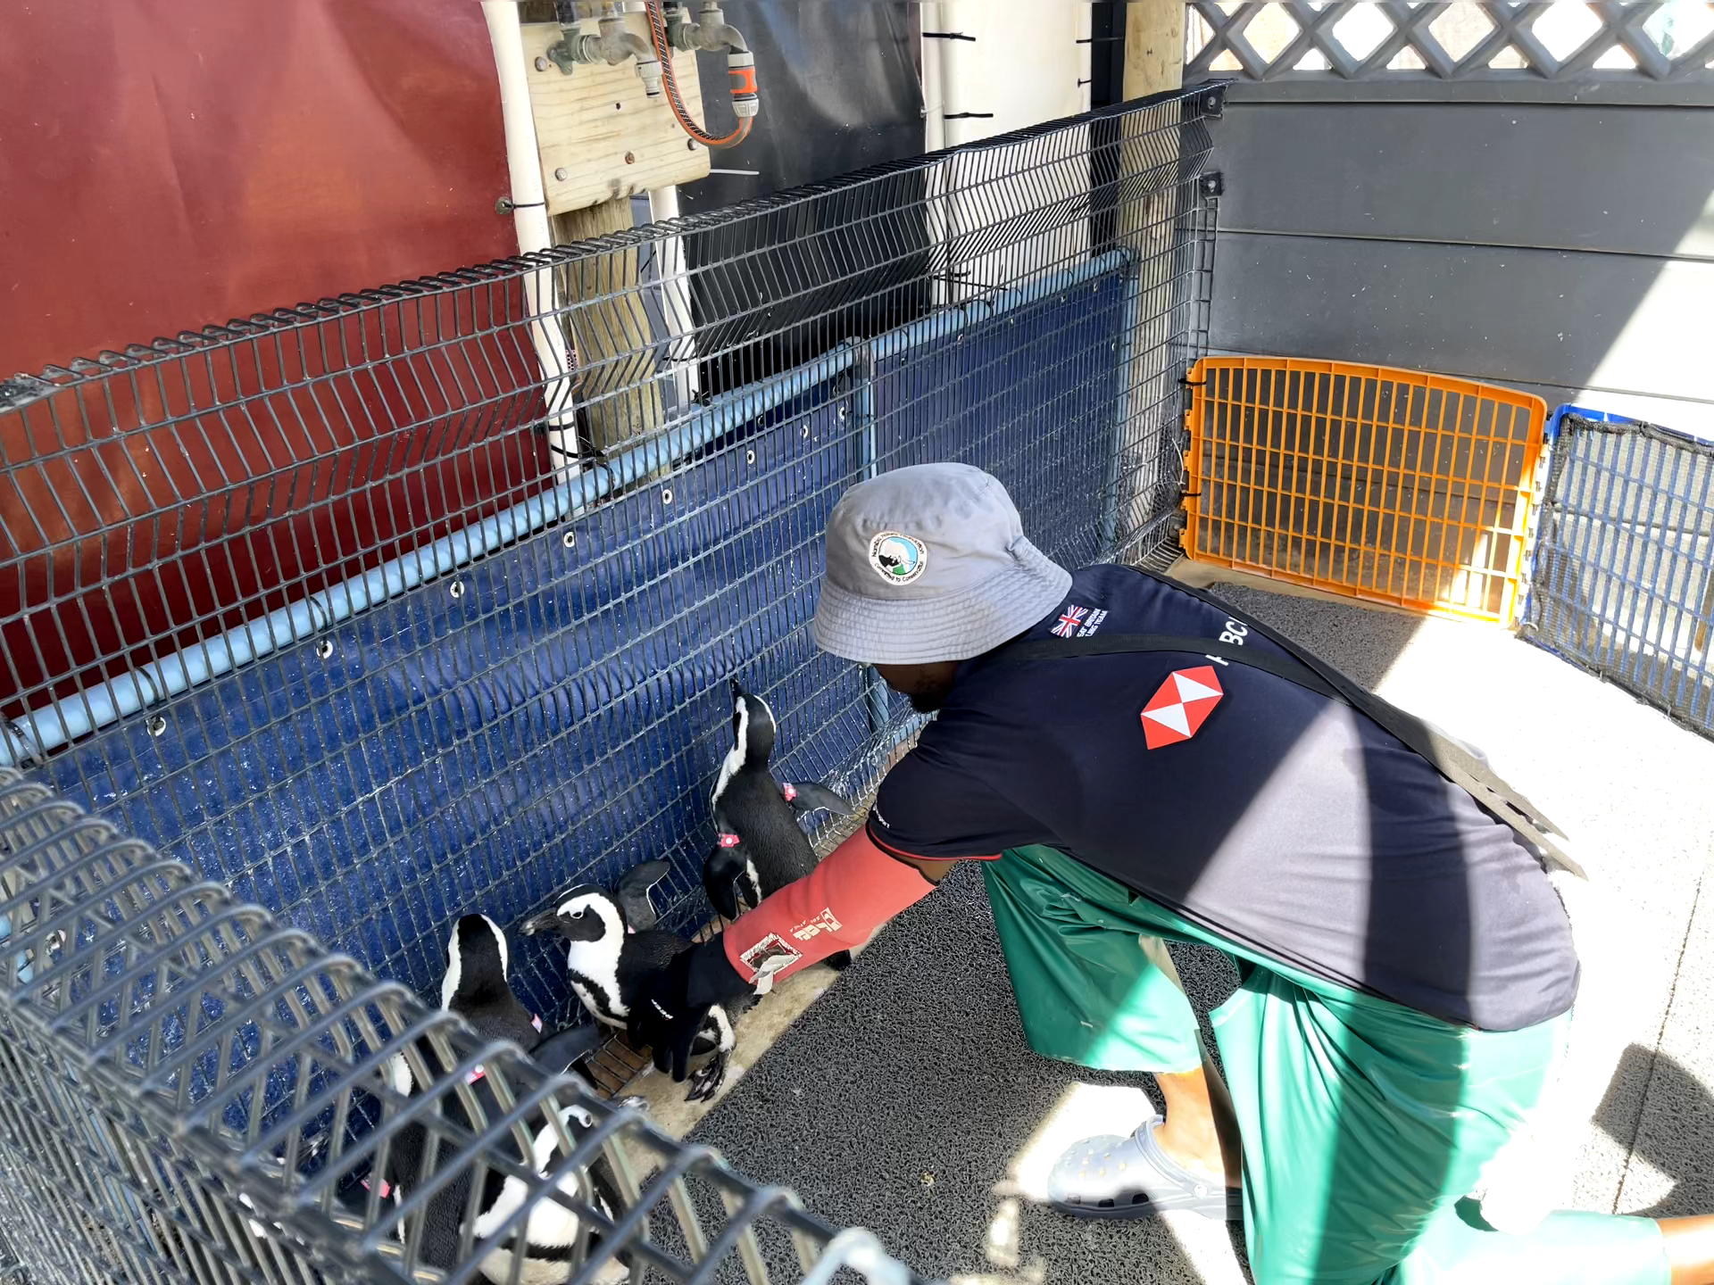
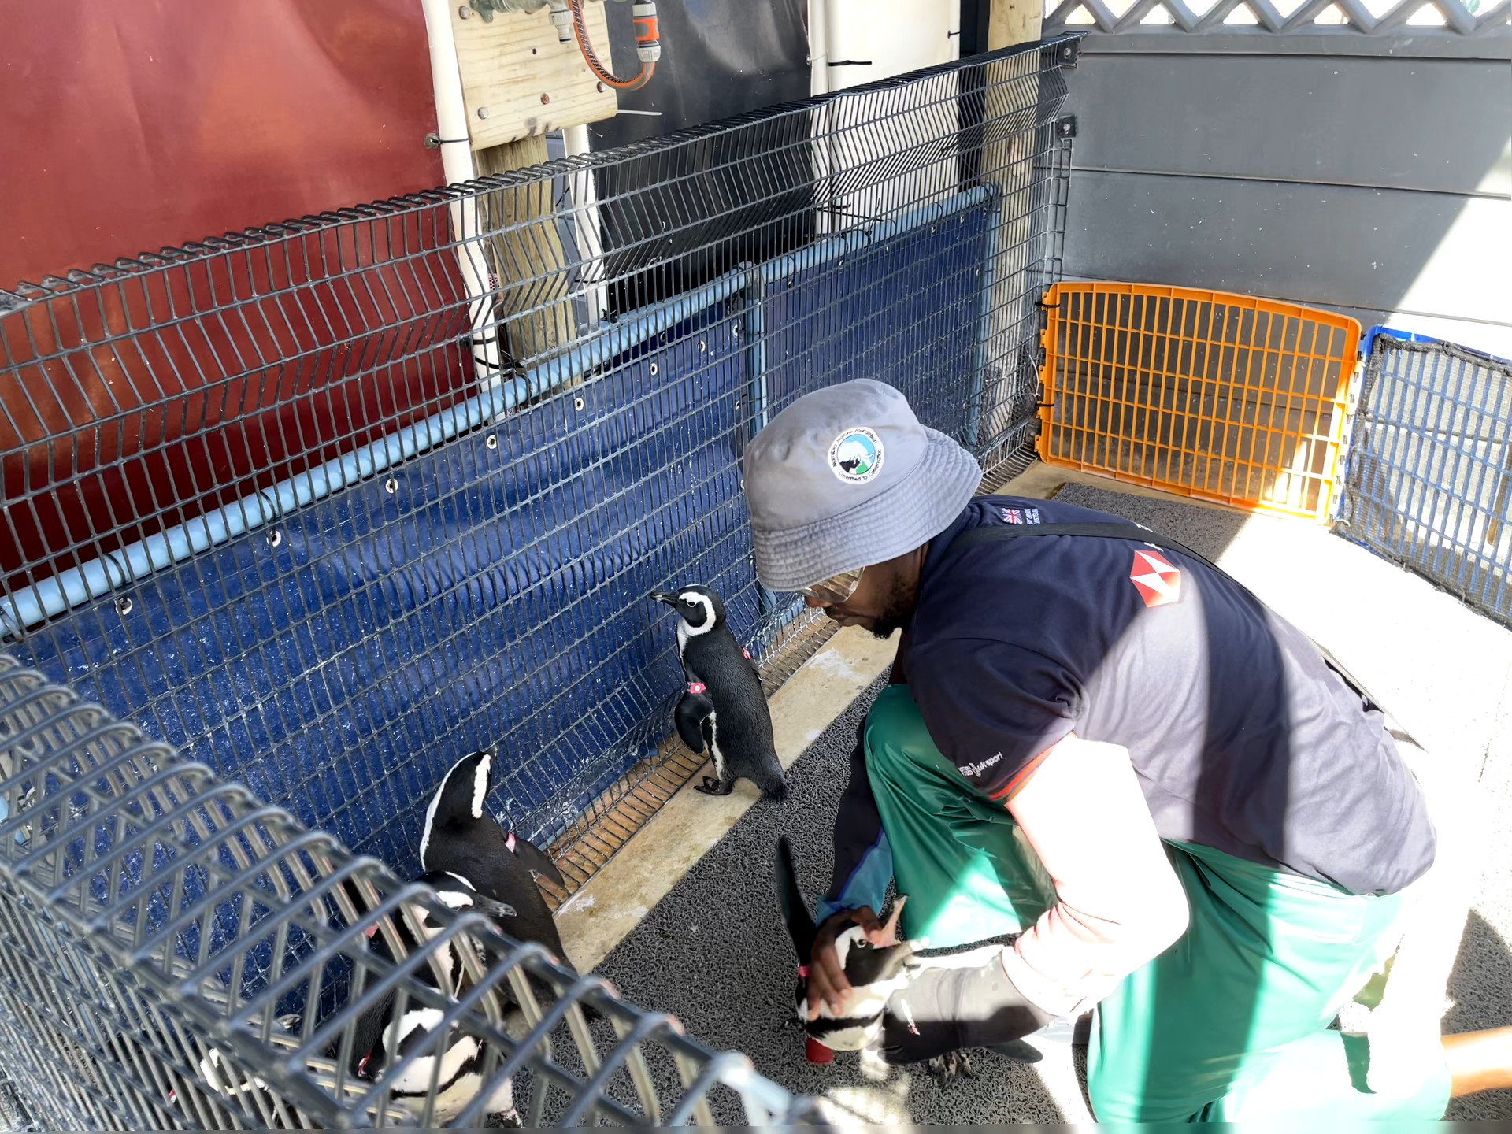
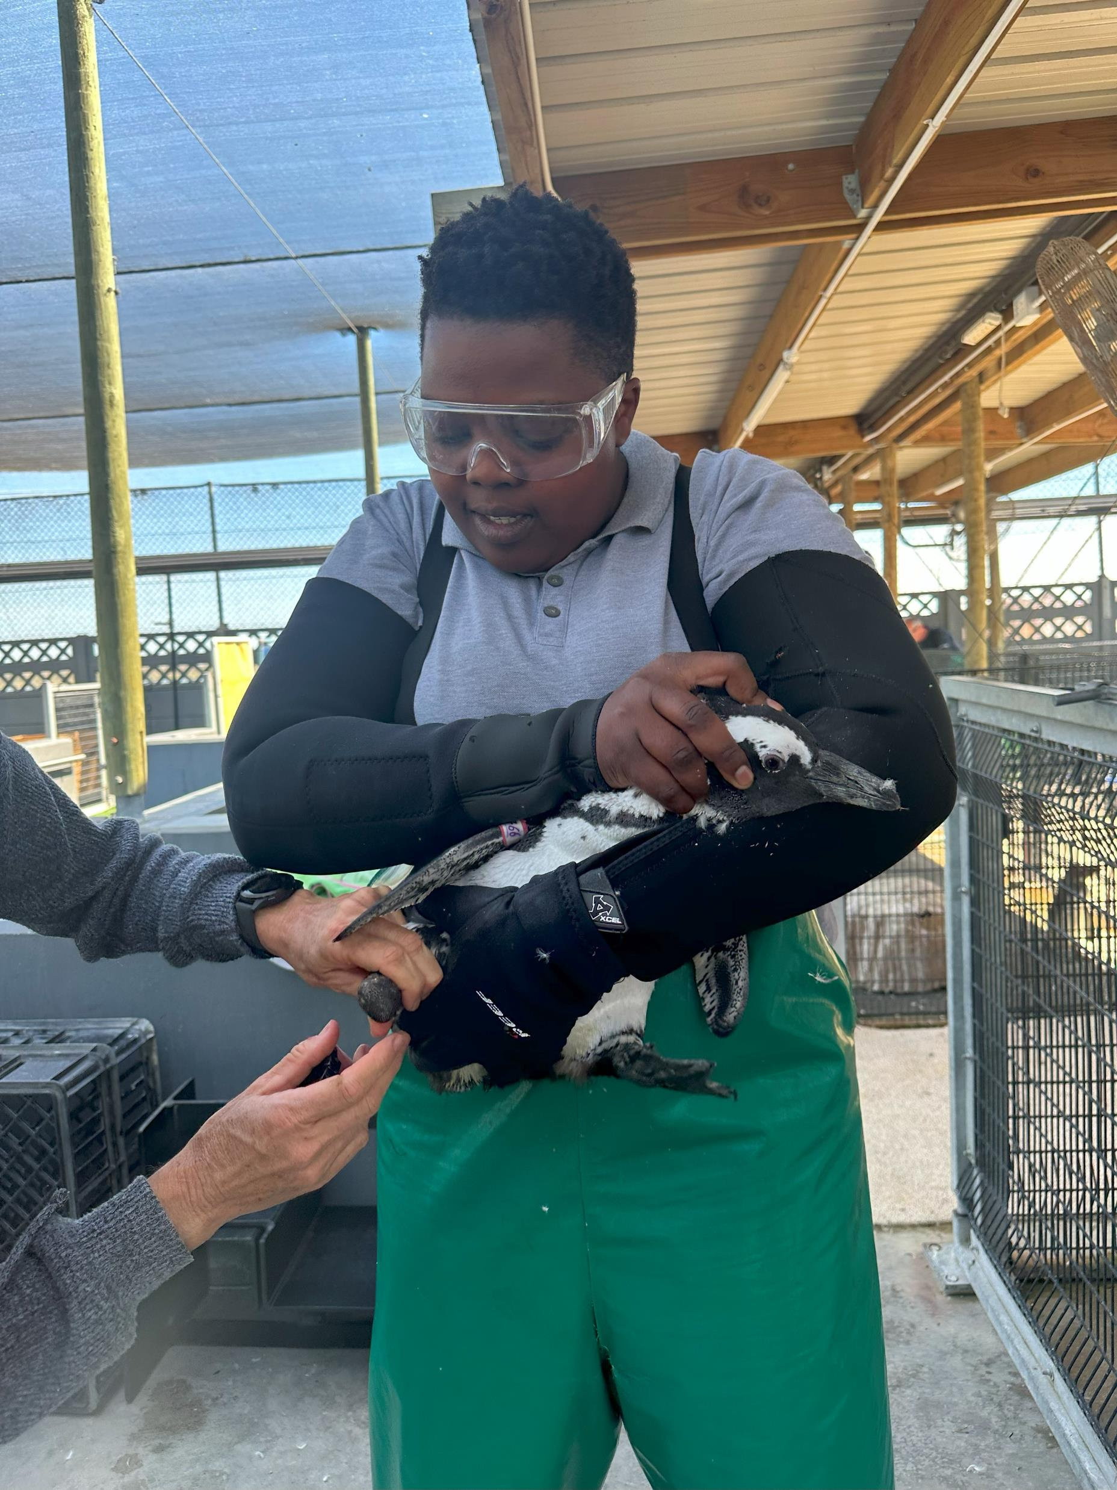
Handling
Distraction
Fast grab of flipper with non dominant hand
Hand on head with dominant hand
Pick up

Slide 13
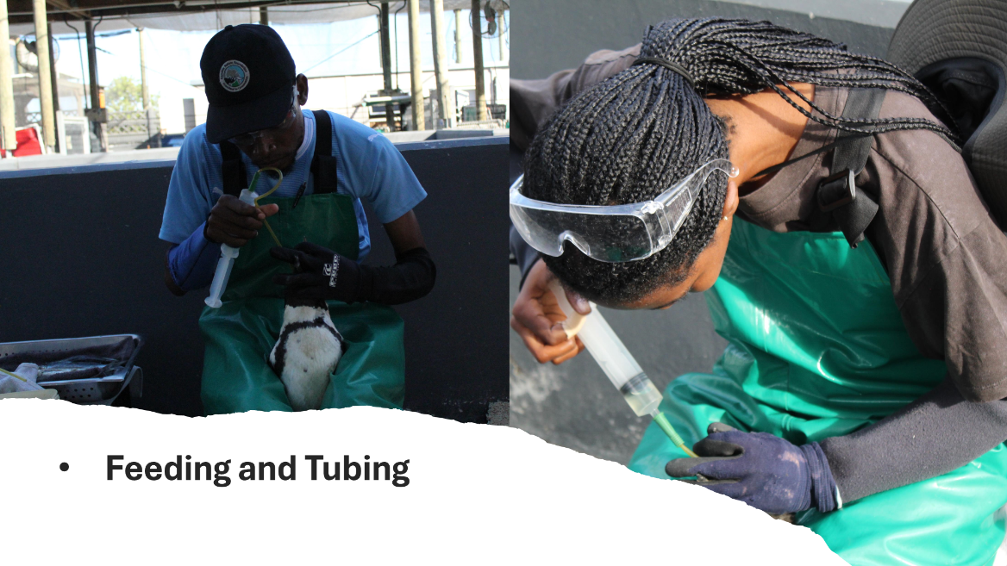

Slide 14
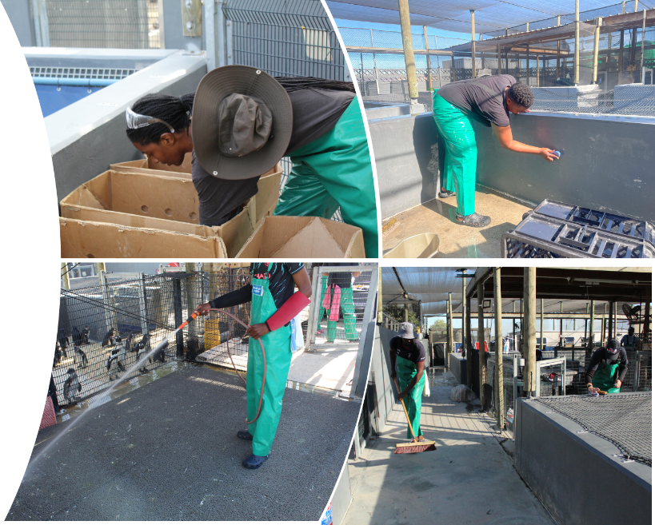
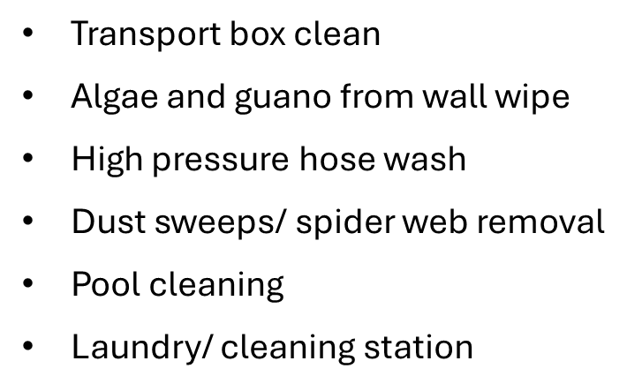
BASIC CLEANING

Slide 15
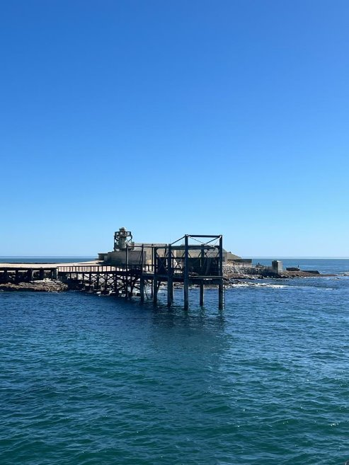
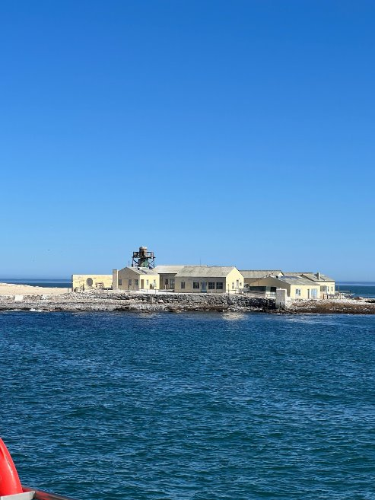
Life of a Ranger on the Island
Monitoring and protecting seabirds in a remote coastal ecosystem

Slide 16
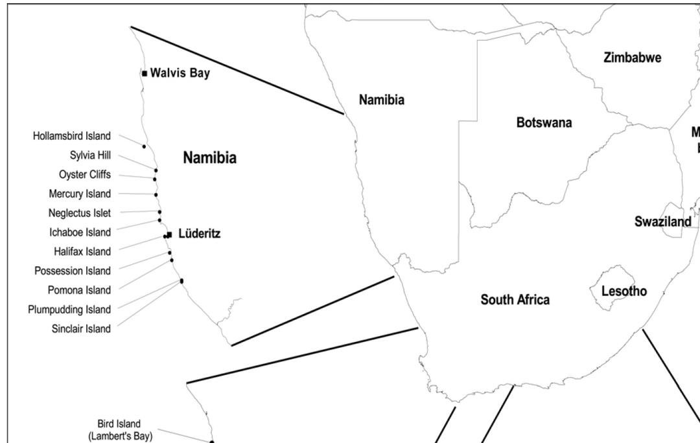

Slide 17
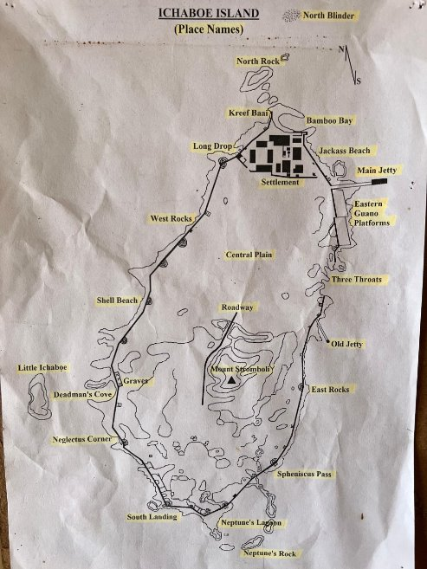
Six weeks of deployment
2 people on an Island then rotate
Water supply
Solar system power

Slide 18
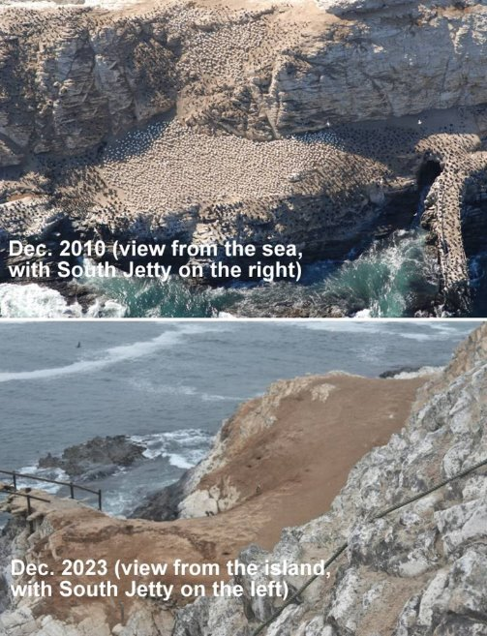
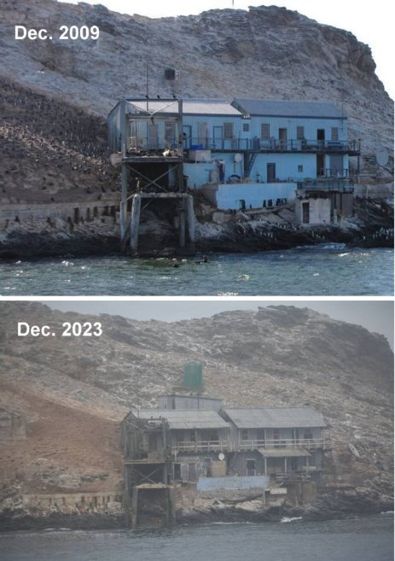
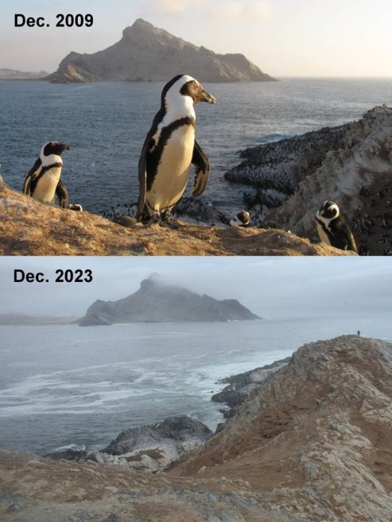
History

Slide 19
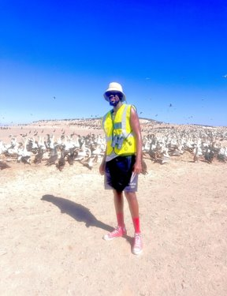
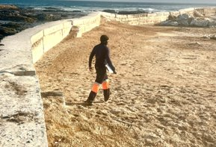
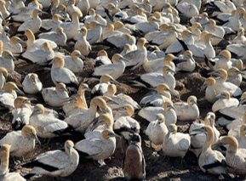
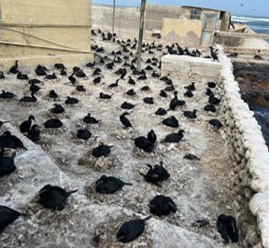
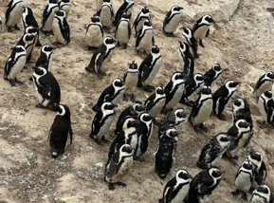
Life on the Island
Islands – small, isolated, and teeming with life.
This is where our days begin and end. Out here, the field is our office. Among the fog, dust, birds' calls, and quiet moments, we are reminded daily just how wild and extraordinary this work is.
Home to African Penguins, Cape Gannets, and Cormorants.
Main Duties: protect, monitor, and understand these seabird colonies.

Slide 20
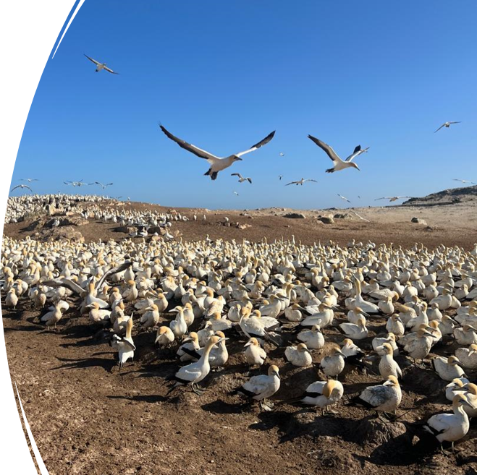
The Weather That Shapes Our Work
Weather sets the rhythm of island life.
We record x3 a day
Average sea temperature: 11.6°C | Air temperature: 14.4°C
Humidity: 78.8%, with gentle NE winds at 6.1 knots.
Mostly clear skies and calm seas — perfect for field operations.
Stable conditions mean easier access for monitoring and data collection.

Slide 21
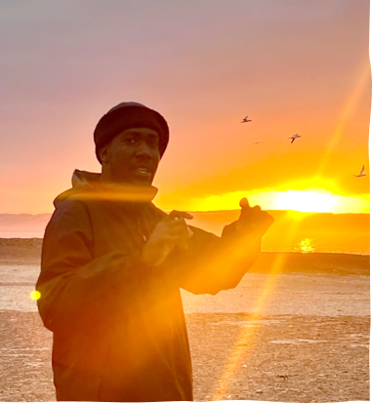
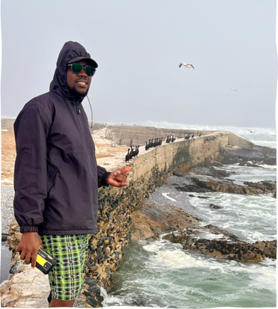
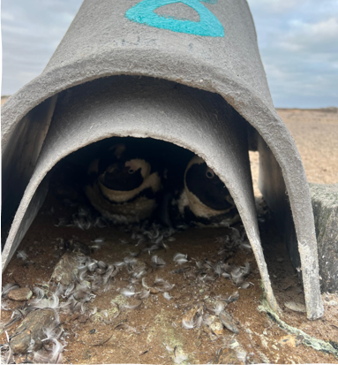
Two main patrols every day: 08:00 and 17:00 (plus occasional midday patrols).
Walk around the island, count seabirds, observe behaviours, and take photos.
Patrols take about 2 hours each —
Weekly nest-box inspections (every Wednesday).
It’s quiet, a routine work — but it keeps us connected to the pulse of the colony.
Daily Patrol Routine

Slide 22
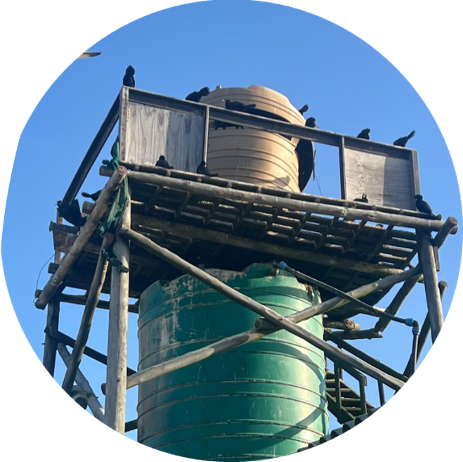
Patrol Routine alteration During breeding season
Full-island patrols reduced to avoid nest abandonment and Kelp Gull predation.
Three times daily patrols from the water tower.

Slide 23


Responding to Seal Disturbances
Not all visitors are welcome!
Cape Fur Seals occasionally invade colonies, attacking and disturbing the birds.
Early-morning (05:00–08:00) and late-night (20:00–23:00) patrols introduced.
Goal: identify, deter, and block seals before they reach the birds.
Blocking off entry points
Full-island patrols reduced to avoid nest abandonment and Kelp Gull predation.

Slide 24




Predation Incidents
Several seal attacks on Cape Gannets recorded.
One breach caused chaos: 30 killed and 15 injured
150 eggs lost to Kelp Gulls.
Barrier strengthened and expanded — and peace returned.

Slide 25
Other Island Visitors
African Black Oystercatcher.
Hartlaub’s & Kelp Gulls: stable adult numbers, limited breeding.
Ruddy Turnstone & Swift Tern: declining presence, no breeding observed.
White-breasted Cormorant: rare visitor, single sighting only.
→ Seasonal patterns show clear preparation for breeding across most species

Slide 26



Rehabilitation Stories
Injured and sick seabirds are rescued, treated, and transported to Luderitz.

Slide 27


Managing Threats
Kelp Gulls:
Tried paintball deterrence – unsuccessful; gulls returned immediately.
Seals:
Old wooden planks repurposed as barriers.
Major success – 27 days without a single seal intrusion!
Continued improvement of barriers after each breach.

Slide 28

Reflections of a Ranger
Life on the island is a balance of solitude, science, and quick thinking.
Long days, unpredictable wildlife, and constant adaptation.
Every sunrise brings a new challenge - and another chance to protect what matters.
It’s tough work but deeply rewarding - every bird saved counts.

Slide 29

Conclusion
Stable weather supported smooth operations and monitoring.
Seal barriers proved highly effective in reducing predation.
Seabird populations show strong signs of recovery and breeding activity.
Rehabilitation efforts and adaptive management made real impacts.
The season’s success highlights the value of teamwork, dedication, and conservation on the frontlines

Slide 30


