Slide 1
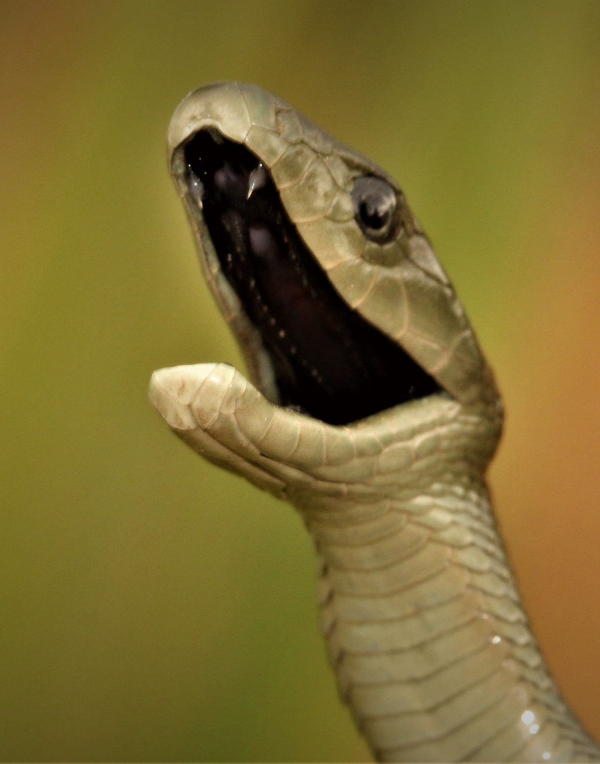
Common Snakes of Namibia by
Francois Theart

Slide 2
Introduction
Basic Biology
Identification
Snake Handling
First Aid & Emergency Numbers

Slide 3
Basic Biology
Vision - Fairly acute at short range, however it is poor at greater distance. Mainly detects movement.
Hearing - External ear holes are absent, snakes cannot hear airborne sounds . They do however have an auditory nerve which picks up vibration.
Shedding - Juvenile snakes shed their skin 12-14 times a year and adults 3-4 times a year. The external layer of the skin does not grow and is therefore shed periodically.
Smell - Snakes make use of their forked tongue in order to pick up particles in the air. When it is drawn back into the mouth these particles are deposited onto organs situated in the roof of the mouth, known as the Jacobson's organ.

Slide 4
Basic Biology
Reproduction - Mating takes place in early spring. Two types of reproduction in snakes, namely: (1) oviparous, in which snakes lay eggs, and (2) viviparous, in which the young develop within the female. Between 4 to 8 weeks after mating the female will select a suitable spot to lay her eggs.
Longevity - 20 to 50 years.
Locomotion - 4 modes of basic progression in snakes. (1) Concertina like movement (2) Serpentine movement (3) Sidewinding (4) Caterpillar like movement.

Slide 5
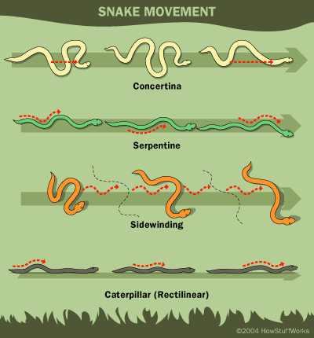

Slide 6
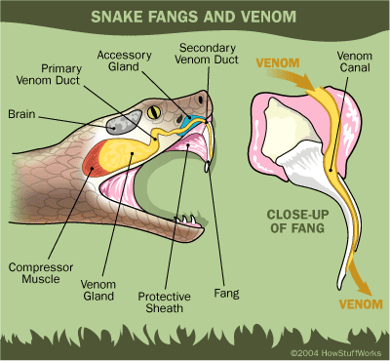

Slide 7
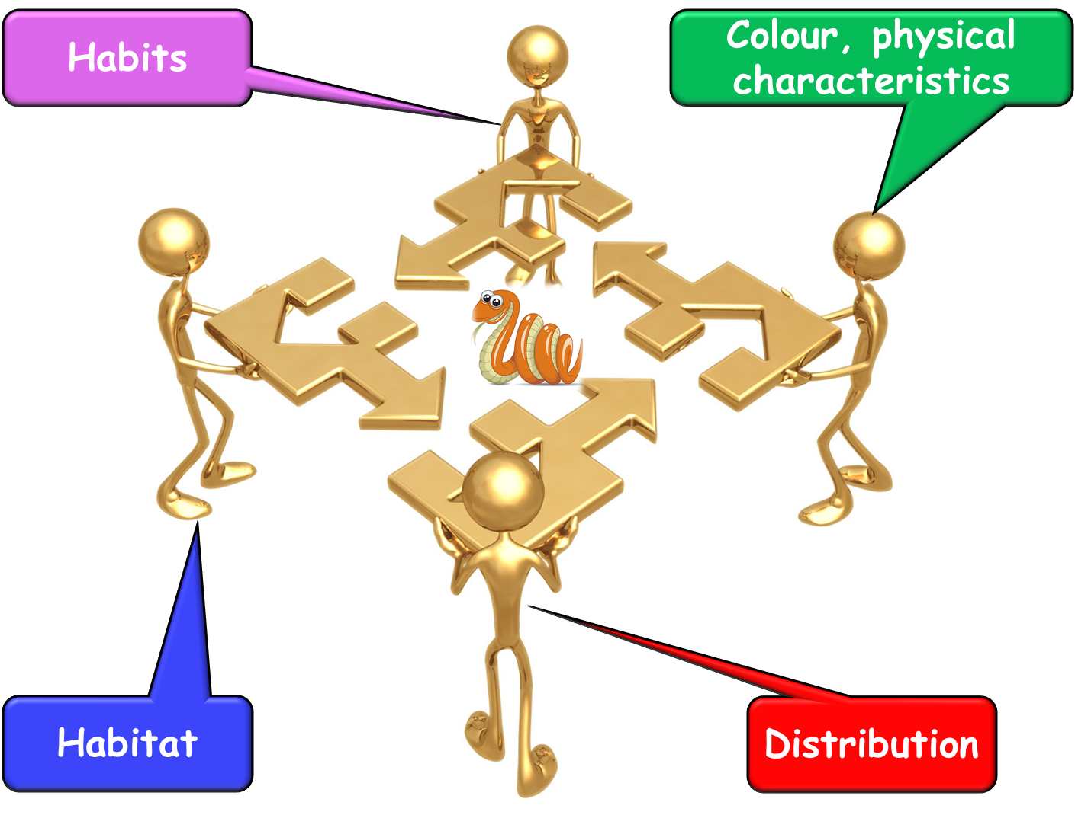
Identification

Slide 8
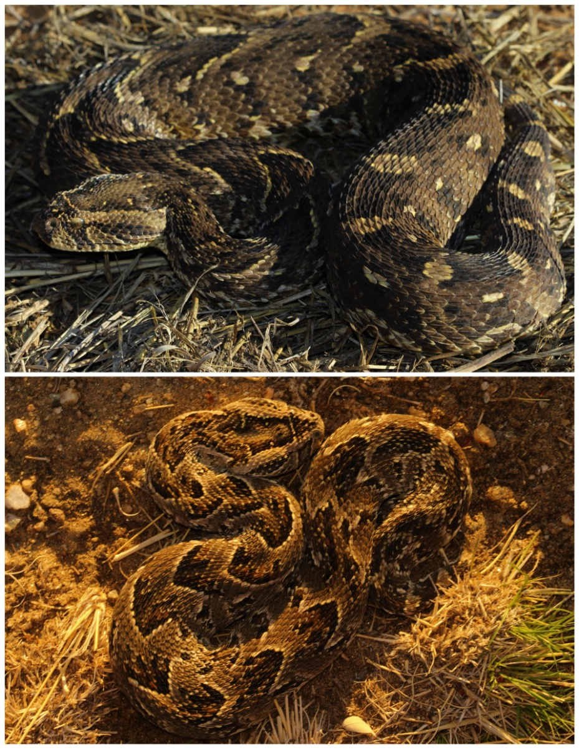
Puff adder
Size
Adults 90cm-140cm, Juveniles 20-25cm
Description
Brown to dark grey above with a series of backward-pointing V-shaped patterns. The head is triangular shaped and is distinctive from the rest of the body. Puff adders are short stocky snakes.
Habitat
Frequently found in grass- and woodland areas throughout Namibia, however absent from the sand seas of the Namib Desert.
Habits
Puff adders are mainly shy snakes active at night and ground dwelling (terrestrial). It is, however, not uncommon to encounter them in broad daylight basking in the sun.
Fun fact
Puff adders strike with astonishing speed and accuracy: The strike speed is up to 12km/h (3m/s).
Venom
Cytotoxic (i.e., damaging the tissue/flesh with swelling and blue discolouration, mainly around the bite area).
Notes:
Size
Adults 90cm-140cm, Juveniles 20-25cm
Description
Brown to dark grey above with a series of backward-pointing V-shaped patterns. The head is triangular shaped and is distinctive from the rest of the body. Puff adders are short stocky snakes.
Habitat
Frequently found in grass- and woodland areas throughout Namibia, however absent from the sand seas of the Namib Desert.
Habits
Puff adders are mainly shy snakes active at night and ground dwelling (terrestrial). It is, however, not uncommon to encounter them in broad daylight basking in the sun.
Fun fact
Puff adders strike with astonishing speed and accuracy: The strike speed is up to 12km/h (3m/s).
Venom
Cytotoxic (i.e., damaging the tissue/flesh with swelling and blue discolouration, mainly around the bite area).

Slide 9
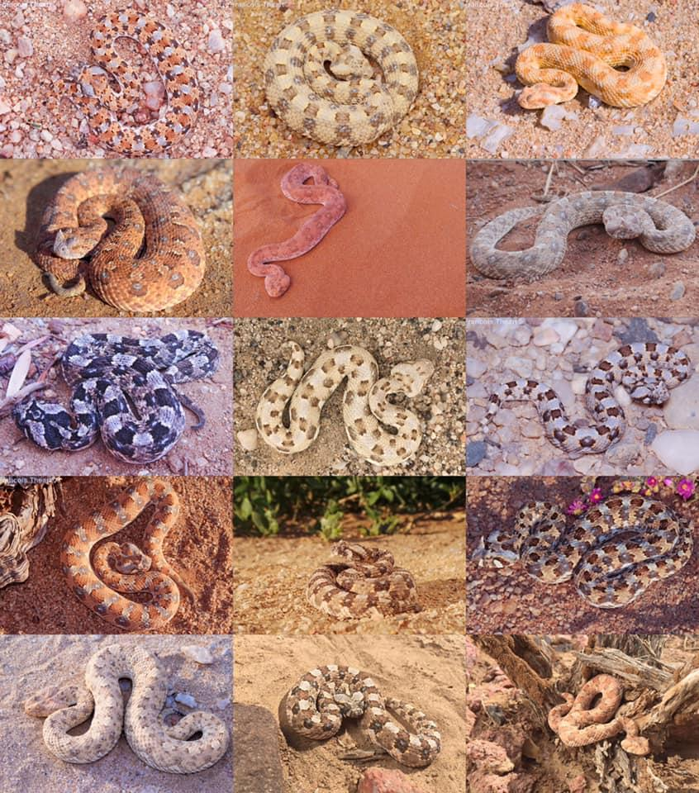
Horned Adder
Size
Adults 40cm-60cm, Juveniles 13cm-15cm.
Description
These are small, sturdy snakes with triangular head shapes. A soft horn is usually present above each eye. Colour is extremely variable ranging from blue to grey above with a series of red-brown oval blotches on the back.
Habitat
This snake occurs in dry sandy, arid savannah regions, throughout most of Namibia.
Habitat
These terrestrial (ground dwelling) snakes burry themselves in sand, leaving only the eyes and the top of the head and horns exposed. It will lie in ambush striking any prey that passes by.
Venom
Cytotoxic. The effects are as for the Puff adder, but less severe.

Slide 10
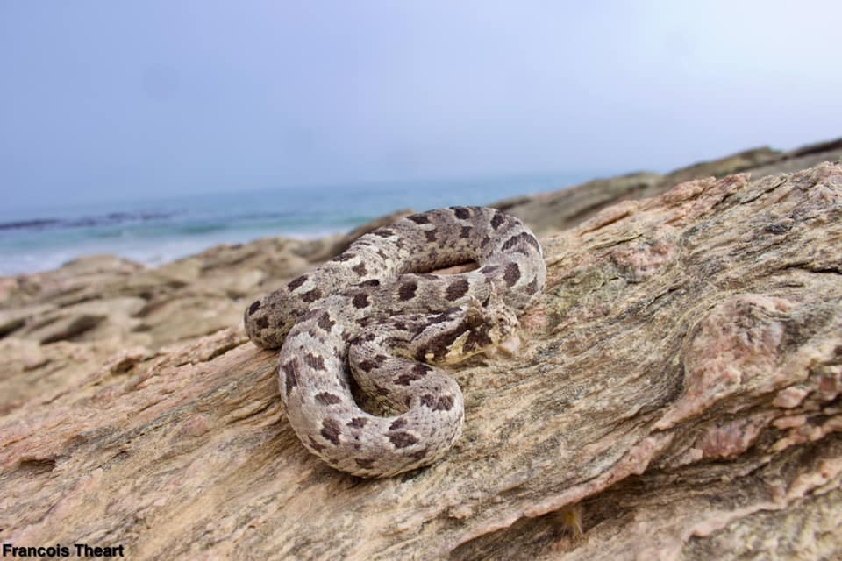
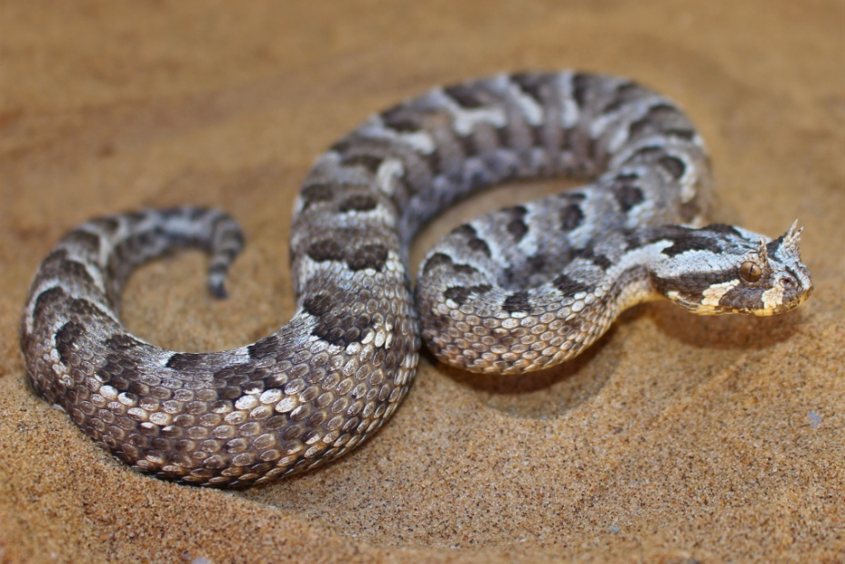
Many Horned Adder
Size
Adults 30cm-50cm, Juveniles 13-16cm.
Description
As for all adders, a triangular shaped head which is distinctive from the rest of the body. Colour vary from grey to light brown with black blotches and pale edging. A horn, consisting of multiple tufts (4-7) above each eye is present.
Habitat
Usually found on gravel plains and in rocky out-crops in southern Namibia.
Habits
Mainly active at night when hunting for small lizards and rodents. Often buries itself in sand and seeks shelter in rocky outcrops.
Venom
Cytotoxic. The effects are as for the Puff adder, but less severe.

Slide 11
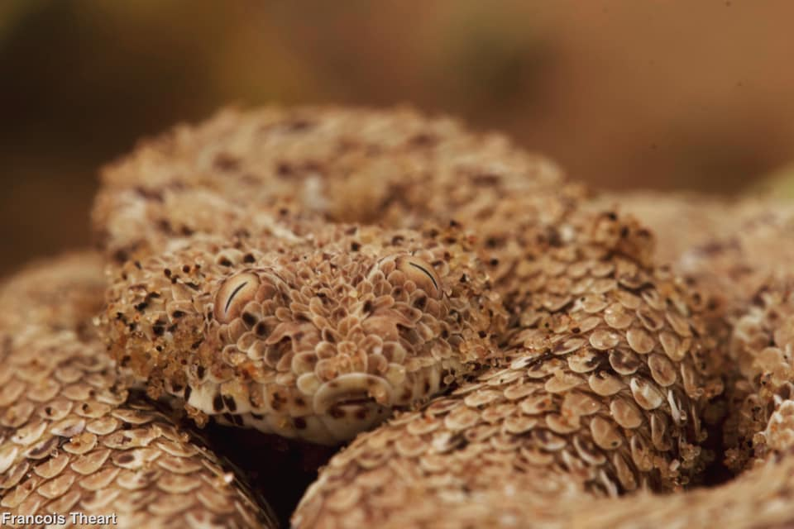
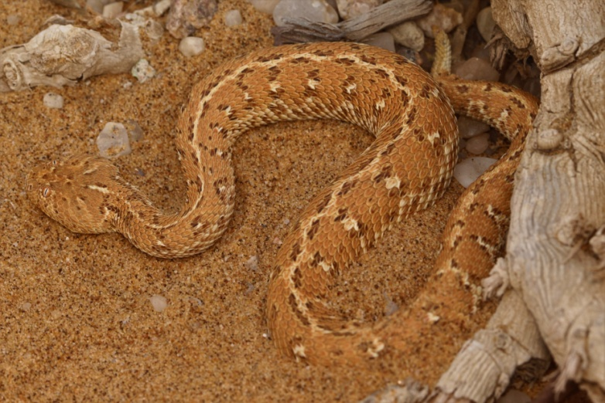
Namib Dune Adder
Size
Adults 20cm-25cm, juveniles 8-13cm.
Description
These adders are sandy-grey to greyish yellow above with three rows of stretched out sandy-brown to grey spots lengthwise on either side of the body. The belly uniformly whitish with small darker spots. The tip of the tail is usually darker or black. They are one of the smallest adder species in the world.
Habitat
It is endemic to the sand seas of the Namib Desert, except possibly Henties Bay.
Habits
These adders are usually nocturnal (active at night). Most of the daylight hours are spent buried in the sand with only the eyes and upper part of the head above the surface. The purpose of the latter is to protect itself from the extreme temperature and to await a possible meal in the form of a wandering-by desert lizard. The eyes are situated on top of the head.
Venom
Mildly cytotoxic and neurotoxic. Moderate to severe pain at the bite site with slight swelling and blue discolouration.
A feeling of "pins-and-needles" of the tongue and lips, nausea and vomiting, a bitter taste, double vision and difficulty to focus the eyes are sometimes experienced.

Slide 12
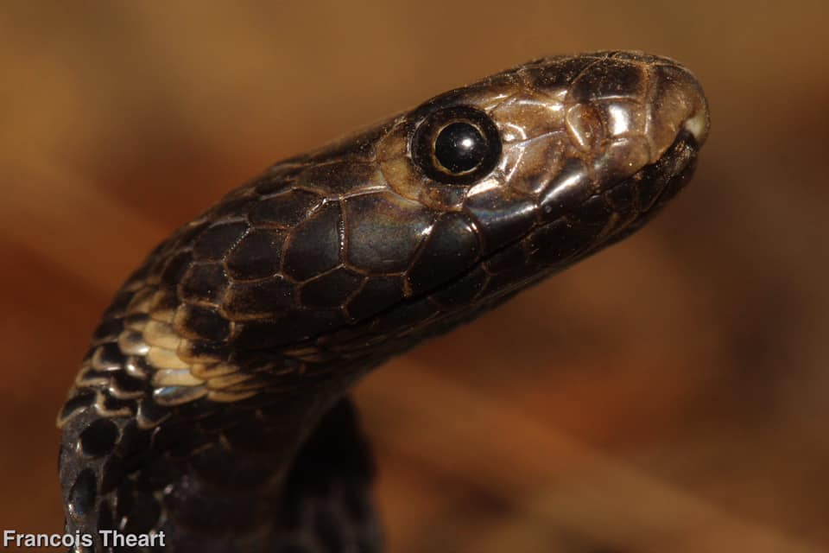
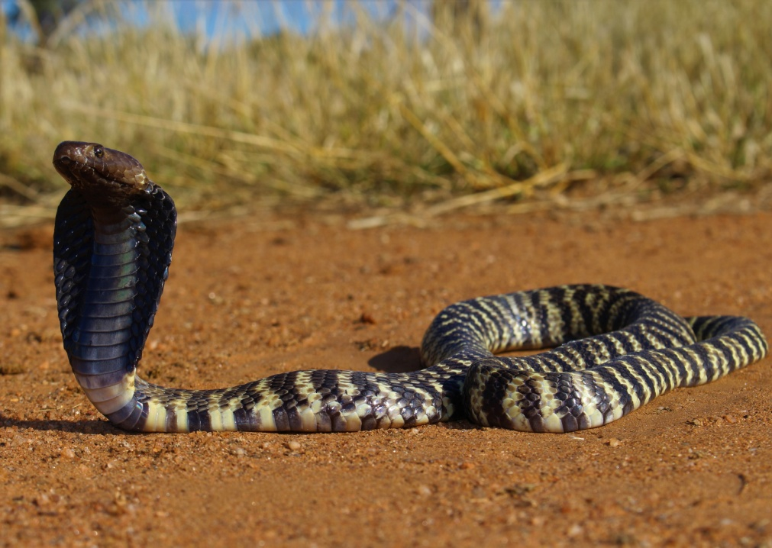
Zebra snake
Size
Adults 150cm-190cm, Juveniles 34-40cm.
Description
A medium sized cobra with a broad head and black crossbars on a cream-white body. The head and neck area is dark brown to black. When threatened, it will spread an impressive hood and spit.
Habitat
This snake is often encountered in dry rocky outcrops, dry riverbeds and arid savannah.
Habits
It is mainly active at night hunting for food (rodents, frogs and other reptiles). This snake shelters down rodent burrows, rocky outcrops and tree hollows and is abundant in built-up areas., often entering homes at night.
Venom
Potent cytotoxic venom causing severe pain and swelling followed rapidly by discolouration and spreading from the bite site. No major, if any, neurological (i.e., affecting the nervous system) effects have been documented. Death is uncommon if treated promptly.

Slide 13
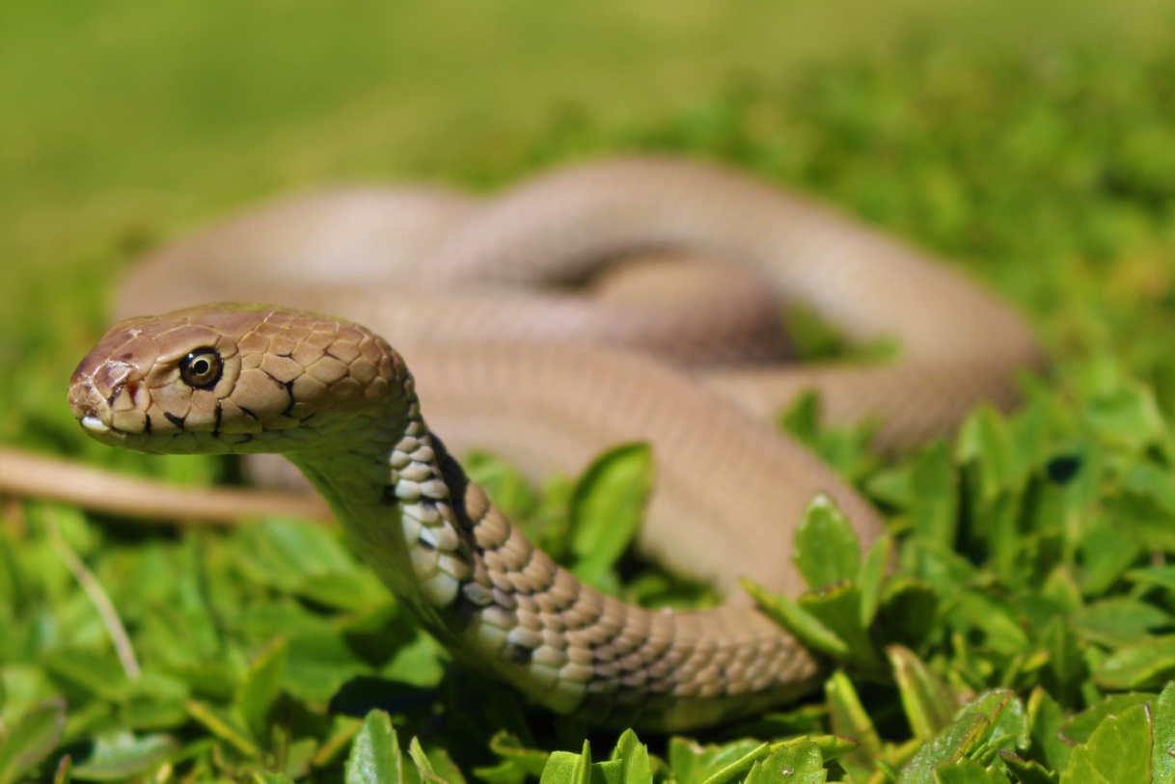
Mozambique Spitting Cobra
Size
Adults 150cm-190cm, Juveniles 34-40cm.
Description
A medium sized cobra with a broad head and black crossbars on a cream-white body. The head and neck area is dark brown to black. When threatened, it will spread an impressive hood and spit.
Habitat
This snake is often encountered in dry rocky outcrops, dry riverbeds and arid savannah.
Habits
It is mainly active at night hunting for food (rodents, frogs and other reptiles). This snake shelters down rodent burrows, rocky outcrops and tree hollows and is abundant in built-up areas., often entering homes at night.
Venom
Potent cytotoxic venom causing severe pain and swelling followed rapidly by discolouration and spreading from the bite site. No major, if any, neurological (i.e., affecting the nervous system) effects have been documented. Death is uncommon if treated promptly.

Slide 14
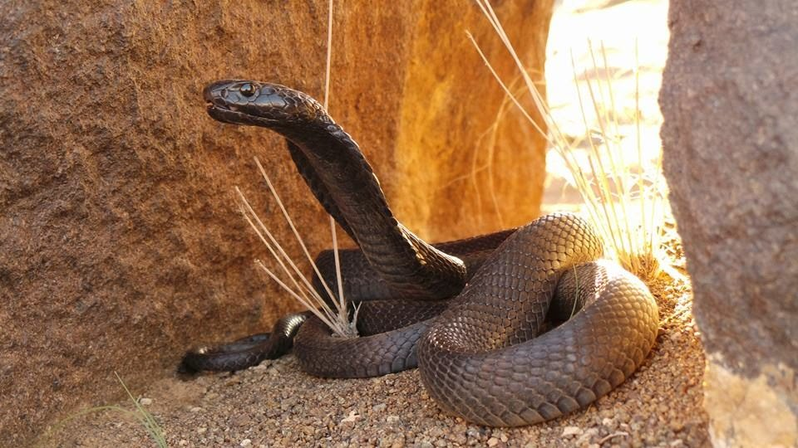
Black Spitting Cobra
Size
Adults 1.5m -1.7m.
Description
Shiny black with a broad head, spreading a hood when threatened.
Habitat
This snake is mainly found in dry riverbeds and rocky outcrops where it hunts for small rodents, lizards and other snakes.
Habits
The black spitting cobra is mainly active during the day; however, individuals have been found foraging at night.
Venom
Potent cytotoxic venom causing severe pain and swelling followed rapidly by discolouration and spreading from the bite site. No major, if any, neurological (i.e., affecting the nervous system) effects have been documented. Death is uncommon if treated promptly.

Slide 15
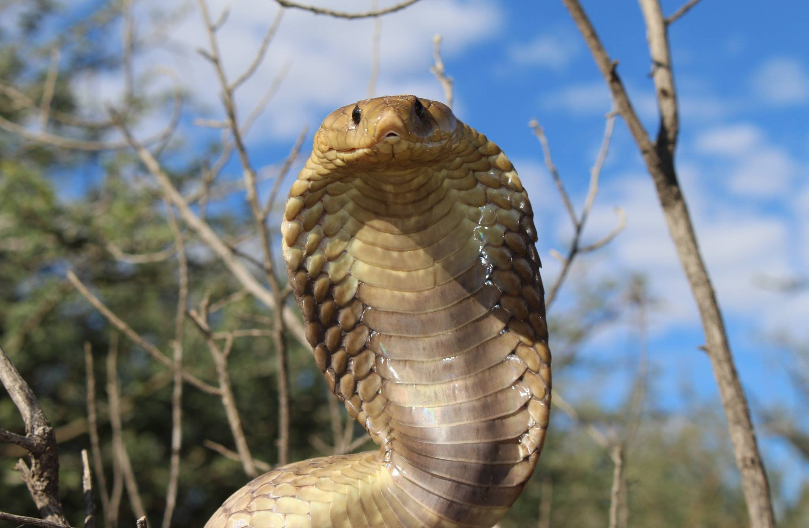
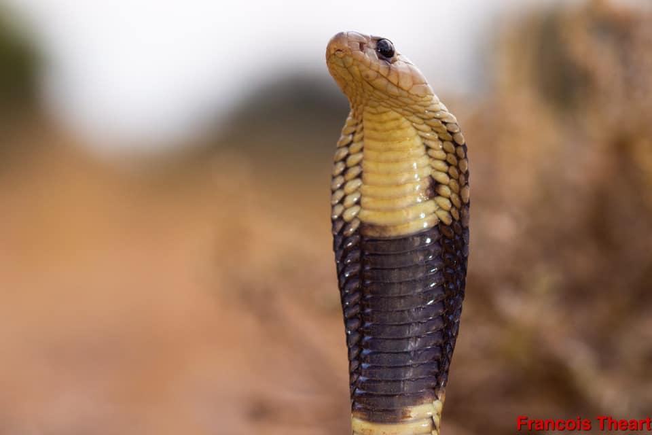
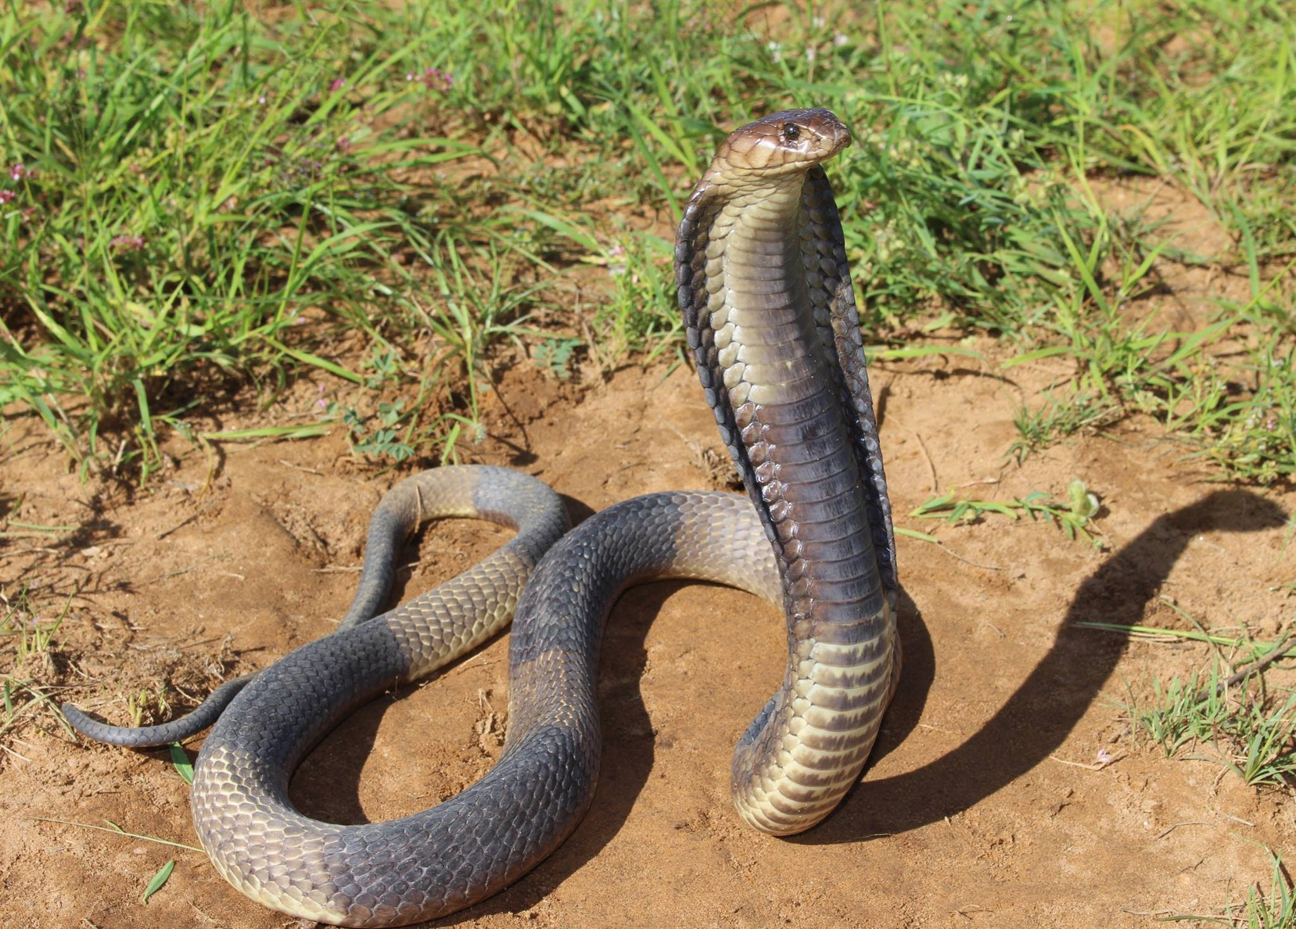
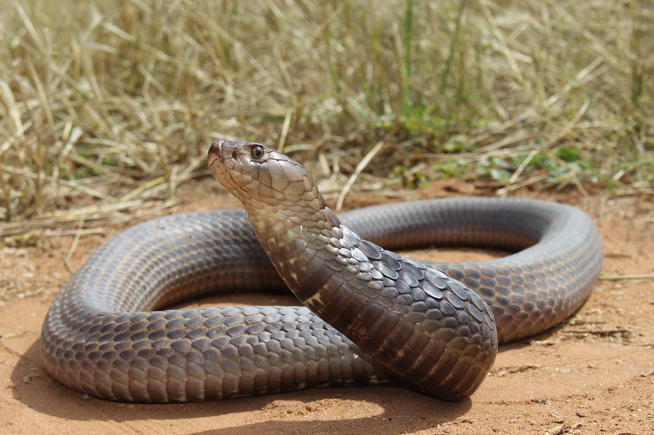
Anchieta’s/Angolan Cobra
Size
Adults 190cm-250cm, juveniles 25cm - 35cm.
Description
This is Namibia's largest cobra and is a non-spitter. The head is pointed and hardly distinct from the rest of the body. Juveniles are yellow above and below and a broad black band encircles the neck. Adults darken to light or darkish brown as they age. A banded variation also occurs with broad black and yellow bands.
Habitat
Mostly found in woodland areas along wetlands and rivers, although no uncommon in more arid regions.
Habits
This is a crepuscular snake (more active late afternoon and early morning - twilight hours). It feeds on a variety of amphibians, small mammals and other reptiles and is often encountered in or around a source water.
Venom
Potent neurotoxin (i.e., affecting the body's nervous system causing sweating, drowsiness, slurred speech, droopy eyelids, difficulty swallowing and later difficulty in breathing and even death if not treated early and adequately).

Slide 16
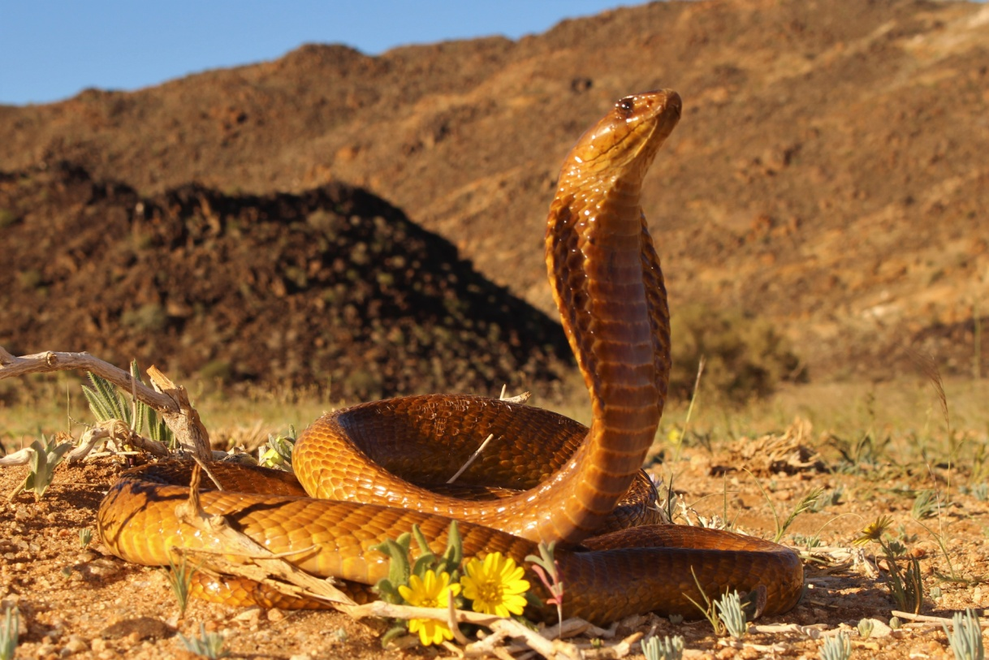
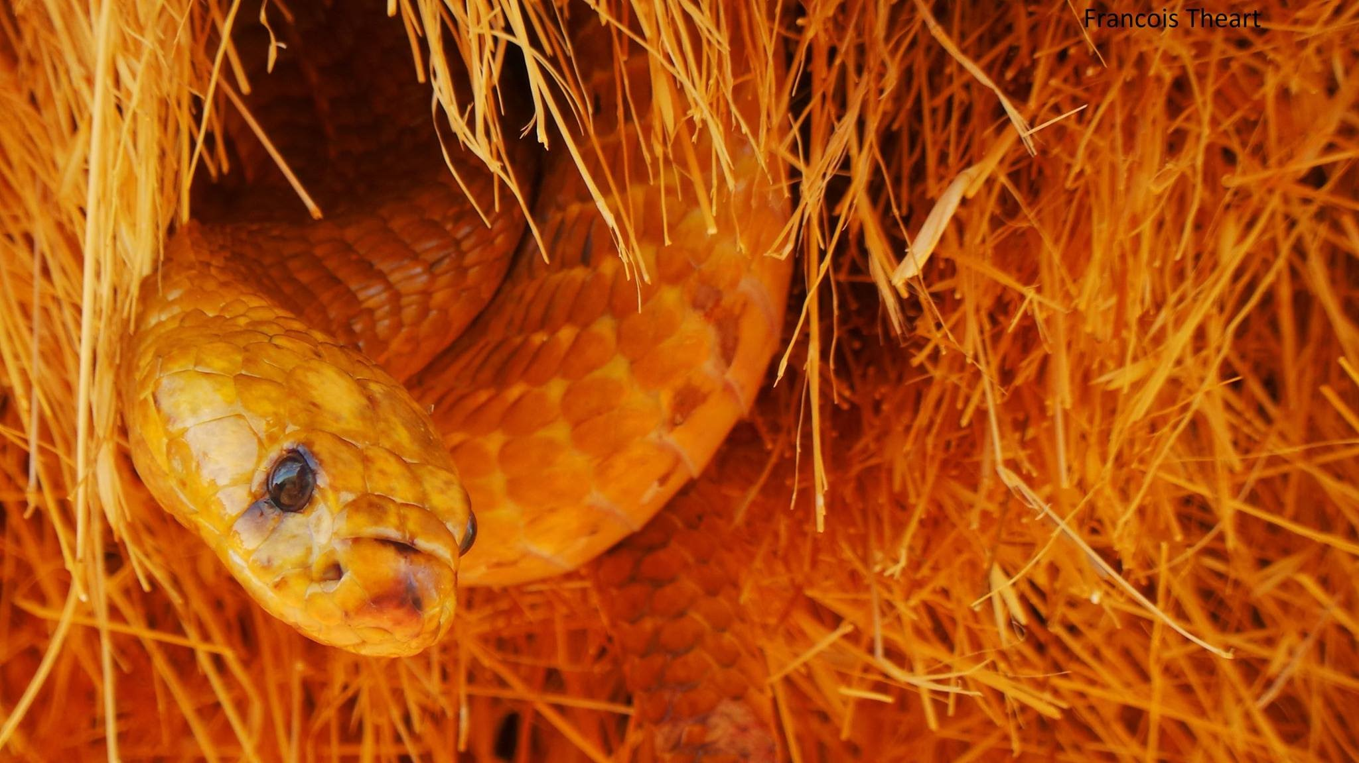
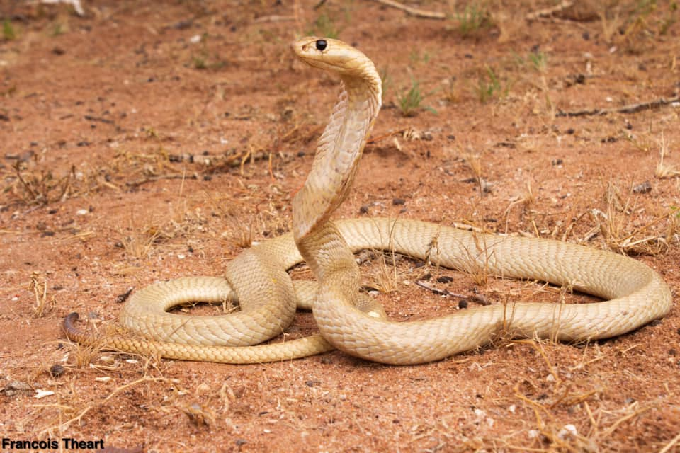
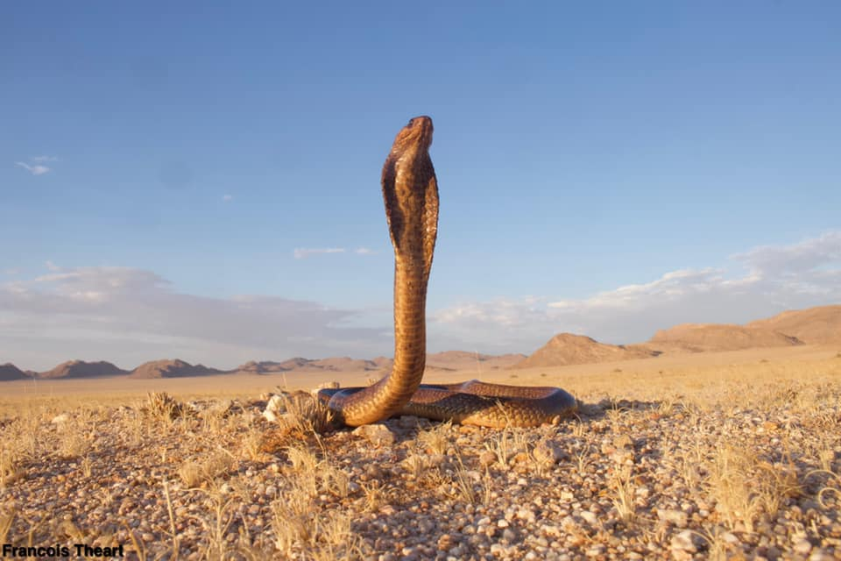
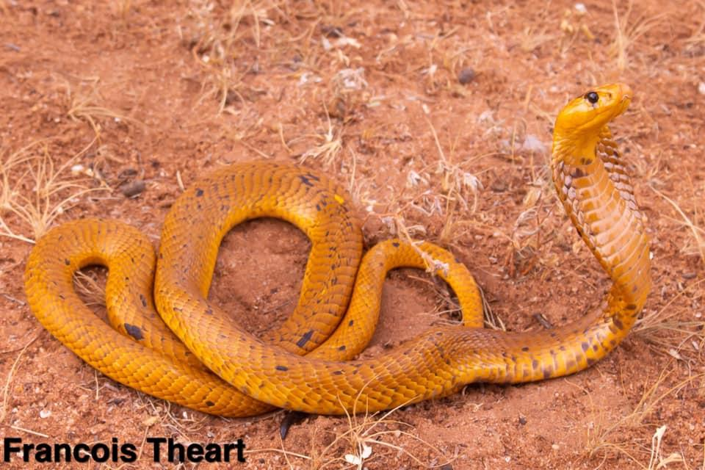
Cape Cobra
Size
Adults 120cm-200cm, Juveniles 34cm-40cm
Description
Slender medium sized cobra with a broad hood. Juveniles are yellow with a black band which fades and disappears completely in adults. Adult colours are extremely variable ranging from yellow to black. Some individuals are speckled.
Habitat
Arid savannah and the Namib Desert where it often inhabits abandon rodent burrows, disused termite mounds and rock crevices.
Habits
The snake is active during the day and early evening and feeds on a variety of prey such as rodents, amphibians, birds and other snakes. They are excellent climbers and are well known for raiding sociable weaver bird nests.
Venom
Potent neurotoxin (i.e., affecting the body's nervous system causing sweating, drowsiness, slurred speech, droopy eyelids, difficulty swallowing and later difficulty in breathing and even death if not treated early and adequately. May also affect the heartbeat). Mild to moderate local swelling, discolouration and pain are present.

Slide 17
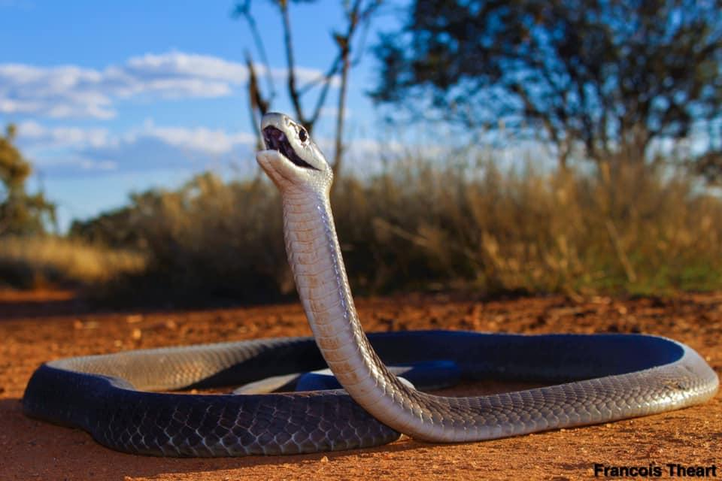
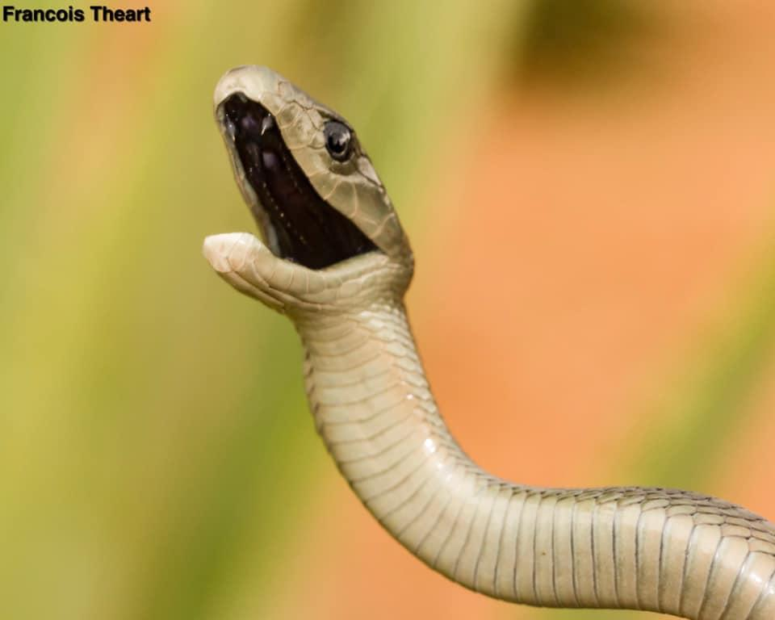
Black Mamba
Size
Adults 2.5m-3.8m, juveniles 60cm.
Description
A long agile snake with an elongated coffin-shaped head and a grimace. The inside of the mouth is black. Juveniles are grey to olive, but darkens with age to gunmetal grey. These snakes are rarely black.
Habitat
Black mambas inhabit well wooded savannah and is common in rocky outcrops. They are both tree dwelling (arboreal) and ground dwelling (terrestrial).
Habits
This diurnal (active during the day) snake mainly feeds on small mammals and fledgling birds. It also hunts from a permanent lair such as rocky crevices, hollow trees and termite mounds. When disturbed, the snake will seek refuge somewhere else. When threatened, the black mamba will raise a third of its body off the ground, spread a small hood and will often gape - exposing the black inner lining of the mouth.
Venom
Potent neurotoxin (i.e., affecting the body's nervous system causing sweating, drowsiness, slurred speech, droopy eyelids, difficulty swallowing and later difficulty in breathing and even death if not treated early and adequately). Mild to moderate local swelling, discolouration and pain are present.

Slide 18
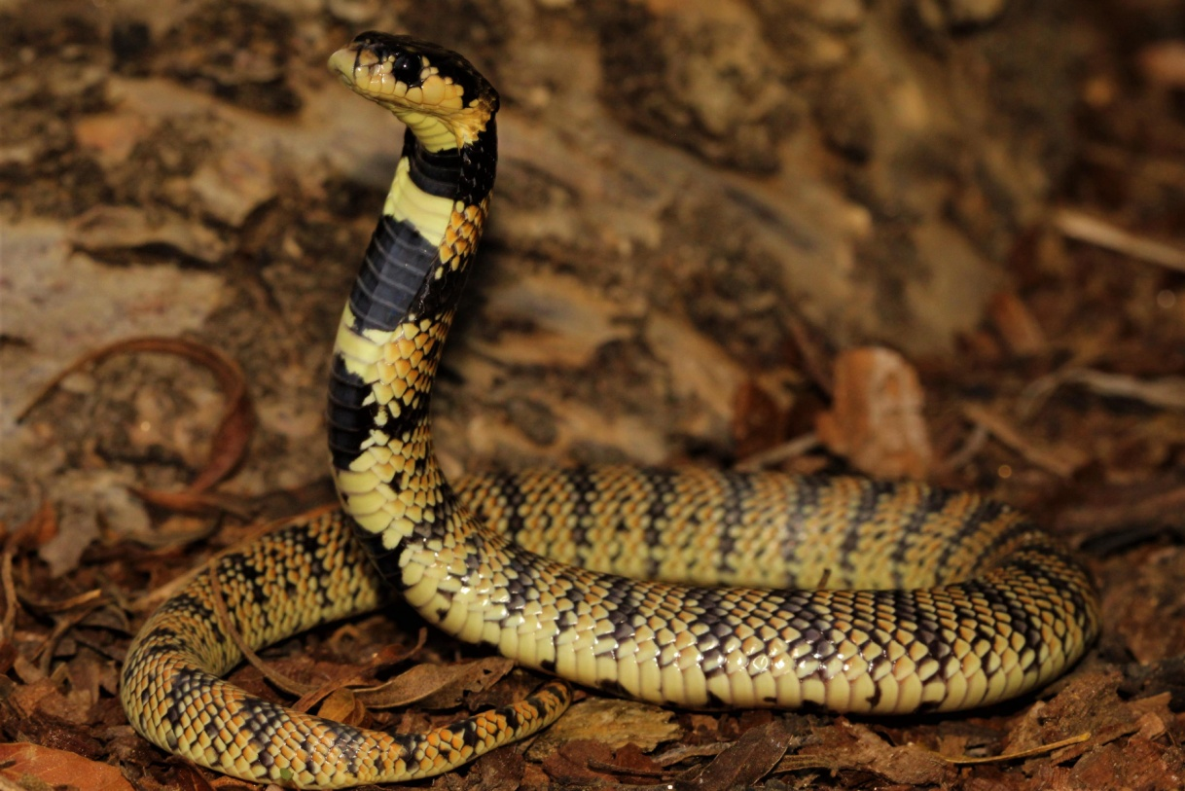
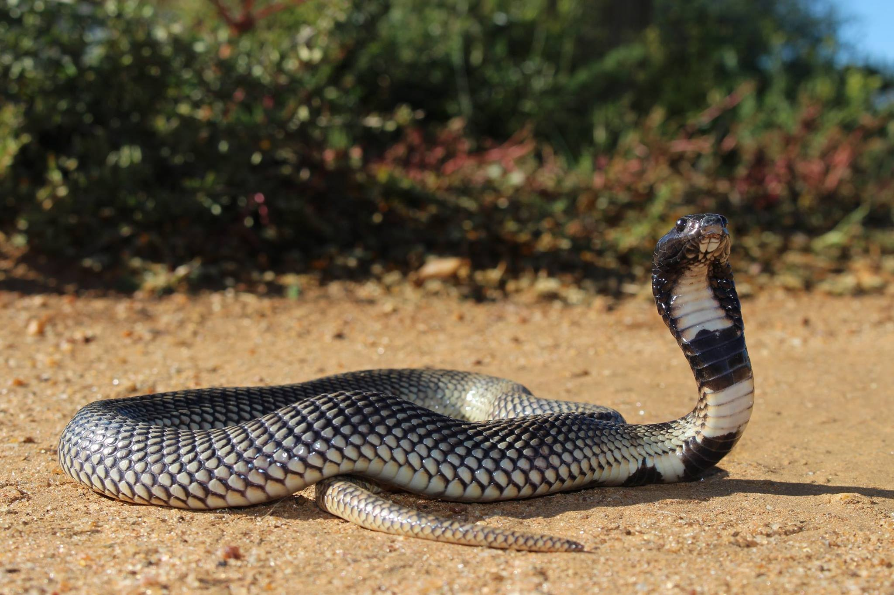
Kunene Shield Cobra
Size
Adults 30cm-75cm, juveniles 17-18cm.
Description
The Kunene shield cobra is grey to brown above with distinct crossbars. The underside is white with black blotches on the neck area. The Cape coral shield cobra is orange to red above with black
Habitat
These snakes are mainly encountered along rocky outcrops and dry sandy regions.
Venom
Neurotoxic effecting breathing

Slide 19
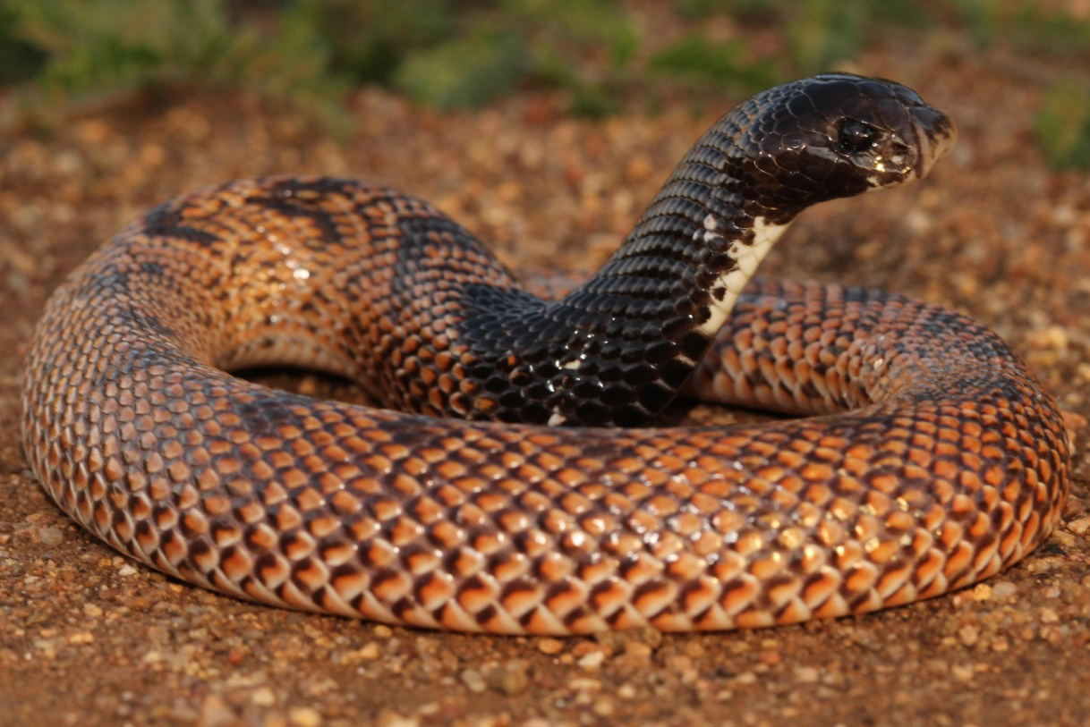
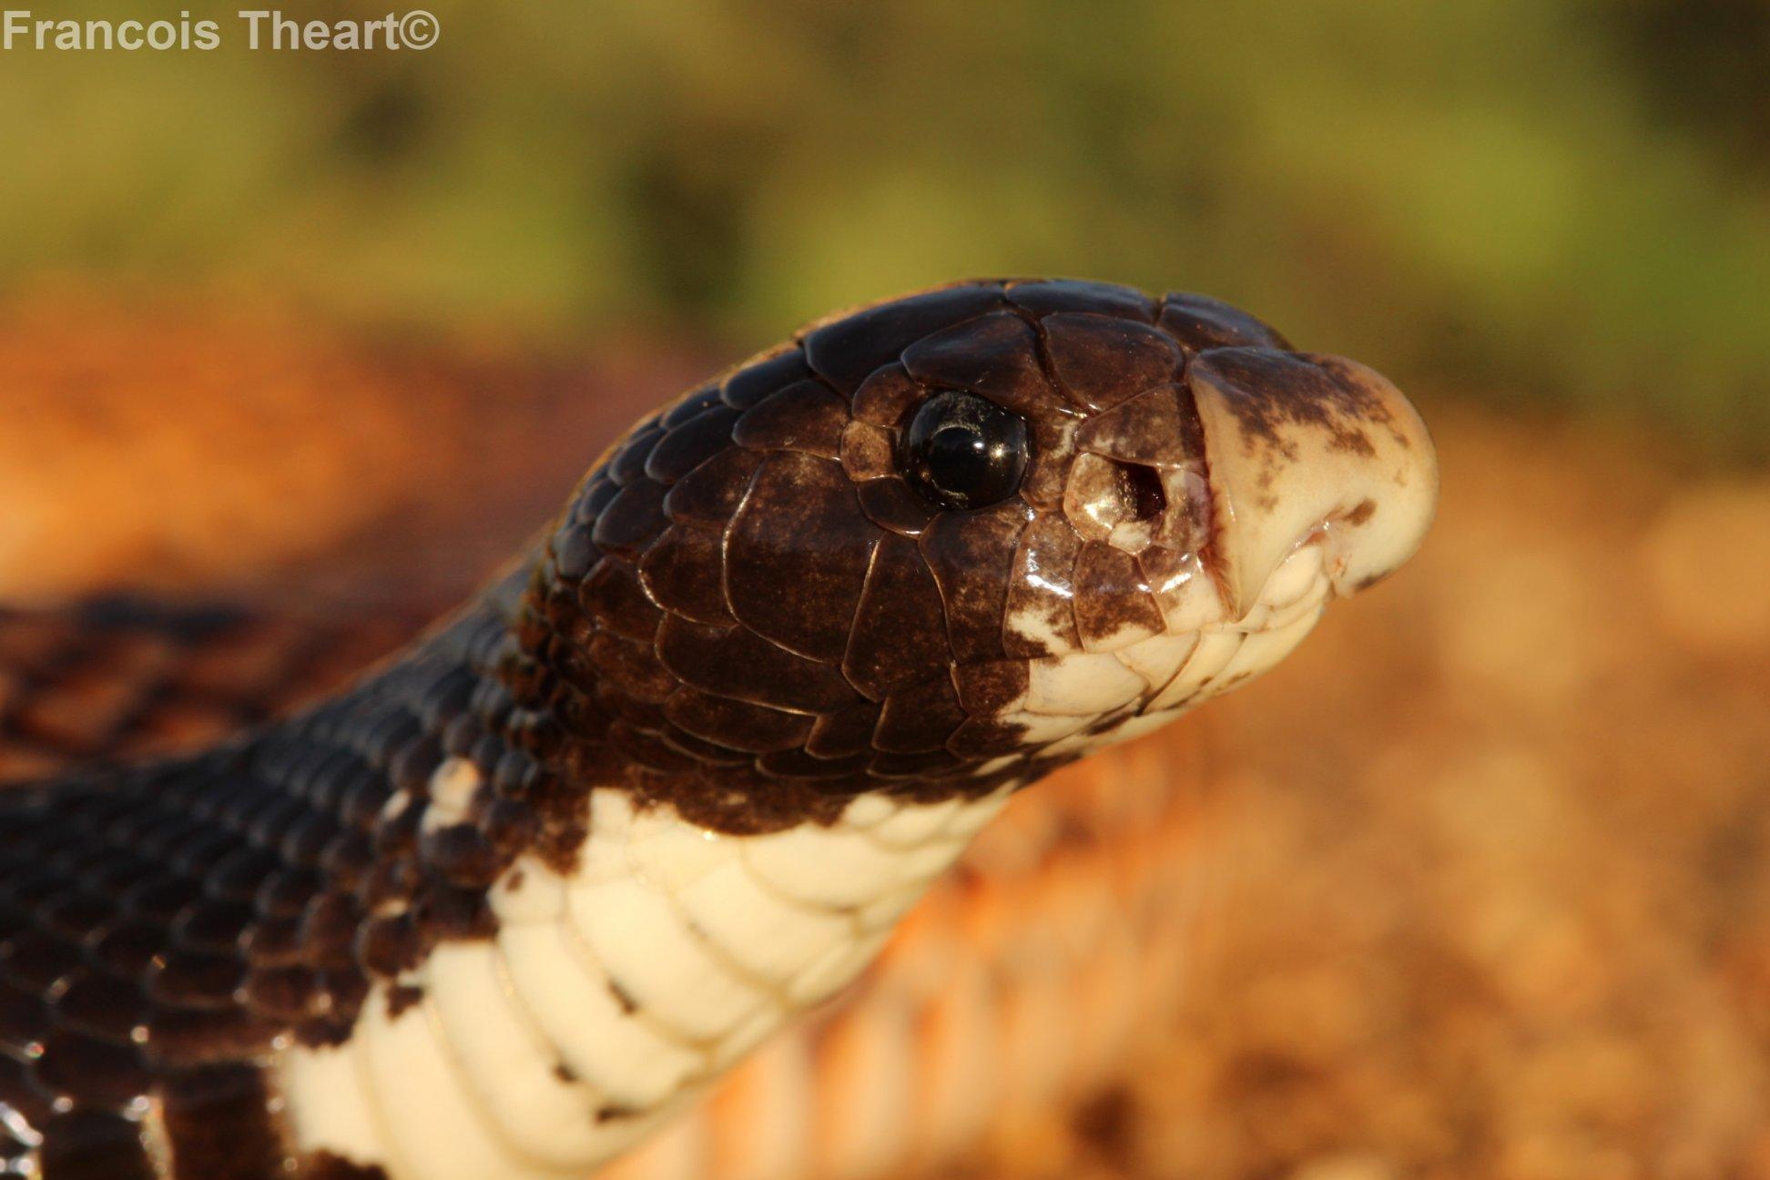
Speckled shield Cobra
Size
Adult 45cm - 75cm, juveniles 16-18cm
Description
This snake has reddish brown above with black blotches on the back. The head and neck area is black with white markings on the throat region. It is a short fat snake with a short stubby head and a large rostral (tip of nose) scale.
Habitat
Found in sandy and rocky areas as well as moist and arid savannah throughout north-eastern and central Namibia.
Habits
This snake is mainly active at night looking for forages for food. When threatened, this snake will raise its head and strike repeatedly. It does not spread a hood like true cobras.
Venom
Mildly cytotoxic and neurotoxic. Bites are very seldom life threatening.

Slide 20
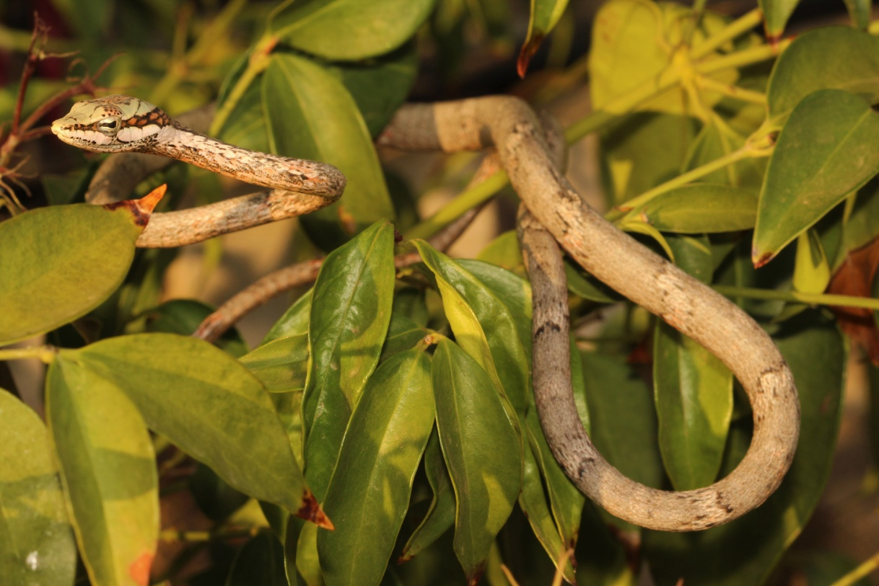
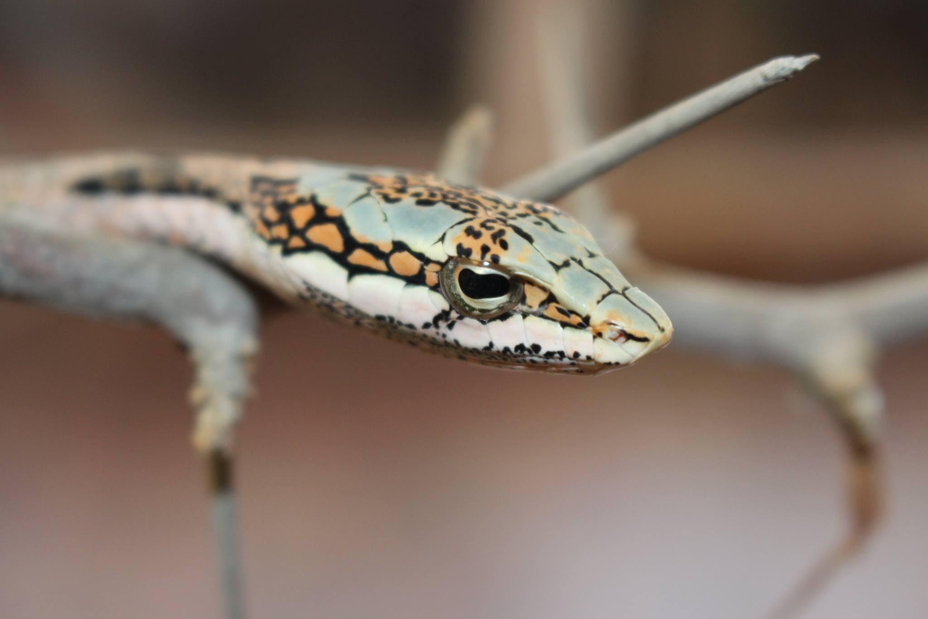
Twig Snake
Size
Adult 140cm-170cm, juvenile 25cm.
Description
Vine snakes have a spear shaped head with a keyhole fashioned pupil. The head above is green while the body is grey with pink flecks. A reddish speckled band runs from the tip of the snout through the eye. The tongue is red with a black tip.
Habitat
They are found in both arid and moist savannah and the Mopani forests of the arid north west of Namibia.
Habits
These snakes are mainly active during the day and spend most of their time in trees and shrubs where it hunts for frogs, lizards and chameleons.
Venom-similar to that of the boomslang.

Slide 21
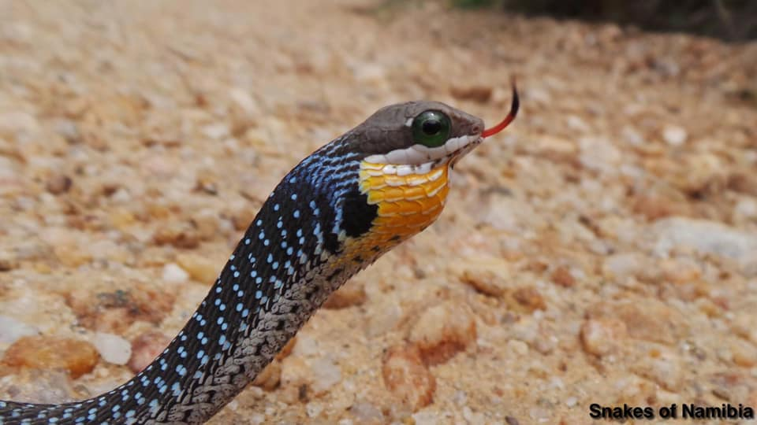
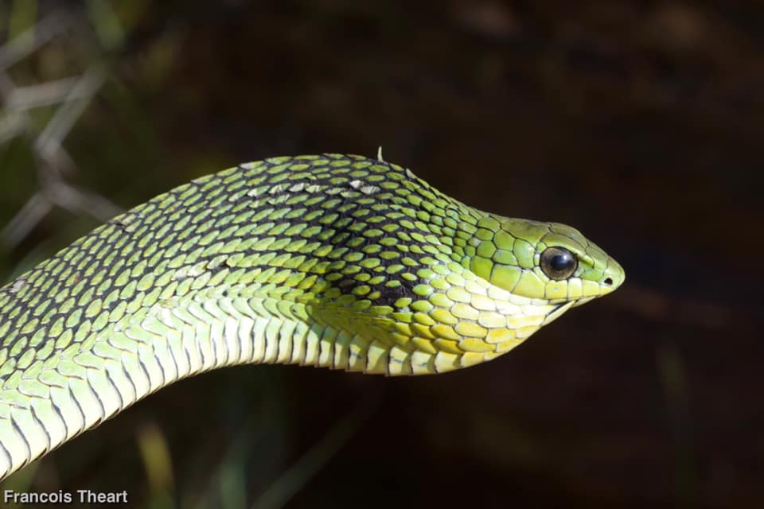
Boomslang
Size
Adult 150cm - 200cm, juveniles 29-38cm.
Description
Boomslang have a short stubby head with a large eye. The colour varies; males are often bright green with black edged scales while females are light brown to grey. Juveniles are grey above with blue and orange speckles between the scales and the neck area is often yellow to orange, which is especially prominent when inflating the neck area. The eyes of juveniles are bright emerald green.
Habitat
Boomslang occurs in arid and moist savannah. They are absent from the sand seas of the arid west and parts of southern Namibia.
Habits
This snake is mostly active during the day and spends most of its time in trees and shrubs. It is here where it actively hunts for fledgling birds and chameleons. Boomslang have also been observed hunting for frogs along streams and puddles.
Venom
Haemotoxic (i.e., affecting the blood system). Mild local pain and bleeding at the bite site. Severe headache develops after a few hours and bleeding (from cuts, scratches, under the skin - blue bruises and from mucous membranes) later following the bite.

Slide 22
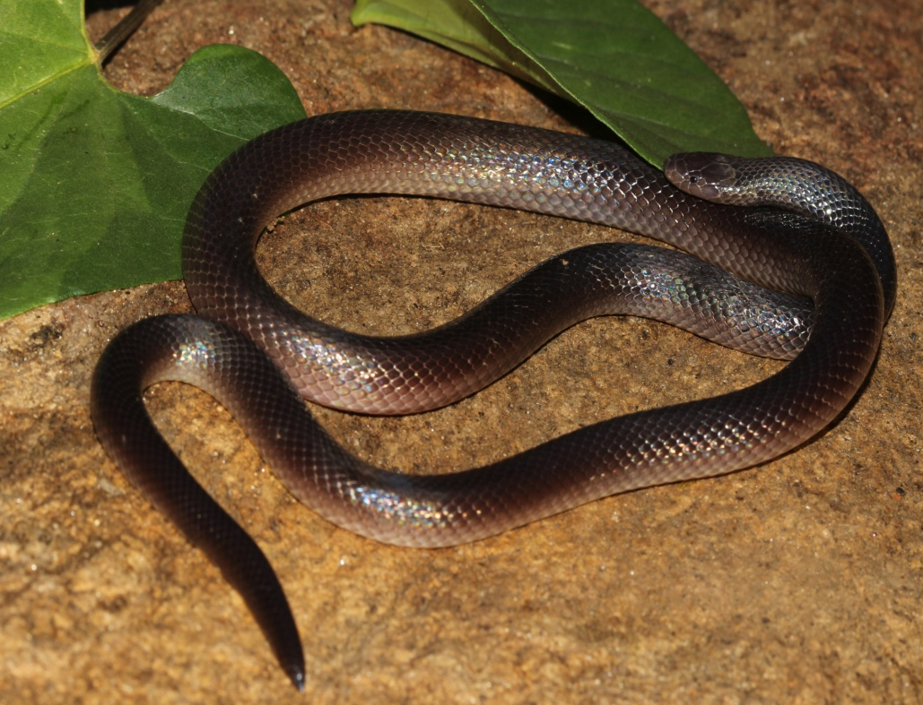
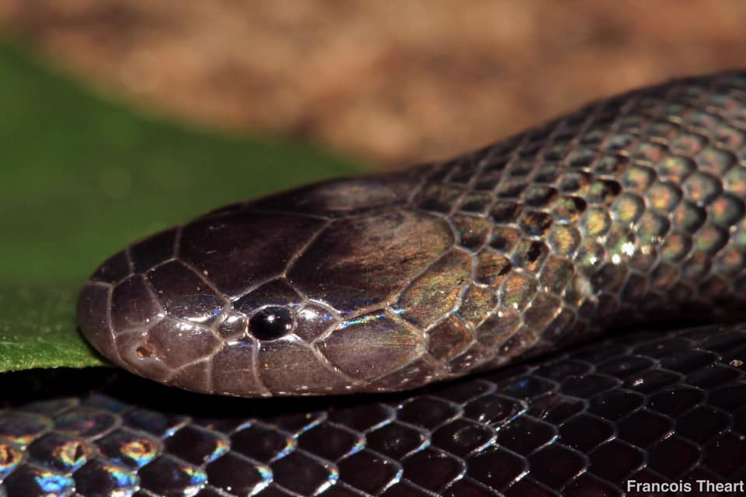
Stiletto snake
Size
Adults 30-60cm, juveniles 15cm.
Description
This is a dark brown to black snake with small dark beady eyes, an indistinctive neck and a blunt ending tail with a sharp tip. In certain regions this snake may have a cream white belly. When threatened, it will arch its neck and twitch around.
Habitat
Found through out most of Namibia, avoiding the true desert and far South.
Habits
Stiletto snakes are short-tempered and mainly active at night. They are often encountered after the rains. During the day they hide underneath rocks, rotting logs and in termite mounds.
Venom
Mostly cytotoxic, causing painful swelling, which may be followed by discolouration and blistering. A single fang puncture mark is present. Regional lymph nodes are involved and become swollen and tender. Mild neurotoxic effect results in nausea, vomiting, dry mouth and throat and headache.

Slide 23
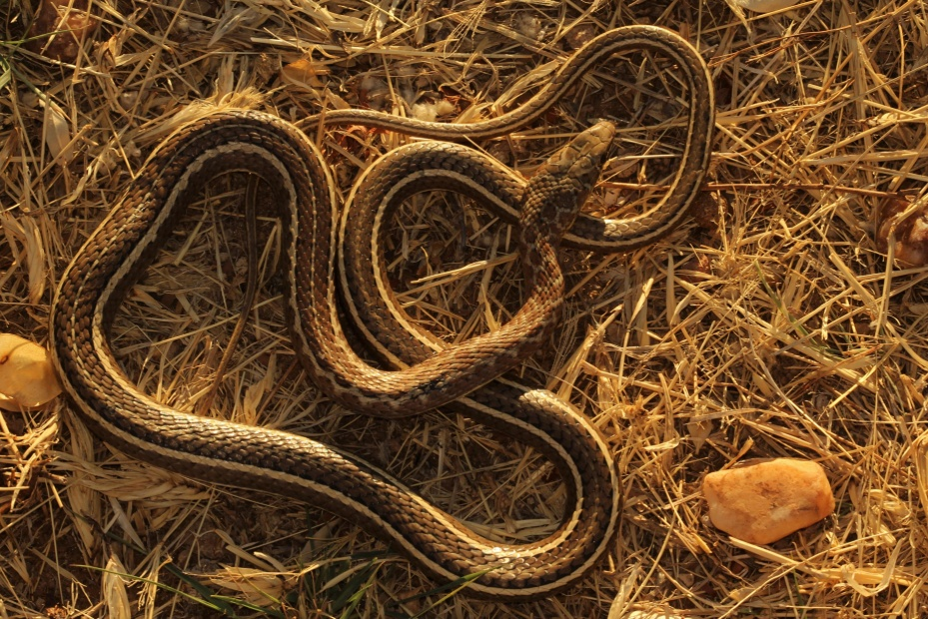
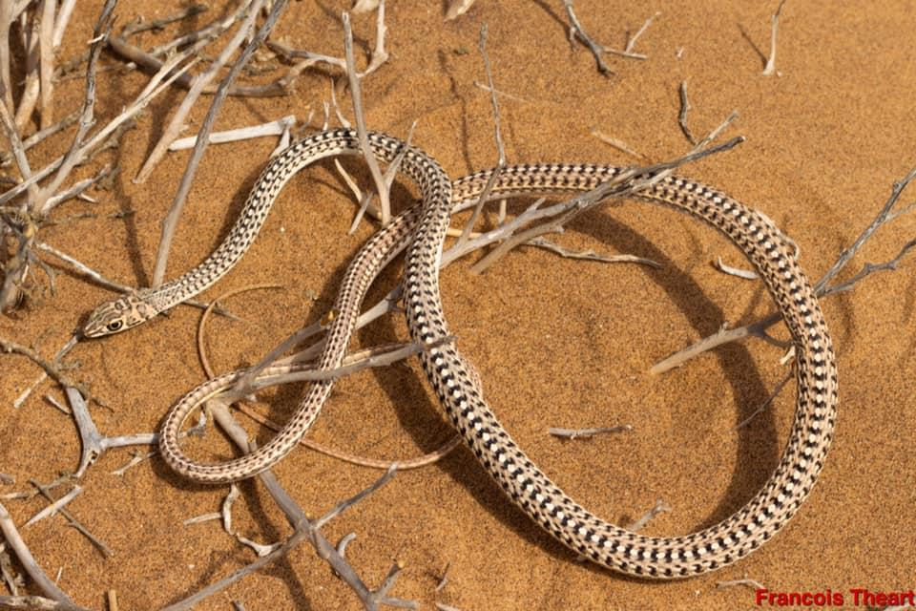
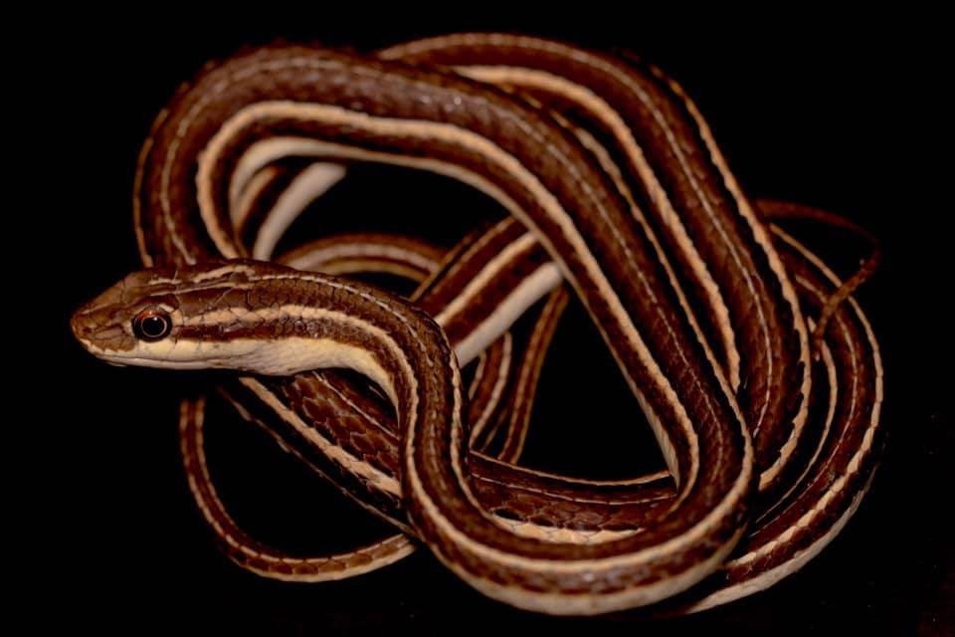
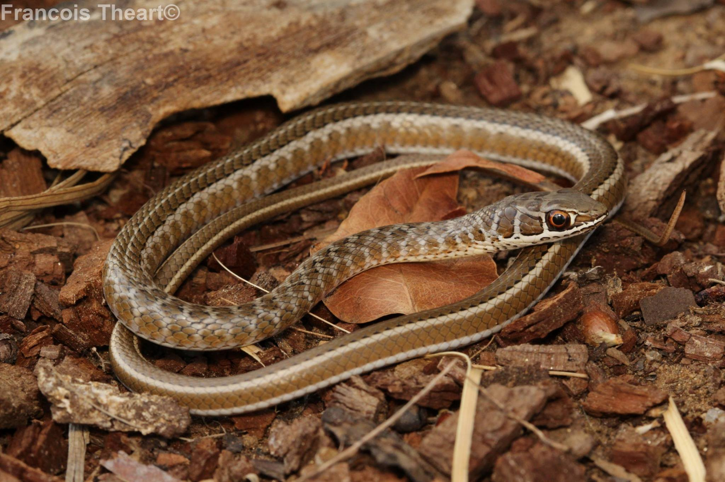
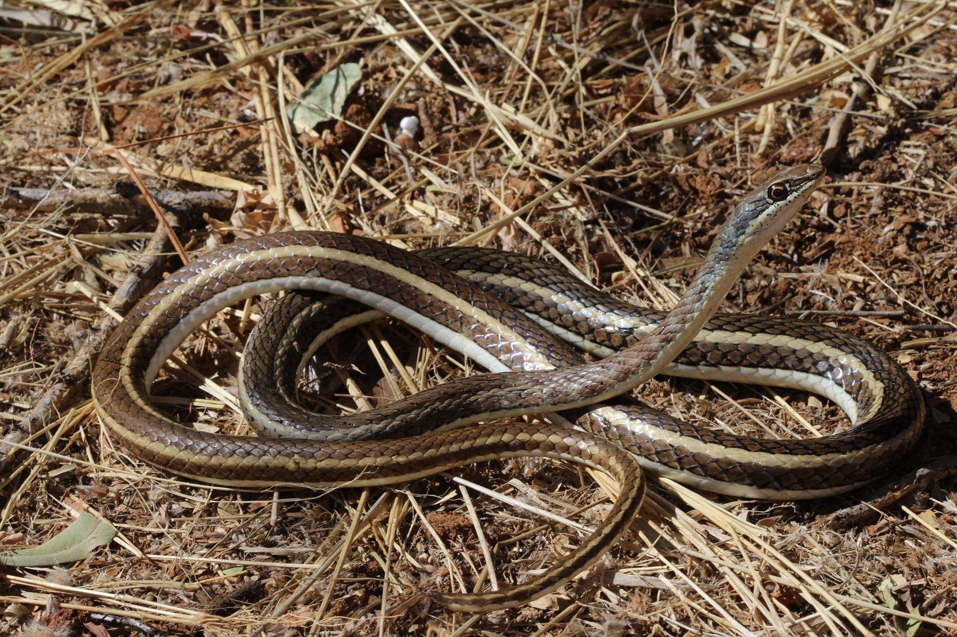
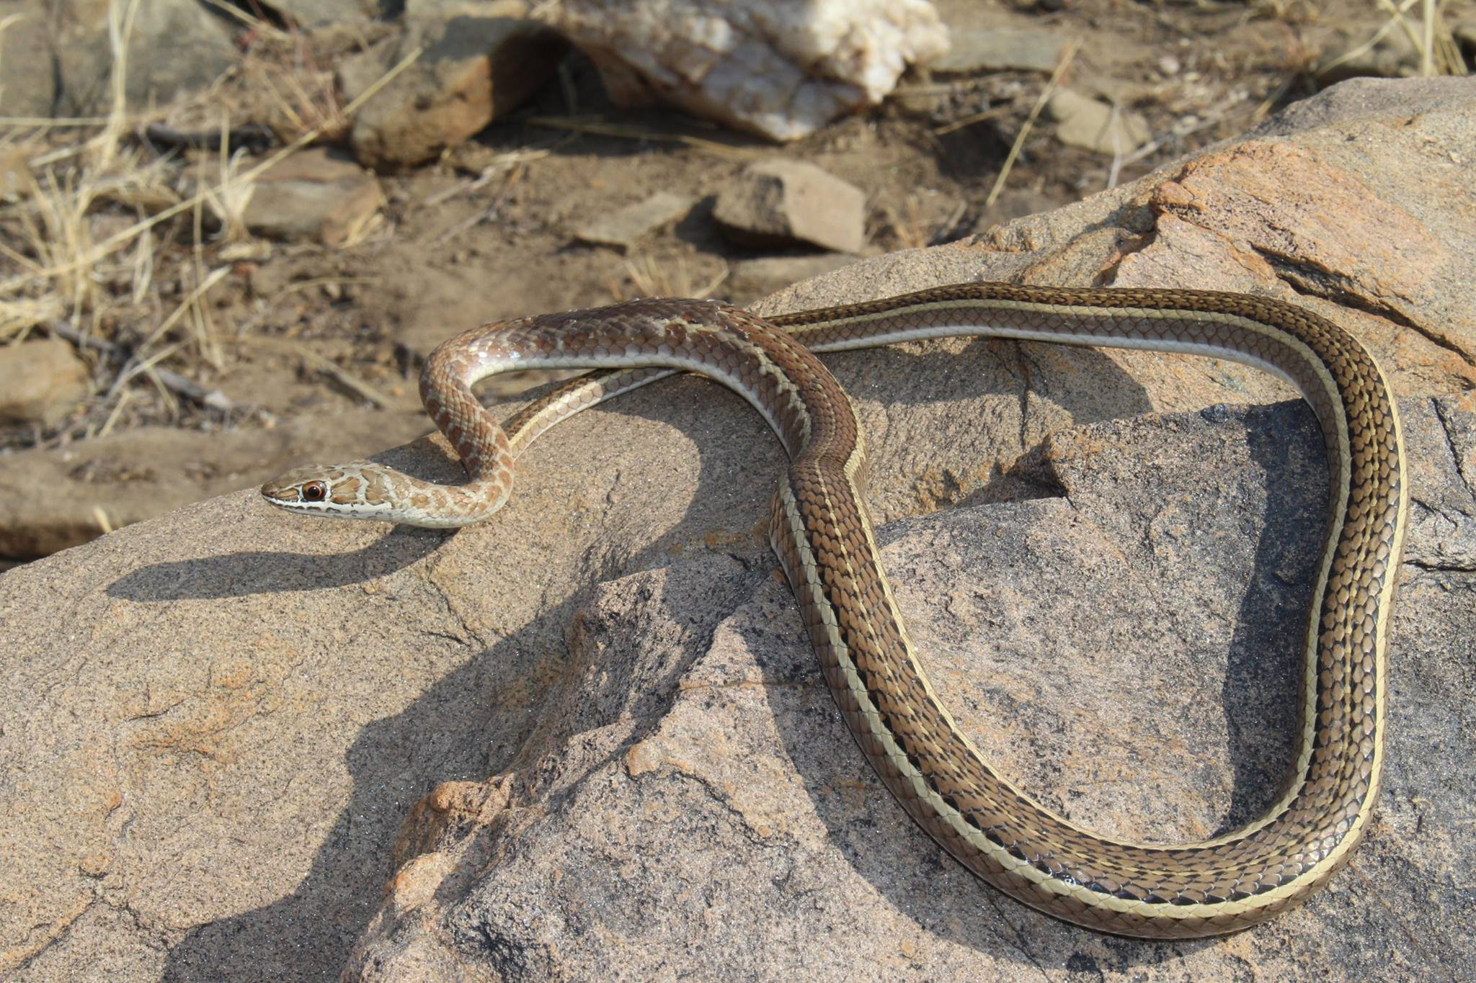
Sand Snakes/Whip Snakes
Size
Adults 120cm-160cm, juveniles 27-30cm.
Description
These snakes have long, slender heads with prominent eyes. The head is brown above with a series of grey spots, which may continue onto the neck. Although there is a great deal of variation in colour and markings, the body is usually brown on top with a yellow to white belly. The slender, whip-like body mostly exhibits stripes - of different thickness and colour - running down the length of the body.
Habitat
This snake inhabits dry, sandy regions and rocky areas. They are also common in grasslands and in dry-moist savannah. They are found throughout Namibia, even in the Namib Desert.
Habits
It is a fast-moving diurnal (active during daytime) snake which mainly feeds on lizards, small rodents and frogs.
Venom
Mildly venomous having no effect on man.

Slide 24
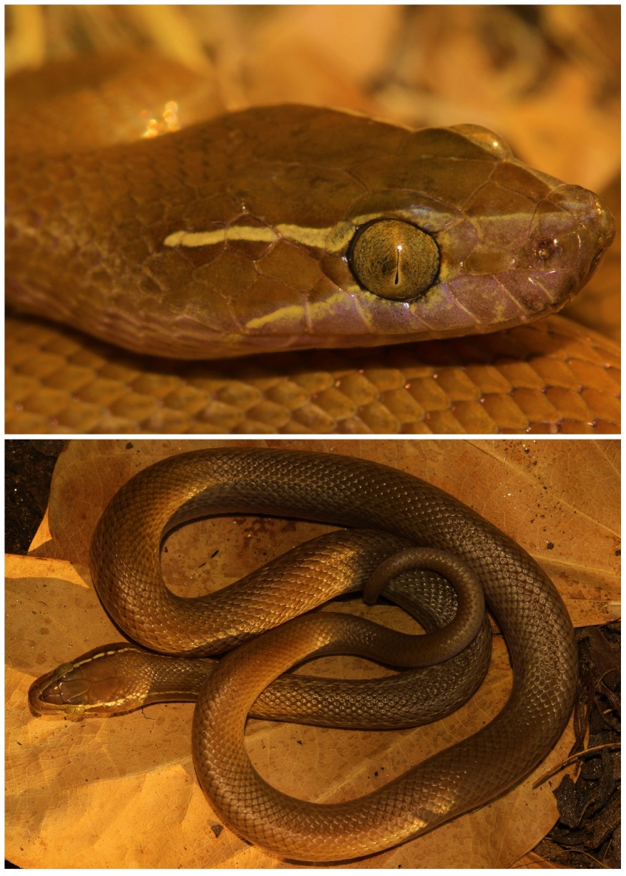
Brown House Snake
Size
Adults 60cm-100cm, juveniles 19-26cm.
Description
Above dark to light brown with a cream white belly. There are two whitish to yellow stripes on each side of the head that runs from the tip of the nose, passing respectively above and underneath each eye, to the back of the head.
Habitat
Found through out Namibia. They are especially common around dwellings.
Habits
This snake emerges at night in search for food (small rodents, bats, lizards and frogs).
Venom
Non-venomous.

Slide 25
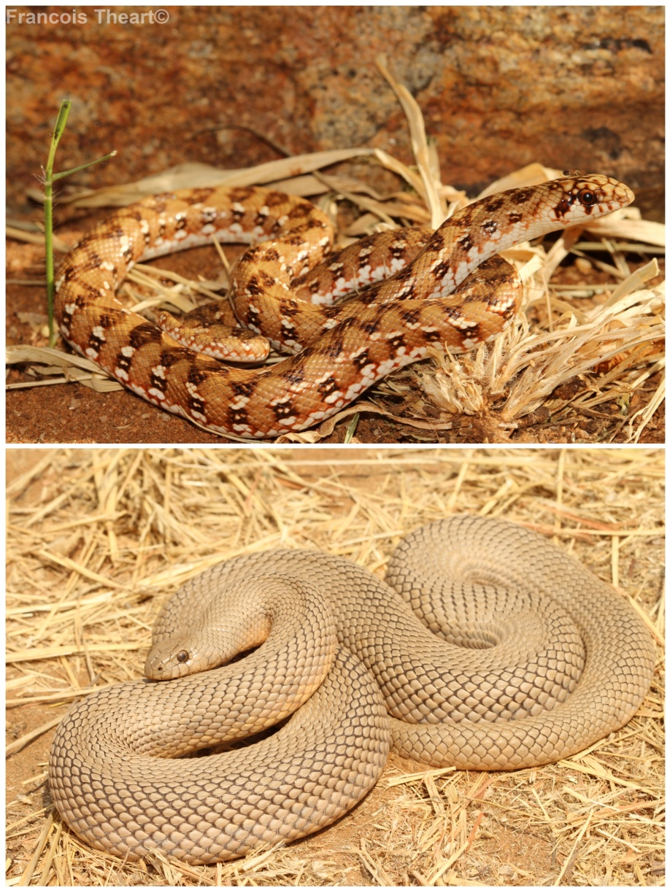
Mole snake
Size
Adults 100cm - 200cm, juveniles 20-30cm.
Description
They are large constrictor snakes with pointed snouts and small heads and indistinct necks which are well adapted for life underground. Adults are usually uniform light grey above (may also be brick red, brown or black) with a white to salmon coloured belly, occasionally with darker blotches. Juveniles are light brown above with a dark zigzag pattern, sometimes with whitish spots.
Habitat
Mainly found in mountainous and desert terrain. They are common in sandy and grassveld regions.
Habits
Mole snakes are mainly diurnal (active during daytime) but spend most of their lives underground hunting moles and other small mammals. Prey is often seized by the head and constricted.
Venom
Non-venomous, however large individuals can inflict a serious bite which may require stitches.

Slide 26
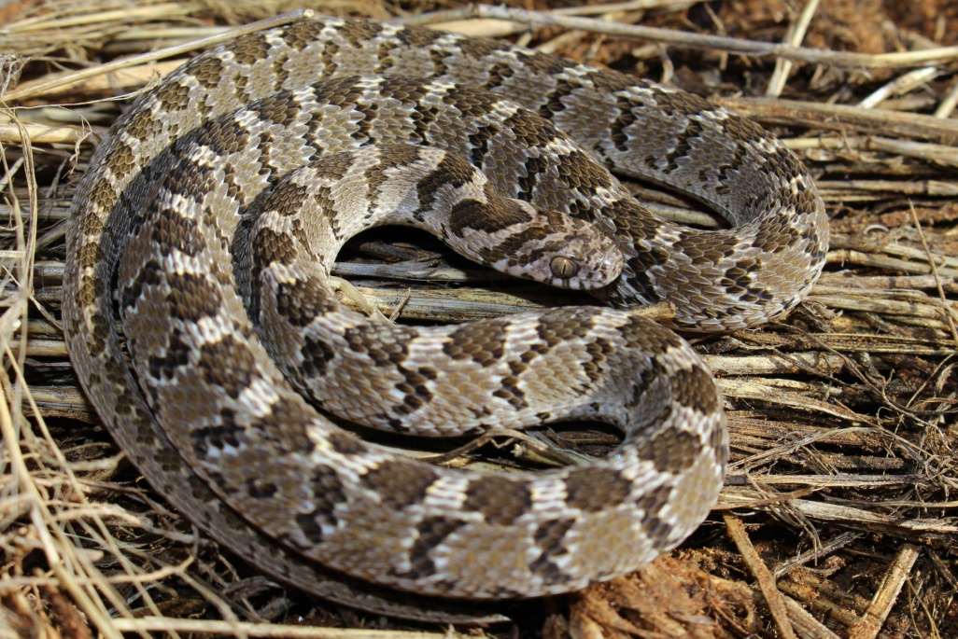
Egg Eater
Size
Adults 40-80cm, juveniles 20-25cm.
Description
Light brown to grey above with dark brown rhombic markings on the body. There is a V-shaped marking on the back of the neck with two similar markings on the back of the head. The head is not distinctive from the rest of the body and the mouth is black on the inside.
Habitat
Found in almost every habitat ranging from arid to moist savannah, but absent from true desert and forest.
Habits
This snake mainly moves at night and is often found hiding under rocks and logs during the day. When threatened, egg eaters will rub theirs scales against each other making a rasping sound which mimics a snake hissing.

Slide 27
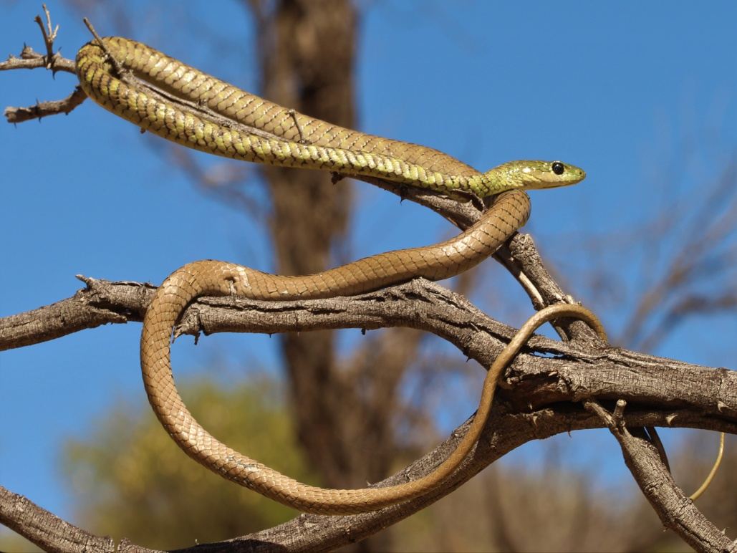
Spotted Bush Snake
Size
Adults 90cm-130cm, juveniles 23-30cm
Description
The first half to two thirds of the body is olive green with black crossbars with the rear half being brown to bronze. Some scales of the head and front part of the body have bluish-white borders. The eye is black with a golden iris while the tongue is blue with a black tip.
Habitat
Found in shrubs, bushes and rocky outcrops.
Habits
Mainly active during the day when it hunts for lizards, frogs and sleeping geckos. It is often encountered in shrubs and bushes. Similar to the boomslang, this snake may inflate its neck when threatened.
Venom-non

Slide 28
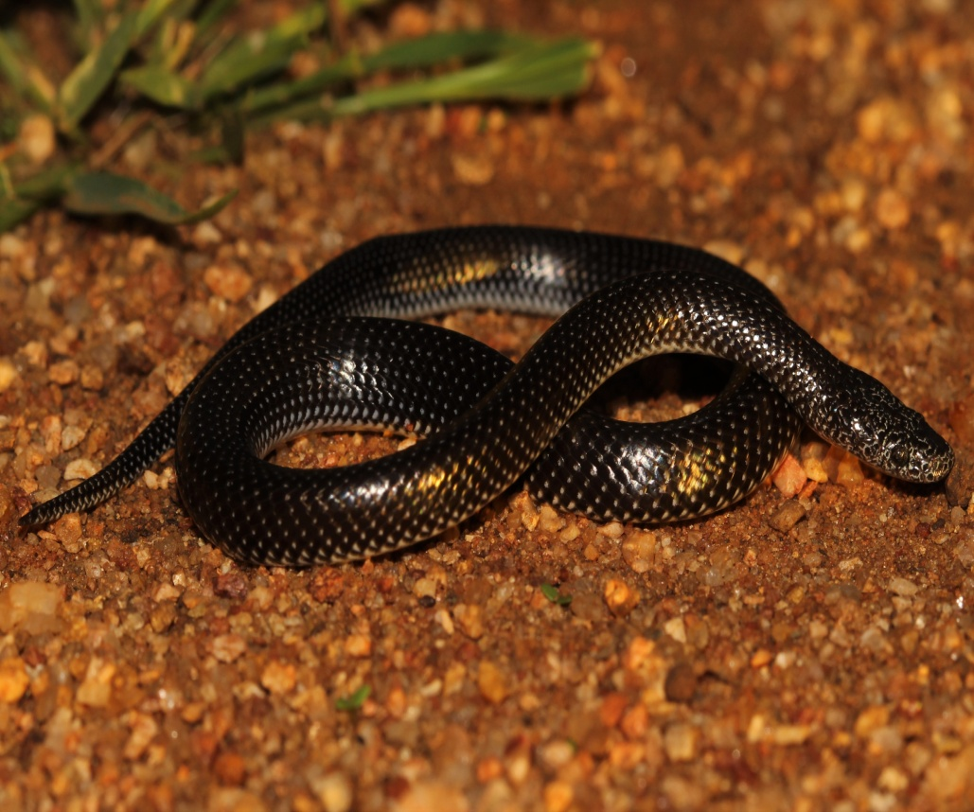
Common Wolf Snake
Size
Adults 40-64cm, juveniles 12-20cm
Description
This snake has a flattened head which is not distinct from the rest of the body. It is black in colour with white speckles on the scales. The belly is a dirty white with dark mottling.
Habitat
This snake prefers arid and moist savannah regions.
Habits
Wolf snakes are mainly active at night when they hunt for resting lizards. They are often encountered in heaps of rubbish and building material and are very active during the rainy season.
Venom
Non-venomous.

Slide 29
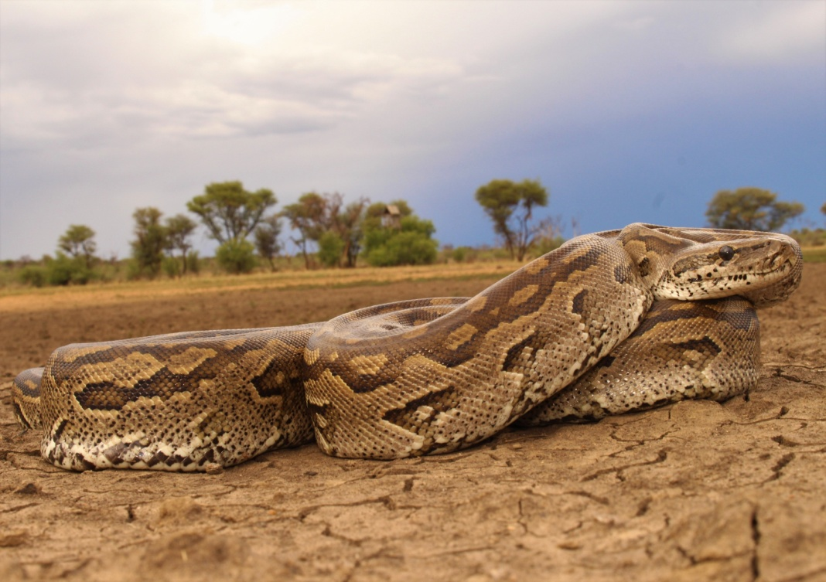
Southern African Python
Size
Adults 300-600cm, juveniles 50-70cm.
Description
Pythons have large spear-shaped heads with dark brown markings on the crown, bordered on each side by a light brown stripe above the eye. The underside is white with black mottling.
Habitat
Found in rocky outcrops and arid savannah. These snakes are usually found close to a source of permanent water from where they hunt.
Habits
Mainly active at night. Often ambushes its prey, latches on (usually to the head) with its powerful recurved teeth and constricts it.
Venom
Non-venomous, however large individuals can inflict a serious bite which may require stitches.
All Pythons are protected by law, It is therefore illegal to catch or kill them without permits.

Slide 30
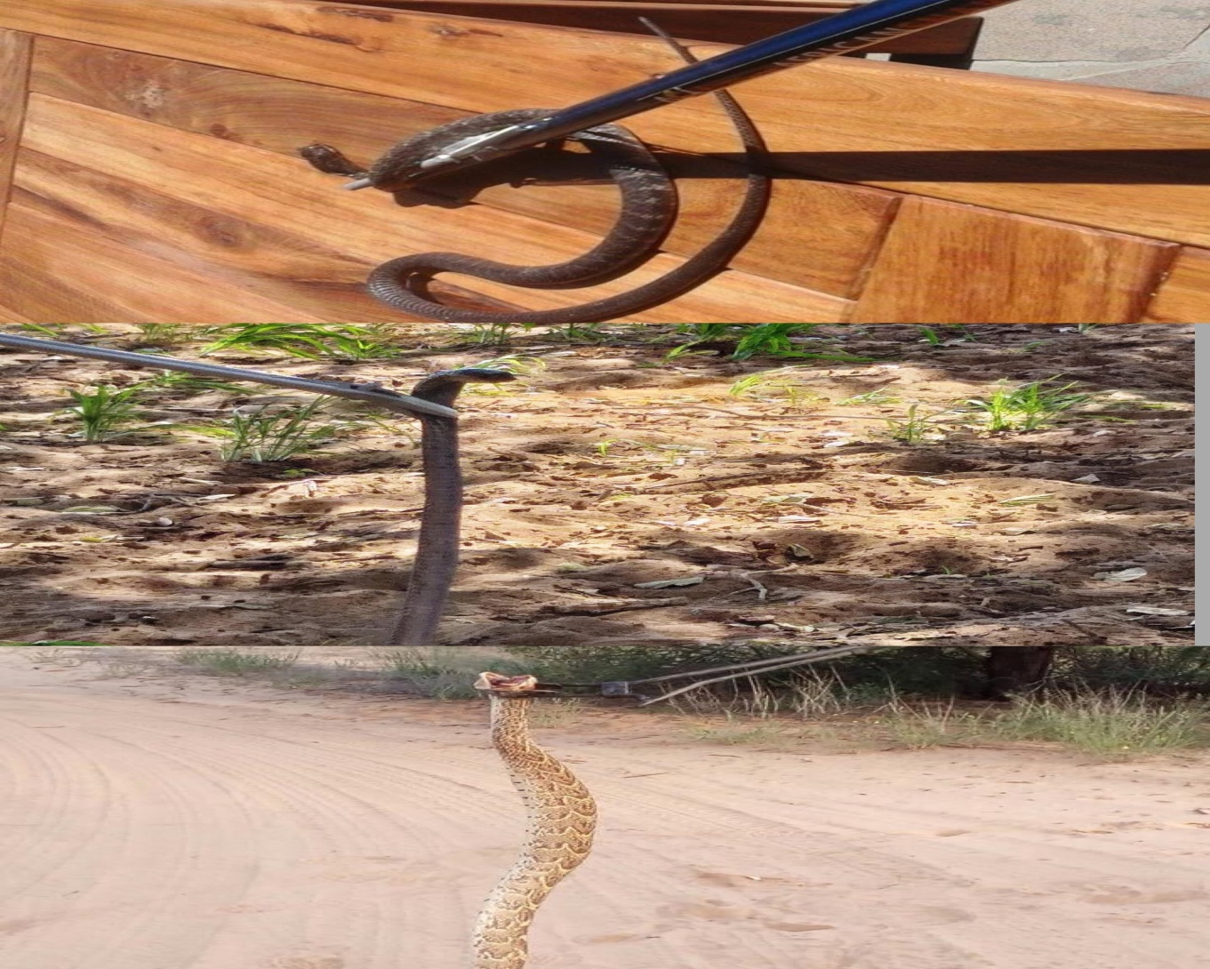
Snake handling (How not to use tongs)

Slide 31
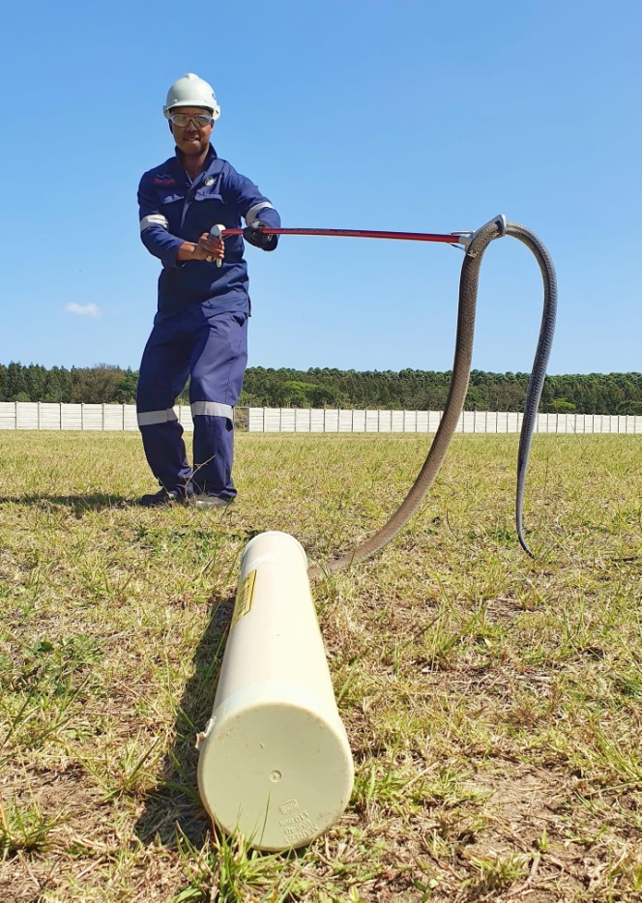
Snake handling (How to use tongs)

Slide 32
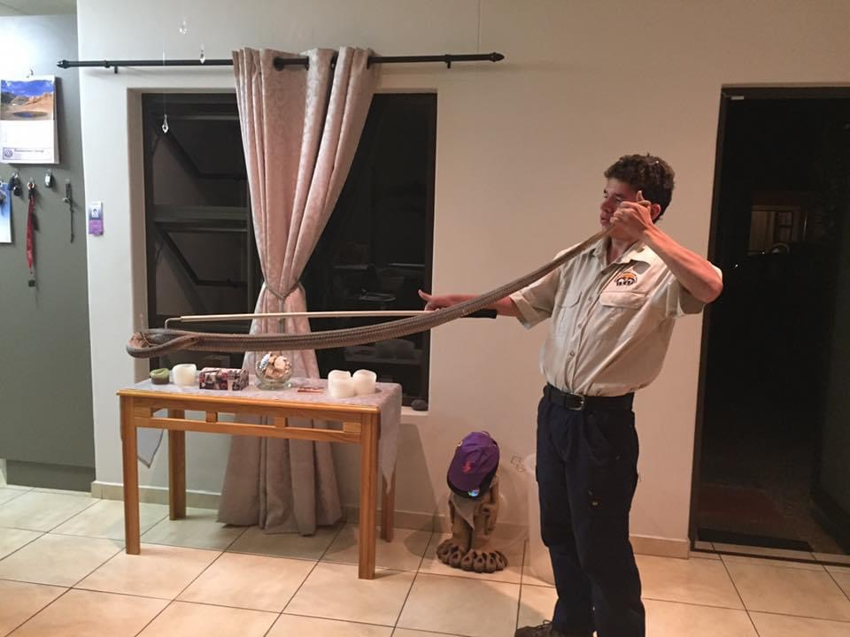

Snake Handling (Hooking and tailing)

Slide 33


Snake handling (Necking vs tubing)

Slide 34
Main Venom Types And Functions
Cytotoxic- Breaks down healthy tissue and cells. Zebra snakes, Puff adders, horned adders and stiletto snakes posses this venom.
Neurotoxic- Causes paralysis and breathing difficulties. Mambas, Cape Cobra and Anchieta’s cobra.
Hemotoxic- Prevent the blood from clotting causing both internal and external bleeding.
The main function of snake venom is to immobilize and digest its prey.

Slide 35
Symptoms of Snakebite
Puff Adder- Immediate burning sensation and throbbing pain at the bite site. Swelling will start with in minutes and continue to move up the entire bitten limb. Swelling will feel hot to the touch. There will be blood or liquid oozing from the bite site. Blue discoloration and blistering may be present.
Zebra snake- Immediate burning sensation and throbbing pain at the bite site. Swelling will start with in minutes and continue to move up the entire bitten limb. Swelling will feel hot to the touch and there will be a blue discoloration blistering may form at a later stage. Little to no bleeding is present.
Stiletto Snake-One fang mark will be present followed by a red to blue discoloration and moderate to severe swelling. Dry mouth, nausea and vomiting may also be present.
Anchieta’s cobra- Little to moderate swelling may be present with acute pain at the bite site. The victim will have difficulty focusing his/her eyes. Limbs will become weak, speech will become slurred followed by nausea and vomiting. Difficulty swallowing and difficulty breathing will follow.

Slide 36
Symptoms of Snakebite
Black mamba-Symptoms will appear within minutes and full paralysis can set in less than an hour. Little to no swelling will be present with little to no pain. The first symptoms to appear will be feeling pins and needles around the lips followed by a metallic taste in the mouth. The victim will have droopy eyelids and trouble focusing this will be followed by slurred speech, nausea and vomiting and a difficulty swallowing. The chest will feel tight and painful and the victim will start to have difficulty breathing.
Boomslang-Symptoms may not be obvious for several hours. Early severe headaches followed by nausea and vomiting. Venom will ooze from the bite site followed by bleeding from the nose, ears, eyes and mouth. Victim will be confused and feel tired.

Slide 37

Snakebite First Aid & Emergency Numbers
Incase of snakebite please call 0812900343 or whatsapp (snakebite) to 0811275109 (this number should NOT be called!!!!)
Emed Rescue-081924
Snake Removals:
0812900343-Francois
0817009879-Heinrich

