Slide 1
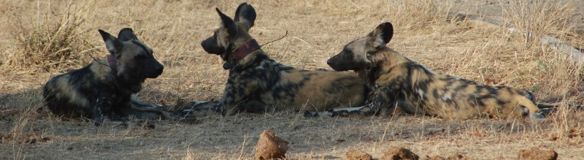
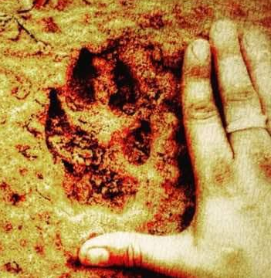
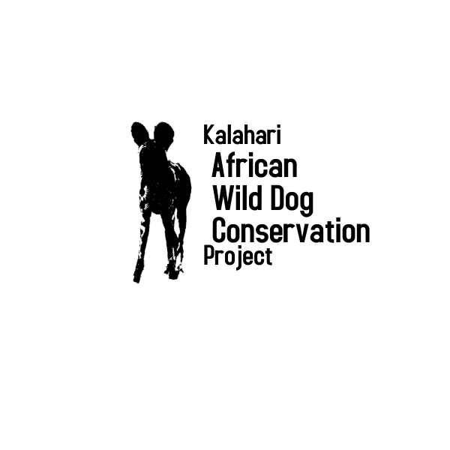

Status of African wild dogs outside of protected areas
Nadja le Roux
KAWDCP Coordinator
Dr. Nikki Anderson
KAWDCP Research Coordinator

Slide 2
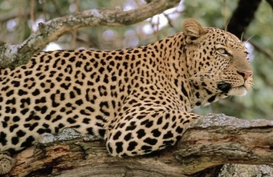
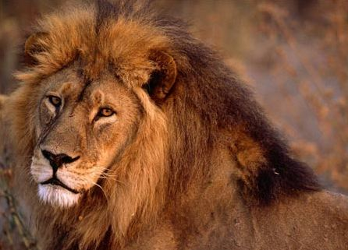
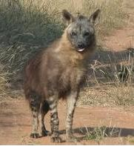
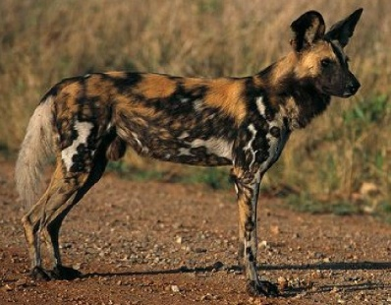
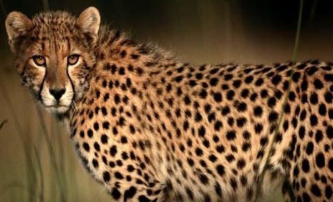
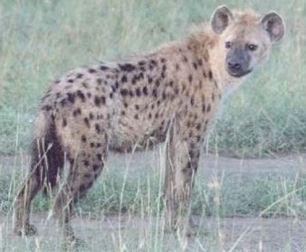
African Carnivore Guild
The African continent supports a vast array of sympatric large carnivores
Important for biodiversity, culture significance, tourism
Similar composition of threatened carnivores across Africa
Ethiopian wolf, African wild dog, cheetah and lion were identified as being in crisis (Ray et al. 2005; Ripple et al. 2014; Winterbach et al. 2012; IUCN 2009, 2017).
Notes:
As we know the African carnivore guild is a critical component of Africa's biodiversity, as a species group they have a strong cultural importance, and also help to generate revenue through tourism and hunting.
Updating the international review done by Fuller with new information from the IUCN, shows that 22 large carnivore species globally are considered threatened.
The African continent shows not only a consistent number but also a similar composition of species to be at risk, with a collective loss of these species across landscapes having a significant impact on ecosystem function. From this small group of species the Ethiopian Wolf, African Wild Dog, Cheetah and Lion were identified as being in crisis.

Slide 3
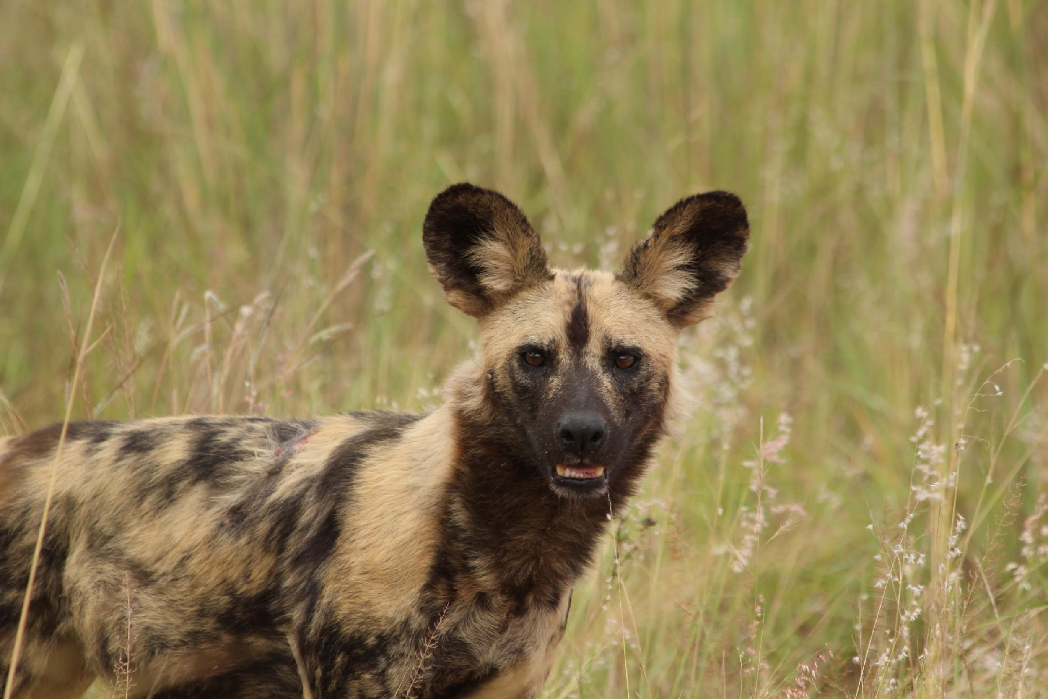

The African Wild Dog
One of the rarest of Africa's mammals
Listed by the IUCN as Endangered C2a(i)
  This criteria infers: Continuing declines in populations over recent decades and generations
  Fewer than 1,400 mature individuals = 700 BREEDING UNITS!!
Not listed on CITES; Listed on Appendix 2 of the Convention of Conservation of Migratory Species (CMS)
Lycaon pictus (Temminck 1820) means “Painted Wolf”
  Lycaon Greek derived word referring to ‘wolf’
  The species name, pictus, originates from Latin and translated means ‘painted’
Notes:
As some of you may know the African Wild Dog is regarded as the second most endangered canid on the African continent, after the Ethiopian Wolf.
Wild dogs are evolutionarily distinct being the only member of their genus. They also show morphological and genetic variation in different parts of their geographic range
Like most wide-ranging species, this carnivore is highly susceptible to habitat loss and fragmentation, the effect of disease, human-wildlife conflict, and road fatalities with there being dramatic declines in populations over the last 30 years. Current global population estimates believe that there are approximately 6,600 individuals remaining with a declining population trend.
The IUCN Red List reassessed this canid in 2020 and reaffirmed its status as Endangered. African Wild Dogs are not listed on CITES, with illegal trade not being a limiting factor to population persistence but are listed in Appendix 2 of the Convention for Migratory species

Slide 4
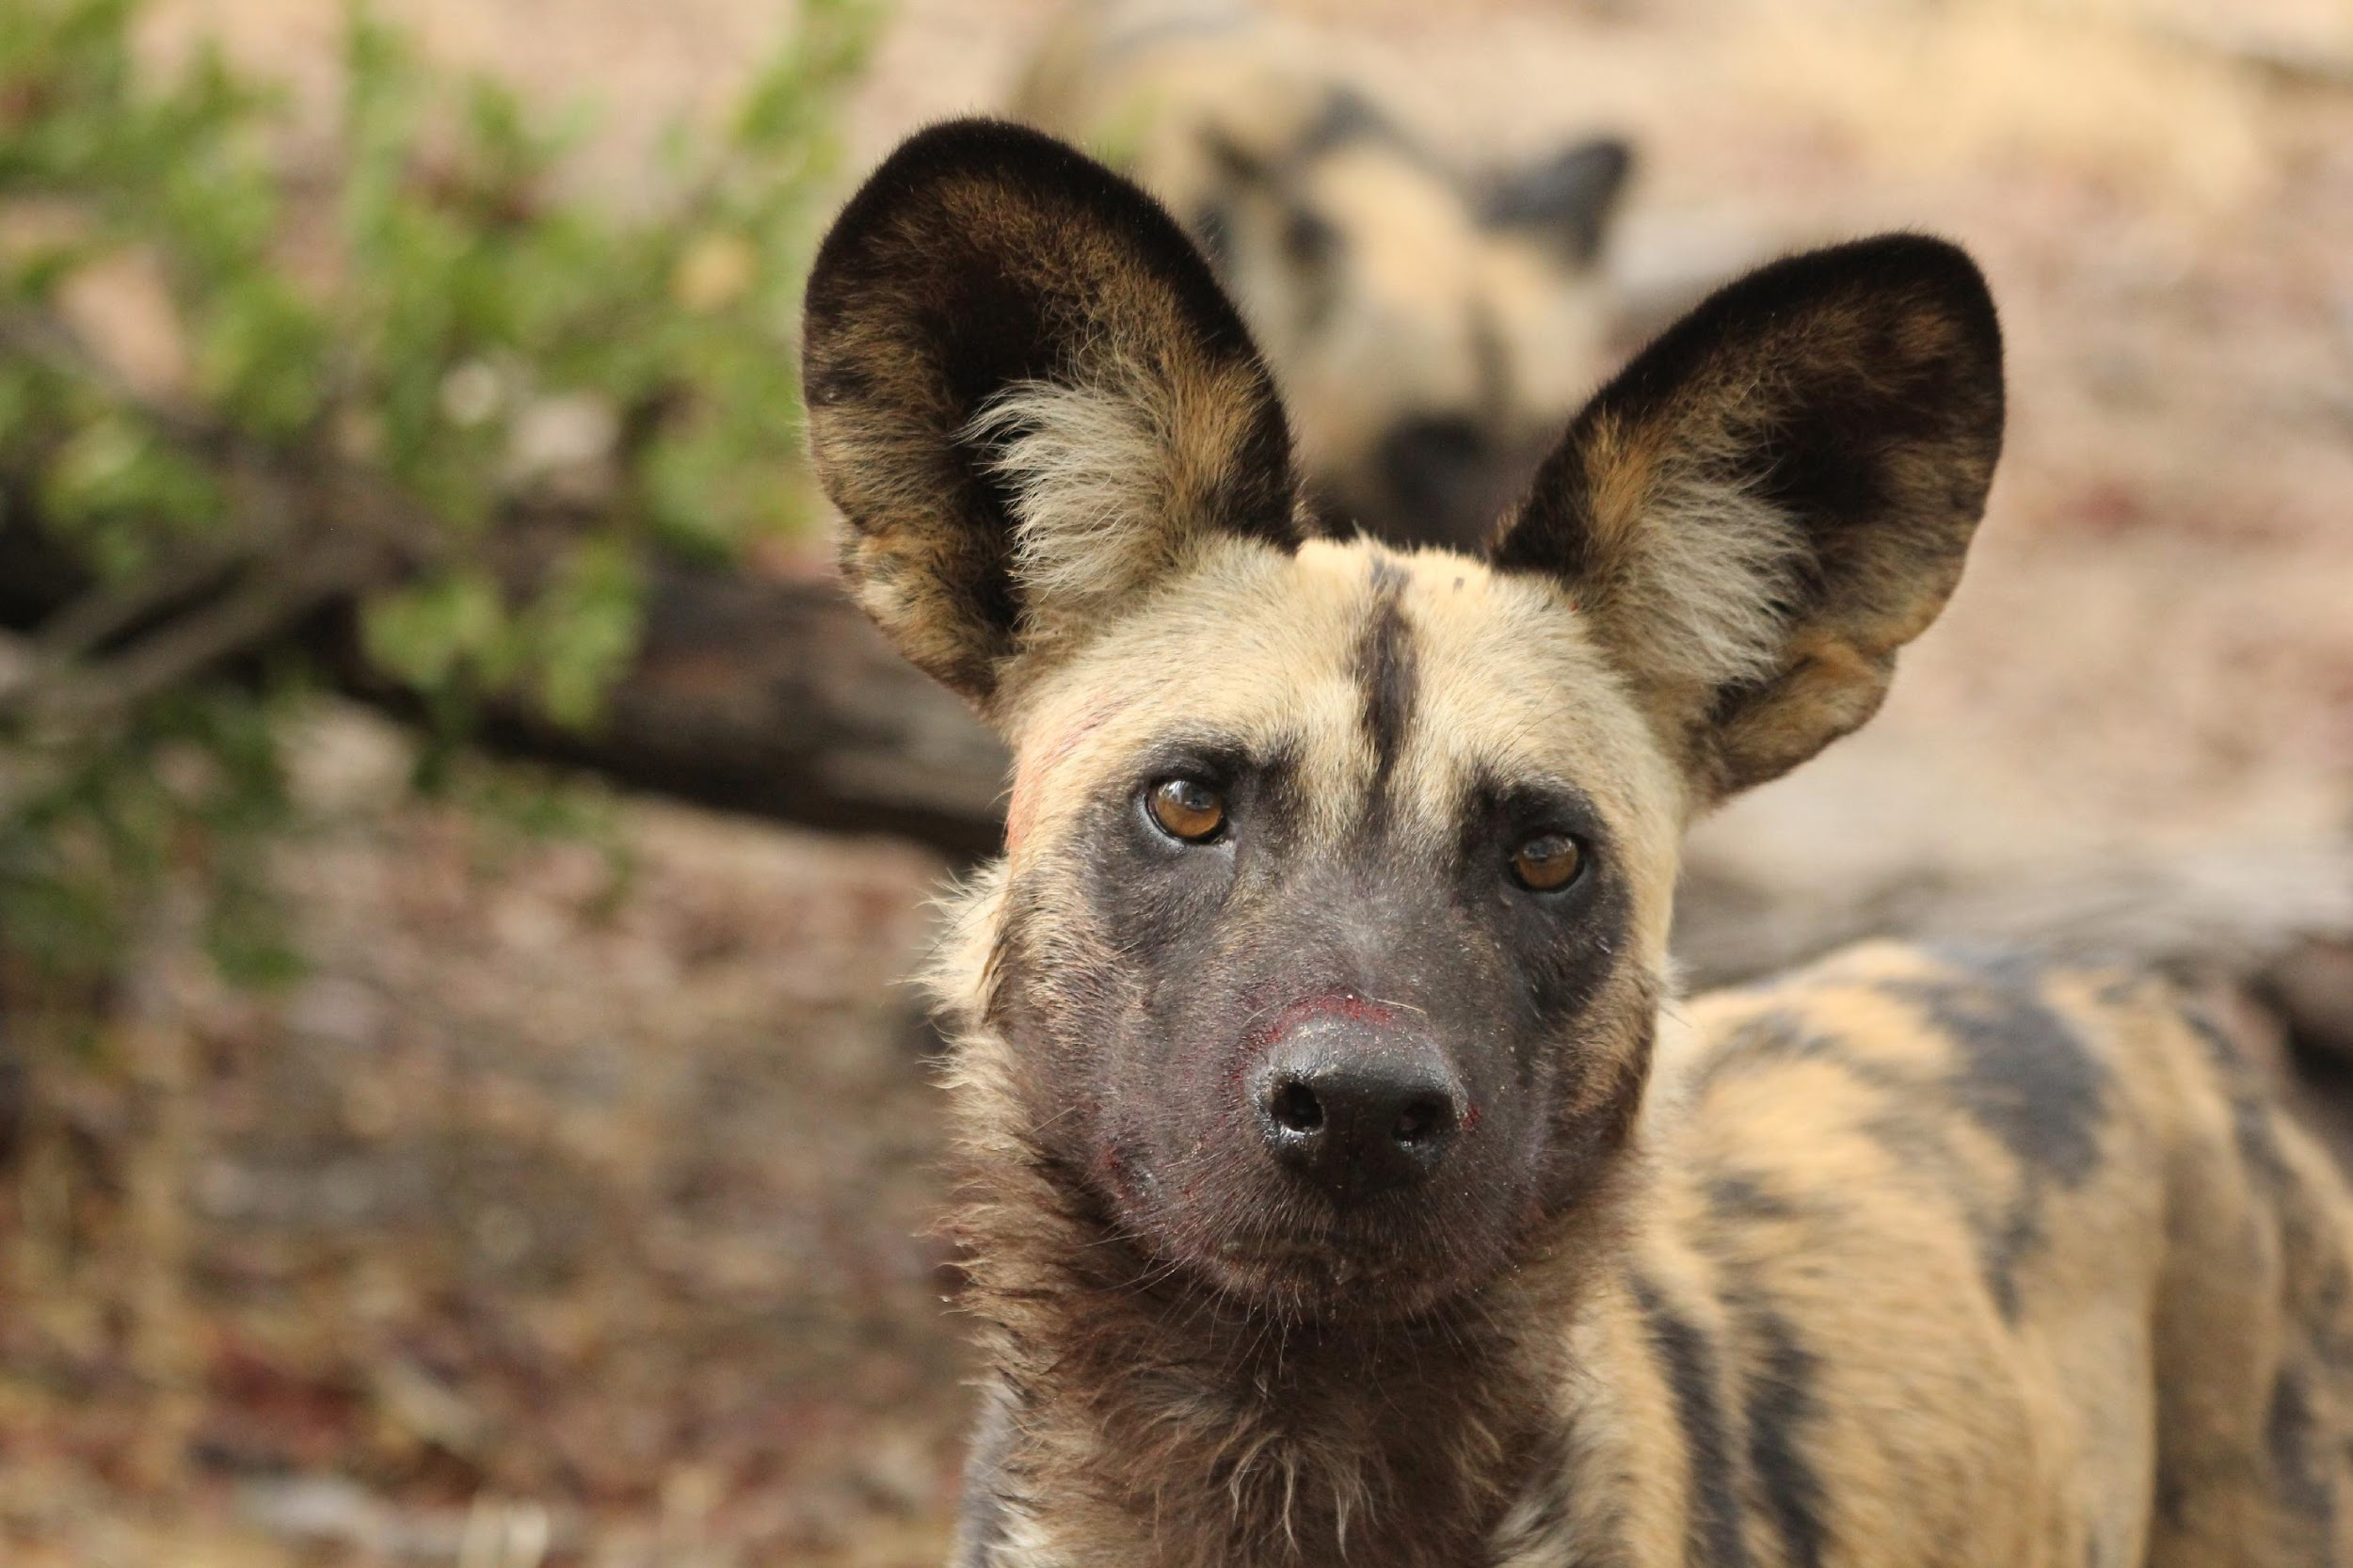
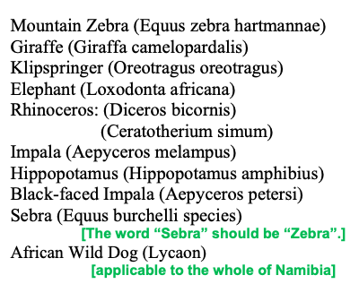

Slide 5
Wild Dogs in Namibia
Only carnivore species to be classed as Critically Endangered
  Listed as a Specially Protected Species
Namibian dogs contribute to 10% of the global range
AT RISK population
Transboundary conservation actions are important for species persistence
Current population estimates are at 350 individuals – but do we really know?
Notes:
Wild Dogs are the only Namibian carnivore that is listed as Critically Endangered, they also have a Specially Protected Species listing.
Their estimated range across the country contributes to approximately 10% of the species global range.
Presently, wild dogs are restricted to the Zambezi, East and West Kavango, eastern Otjozondjupa and northern Omaheke regions, equating to an area of 181,441 km2.
Some conservancies such as Nyae Nyae, Okamatapati and Otjituuo have important wild dog habitat, despite not holding protected area status.
Namibia's wild dog population heavily relies on transboundary conservation actions, with habitat within KAZA also being important for the long term persistence of this species in this country.
KAWDCP is interested in exploring any opportunities in these areas with any relevant stakeholders particularly in the Otjituuo area where we have been monitoring some free ranging dogs and working with community, I’ll touch on this later in the presentation.
With considered management for both communities and wildlife, there remains significant opportunities for greater protection, re-establishment or the expansion of wild dog populations outside of protected areas.
Improving the wild prey populations within communal conservancies is a key requirement for reducing livestock losses in the long term.
The best estimate on the current population of wild dogs in Namibia is around 544 animals, with more local estimates being closer to 350.

Slide 6
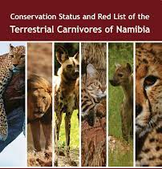
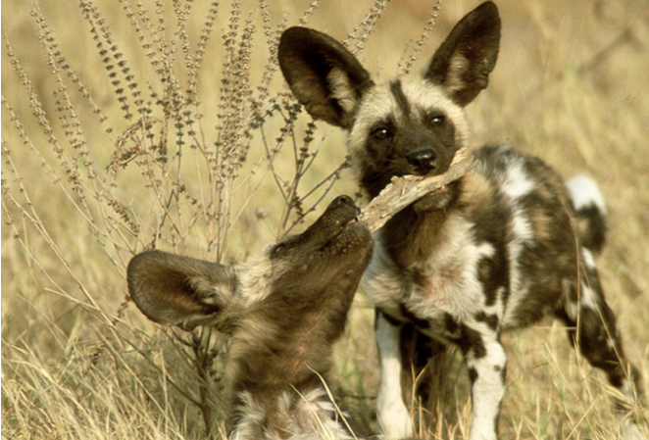
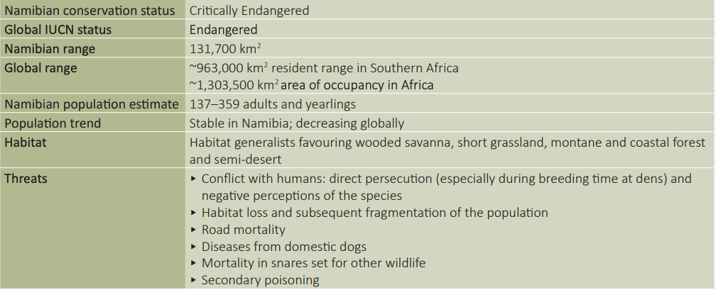


STATUS OF AFRICAN WILD DOGS IN NAMIBIA

Slide 7
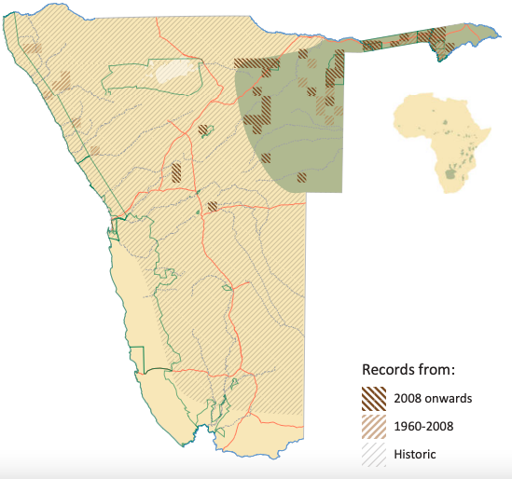
Namibia’s Free-roaming African Wild Dogs
African Wild Dogs
Notes:
Here’s a map representing the distribution records of African wild dog, this is taken from the Conservation Status and Red List of the Terrestrial Carnivores of Namibia.
This map includes the estimated area of distribution across the country, including vagrant sightings in the west and managed populations in fenced reserves further south of the freeranging resident range.
The hatched area shows the estimated distribution for wild dogs from the 1940s

Slide 8
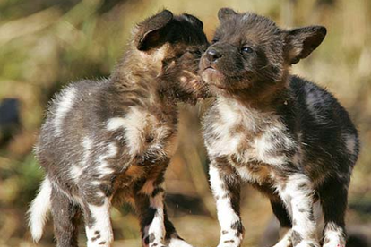
ECOLOGY & SOCIOLOGY
Highly social member of the canid family
Packs cooperatively hunt for their prey
Are cursory or pursuit hunters rather than ambush hunters
Packs are the reproductive unit
  Cooperatively breeders: alpha male and female breed but all pack members contribute to pup care
Disruptions in the social makeup of packs can result in pack dissolution -> increased risk of local extinction
New packs form when young animals (~2-3yrs) disperse
Dispersal groups may travel hundreds of kilometres
  Can complicate the interpretation of distribution data
  May not indicate the presence of a resident population
MORE RESEARCH IS REQUIRED FOR NAMIBIAN DOGS
Habitat generalists
Populations seem unable to maintain residency in areas with <200 mm rainfall.
Home range size average between 560 and 760km²
  Greater in semi-arid habitats KAWDCP RESEARCH
Home range between packs overlap, excluding core breeding areas
Movement within home range is generally nomadic

Slide 9
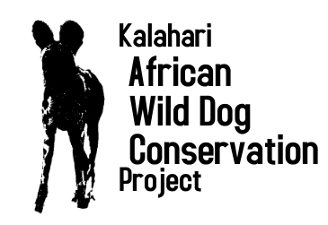
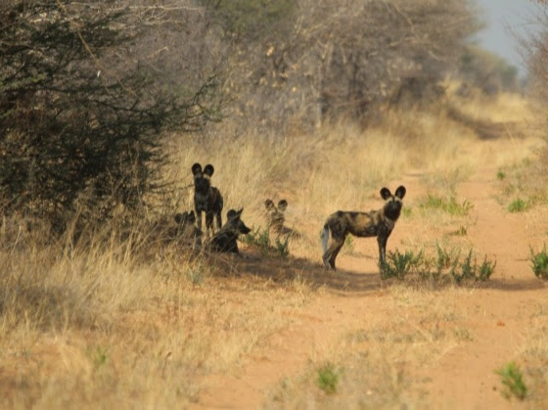
THE KALAHARI AFRICAN WILD DOG CONSERVATION PROJECT
The current accurate distribution and population of African Wild Dogs outside of protected areas, National Parks, is unknown, however, high levels of persecution and intolerance of African Wild Dogs amongst farming communities is well documented. The aim of KAWDCP is to:
Gain a better understanding of African Wild Dog density, distribution and ecology within the study location in order to identify potential solutions through research, monitoring, collaborations and human wildlife conflict mitigations.
Promote AWDs nationally and internationally as an iconic species for tourism, adding economic value to the country and its communities.
Mission
KAWDCP will accomplish its purpose through evidence-based conservation practices, community engagement and advocacy.
Vision
conserve free-ranging wild dog through an interdisciplinary approach using research, conflict resolution, coexistence strategies, and disease prevention.
Purpose
To ensure free-ranging African wild dog population are viable for future generations.
Notes:
So where does Kalahari African Wild Dog Conservation Project fit in?
We are a grass roots organisation, mainly women, who formed a couple of years ago over a shared passion for wild dogs, with each of us coming from different backgrounds and skill sets.
Nicole, Kendell, Me, Robin, Nadja,
For anyone who knows Nadja le Roux shes very passionate about wild dogs, understanding the realities of their management, and a driving force for wanting good conservation outcomes.
KAWDCP will work towards ensuring free-ranging African wild dog populations are viable for future generations, being accomplished through evidence-based conservation practices, community engagement and advocacy. We will help conserve free-ranging wild dogs through an interdisciplinary approach of research, conflict resolution, coexistence strategies, and disease prevention.
Our strategic direction aligns with some of the suggested Conservation Actions outlined in the Conservation Status and Red List of the Terrestrial Carnivores of Namibia, and the conservation strategy for KAZA transfrontier conservation area

Slide 10
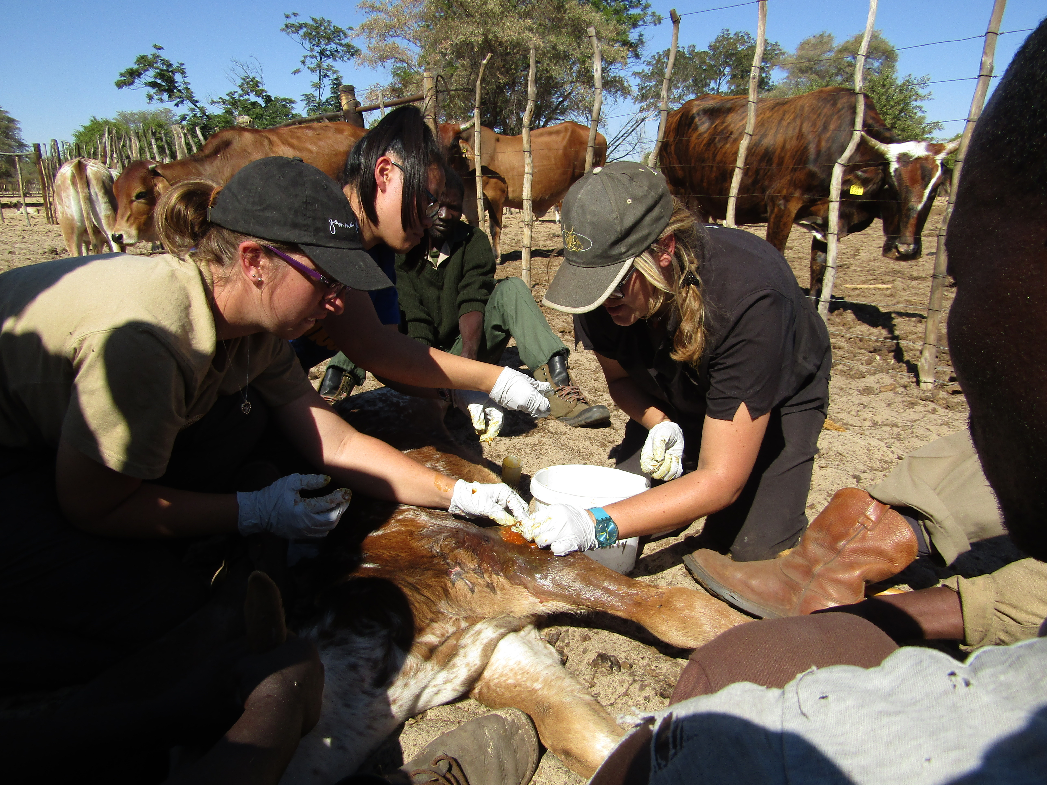
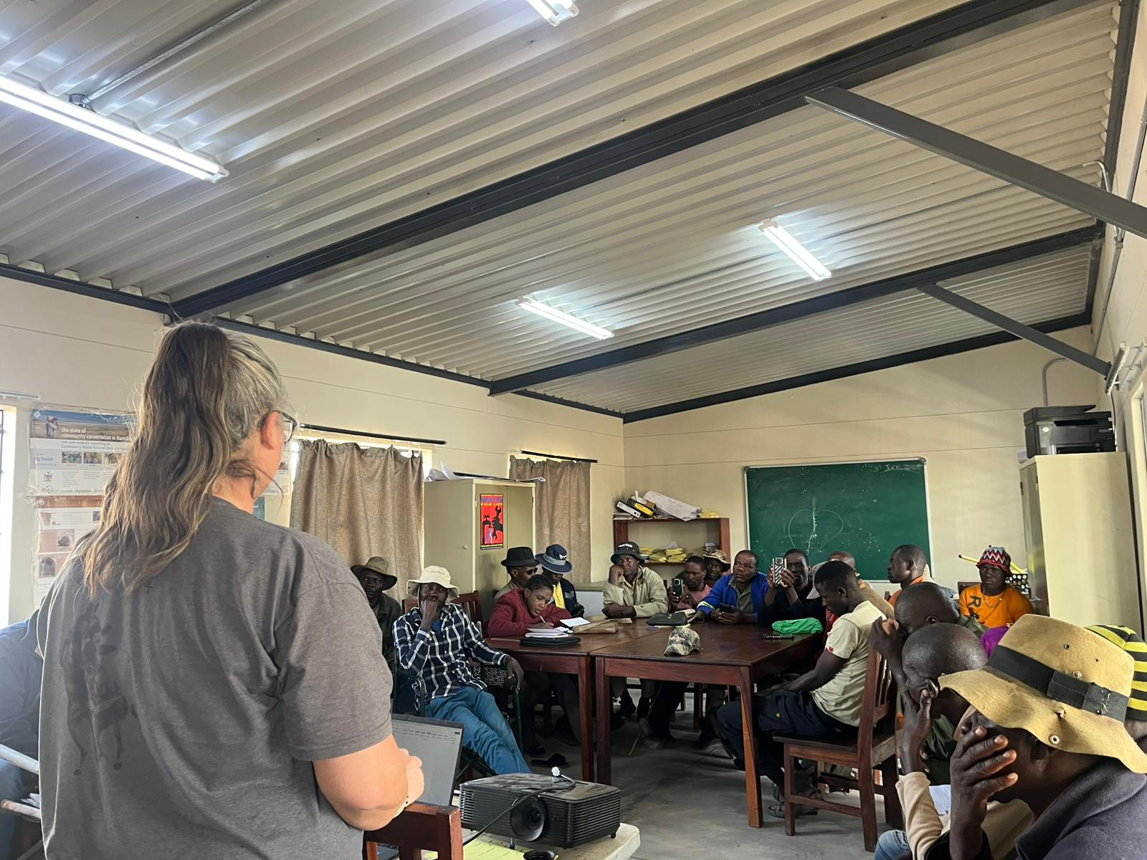
Our Goals
Goal 1: Conflict resolution:
Identify high conflict areas and develop sustainable mitigation approaches alongside communities to ensure the dogs’ long-term survival.
Goal 2: Building coexistence:
Build coexistence through an understanding of the drivers and factors that influence human-wildlife interactions.
Develop appropriate management and community educational programs.
We aim to increase environmental stewardship and a responsibility for sustainable wildlife management.
Notes:
Goal 1: Conflict resolution:
Identify high conflict areas and develop sustainable mitigation approaches alongside communities to ensure the dogs’ long-term survival. Through community engagement and a practical understanding of each communities needs, creative solutions will be developed to lower incidents of livestock predation.
Goal 2: Building coexistence:
We believe that both humans and wildlife are part of a dynamic system. Building coexistence requires a holistic understanding of the drivers and factors that influence human-wildlife interactions. Through community partnerships and an integrated approach to reducing conflict, we aim to increase environmental stewardship and a responsibility for sustainable wildlife management.

Slide 11
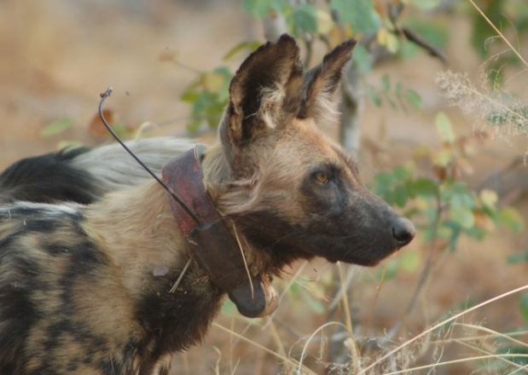
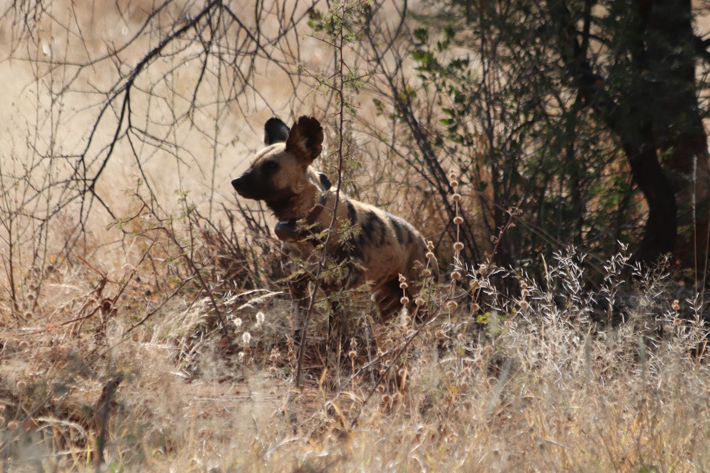
Our Goals
Goal 3: Research:
Long term conservation will be informed by evidence-based practices.
A variety of technologies will be used to gain further insights into how the dogs interact with their environment.
KAWDCP will partner with a broad range of organisations to increase our expertise.
Goal 4: Disease prevention
KAWDCP will conduct animal health studies.
Contribute to better management and mitigation of existing and emerging infectious disease for communities and associated animals.
Notes:
Goal 3: Research:
Conservation of wild dogs will be informed through data collection and analysis. KAWDCP uses technology such as drones, camera traps and telemetry to study wild dogs in their habitat. Research is essential to not only expand our knowledge on how wild dogs interact with their environment, but it also helps us devise evidence-based management practices to assist in their conservation. As an organization we are open to partnering with other stakeholders to capacity build and answer broader research questions.
Goal 4: Disease prevention:
Infectious diseases can affect people, wildlife and domestic animals, with many pathogens having the ability to infect multiple species. To improve our scientific knowledge and to find the best ways to prevent, diagnose and treat disease and other conditions that can affect wild dogs and potentially other species, KAWDCP will conduct animal health studies. Through outreach programs there is scope for better management and mitigation of the risks of emerging infectious disease for communities and animals alike.

Slide 12
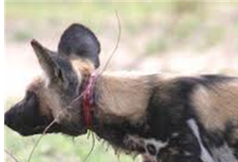
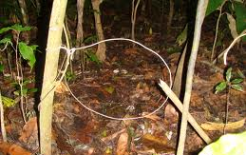
Human wildlife conflict
Yearly records indicate that HWC has progressively increased.
Lethal persecution can leave populations of this Critically Endangered species vulnerable to local extinction
Event Book data from eight communal conservancies
  Highest counts: conservancies that border Botswana
  Lowest counts: Otjituuo, Okamatapati
Notes:
Lethal persecution can disrupt pack sociality and leave populations vulnerable to local extinction

Slide 13
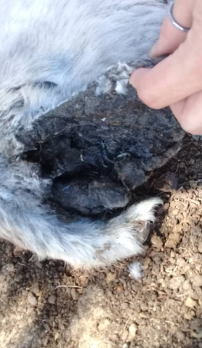
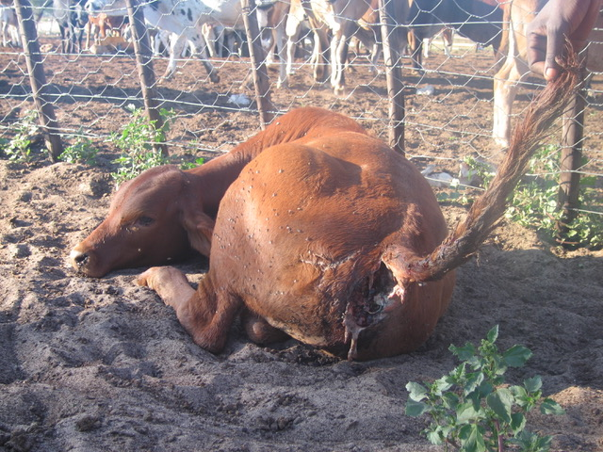
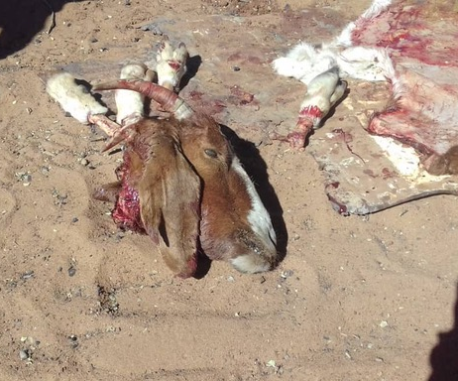
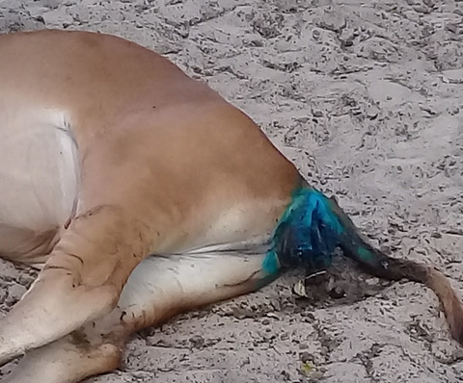
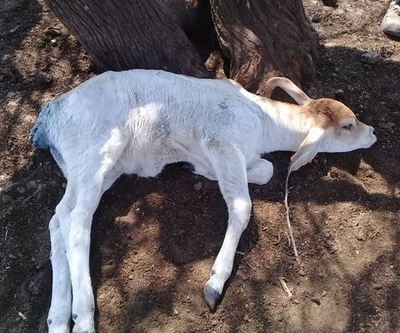

Slide 14
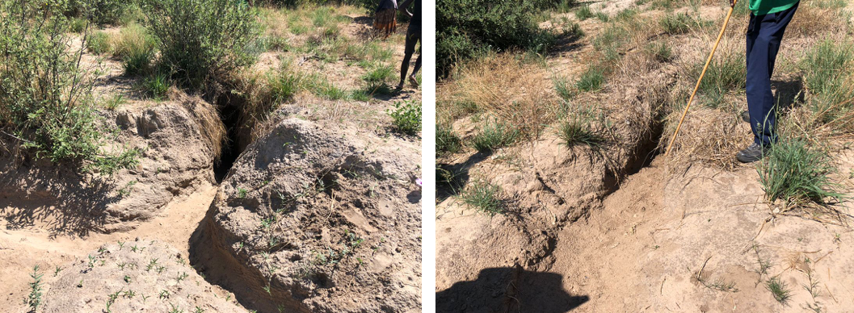
Persecution
Otjozondjupa, Omaheke & Kavango Regions
  Intentional road mortalities
  Shooting
  Destroyed dens, significance disturbance and fatalities
Notes:
Persecution was confirmed in Ondjou and Eiseb Conservancies and reported in Okamatapati Conservancy.
In Eiseb, there was a confirmed incident of intentional roadkill mortalities of 5 pups, with individuals estimated to be approximately 5 months of age.
In Eiseb, an additional site was investigated where it had been suggested that African wild dogs had been shot. This was confirmed with one mortality located.
In Ondjou Conservancy a destroyed den was investigated with reports of adults and pups killed

Slide 15
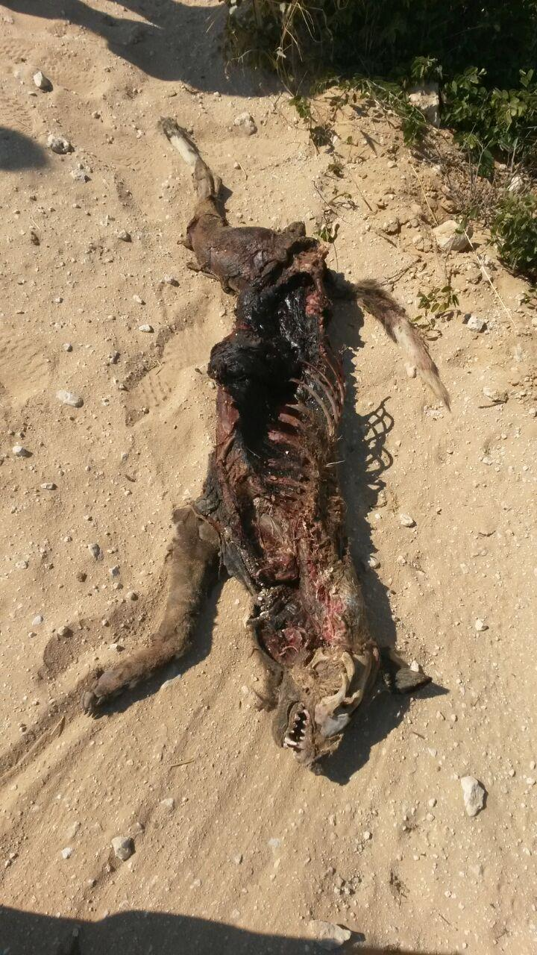
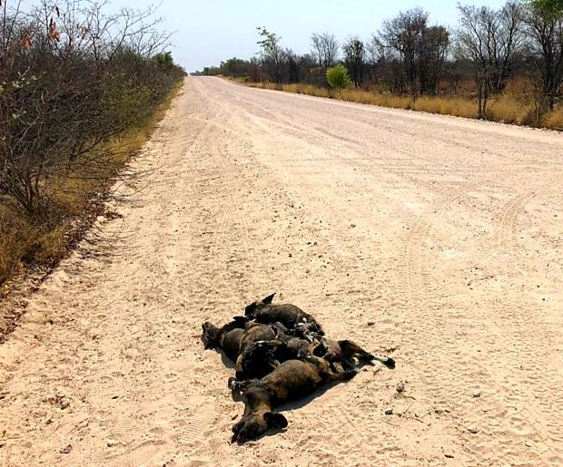
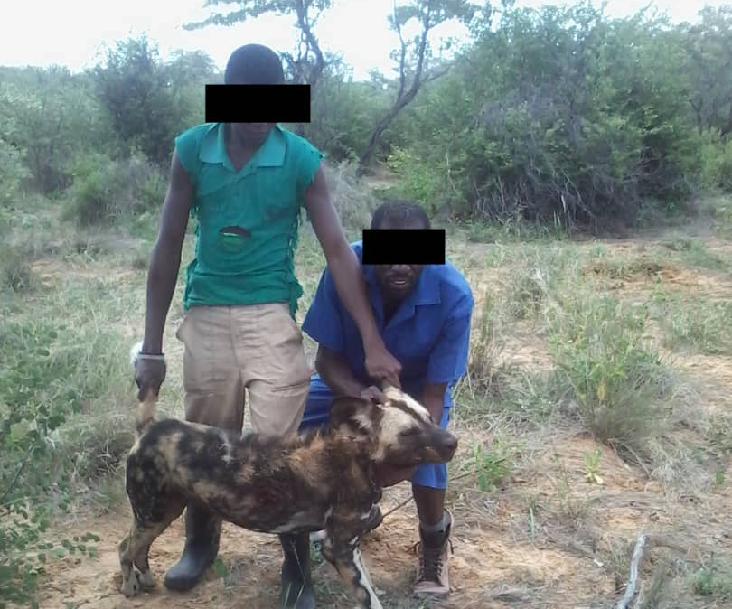
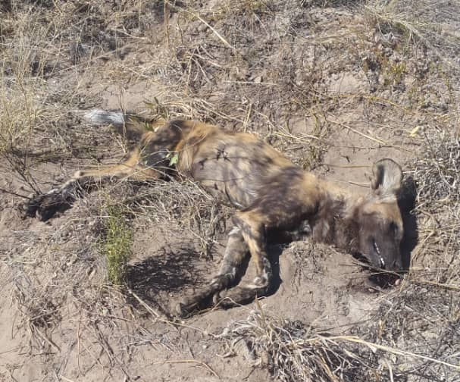
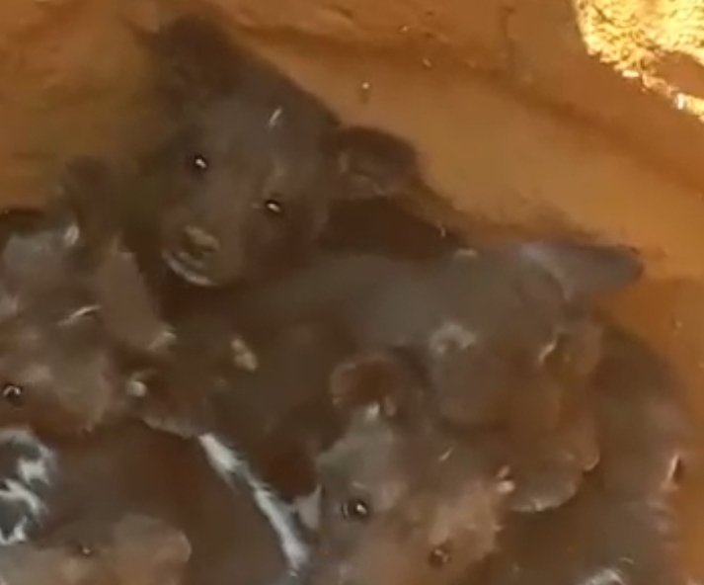

Slide 16
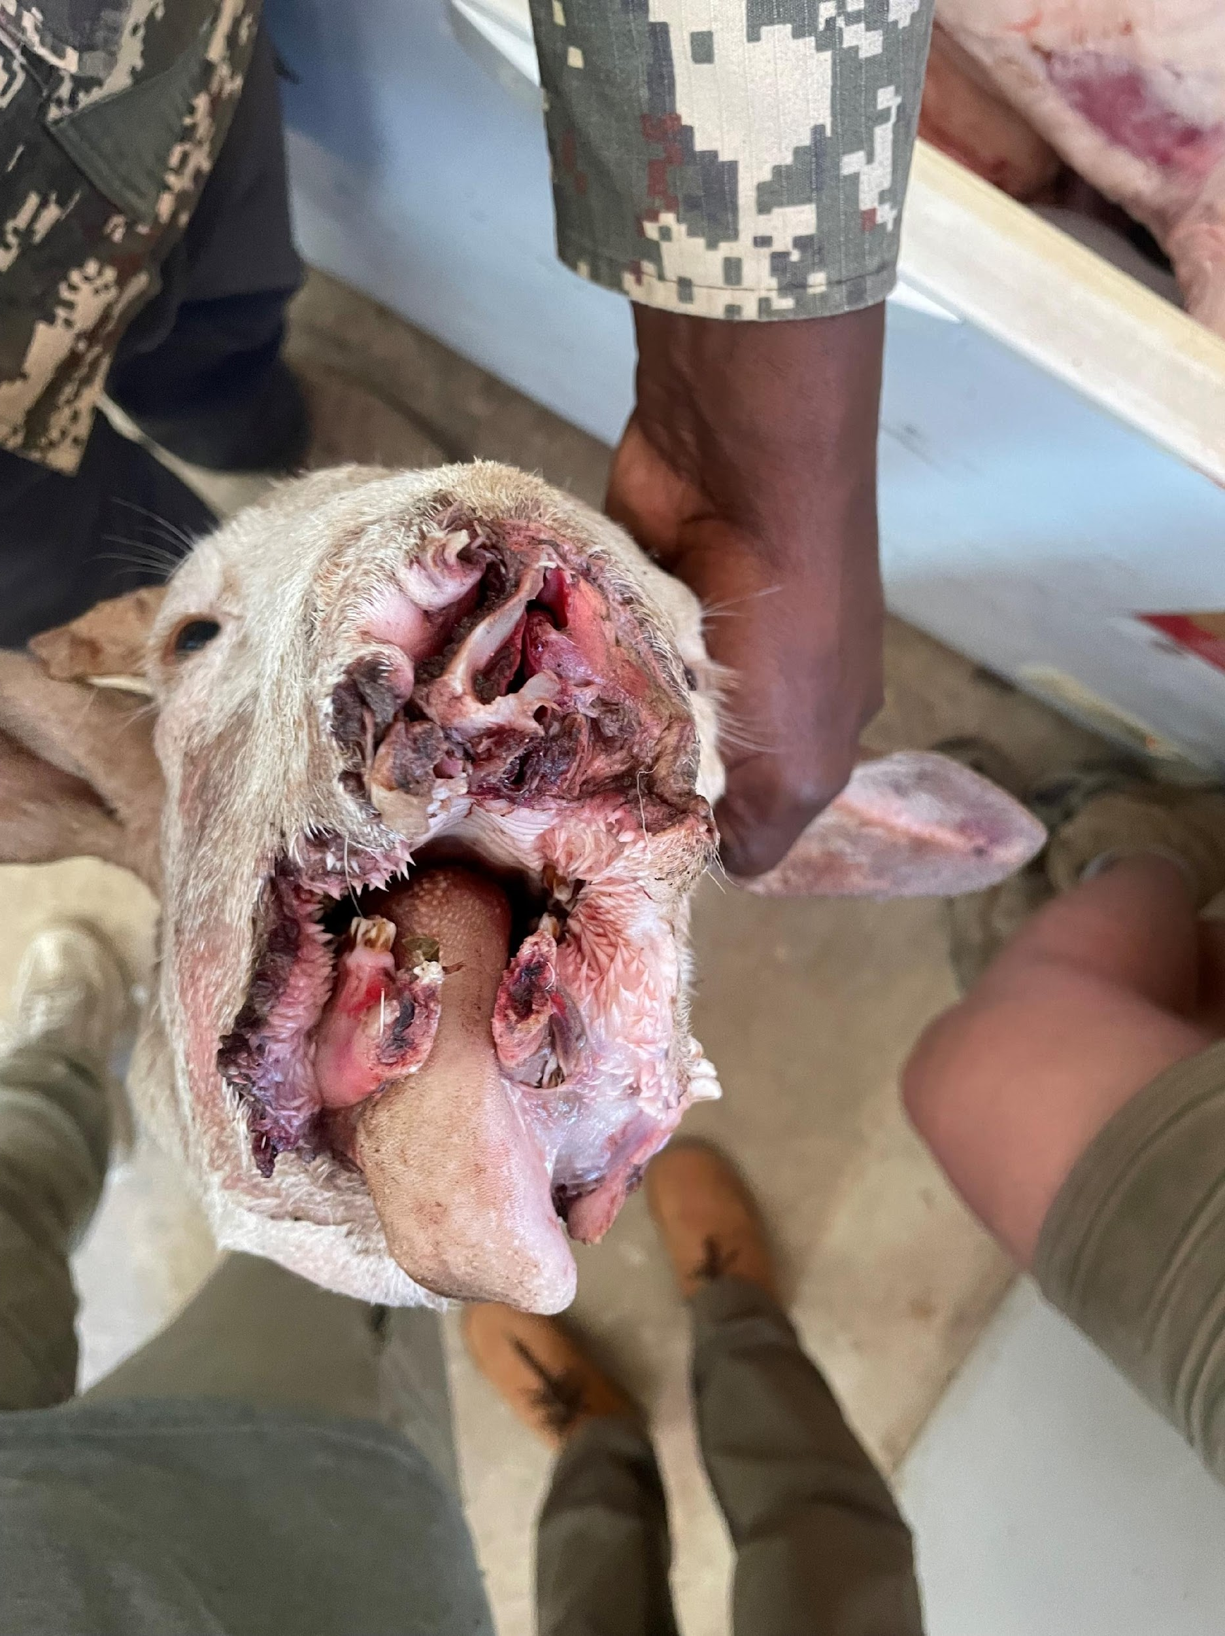
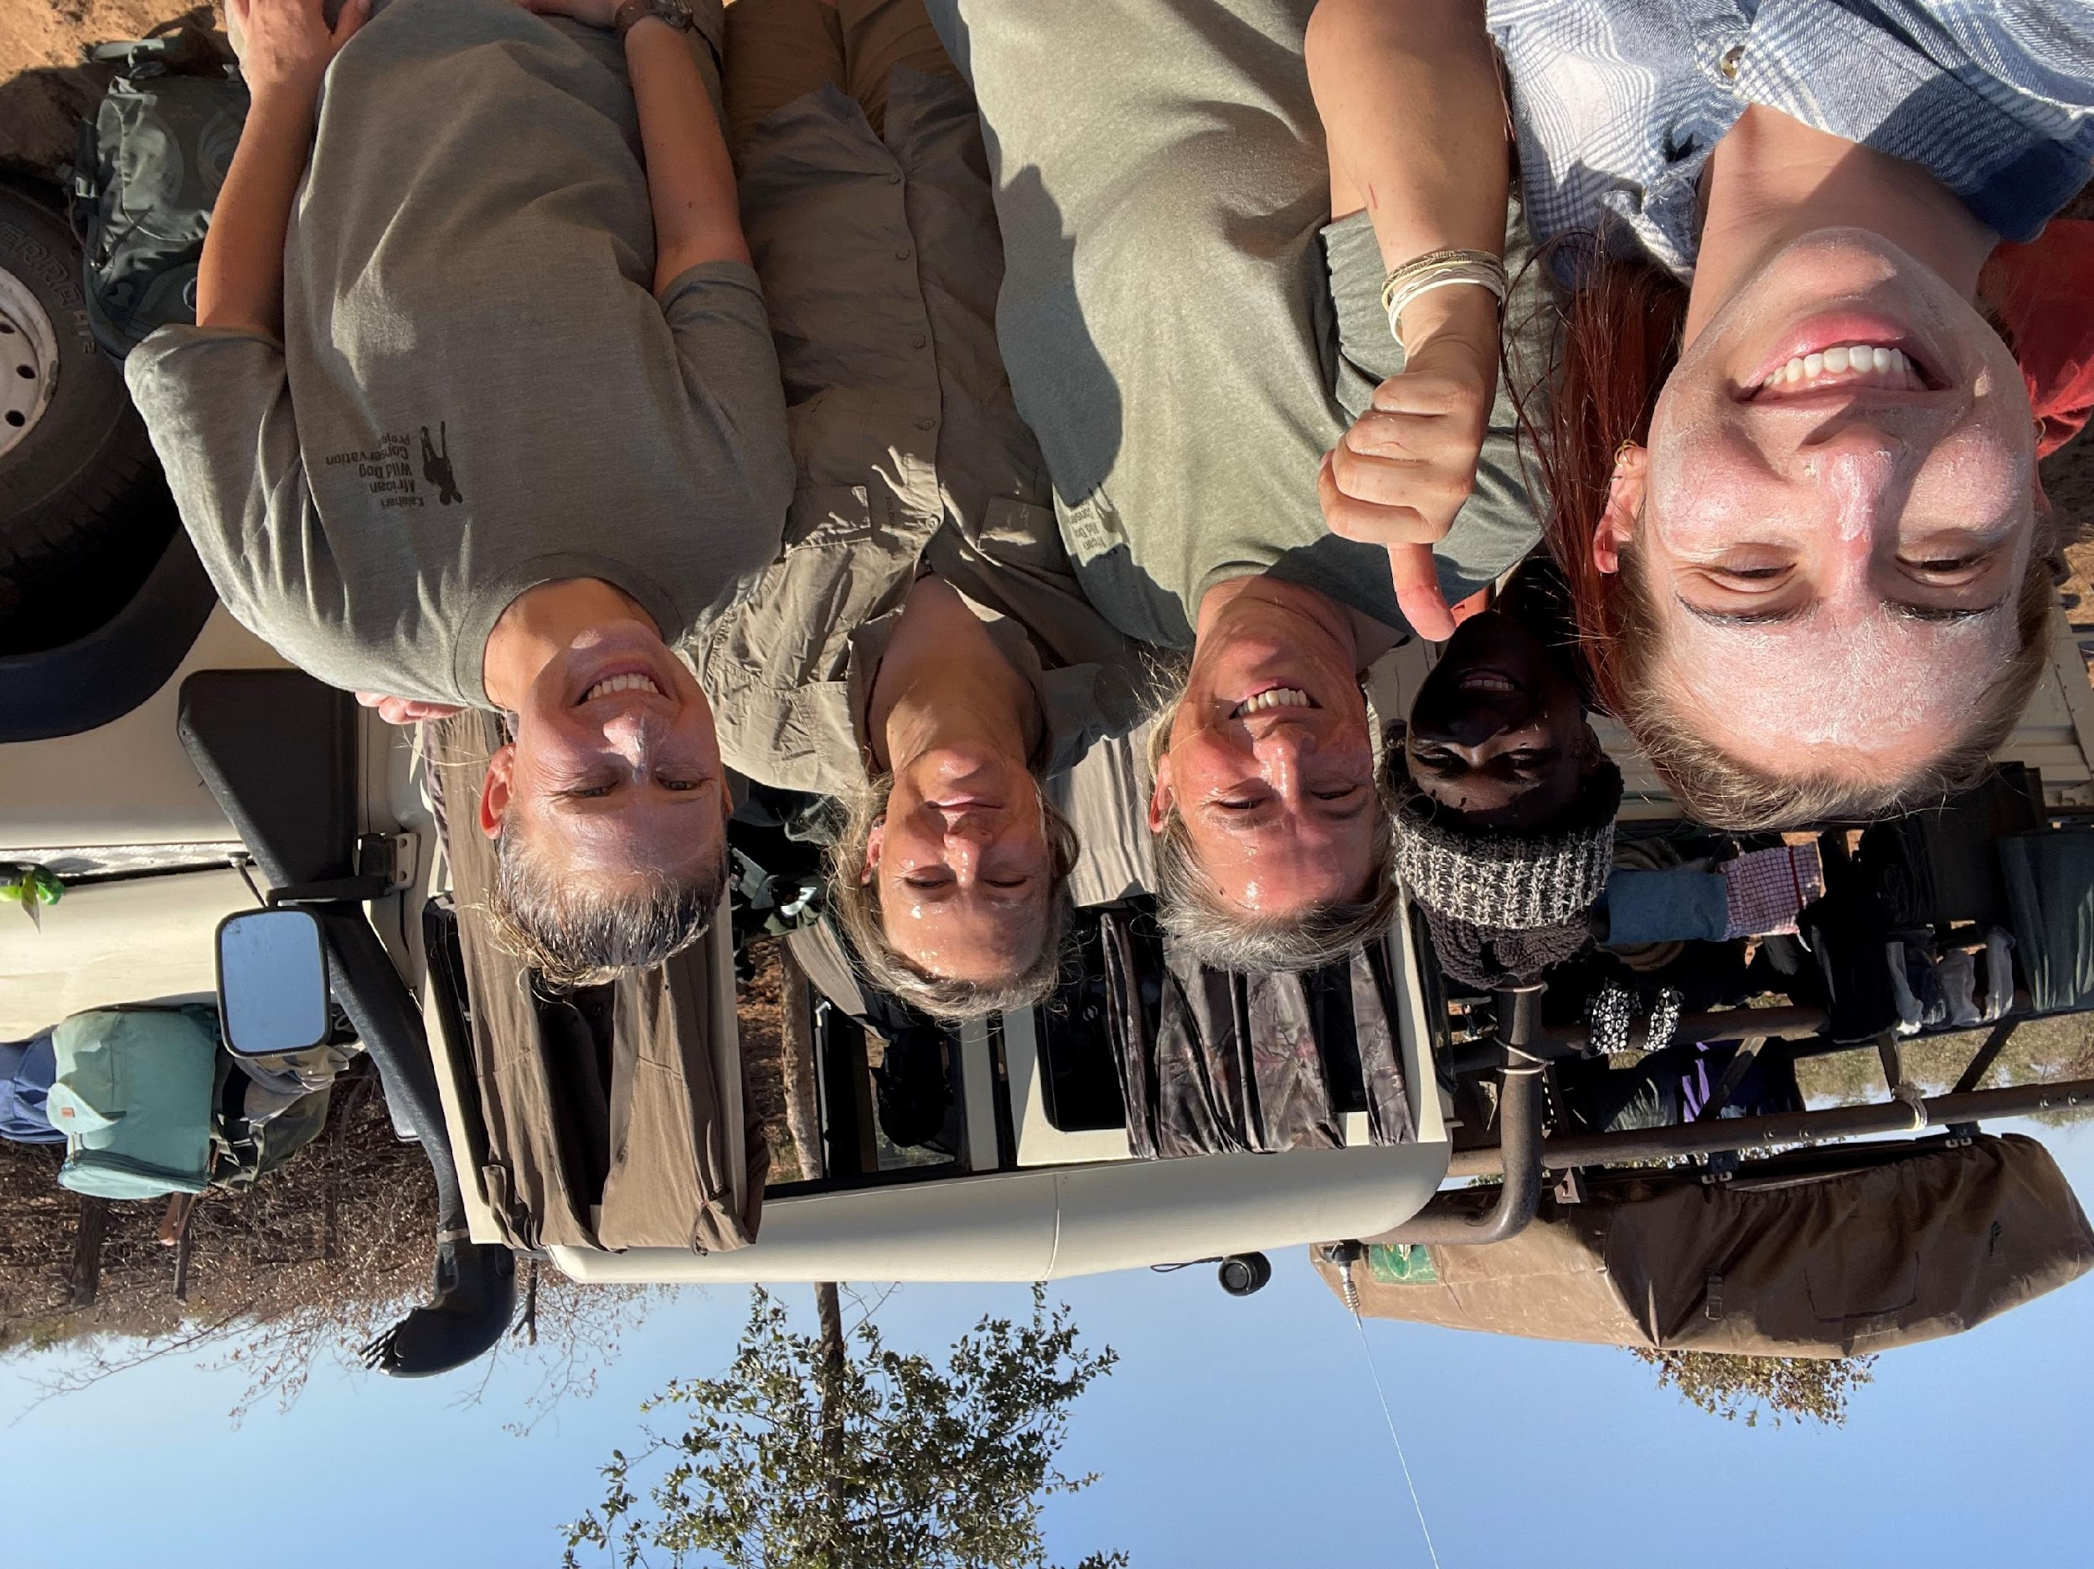
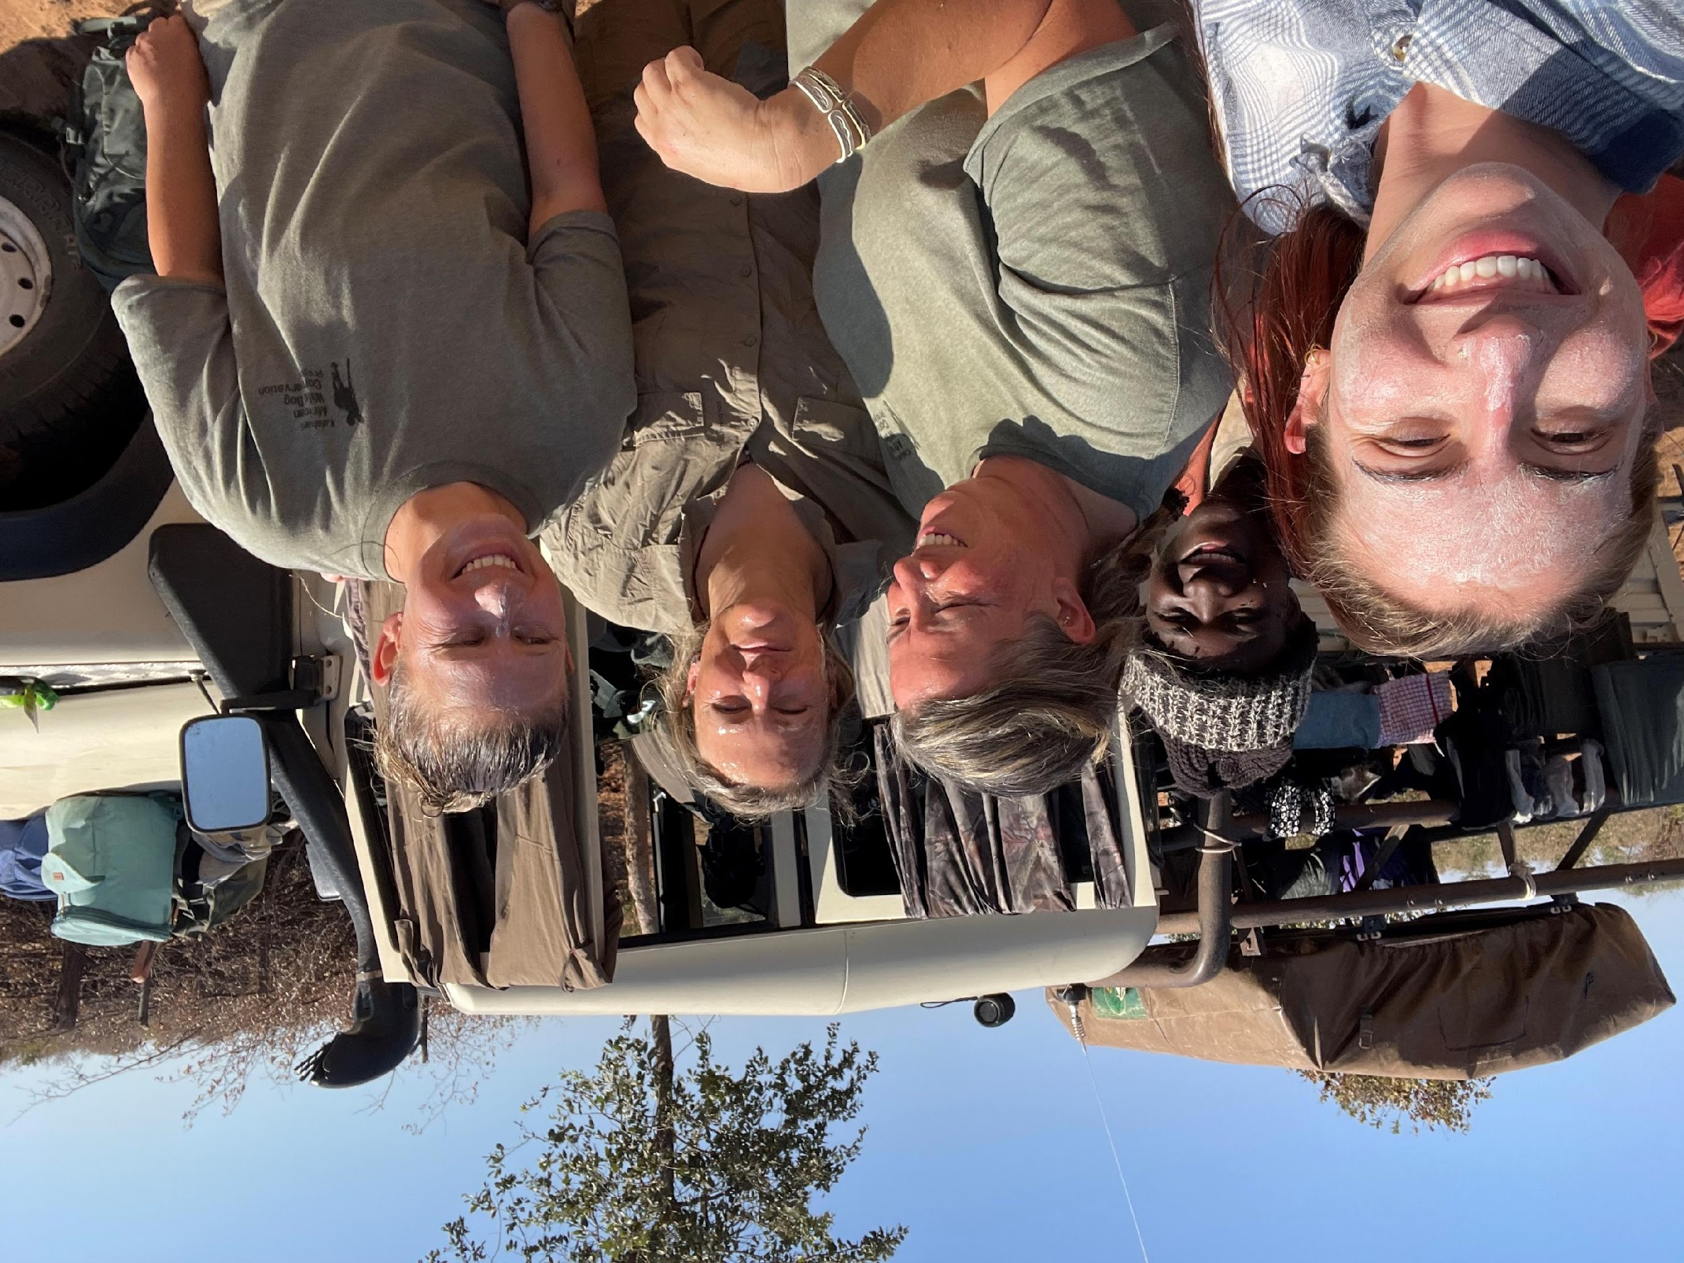
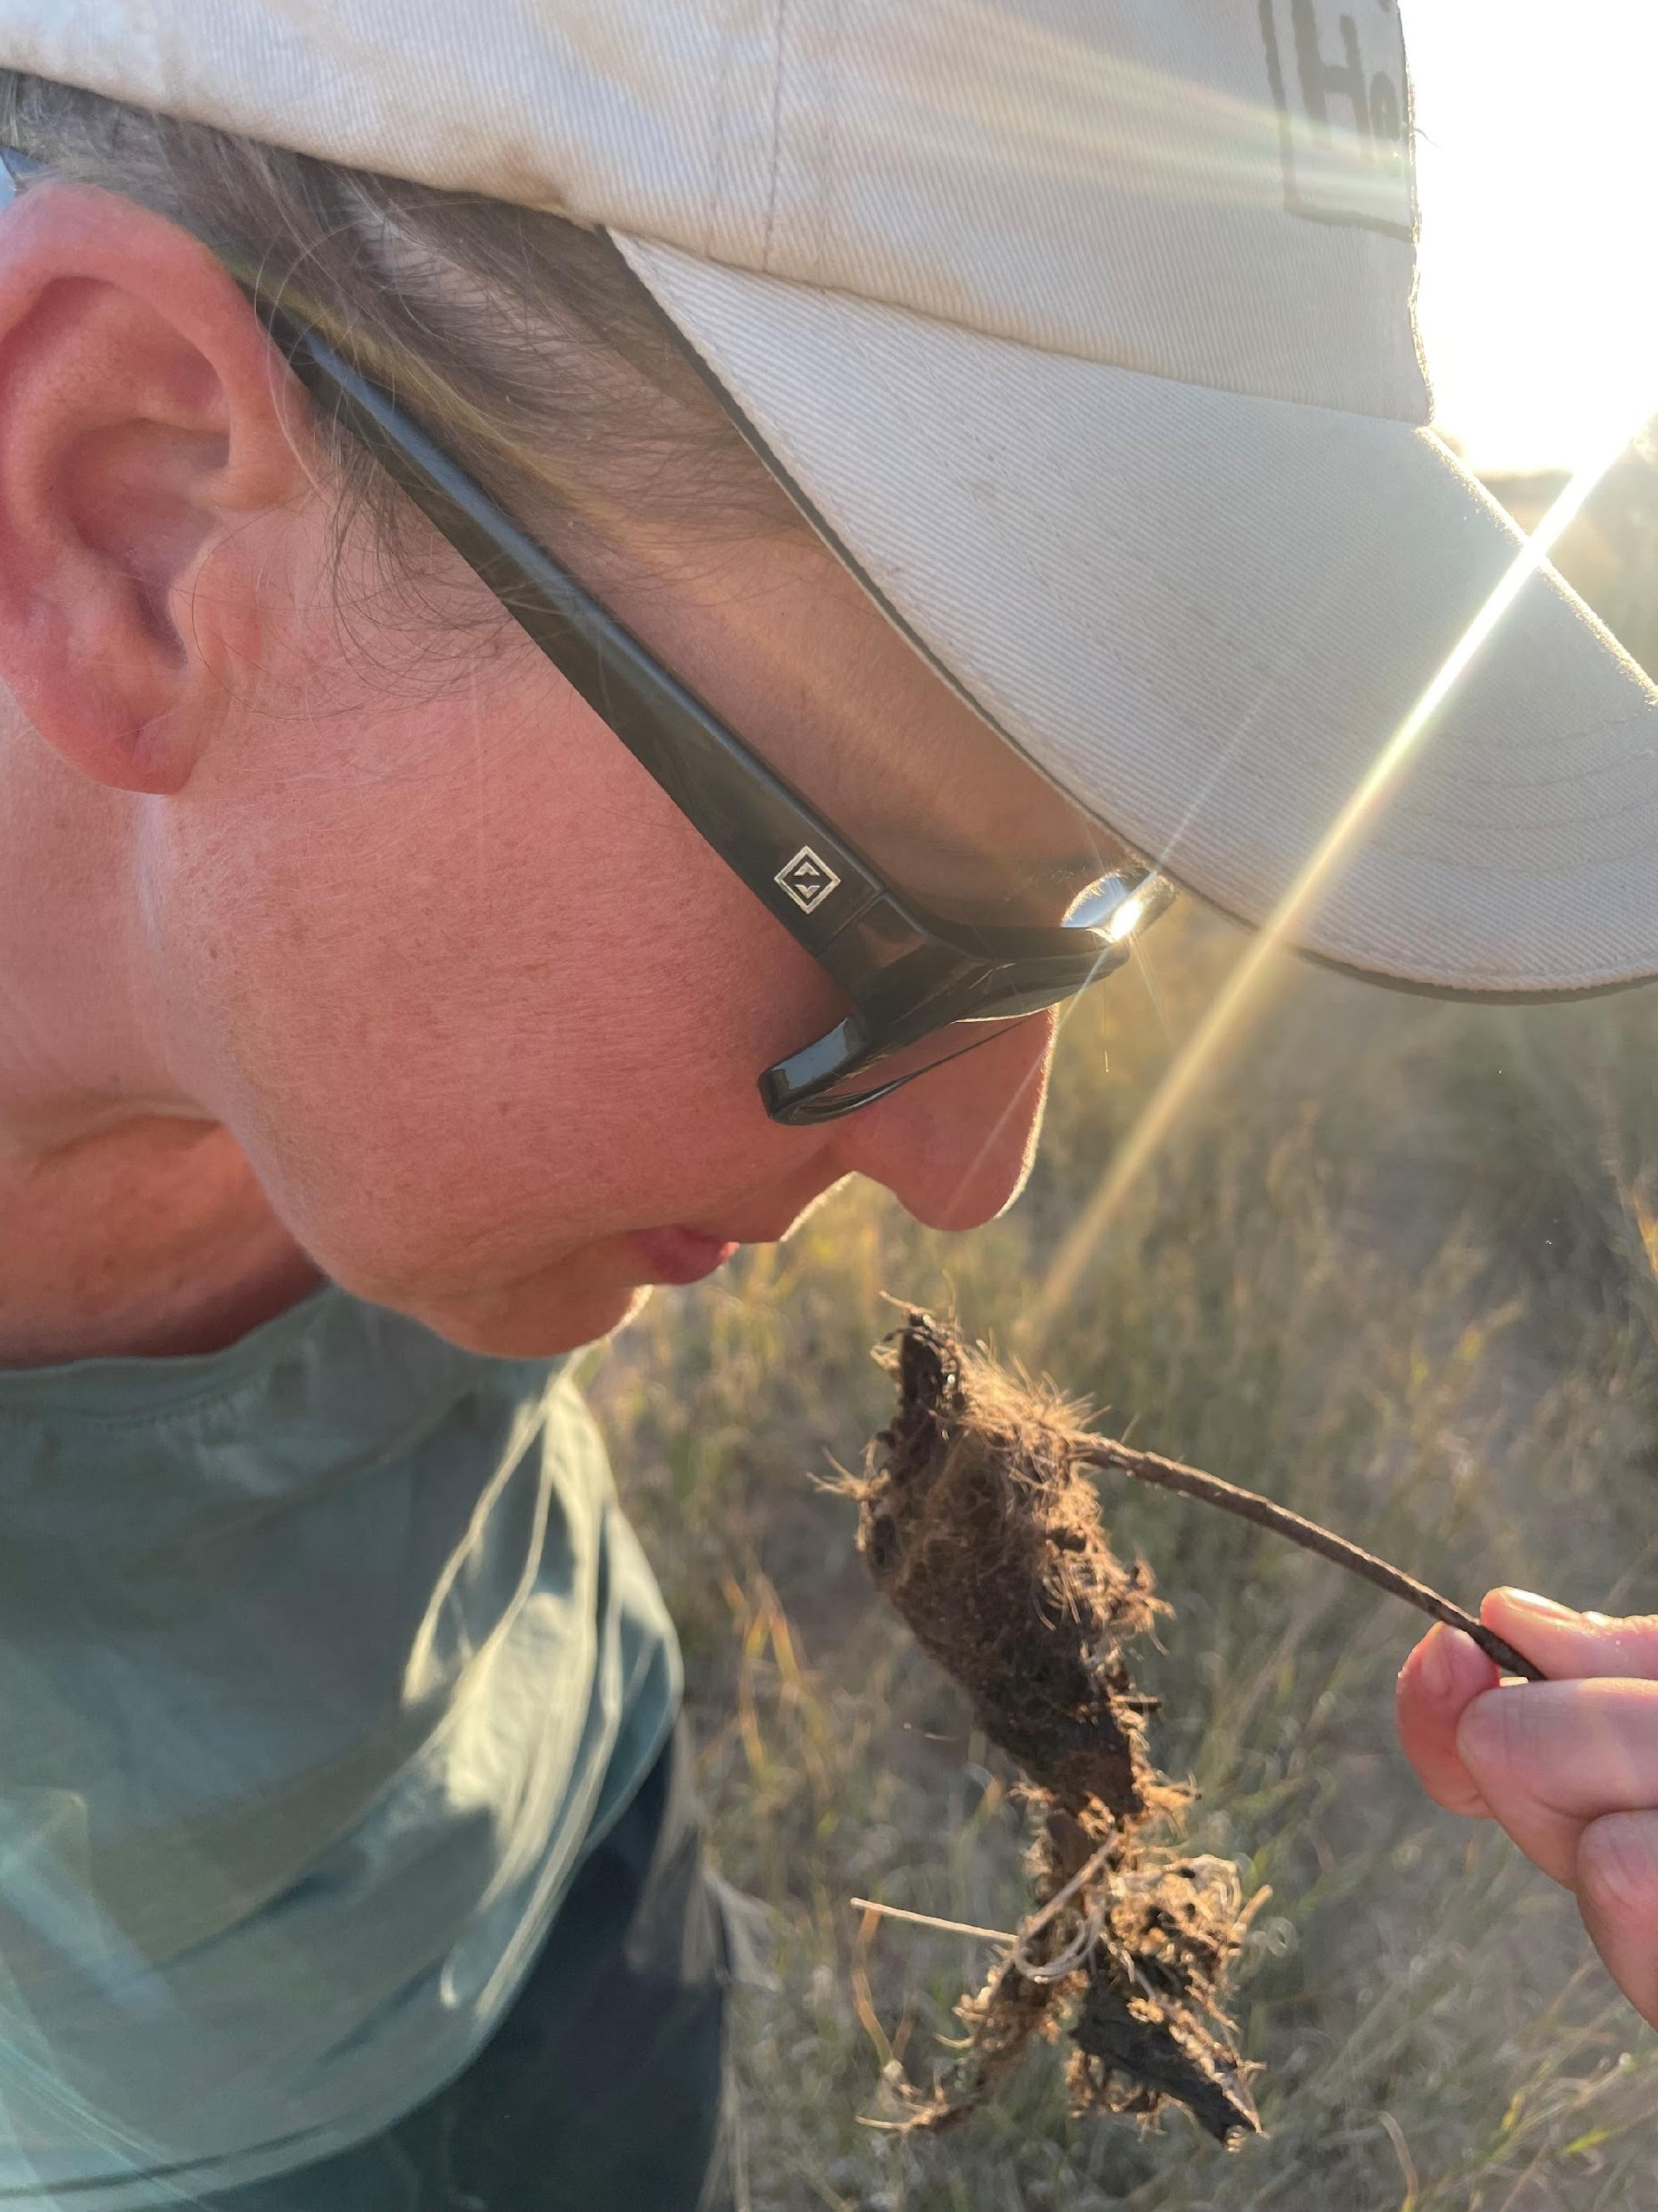
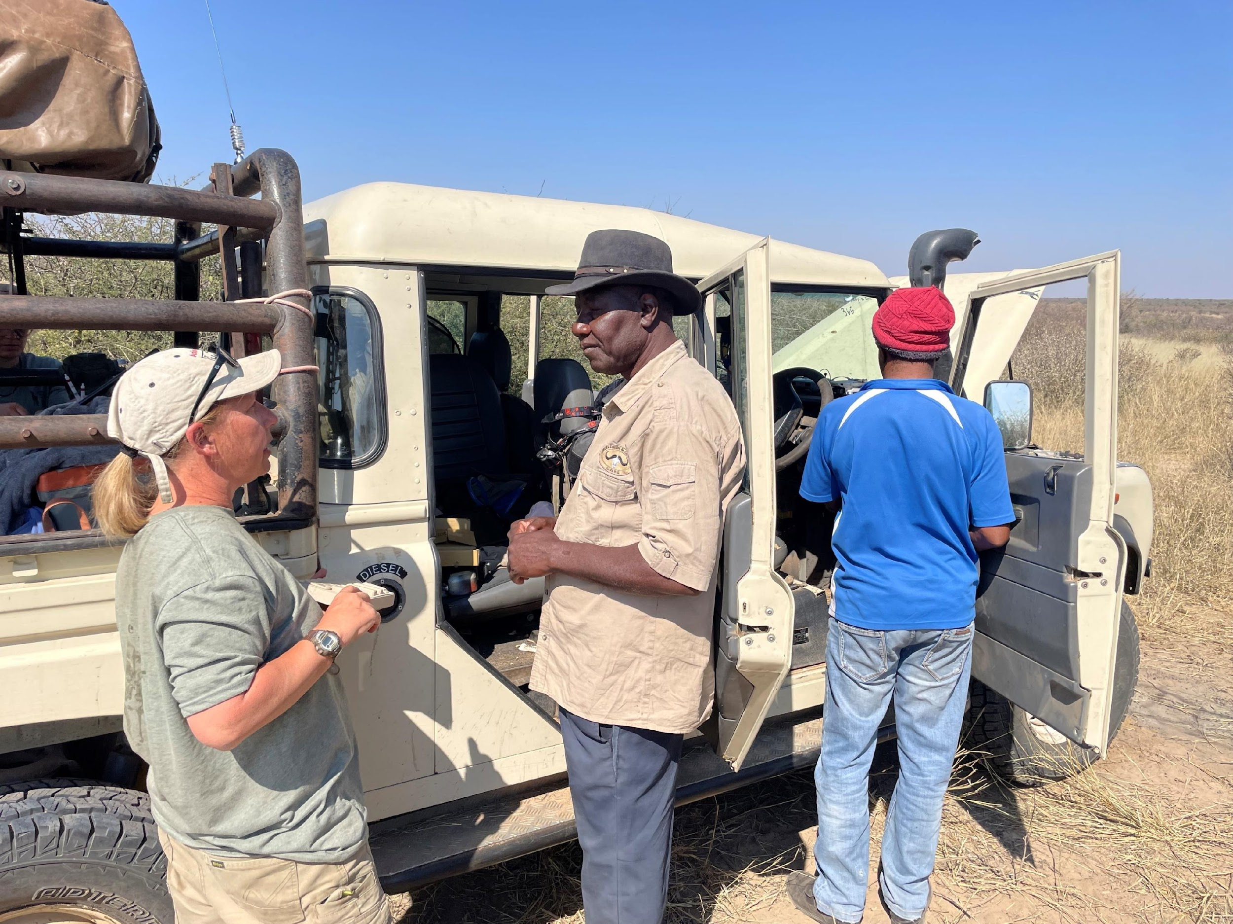
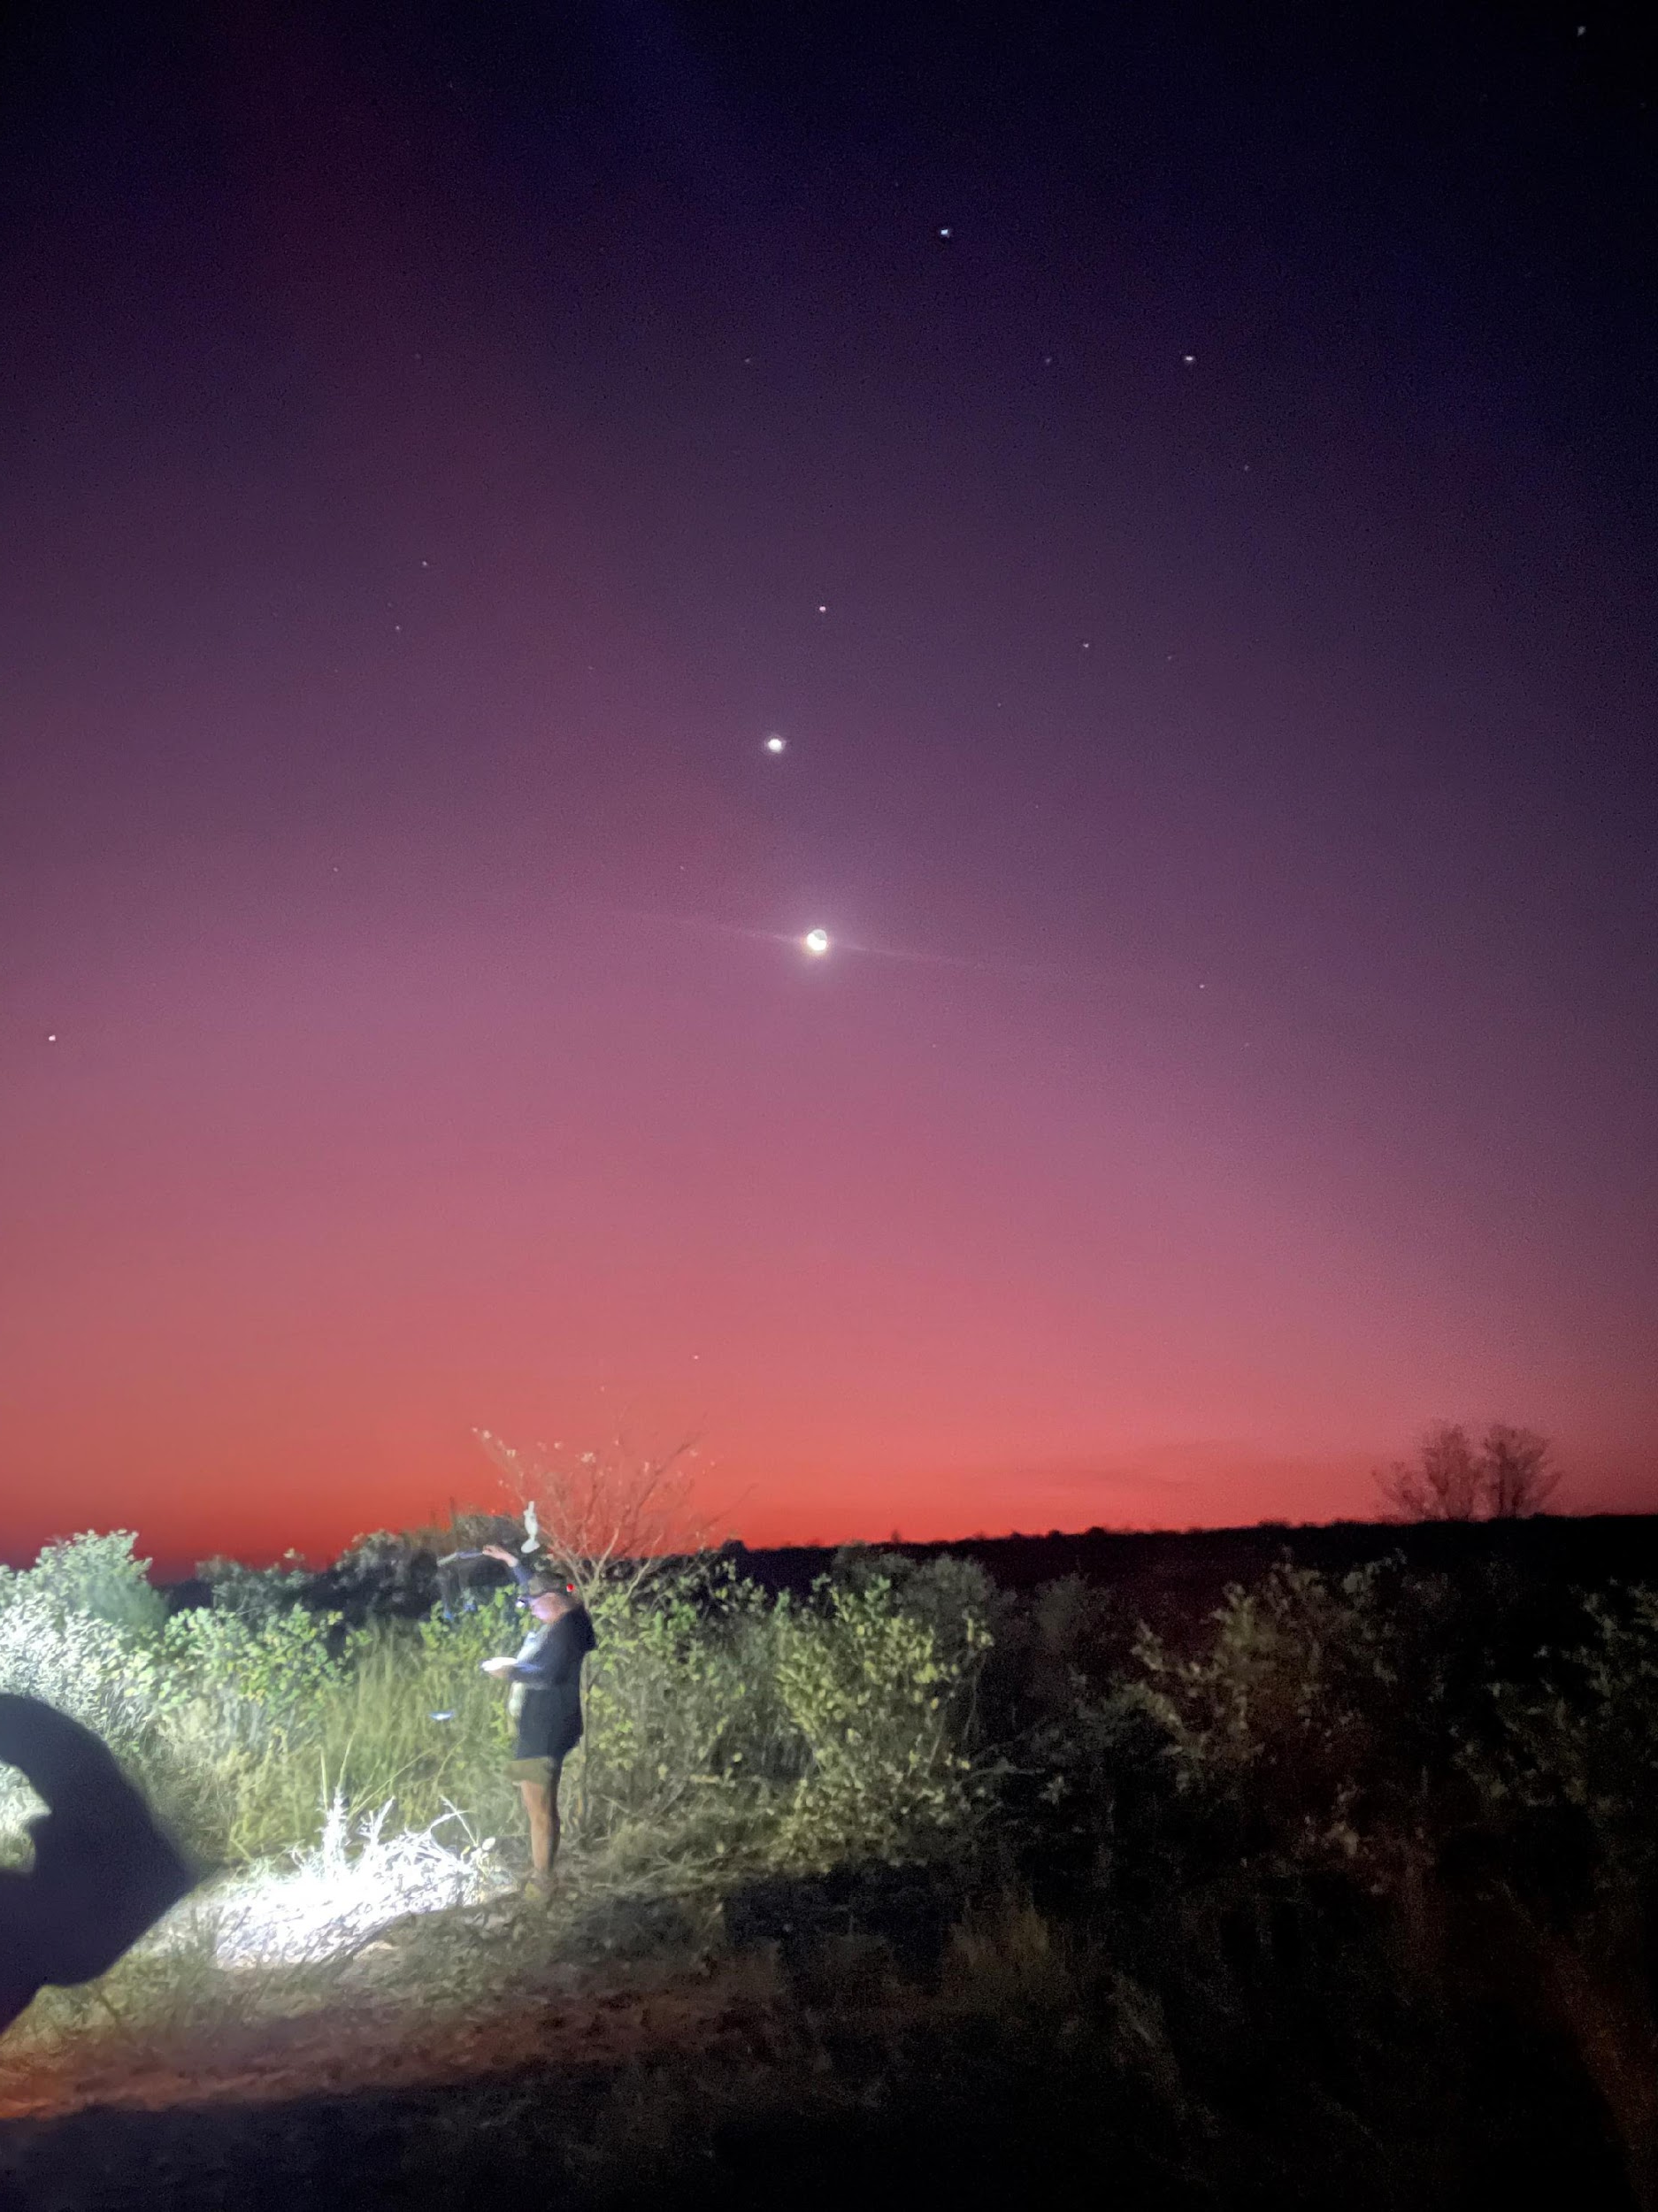
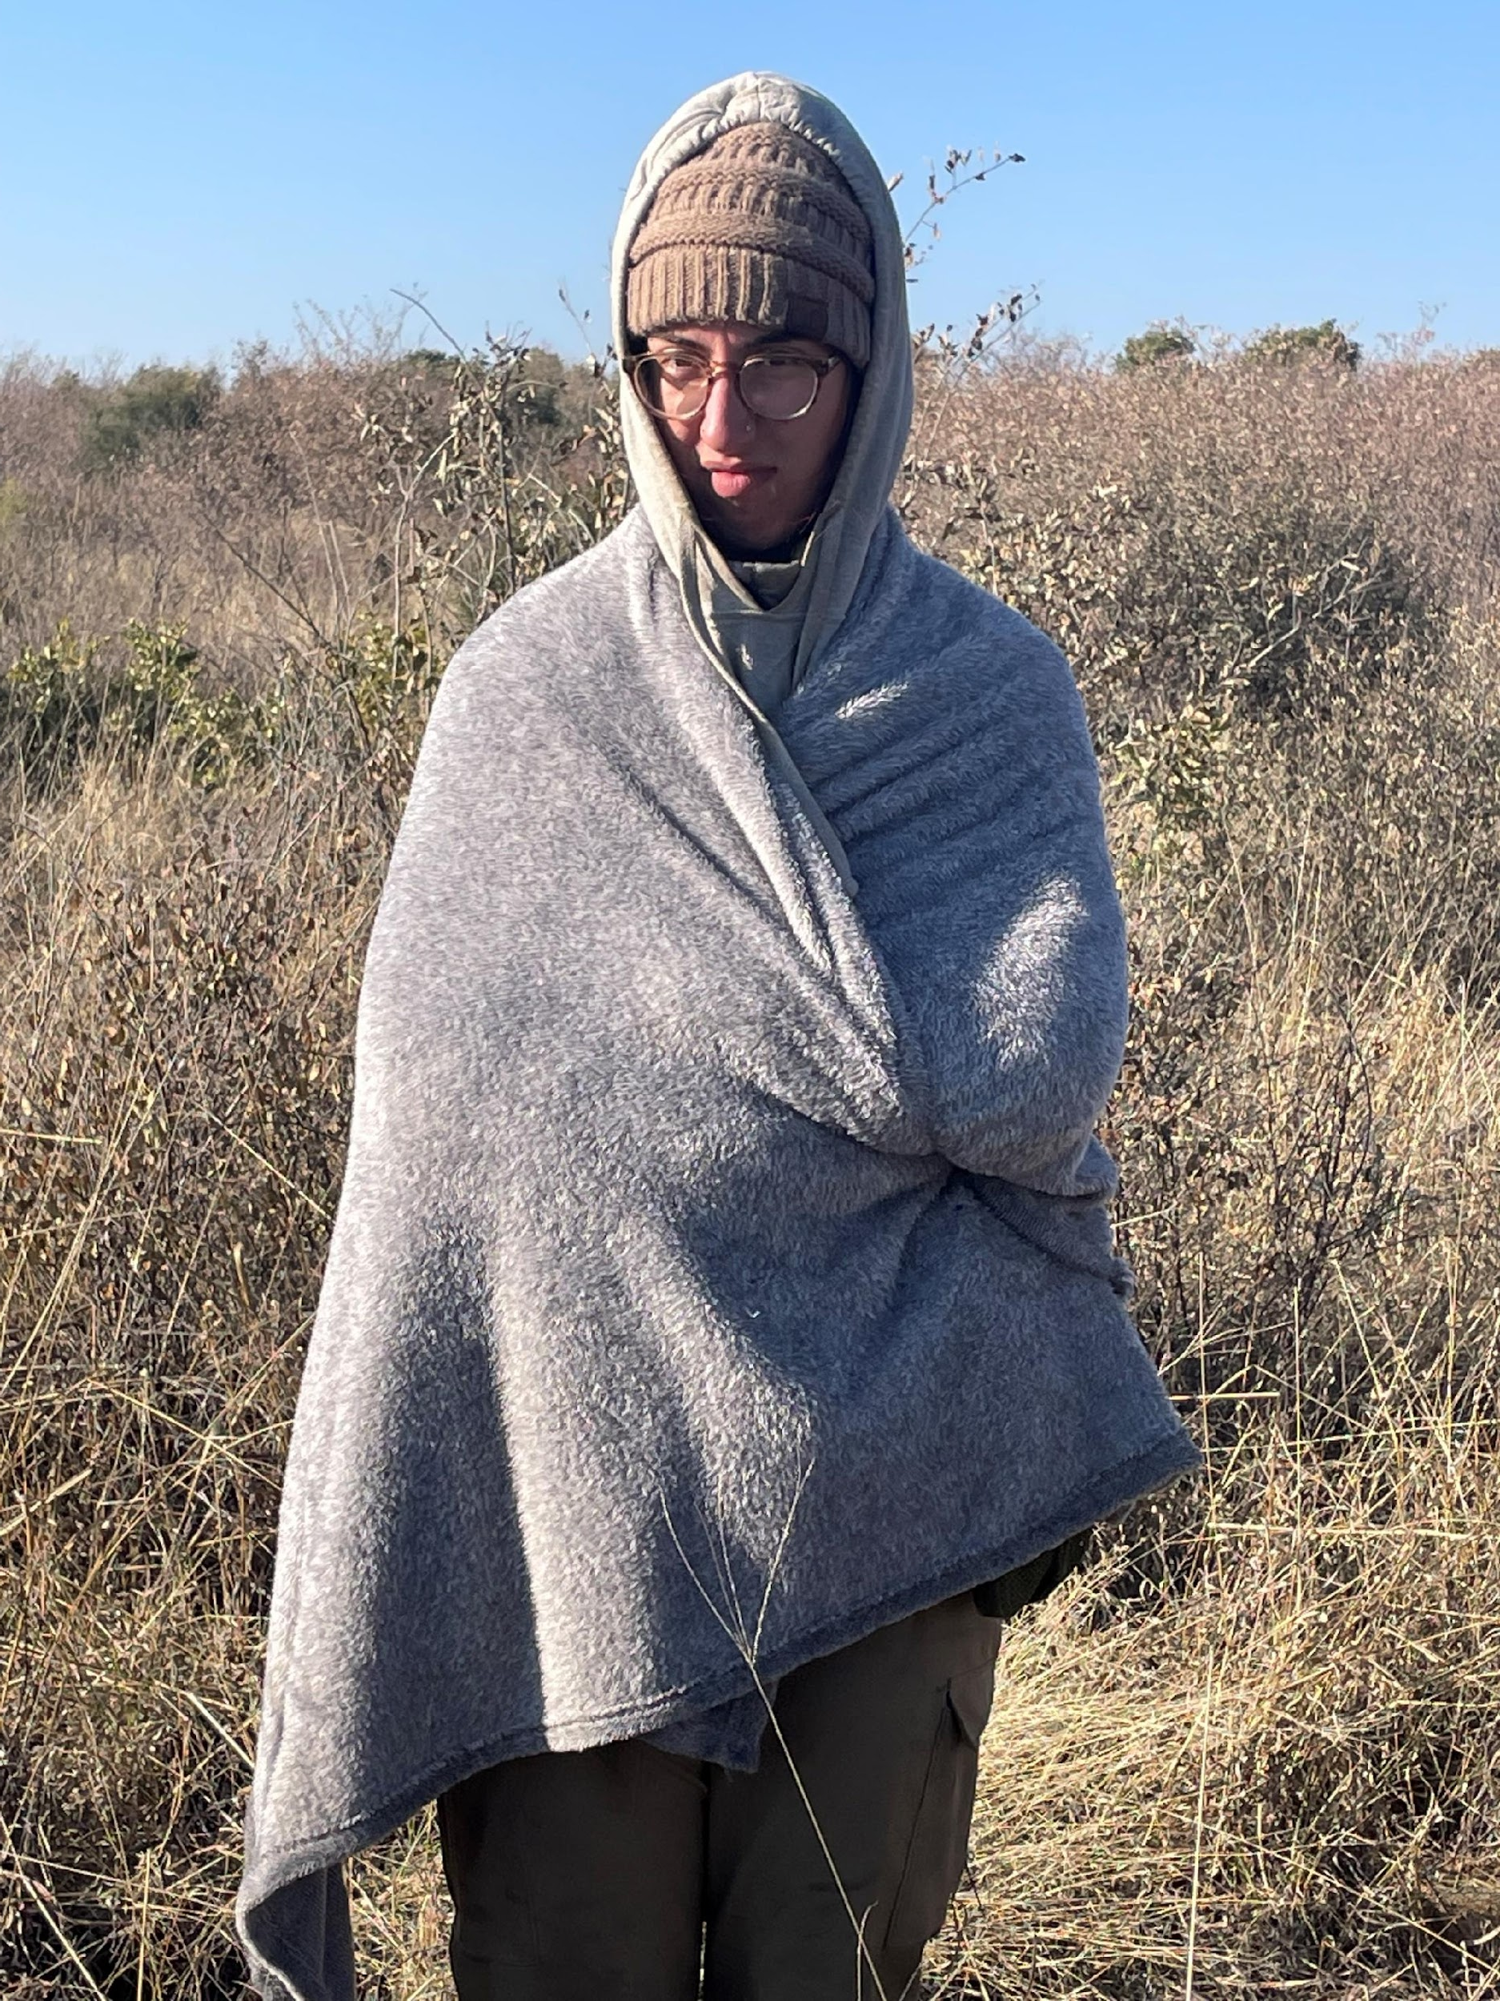
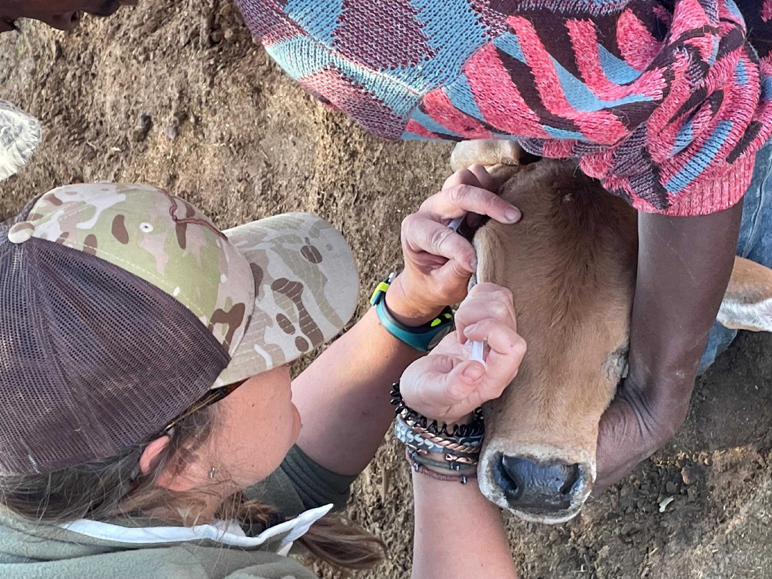
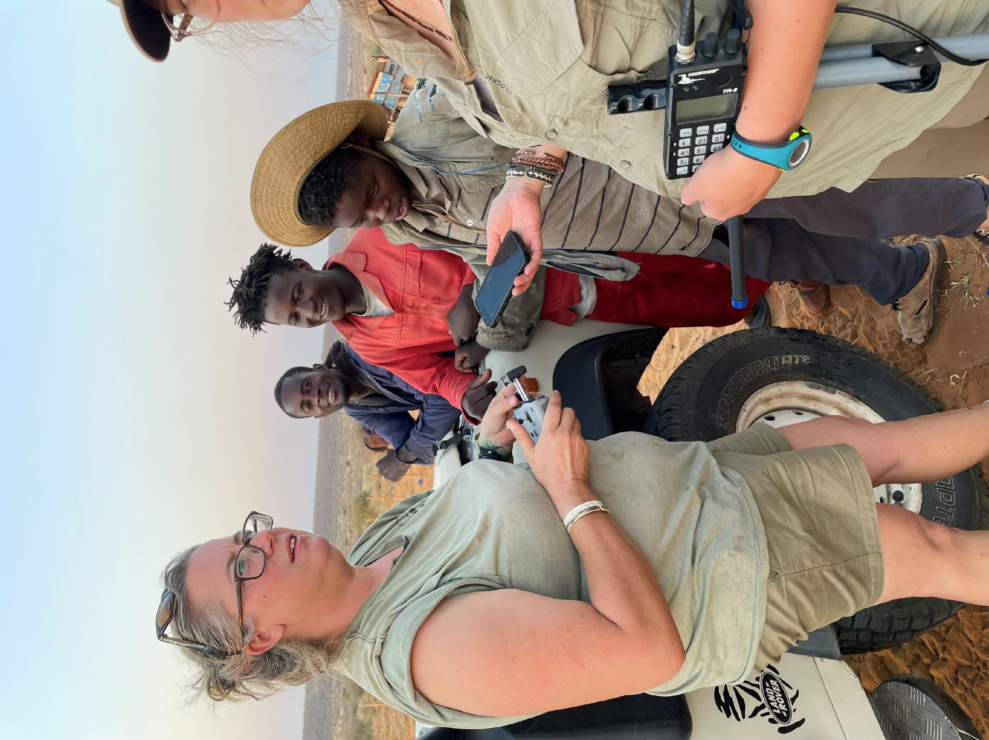
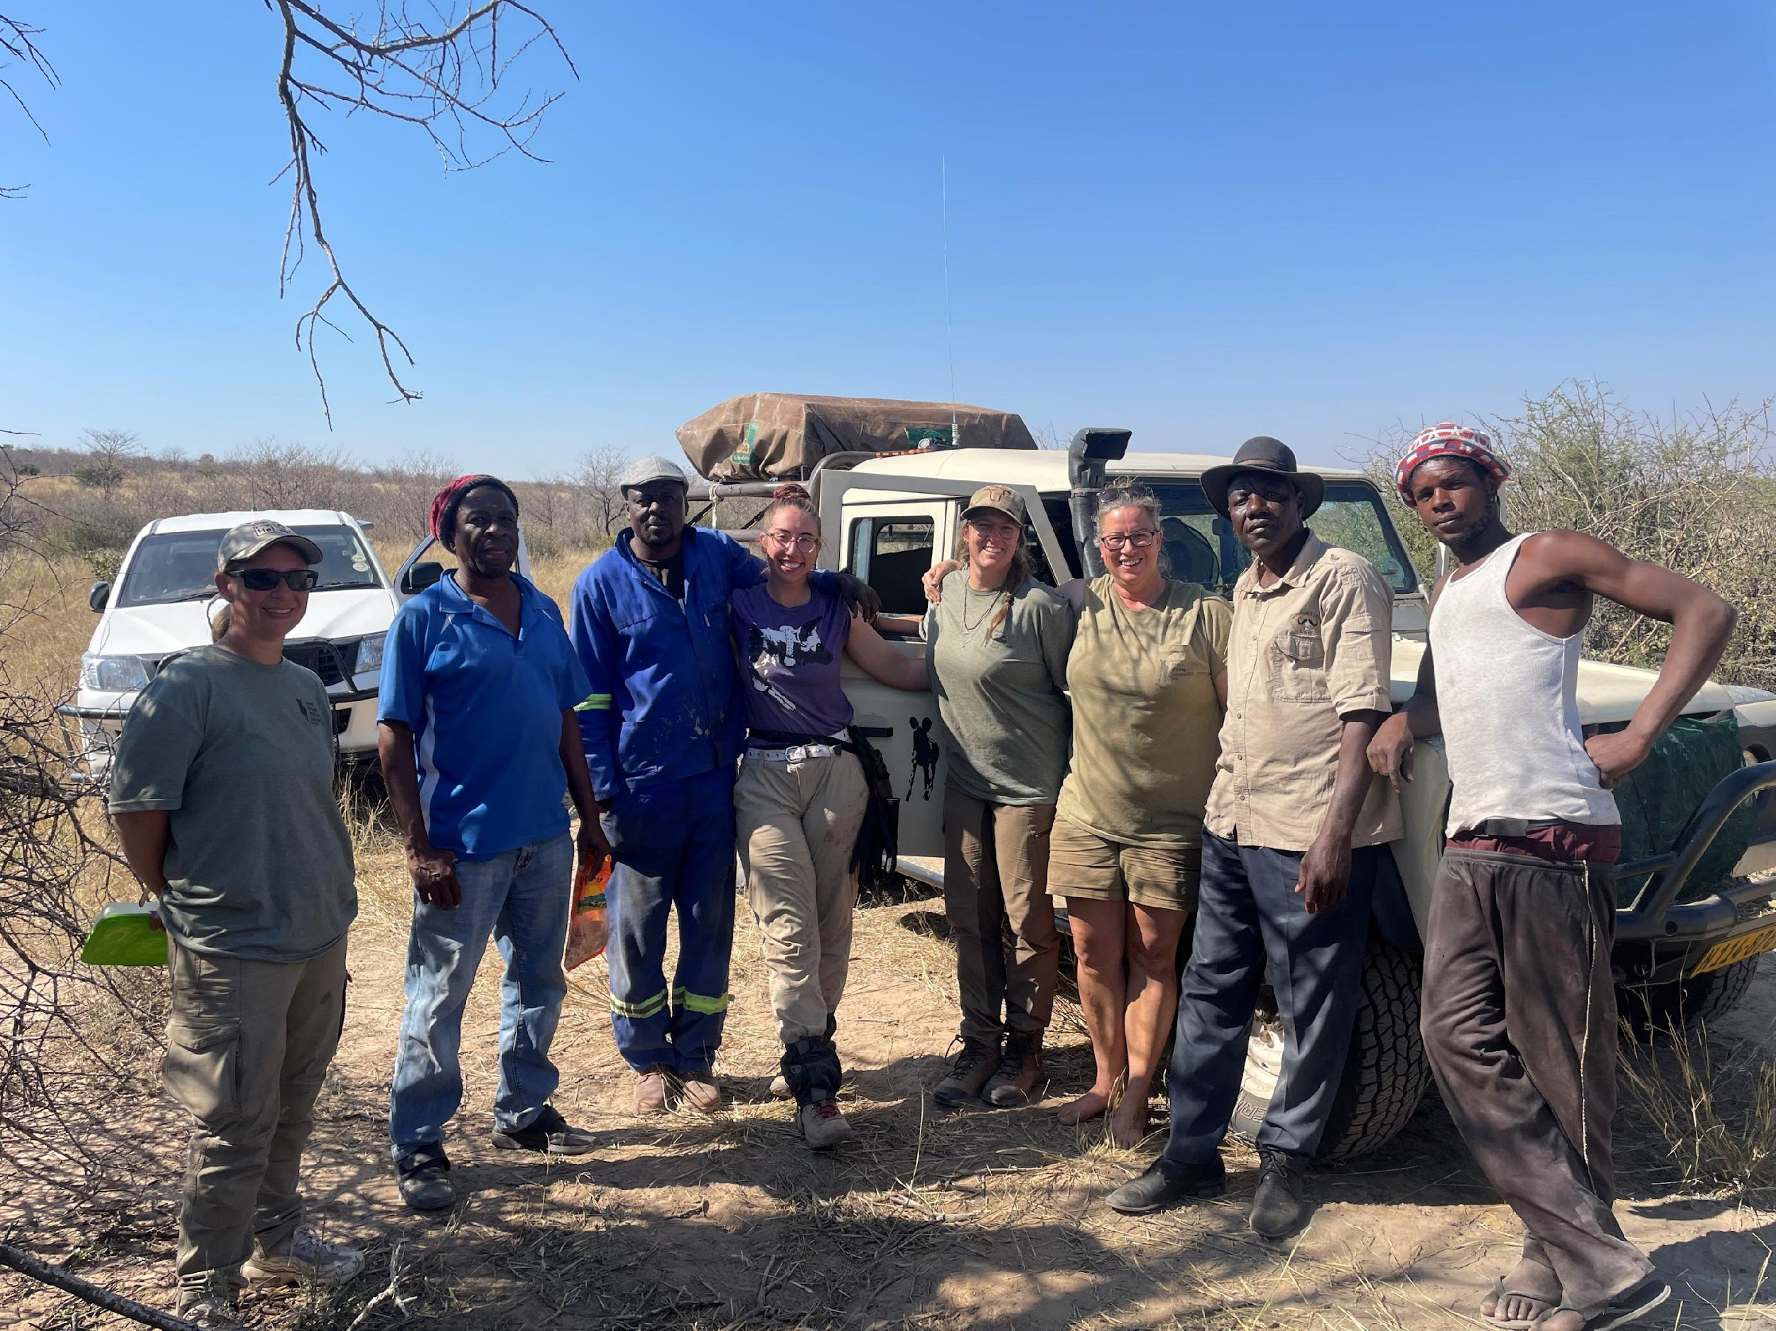
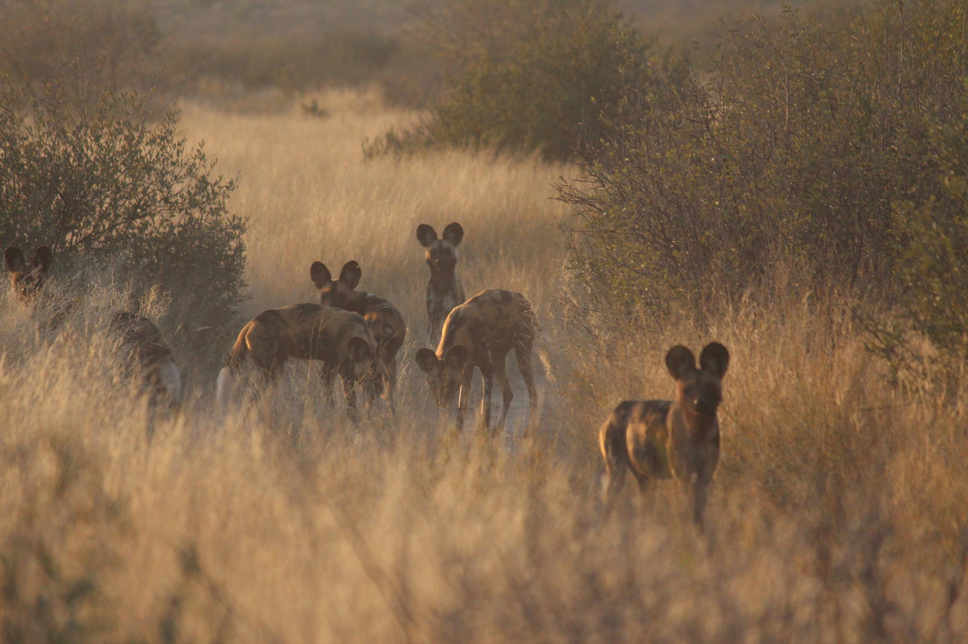
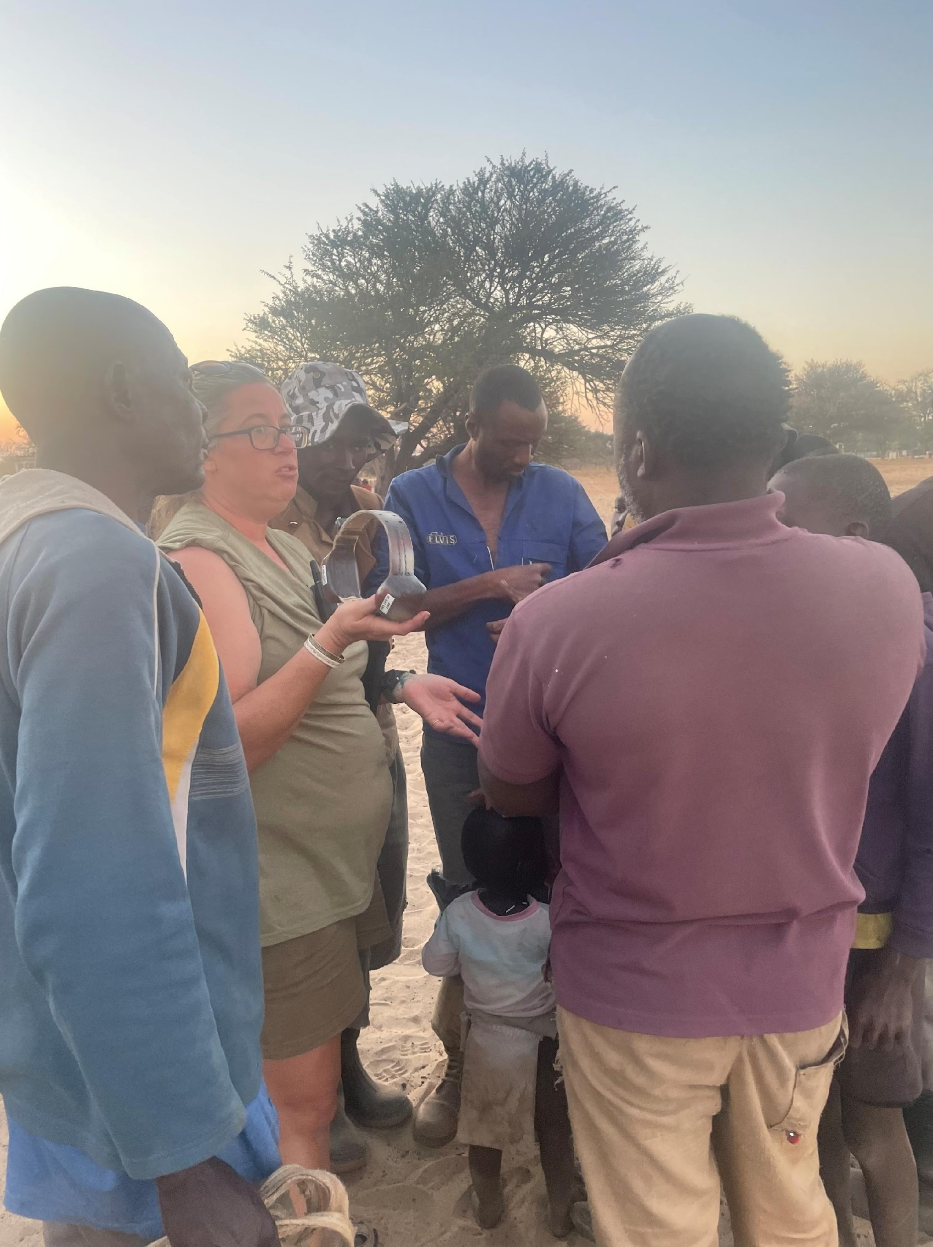
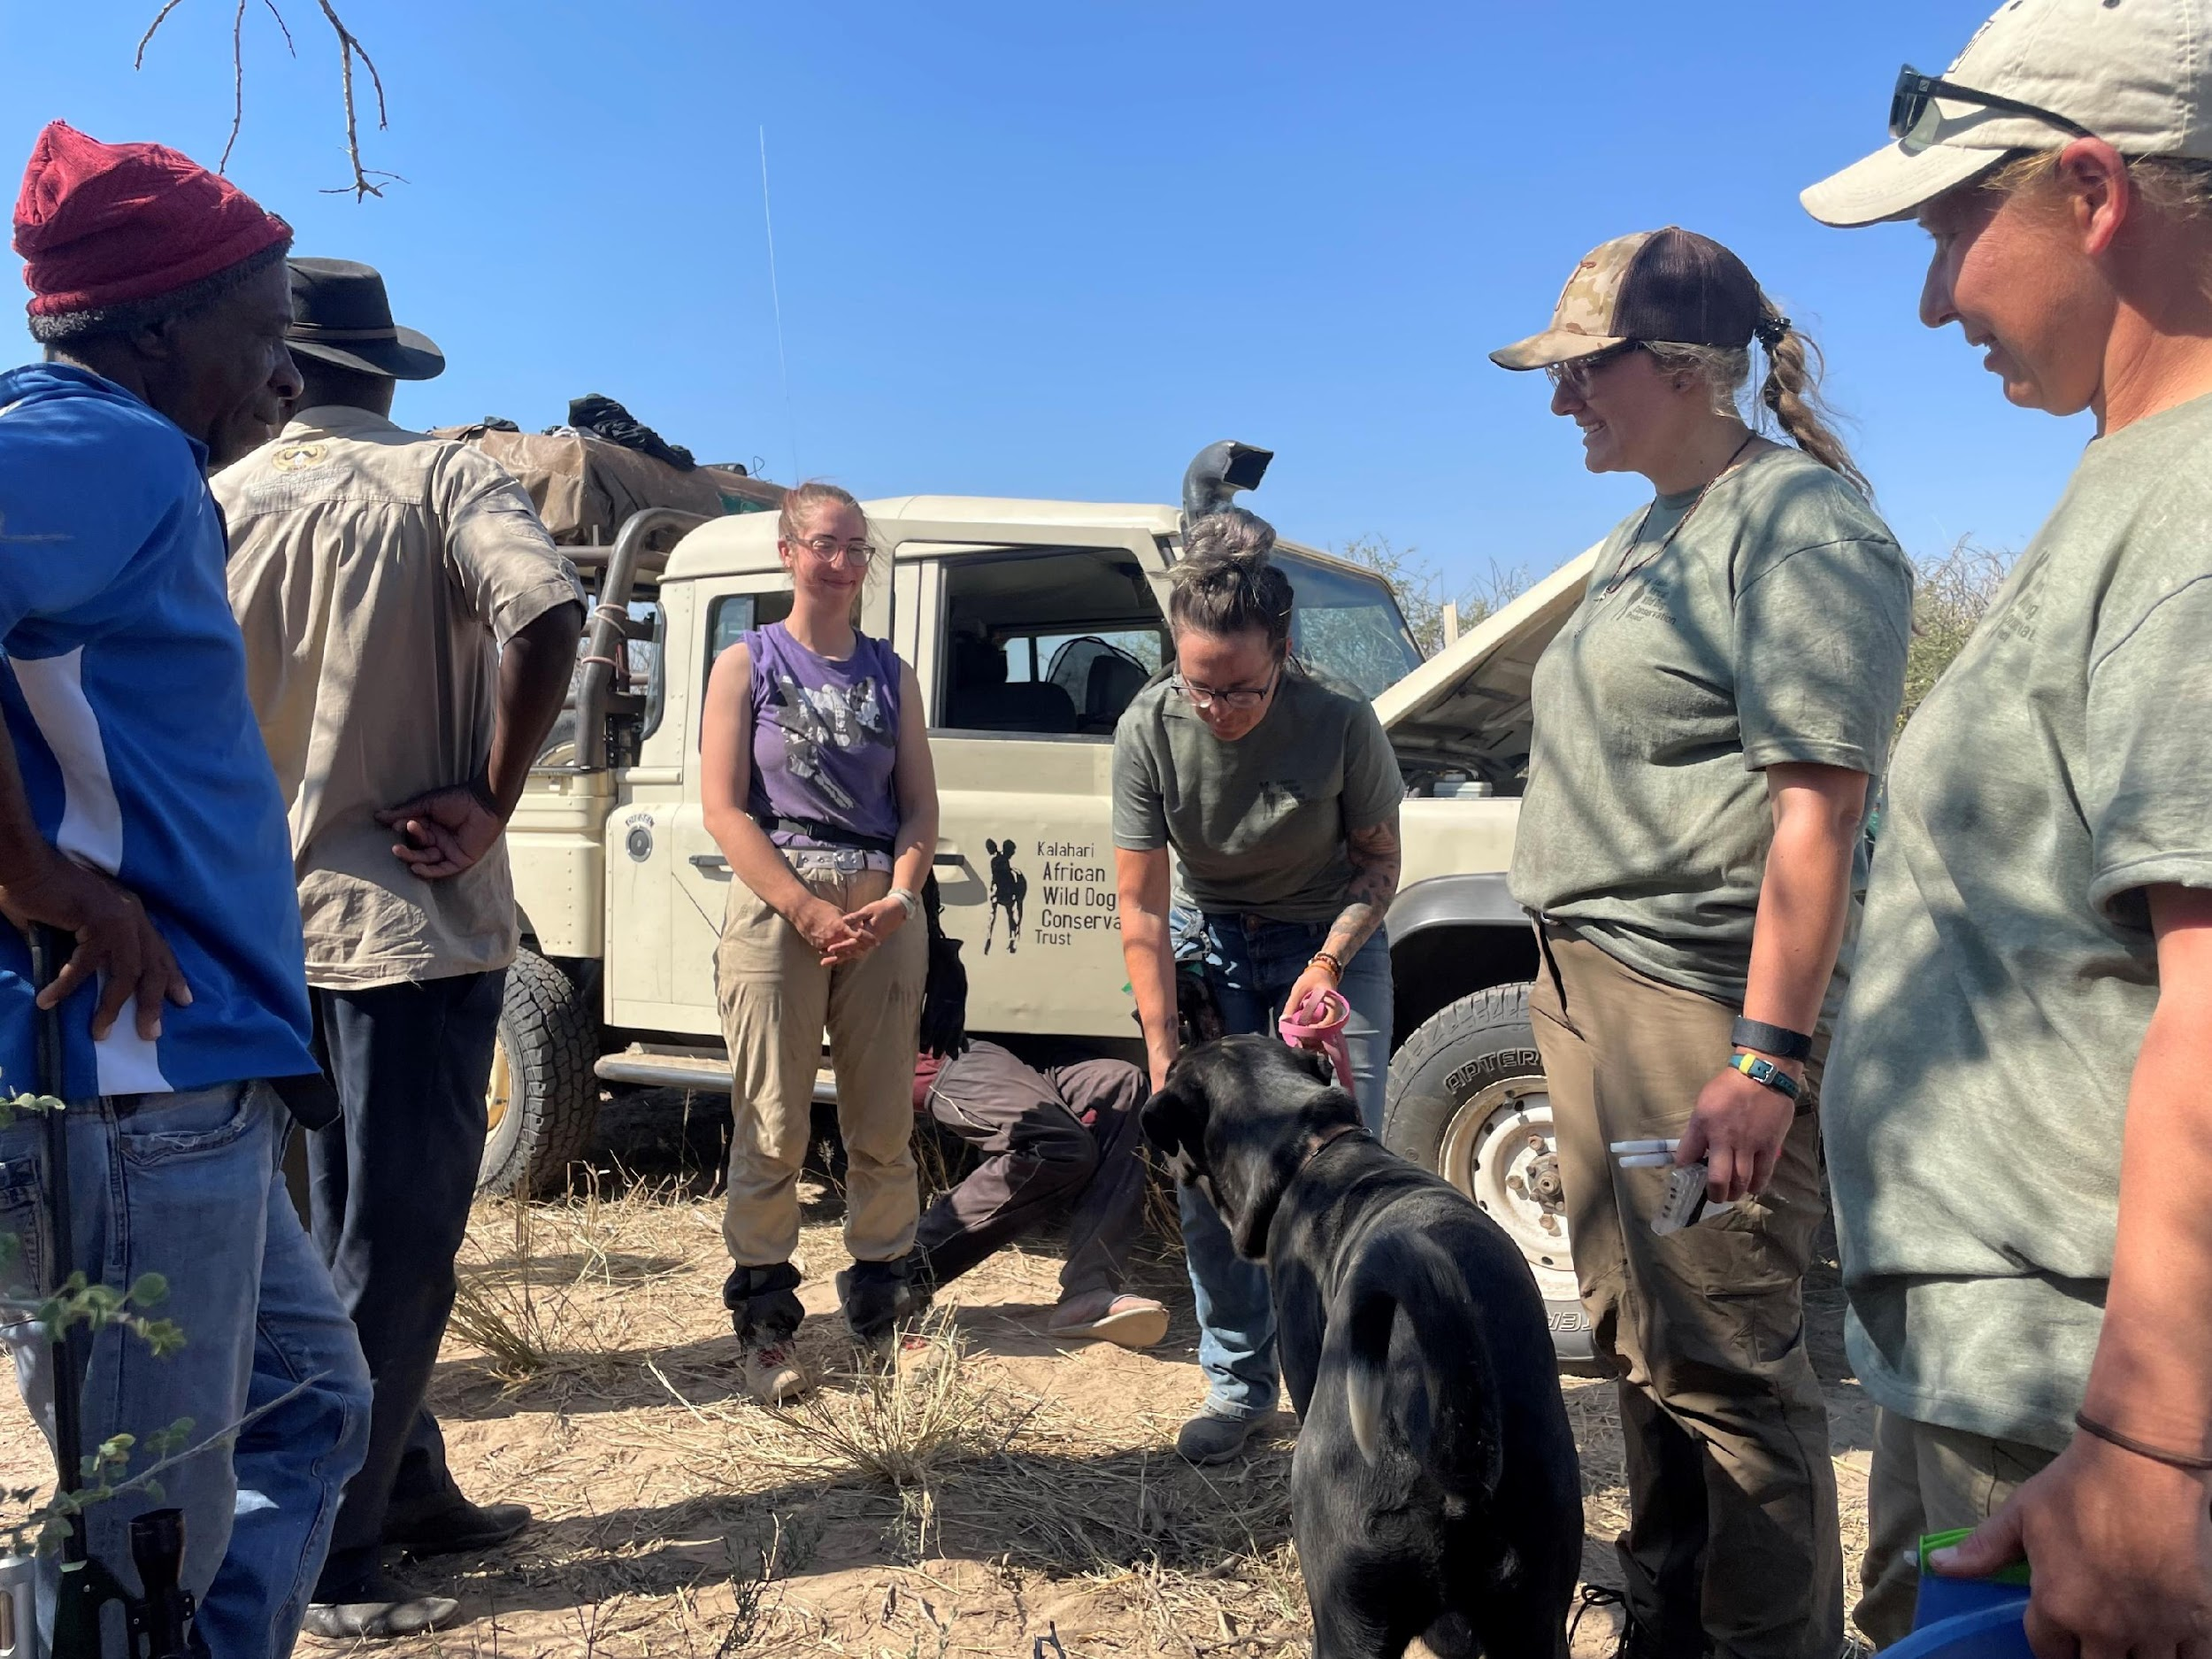
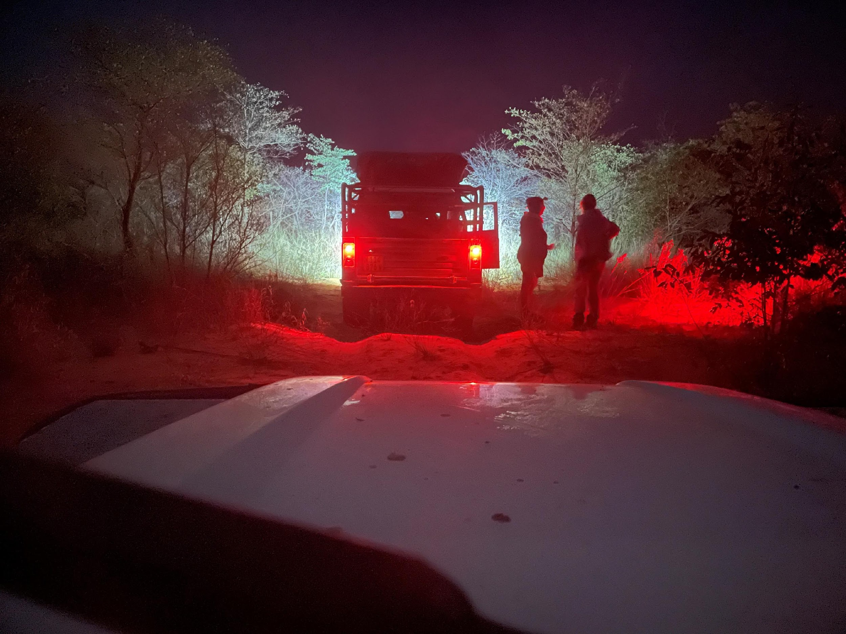

Engaging with Communities
Building relationships, understanding the state of play
Nature markets: CBNRM program, Wildlife Credits scheme
  Use wild dogs as a focal species
Farmer surveys to assess attitudes, gather community knowledge
Opportunity to educate community
on wild dogs
Veterinary outreach to farmers
Notes:
Engaging with local communities at the coal face is something that KAWDCP does really well. Nadja has been operating in this space for many years, which has helped understand people's situation, attitudes, and importantly develop relationships.
We know that carnivores are perceived poorly in many areas so developing those relationships are vital, particularly as the majority of wild dogs live outside formally protected areas.
The continued survival of wild dogs depends on the attitudes and actions of farmers and local communities, so our relationships with them is important.
The nature market is an untapped opportunity using CBNRM, Wildlife Credit Schemes, or applying a similar type of thinking within such frameworks, using wild dogs as focal species, could have benefits to both wildlife and communities.
Having a registered wildlife veterinarian as part of the KAWDCP team has also enabled us to provide veterinary outreach to farmers, which has helped to build rapport and has been a foundation to developing more meaningful relationships.

Slide 17

KAWDCP Activities
Telemetry study: Ondjou communal conservancy
  First wild dogs collared outside of National Parks in Namibia
  Estimating space use, temporal patterns, habitat preferences, and determining centers of animal activity
GPS data will help to identify main areas and pathways in the landscape (i.e., habitat corridors)
Telemetry data will also feed into targeted management and education programs to help mitigate human-wildlife conflict within these areas.
Notes:
So in August 2022, two dogs were collared in Ondjou. This has been a great step forward in understanding how free-ranging dogs use the landscape in this area.
Habitat utilisation approaches, like home range analysis, is a first step in identifying main areas and pathways used by these packs.
Understanding the linkages in the landscape that allow for the movement of species is critical in the maintenance of ecological processes, including enabling migration or long-range movement and the exchange of individuals for gene flow.

Slide 18


THE FIRST AFRICAN WILD DOGS COLLARED OUTSIDE OF PROTECTED AREAS
Notes:
So in August 2022, two dogs were collared in Ondjou. This has been a great step forward in understanding how free-ranging dogs use the landscape in this area.
Habitat utilisation approaches, like home range analysis, is a first step in identifying main areas and pathways used by these packs.
Understanding the linkages in the landscape that allow for the movement of species is critical in the maintenance of ecological processes, including enabling migration or long-range movement and the exchange of individuals for gene flow.

Slide 19


Assessing Home Range and Land Use Patterns of African Wild Dogs in the North-Eastern Kalahari, Namibia
Stella Emvula
Notes:
Spatial distribution of each of the collars since they were deployed from August till the end of April this year.
The blue and green polygons are the core area for each of the collars, showing there is a slight overlap

Slide 20


Slide 21


Slide 22


Slide 23


Slide 24


Slide 25


Slide 26


Slide 27


Slide 28





Slide 29


COLLARED FEMALE 8280
Rescue Mission Overview
Alpha female African Wild Dog caught in gin trap on farmland
Discovered lactating with dependent pups in nearby den
Severe injury required hind leg amputation to save her life
Operation Highlights
Monitored the pack for 3 weeks post-surgery
Surveyed area determined unsuitable Wild Dog range due to:
  High human-wildlife conflict risk (livestock farming)
  Proximity to busy roads and settlements
  Limited prey base to sustain a pack
  Habitat fragmentation and lack of safe corridors
Conservation Impact
First rescue and relocation of its kind in Namibia
Successfully relocated pack to safer habitat
Preserved pack integrity and pups’ survival
Forcing conversations and actions to improved coordination and collaboration

Slide 30




Slide 31






Slide 32


Summary
Wild dog persistence is dependent on the attitudes and actions of farmers and local communities
  Community engagement is vital, mitigation of HWC
Future changes in land use practices are likely to have significant effects on populations
Use wild dogs as a focal species to develop an appropriate nature market to support conservation and communities
Increased research on free-ranging dogs will help guide the development of evidence-based practices

Slide 33







What it takes to work in the field
Academics help, but attitude matters more
Excitement, enthusiasm, and genuine passion
Strong sense of responsibility and humility
Respect for people, wildlife, and the bigger picture
Willingness to start at the bottom and do tough jobs
No entitlement – you have to earn your place
Resilience: long days, little sleep, and hard work
Ability to handle isolation and loneliness

Slide 34

…. African Proverb
If you want to go fast,
GO ALONE
If you want to go far,
GO TOGETHER
QUESTIONS??

