Slide 1
Namibia's Environmental Impact Assessment Tracker
An online tool to promote transparency, public input and understanding of the EIA process in Namibia.
SIMEON N NAMWEYA
JOHN PALLETT

Slide 2
Namibia: Many projects, many EIAs

Slide 3
EIAs and the Environmental Management Act
Most countries have laws to assess project impacts on the environment.
An Environmental Clearance Certificate (ECC) is required for all projects, based on the EIA.
EIAs in Namibia are governed by the Environmental Management Act (EMA)
The Department of Environmental Affairs (DEA) oversees EIAs, with the Environmental Commissioner responsible for ECC approval.

Slide 4
EIA Documents on the EIS

Slide 5
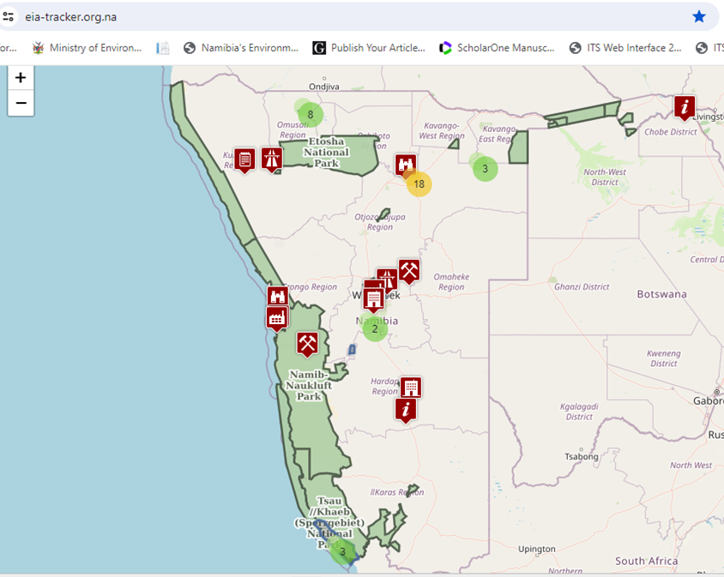
EIA Tracker
https://eia-tracker.org.na

Slide 7
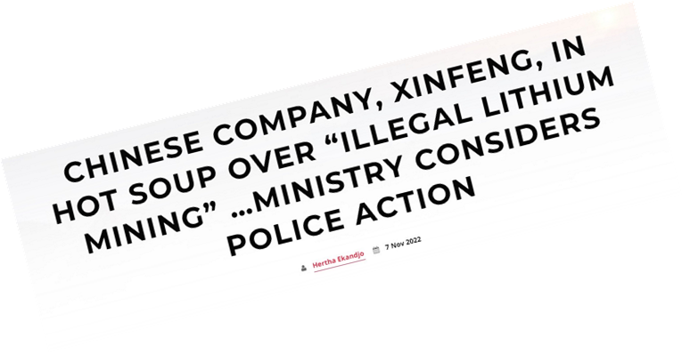
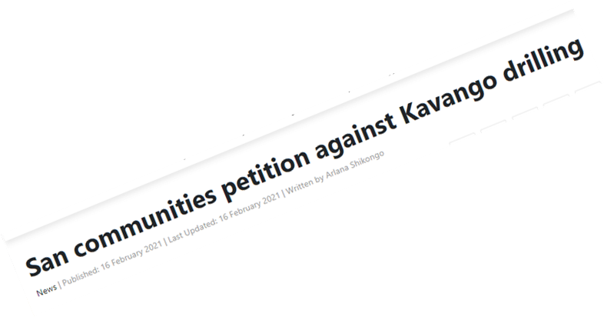
EIA Tracker Why is it necessary?
Concerns About EIA Effectiveness
Low Public Trust in the EIA Process

Slide 8
Aims of the EIA Tracker
Promote transparency
Enable public participation
Build understanding of the EIA process in Namibia
The Tracker provides a public platform
for EIA information,
enabling interested and affected parties
to shine a light on issues and concerns
that are useful for a successful EIA.

Slide 9
EIA Tracker Features
Easy access and navigation
Information displayed on an interactive Namibia map
Up-to-date EIA info from newspaper ads and DEA website
Permanent access to all relevant EIA info
Searchable database with clear spatial overview

Slide 10
EIA Tracker Features continues…
EIA data are displayed in both a map and a table.
Map layers include land uses like protected areas, biodiversity hotspots, and heritage sites.
Users can select layers to assess potential impacts on protected areas or farms.
Aligned with the Access to Information Bill, promoting proactive information sharing.

Slide 11
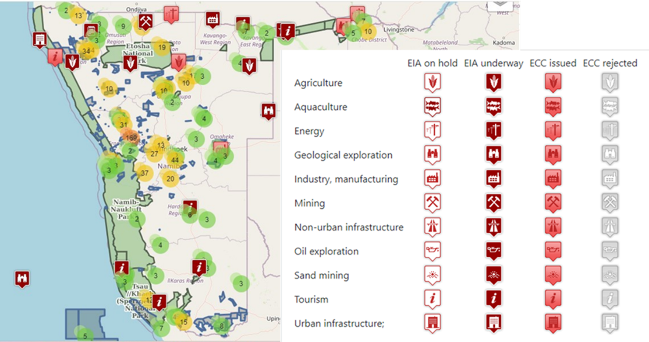
EIA Categories
https://eia-tracker.org.na

Slide 12
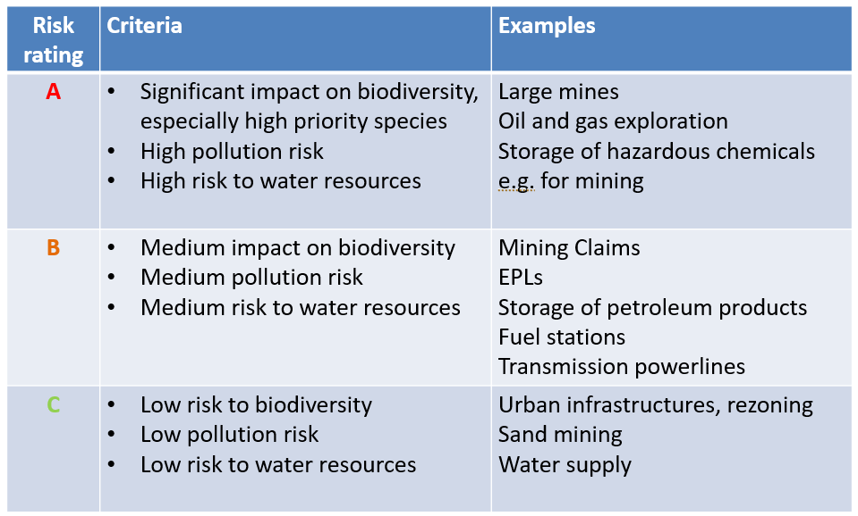
Projects Risk Ratings
Project Risk Ratings assess the potential environmental impact of projects

Slide 13
Findings from tracking EIAs
Many EIAs lack quality and fail to provide balanced information.
Public input is often minimized, and concerns from interested parties are overlooked.
EIA Practitioners lack regulated standards, unlike Engineers, Surveyors, or Doctors.

Slide 14
Professional body for EAPs
Establishing a formal Professional Council for Environmental Assessment Practitioners (EAPs)
EAPAN exists but lacks official government recognition and mandatory membership. Without legal authority, EAPAN cannot prevent poor or corrupt practices in the field.

Slide 15
CONCLUSION
The EIA Tracker provides
a public platform for EIA information,
to enhance public participation in EIAs
and improve overall environmental management
by promoting a
democratic and transparent process
for EIAs.
https://eia-tracker.org.na
https://eia-tracker.org.na
https://eia-tracker.org.na

Slide 16
THANK YOU!

