Slide 1
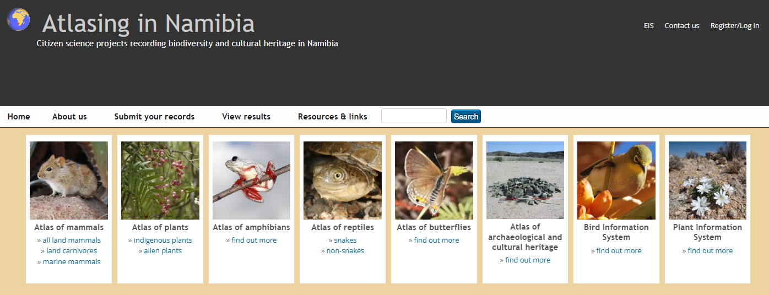
Citizen Science: Atlasing in Namibia www.the-eis.com/atlas
By Alice Jarvis

Slide 2
the-eis.com
Components:
eLibrary of resources (reports, articles, papers, datasets, shapefiles, gazettes, theses, databases etc)
Atlasing in Namibia (Citizen Science)
Namibian Journal of Environment
EIA Tracker
Photo Library
Birds & Powerlines tool
Bird Information System
Plant Information System

Slide 3
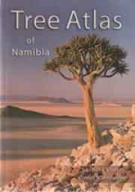
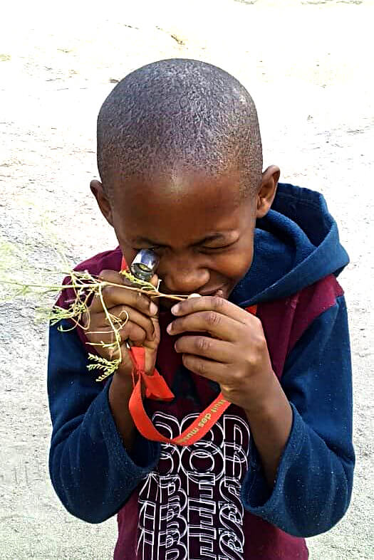
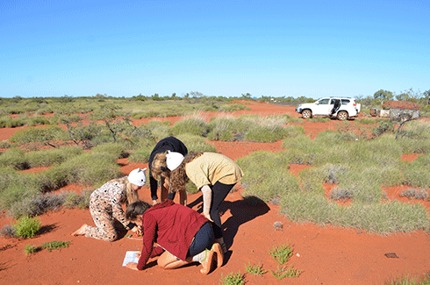
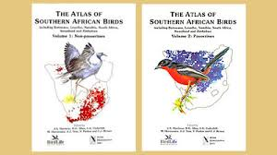
What is citizen science?
“the collection and analysis of data relating to the natural world by members of the general public, typically as part of a collaborative project with professional scientists”
Some examples in Namibia:
Southern African Bird Atlas Project – BirdLasser app
Tree Atlas Project
Raptor Road Counts
Giraffe Spotter
Baboon Spider atlas
Bird Ringing

Slide 4
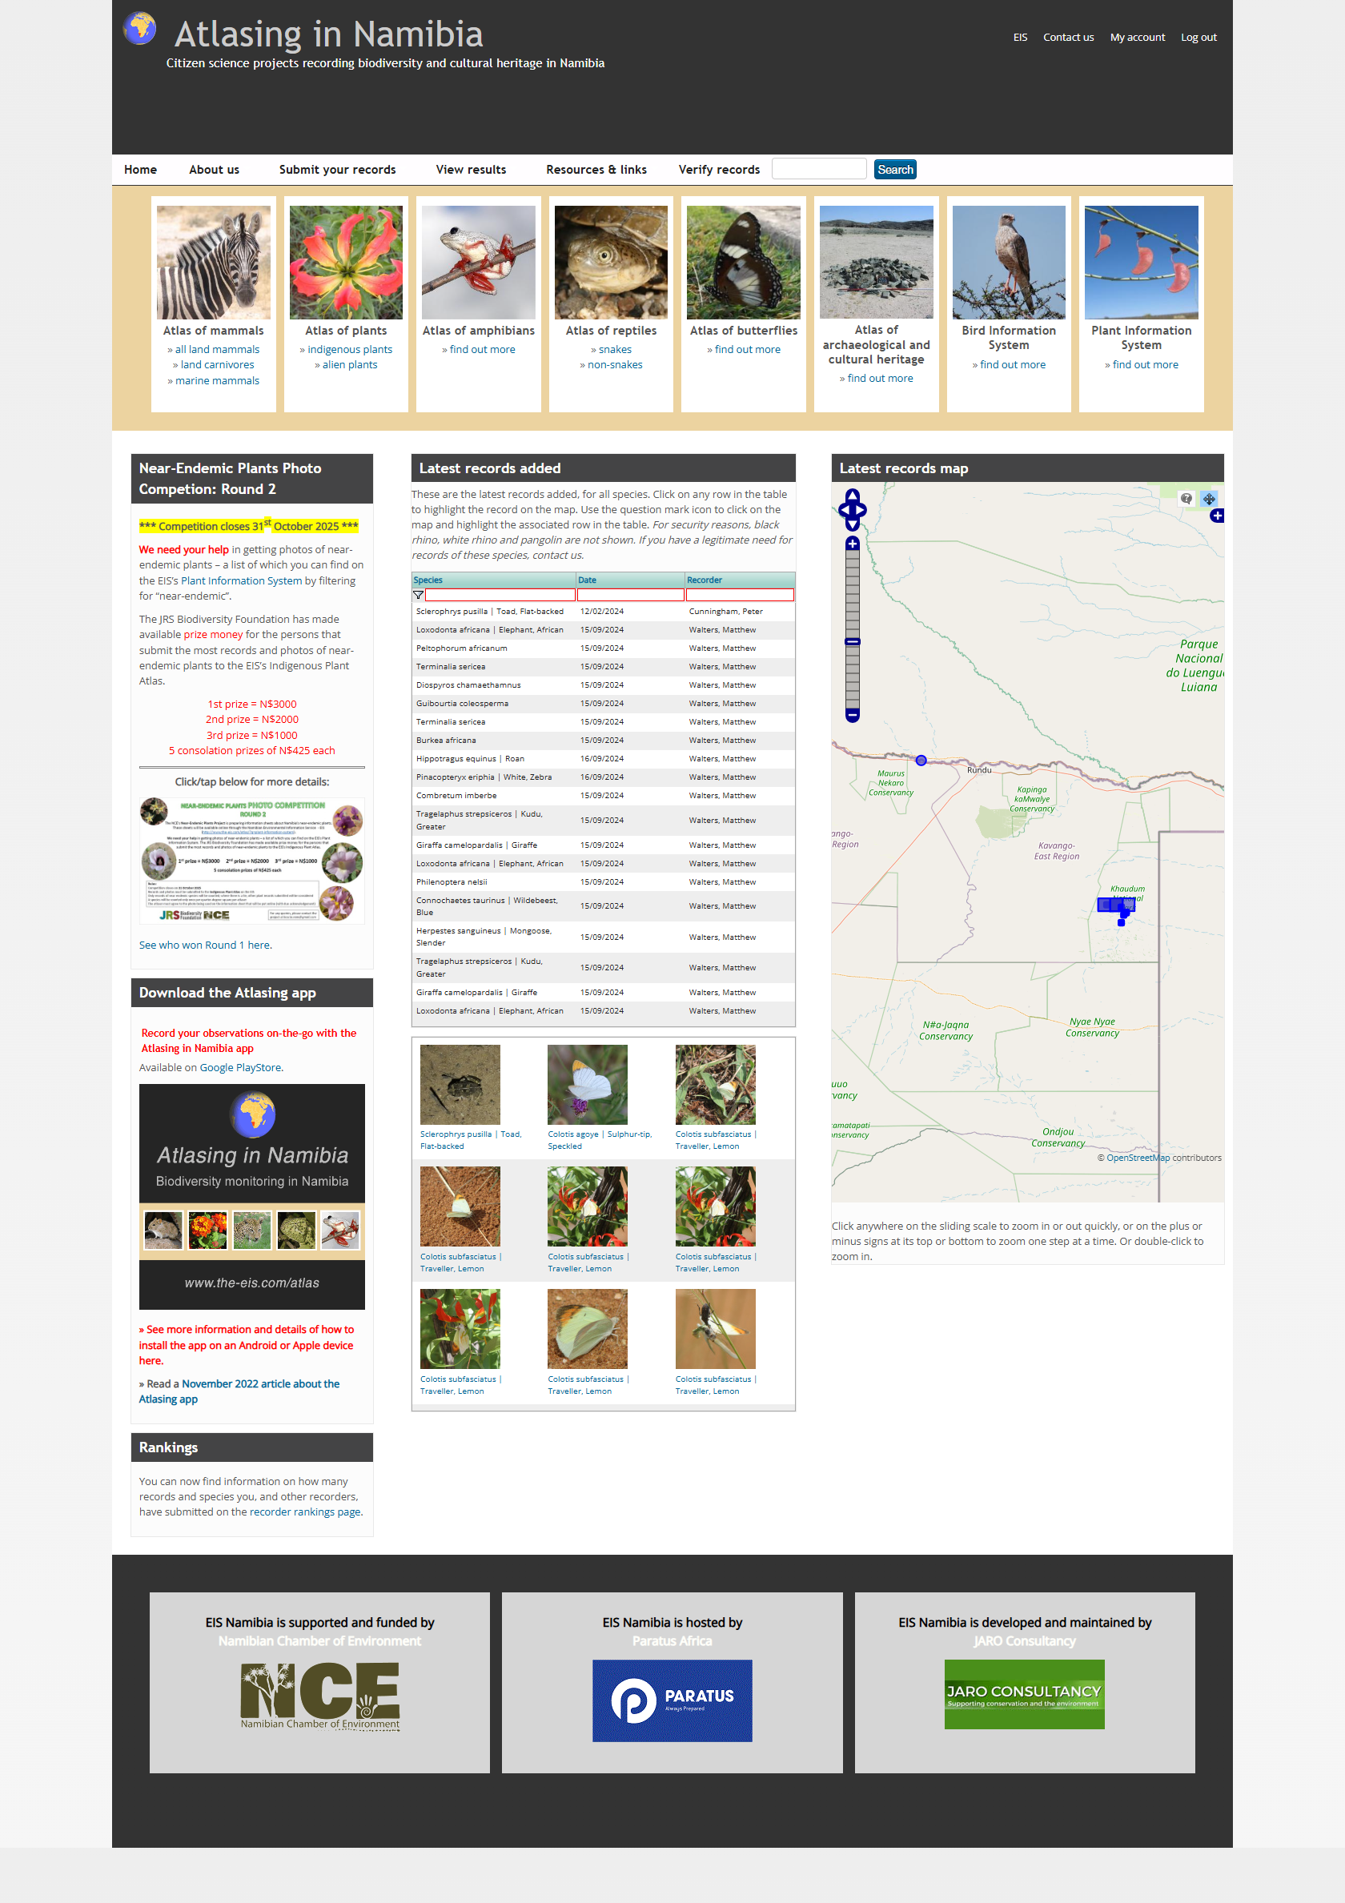
the-eis.com/atlas
Atlasing in Namibia
Citizen science programmes for biodiversity recording:
Mammals (terrestrial and marine)
Snakes
Other reptiles
Indigenous plants
Alien plants
Frogs & toads
Butterflies
Dragonflies & damselflies
Breeding birds
Archaeological & cultural heritage

Slide 5
Why record biodiversity? Some uses and outputs
Baseline distribution data
Education and awareness
Monitoring range expansions and contractions
Tracking alien species and their spread
Assessing impacts of infrastructure (e.g., roads, fences)
Understanding species status and breeding success
Identifying priorities for conservation efforts
Informing Environmental Impact Assessments (EIAs)
Guiding new development projects
The Red Data Book of Carnivores
made extensive use of citizen science data

Slide 6
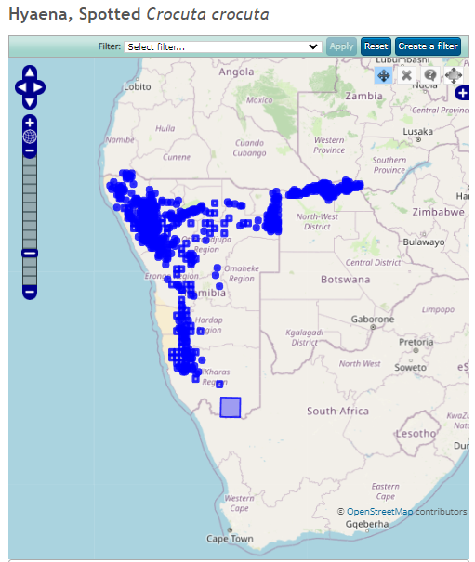
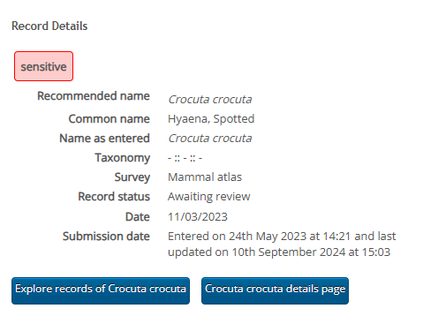
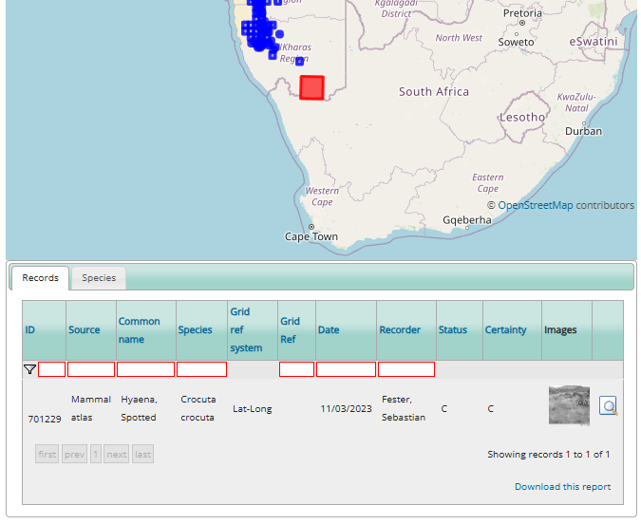
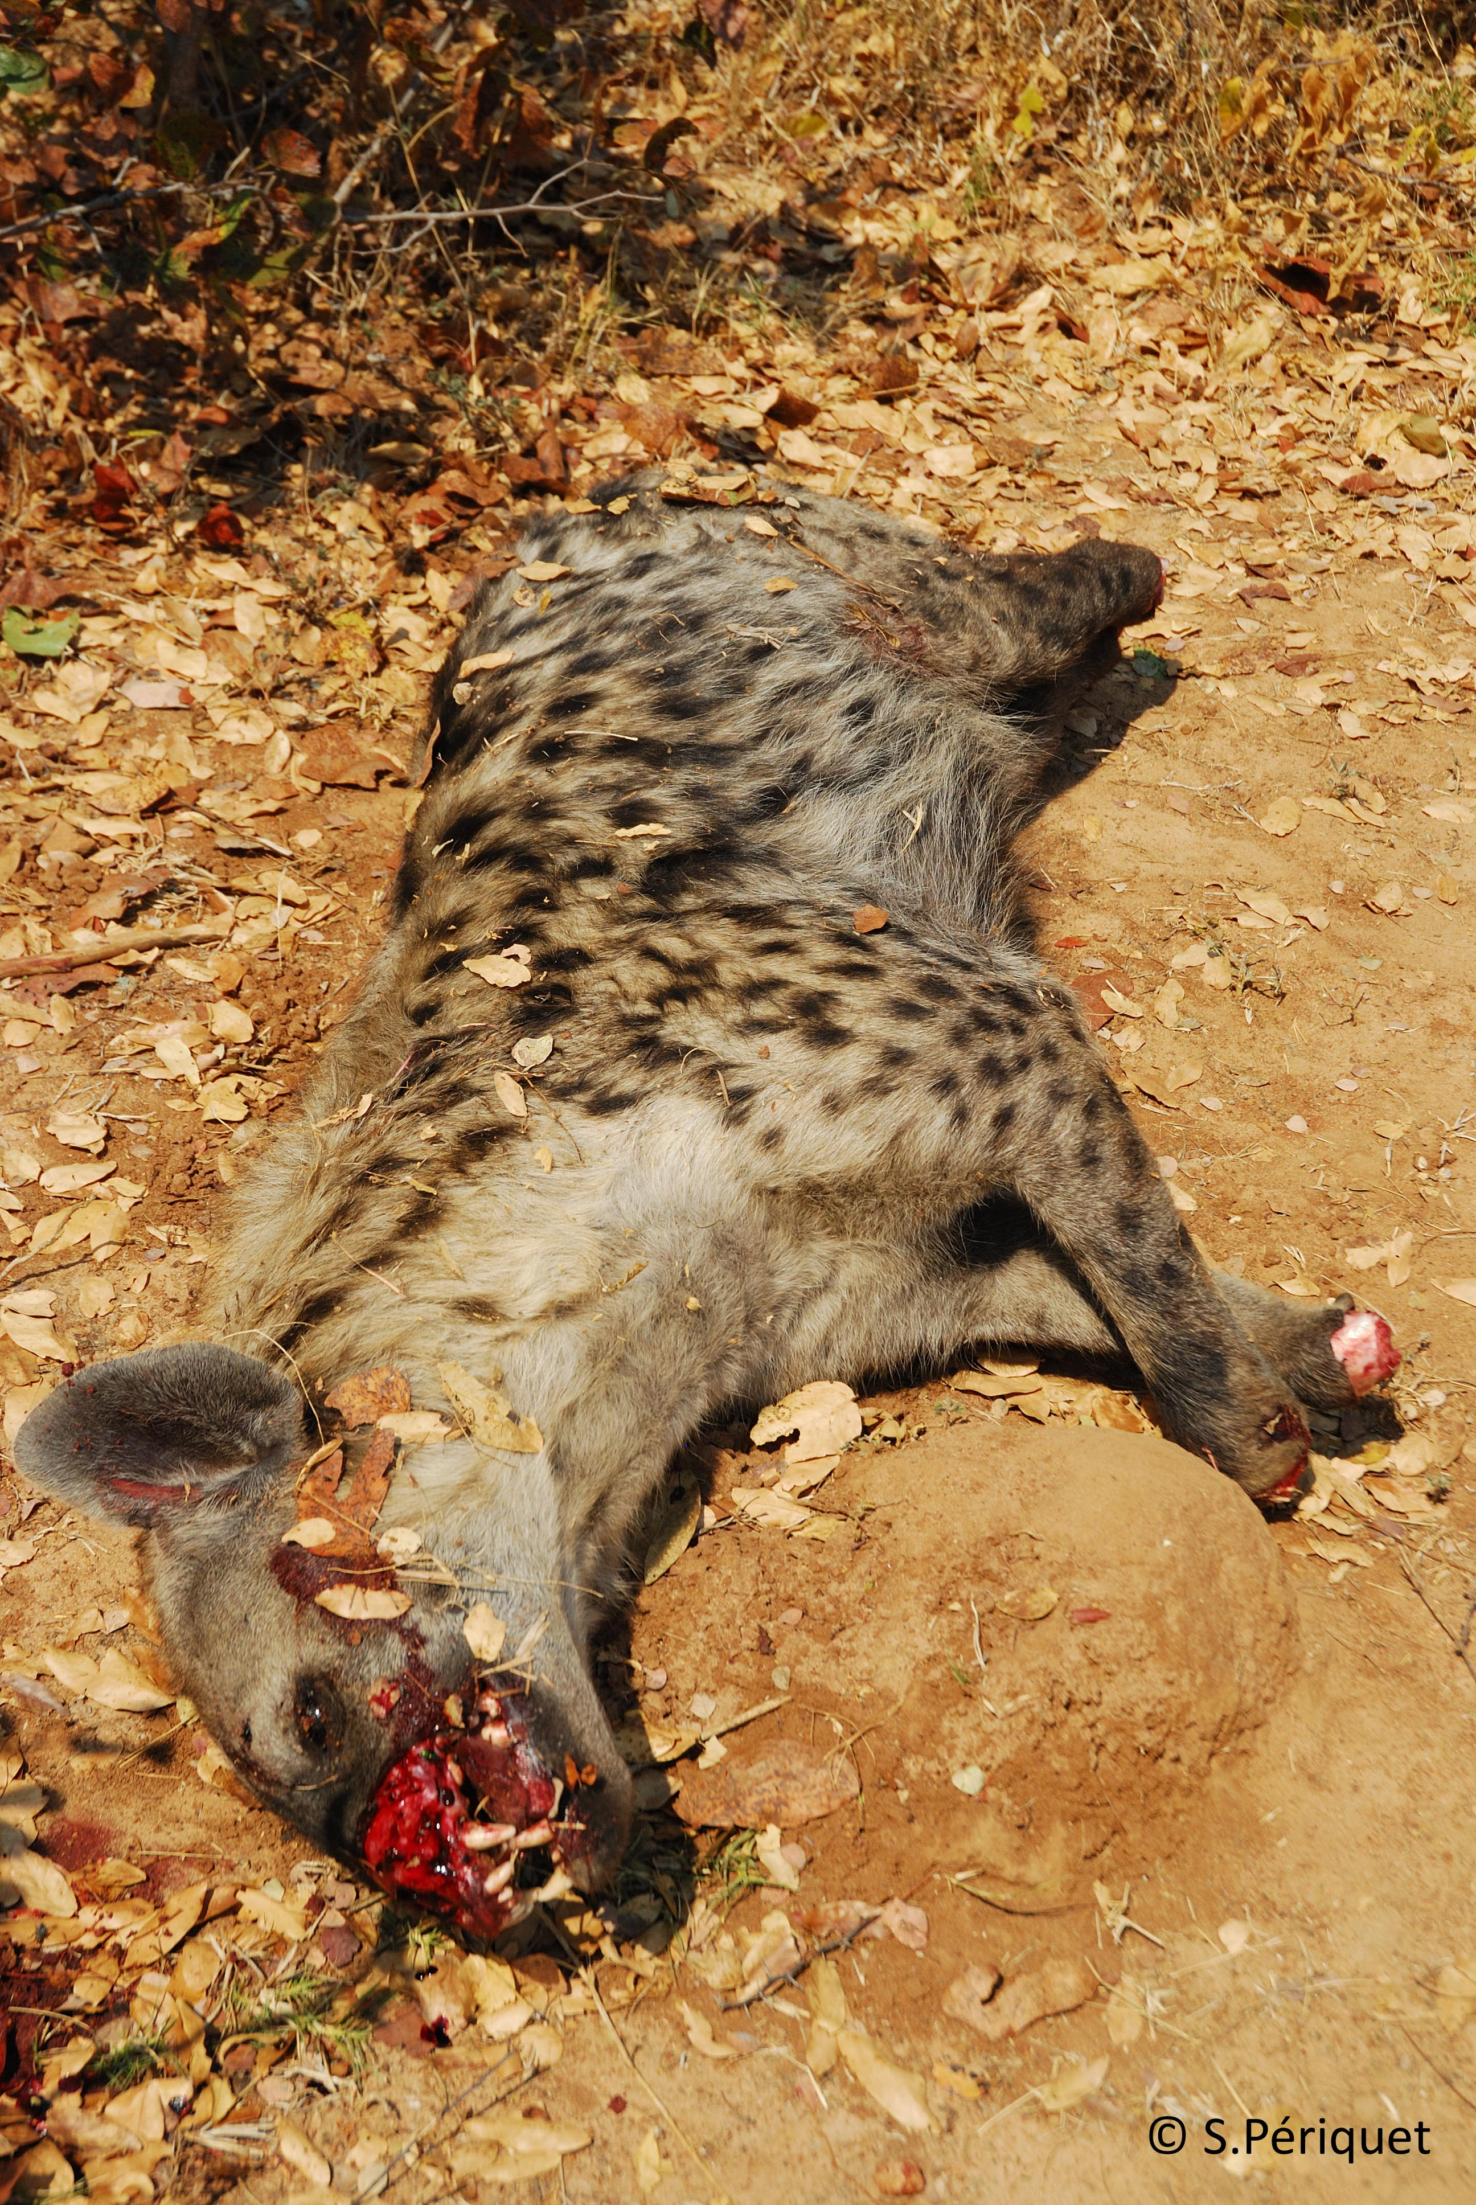
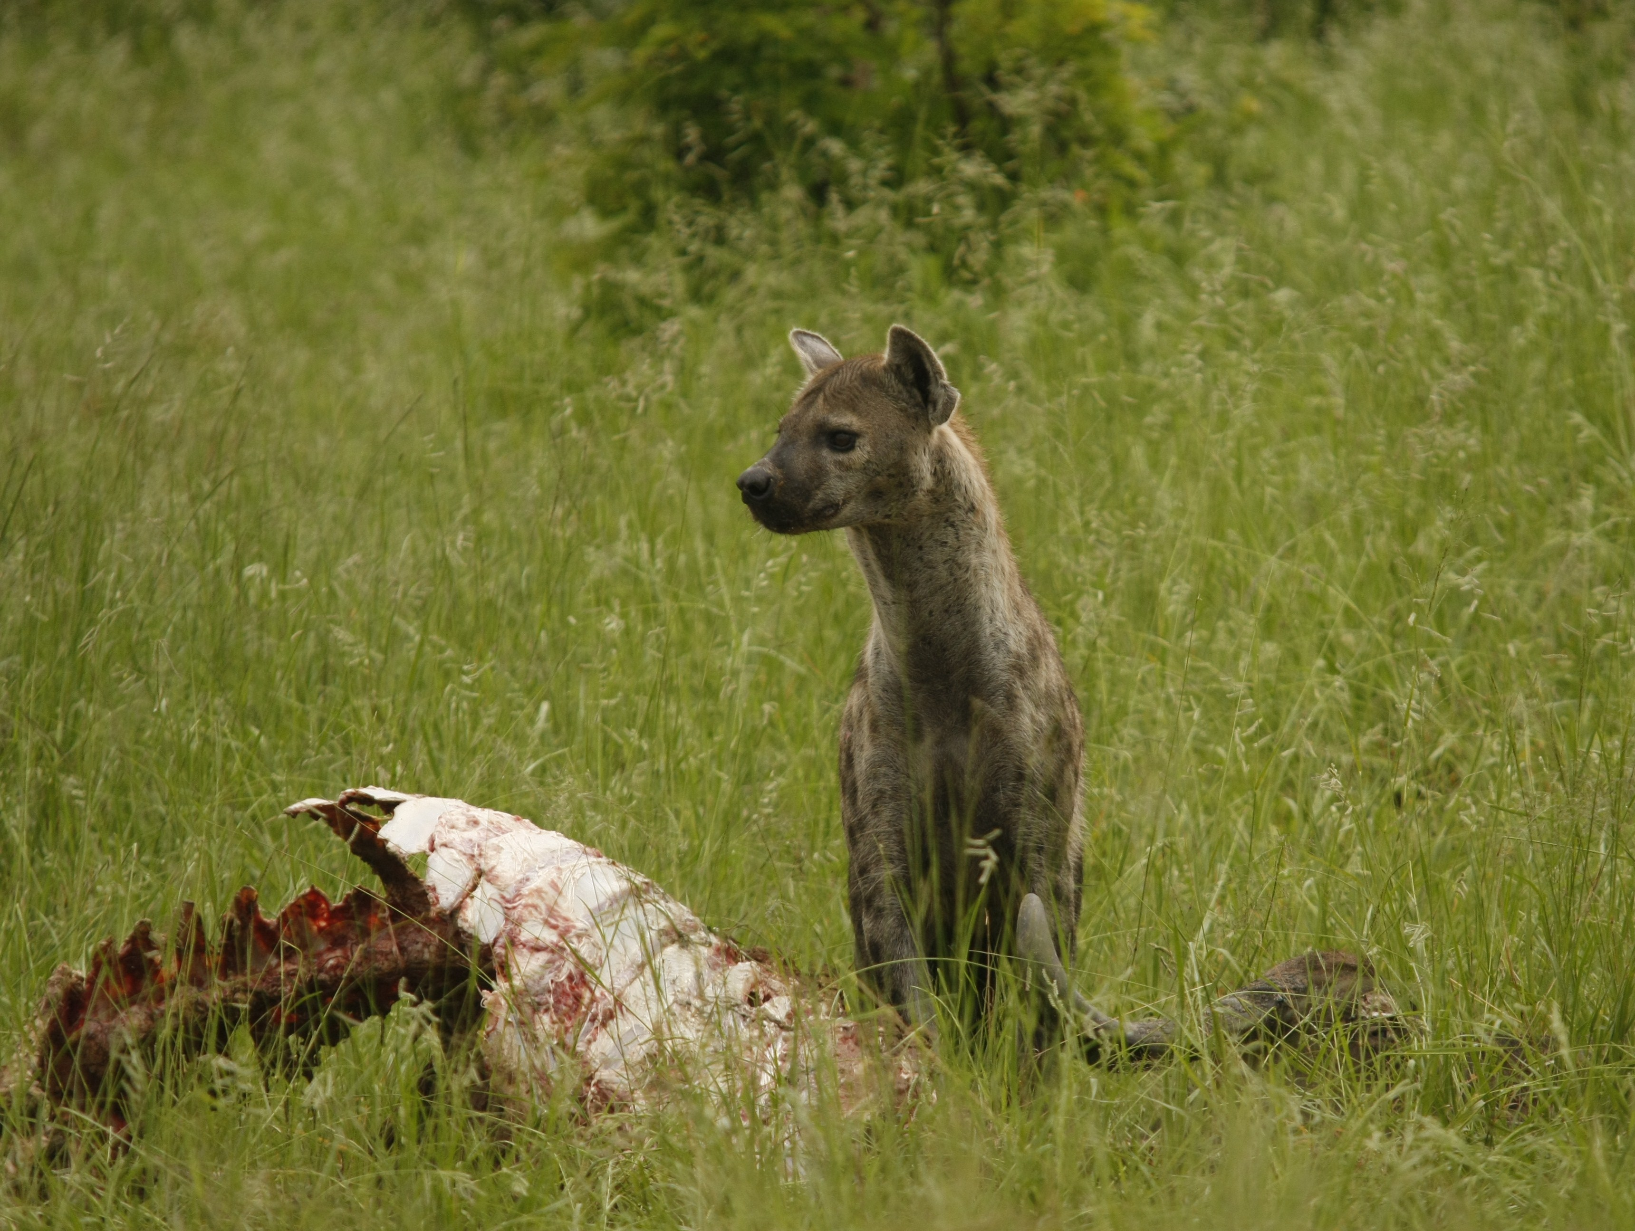
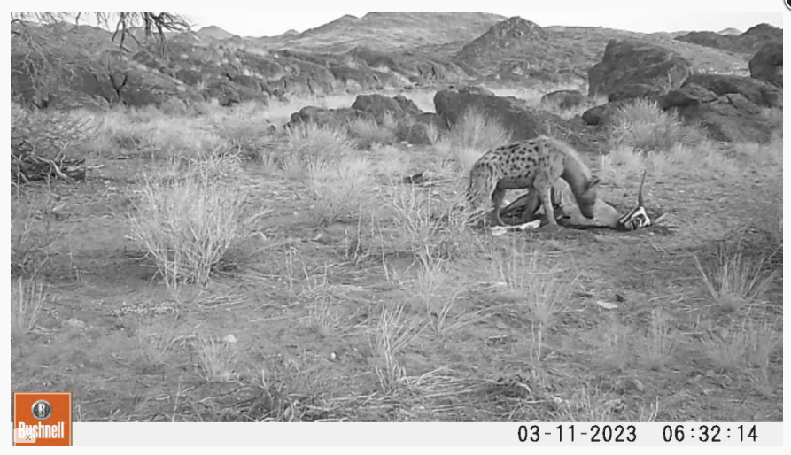
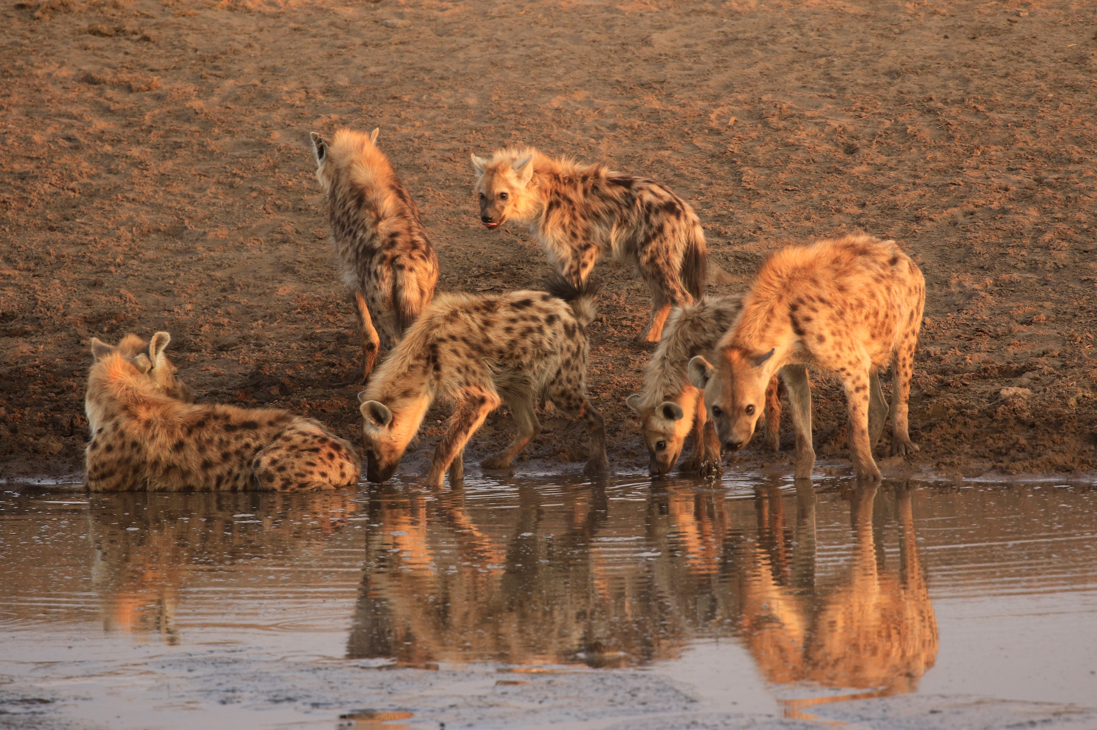
Why record biodiversity? An example
Indigenous Namibian carnivore.
Conservation status in Namibia: Vulnerable
Threatened by persecution and retaliation, trade in body parts, road kill etc

Slide 7
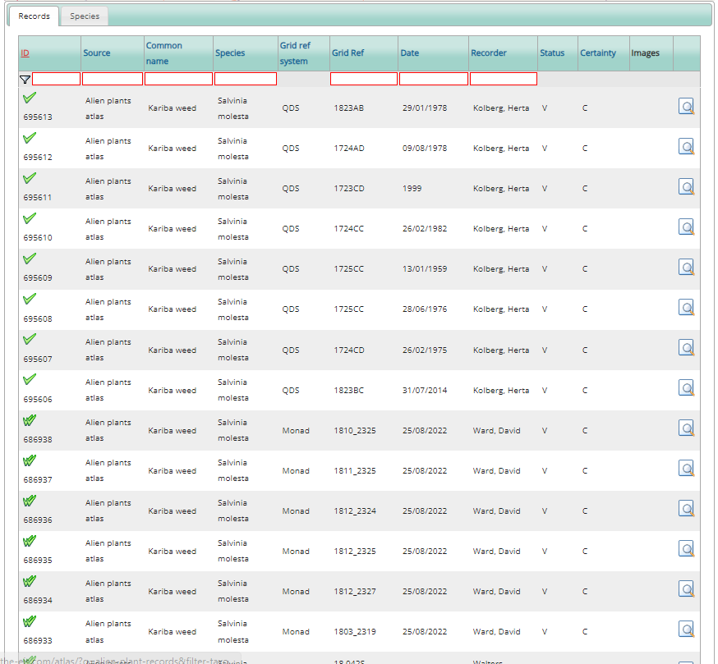
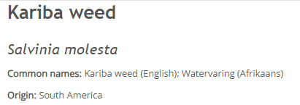
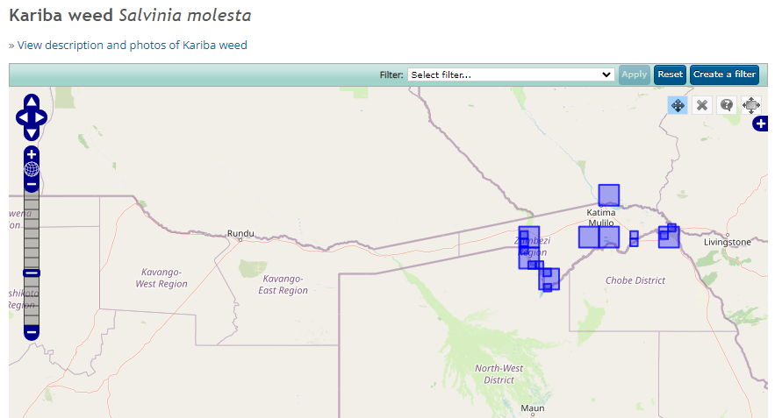
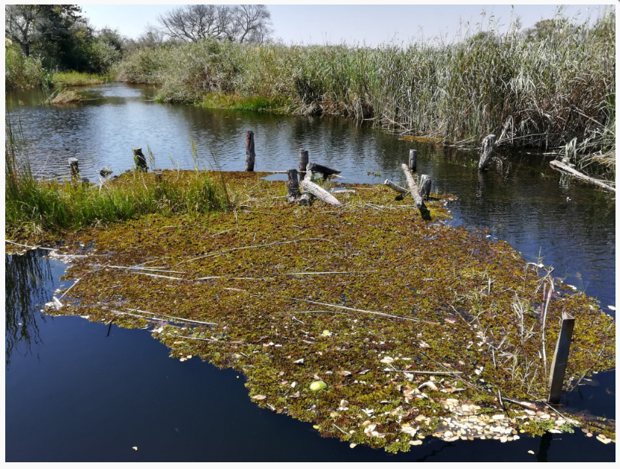
Why record biodiversity? An example
invasive alien plant from South America
infests large areas of standing and slow-moving water
forms dense mats which reduce water flow, light and oxygen, resulting in stagnant, dark environments
reduces biodiversity and abundance of freshwater species altering wetland ecosystems and causing wetland habitat loss
threatens socio-economic activities e.g. fishing, hydro-electricity generation

Slide 8
Other potential uses?
What does ChatGPT say…?
Enhancing biodiversity monitoring
Early detection of threats to ecosystems
Building local awareness of conservation
Preservation of archaeological sites
Cultural heritage education
Supporting sustainable tourism development
Engaging youth in science and education
Improving resource management
Contributing to global scientific databases
Strengthening community resilience
etc

Slide 9
Citizen Science: Atlasing in Namibia
How do I contribute…?
Register on the website and submit records there
Register on the website then submit records on the App

Slide 10
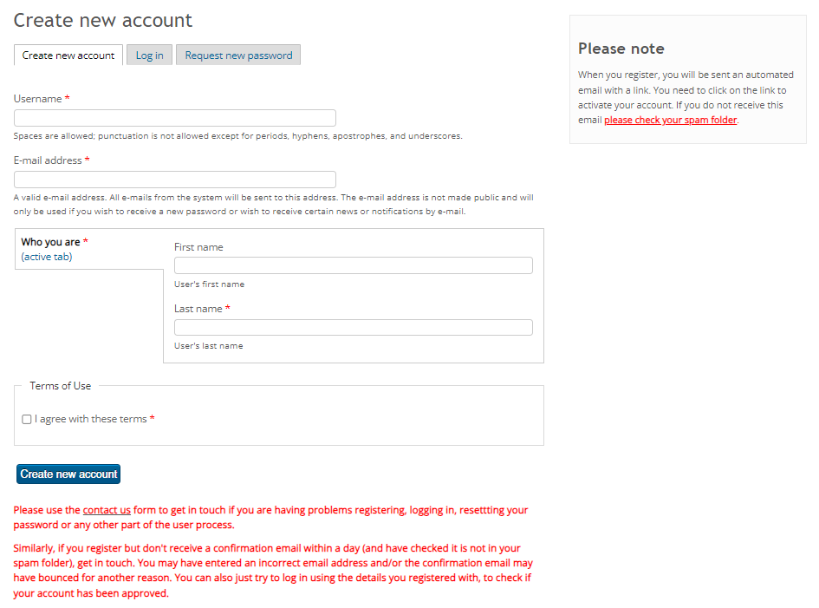
Register on the website…

Slide 11
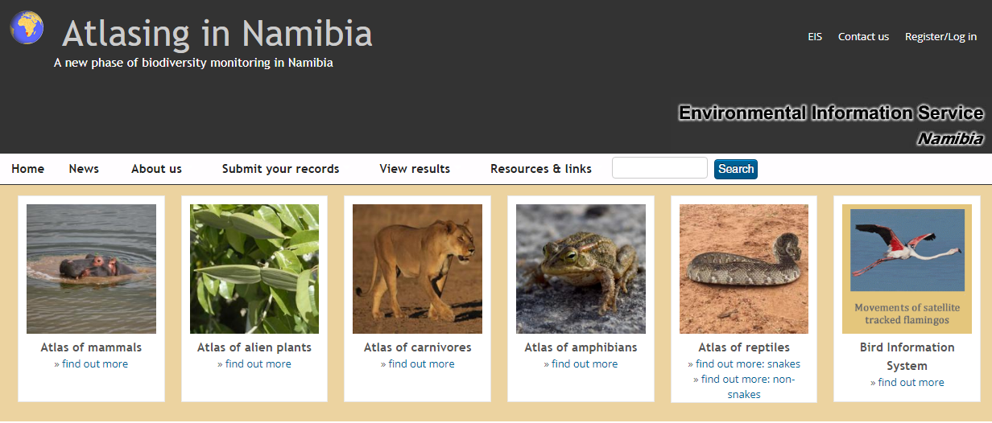
Citizen Science: Atlasing in Namibia
How do I contribute…?
Register on the website and submit records there
Register on the website then submit records on the App

Slide 12
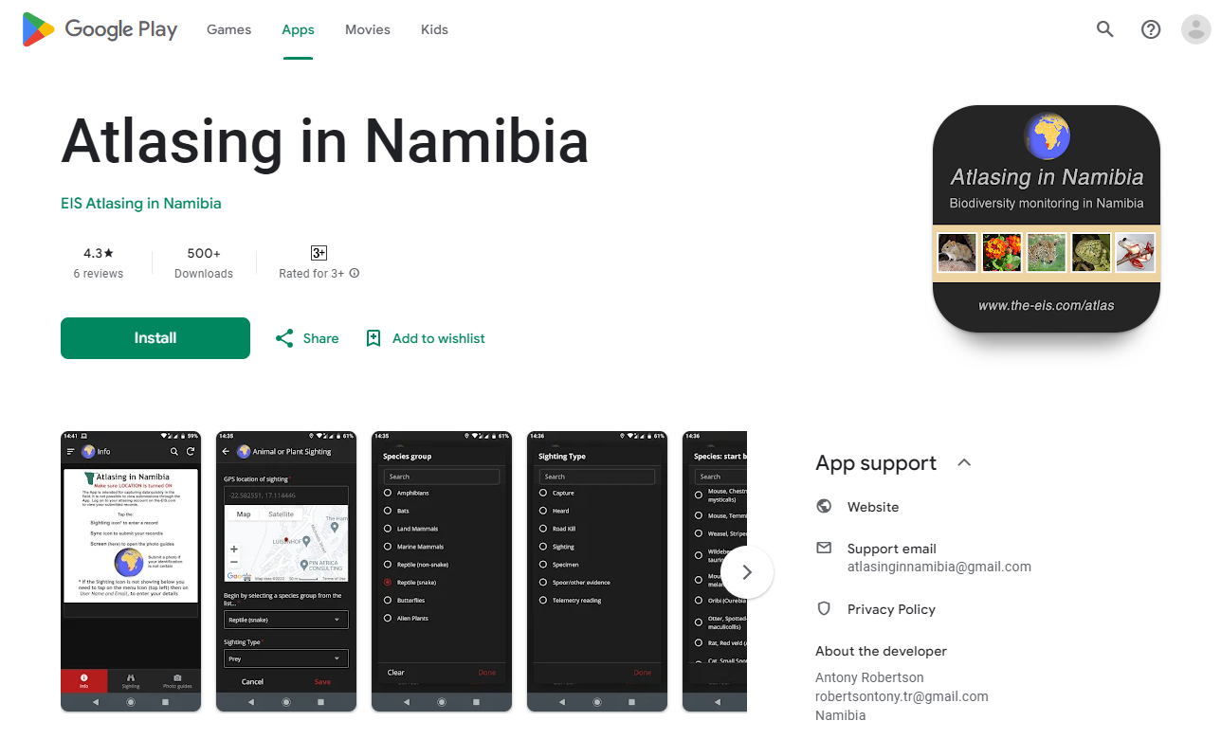
Install the App and submit records there
On your device:
Find the Atlasing in Namibia app on Play Store
Click on Install. Allow it to have access to your location and camera
Once successfully installed, you will see a new icon on your device's homepage which says "Atlasing"
For iPhones and iPads: the app is downloaded via a link on the website. Full details are here:

Slide 13
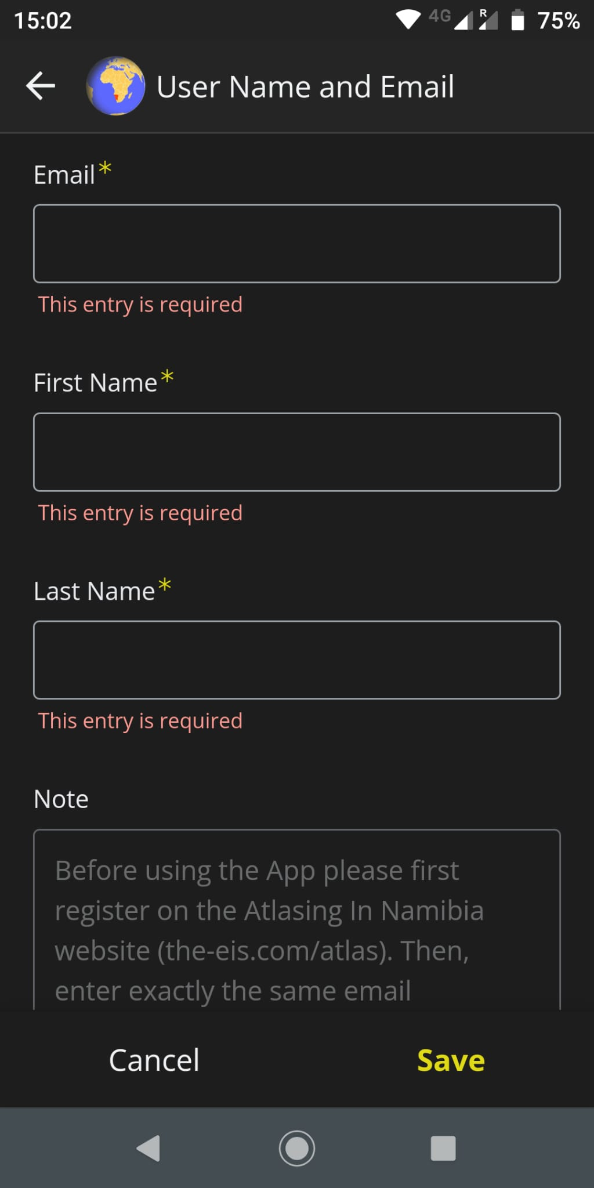
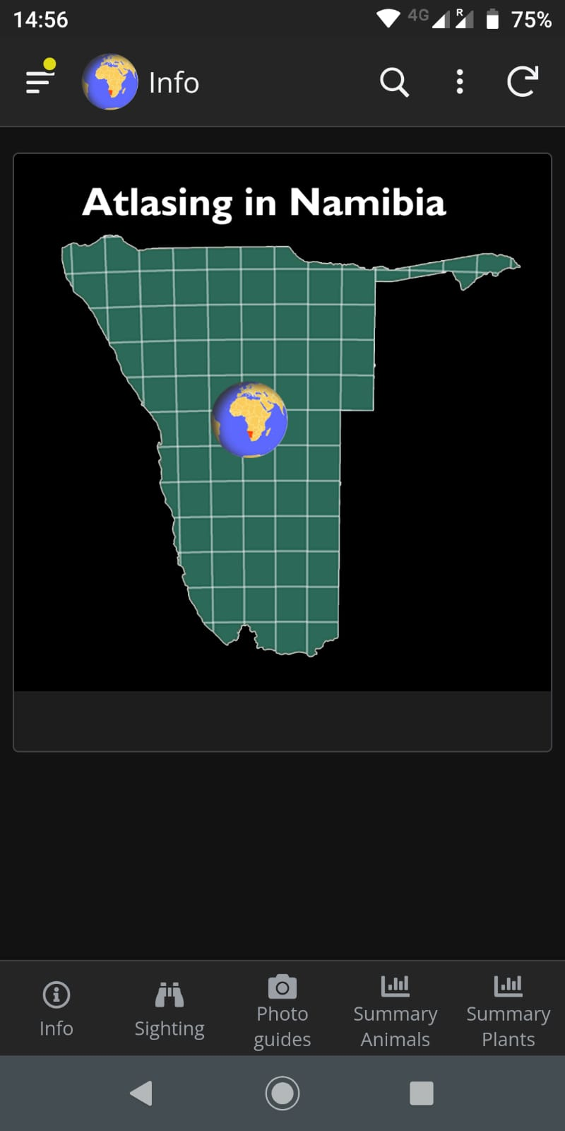
Open the app. Fill in your name and email and click on Save. You only need to do this once - the first time you open the app after you install it.
Use the same first and last name, and email address that you used on the website so we can attribute all of your records to you.
If you want to change this at any time, you can click on the menu icon

Slide 14
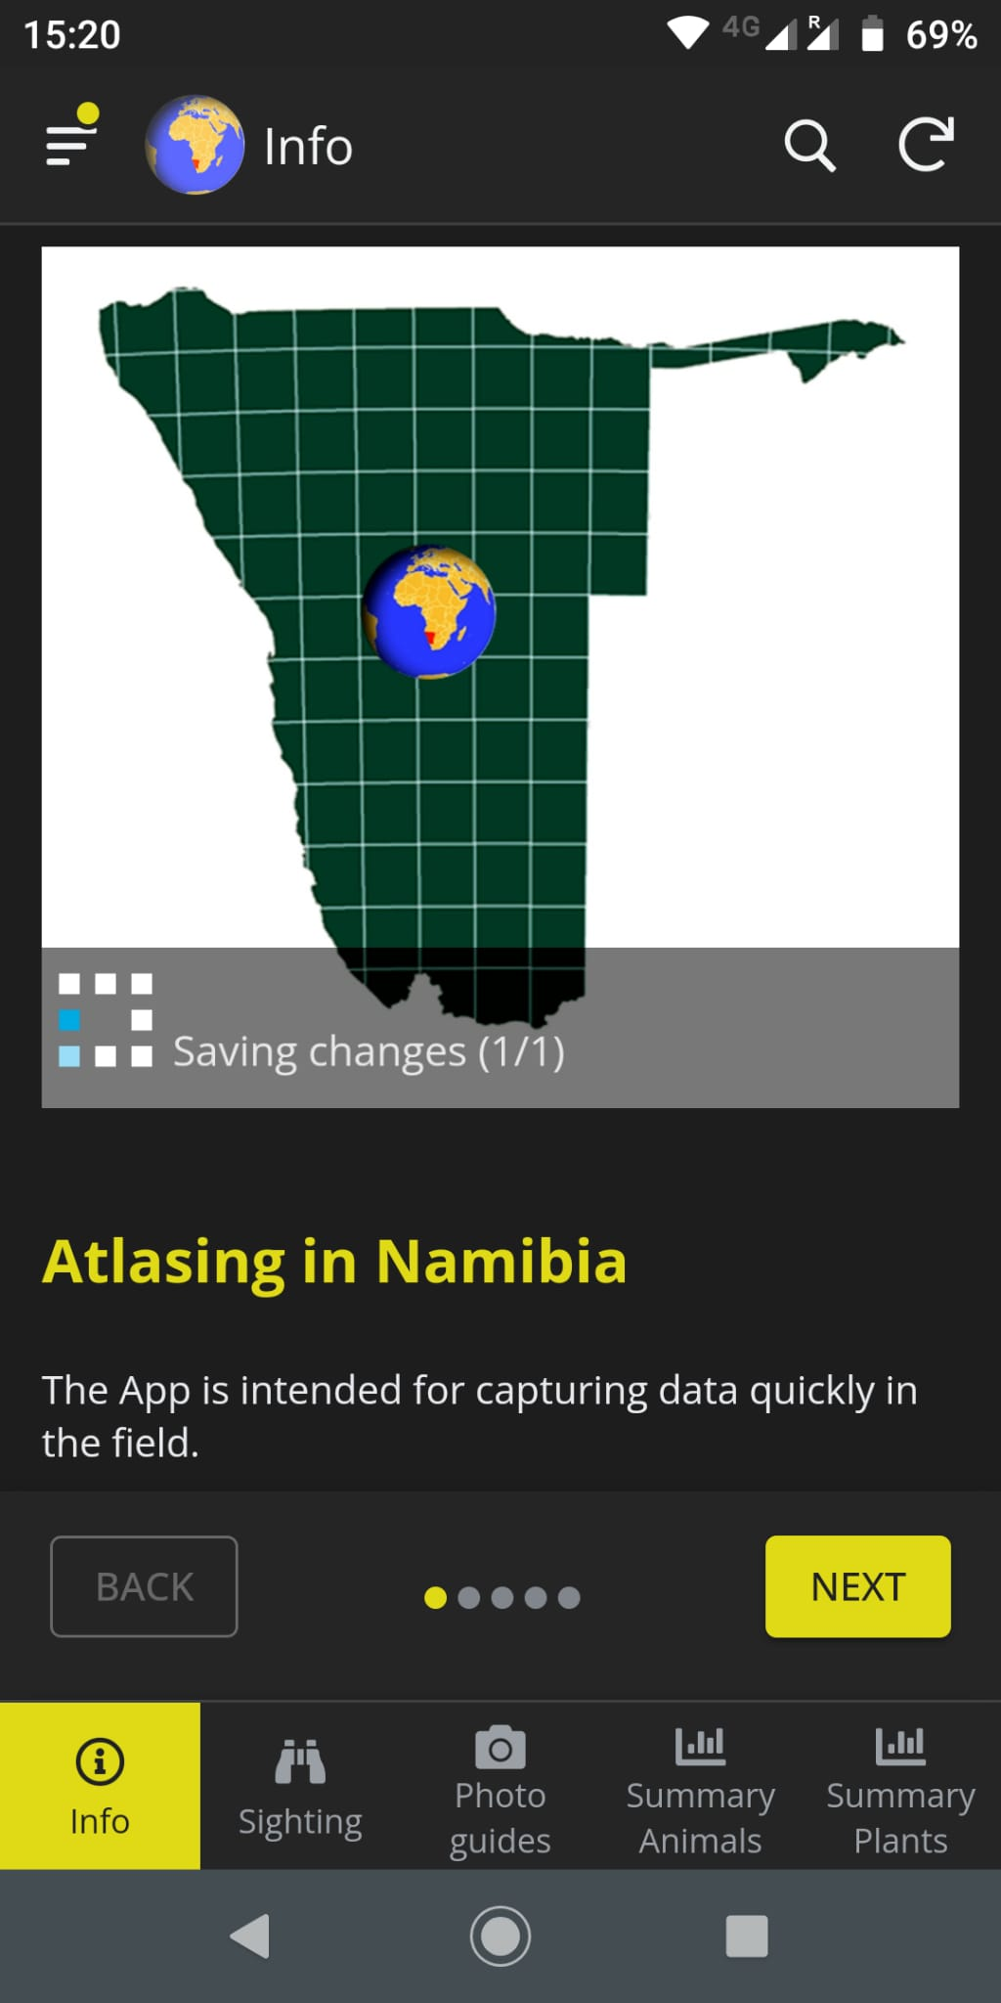
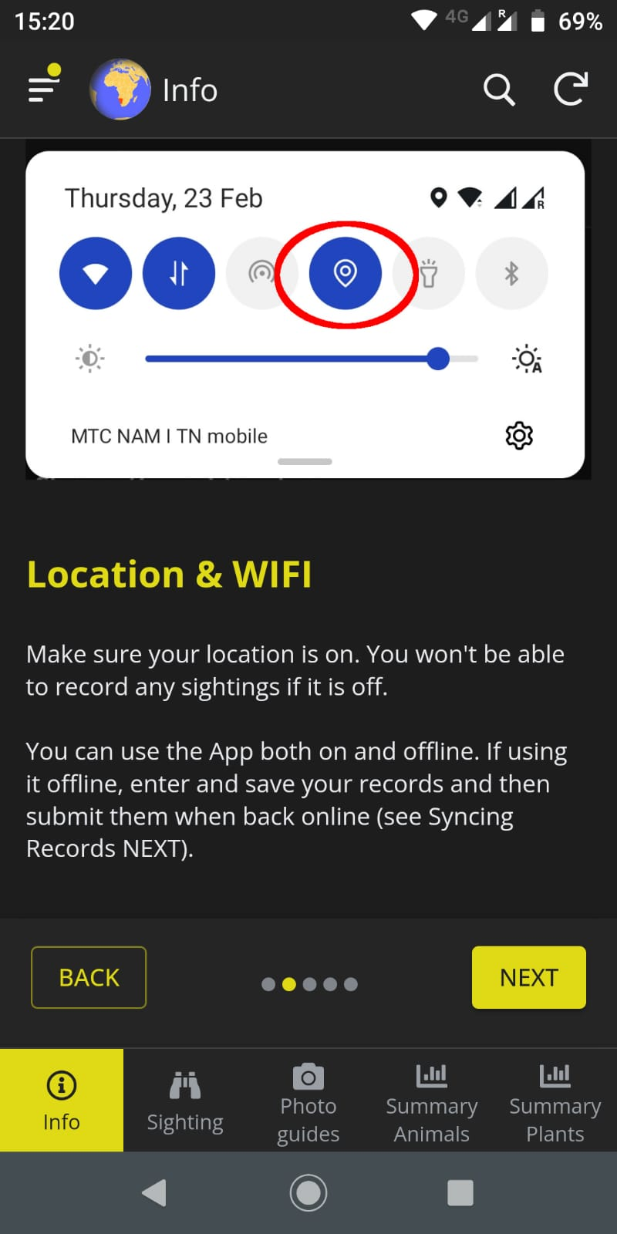
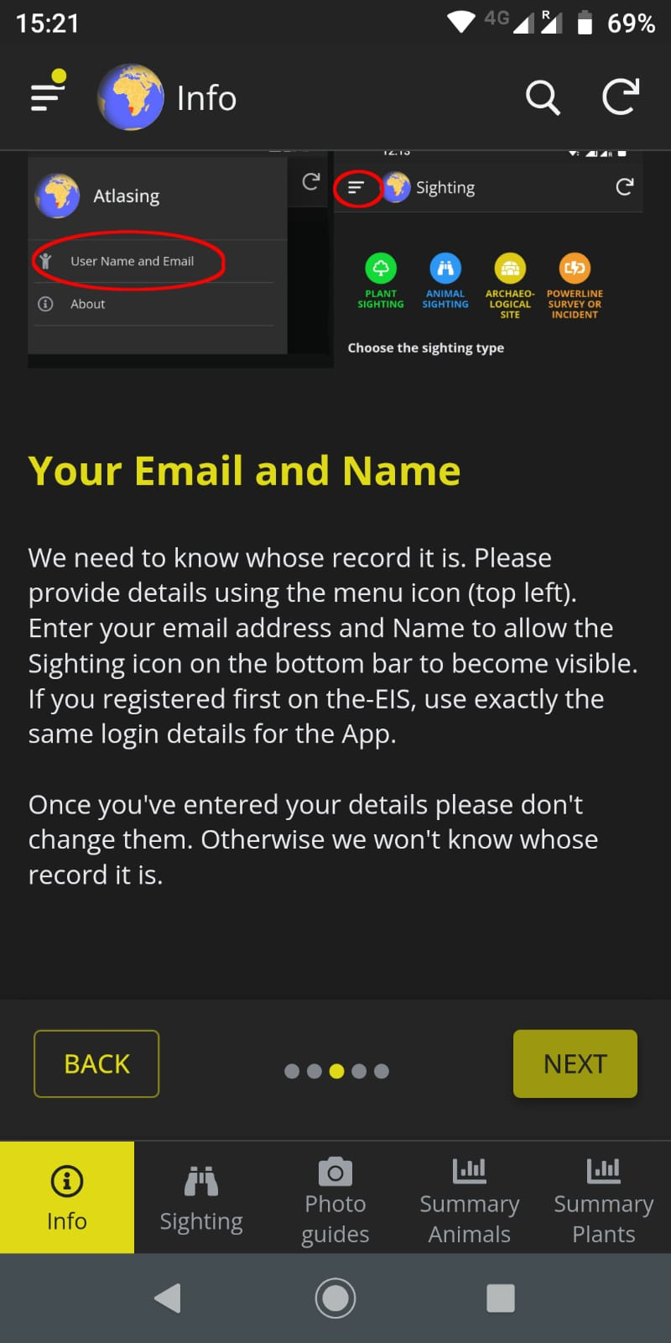
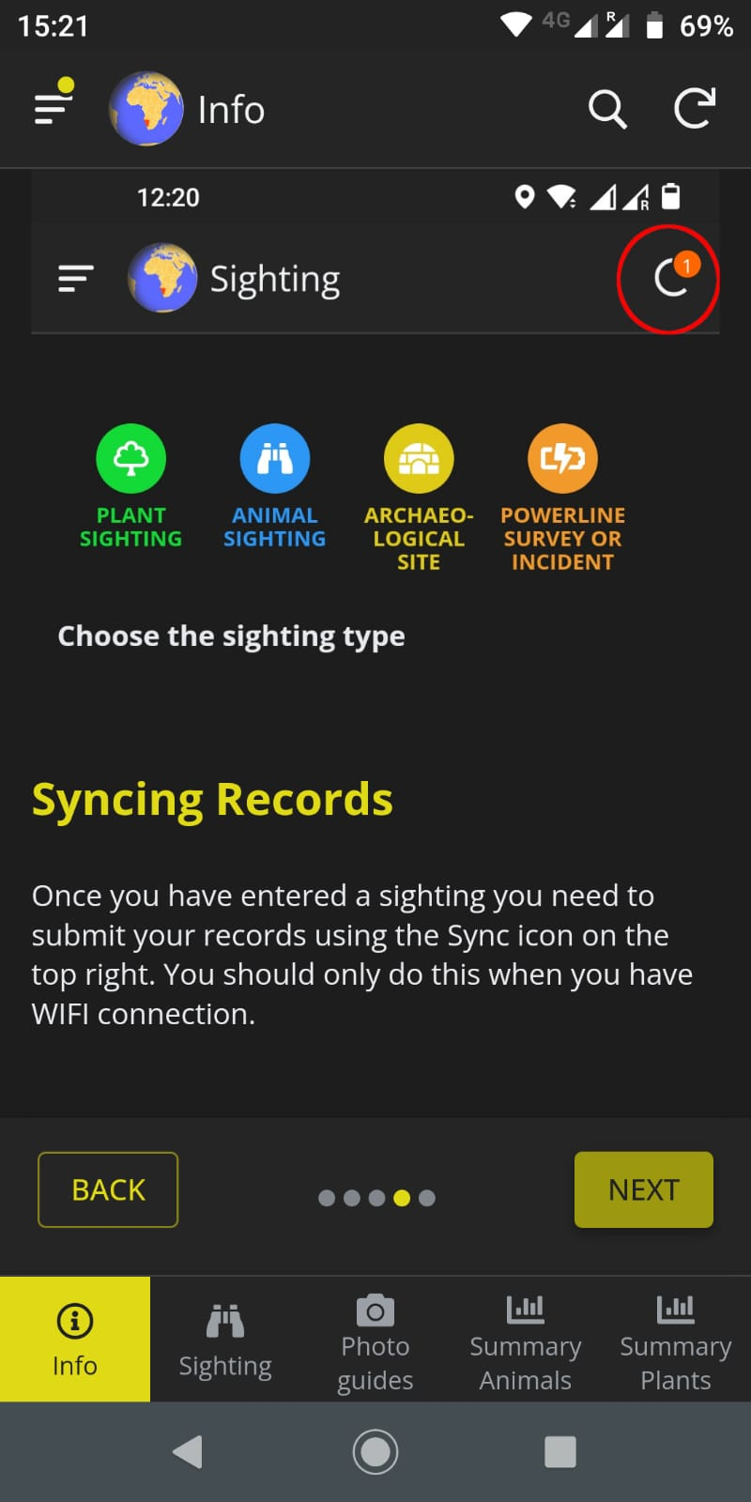
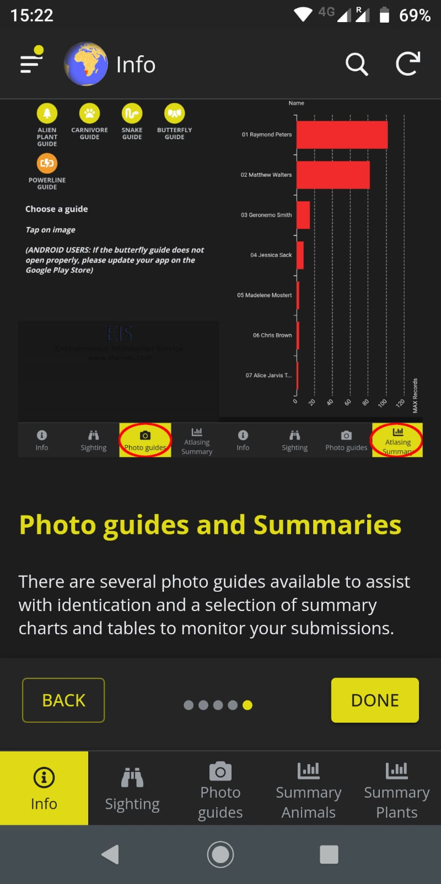
Using the App
You don't need to be online (connected to the internet) to use the app but you do need to have your device's GPS switched on.
Tap the “Info” icon to go through the 5 info screens that tell you about the app.

Slide 15
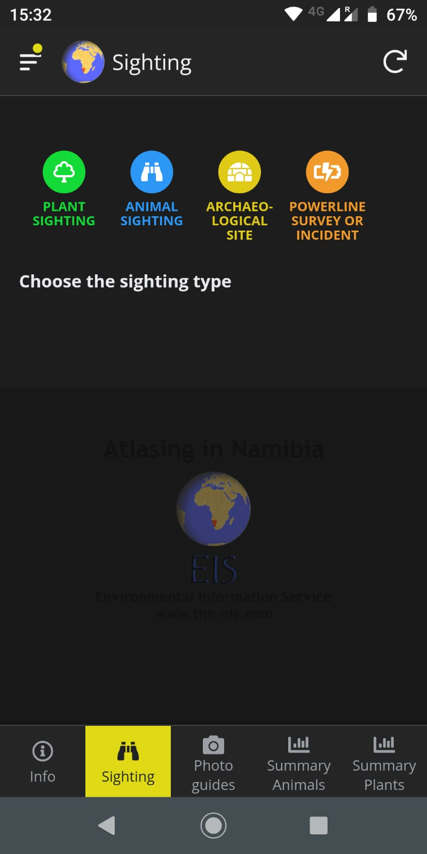
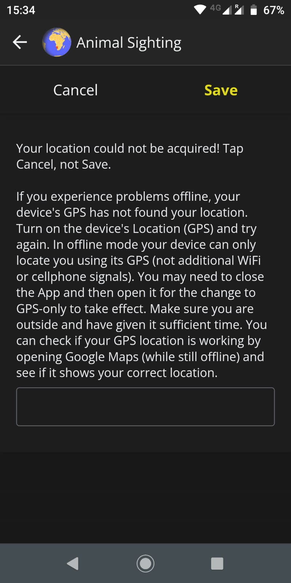
You don't need to be online (connected to the internet) to use the app but you do need:
to have your device’s GPS switched on
to have given the app permission to use Location

Slide 16
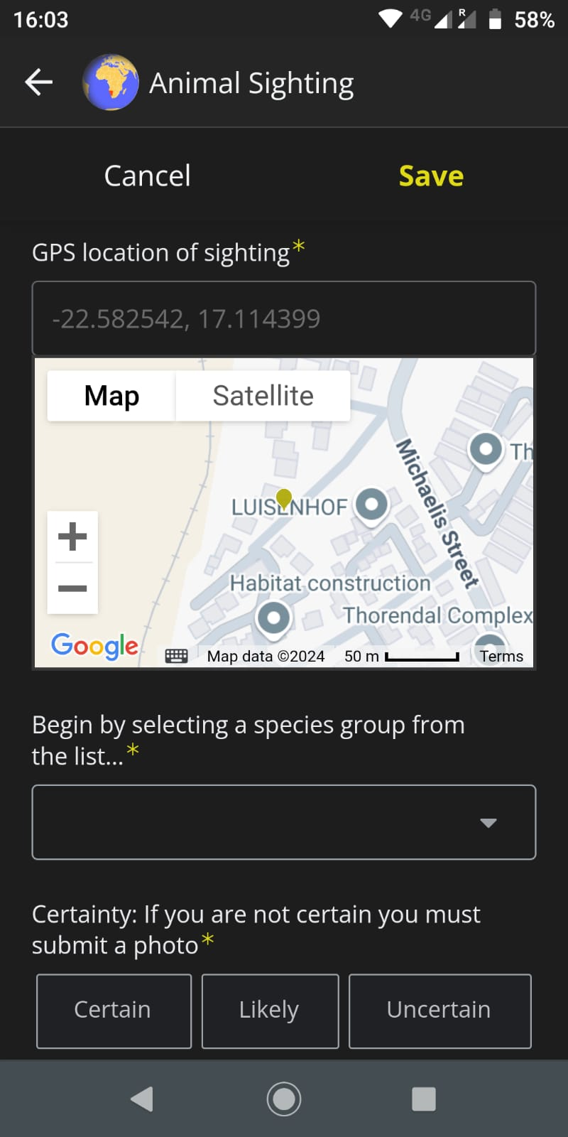
Record sightings any time even if you don’t have an internet connection

Slide 17
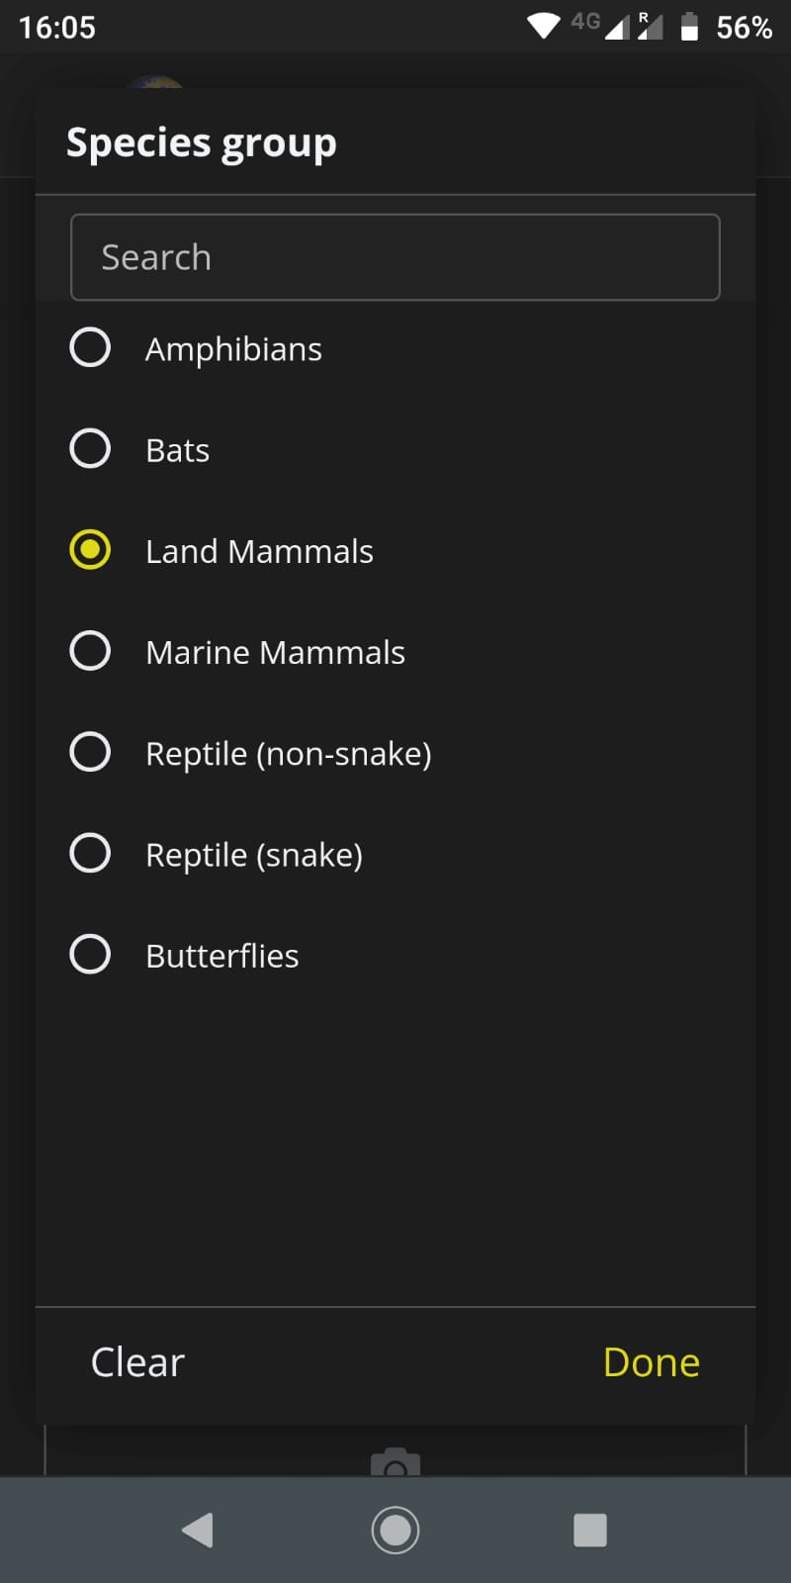

Slide 18
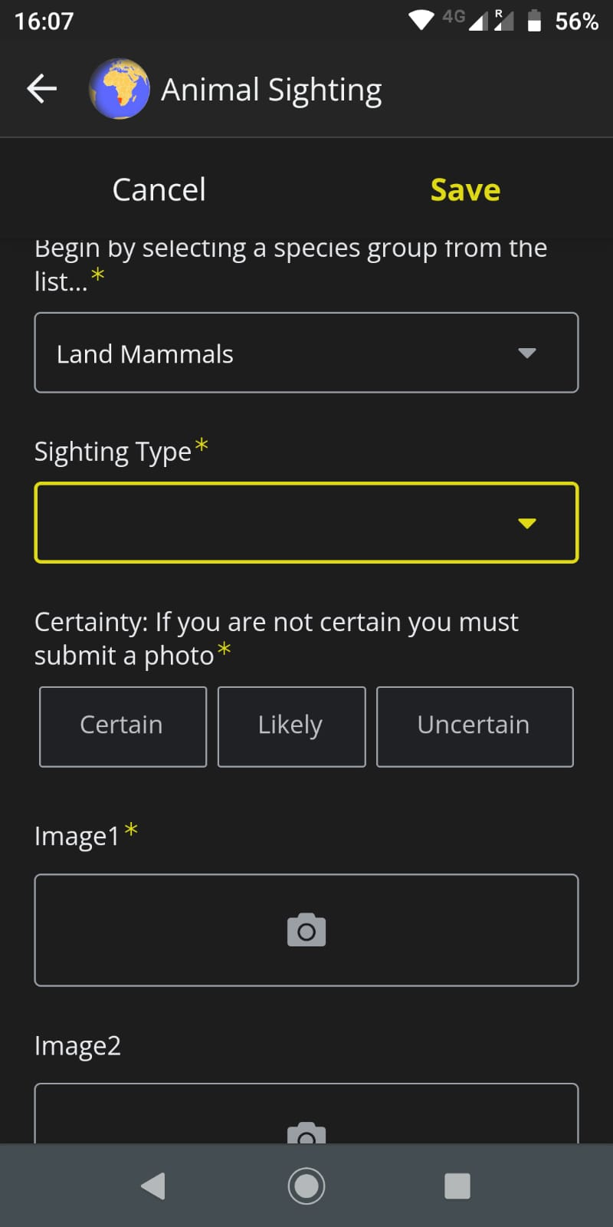
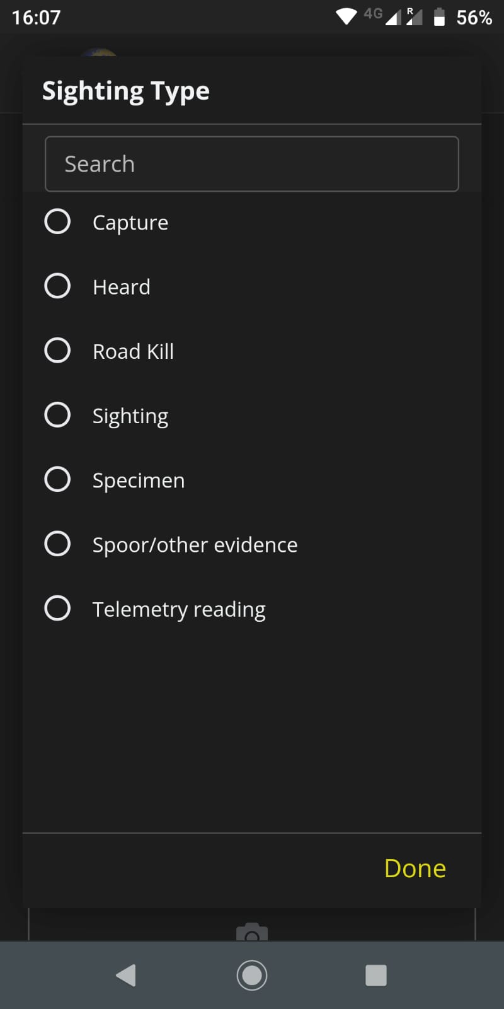

Slide 19
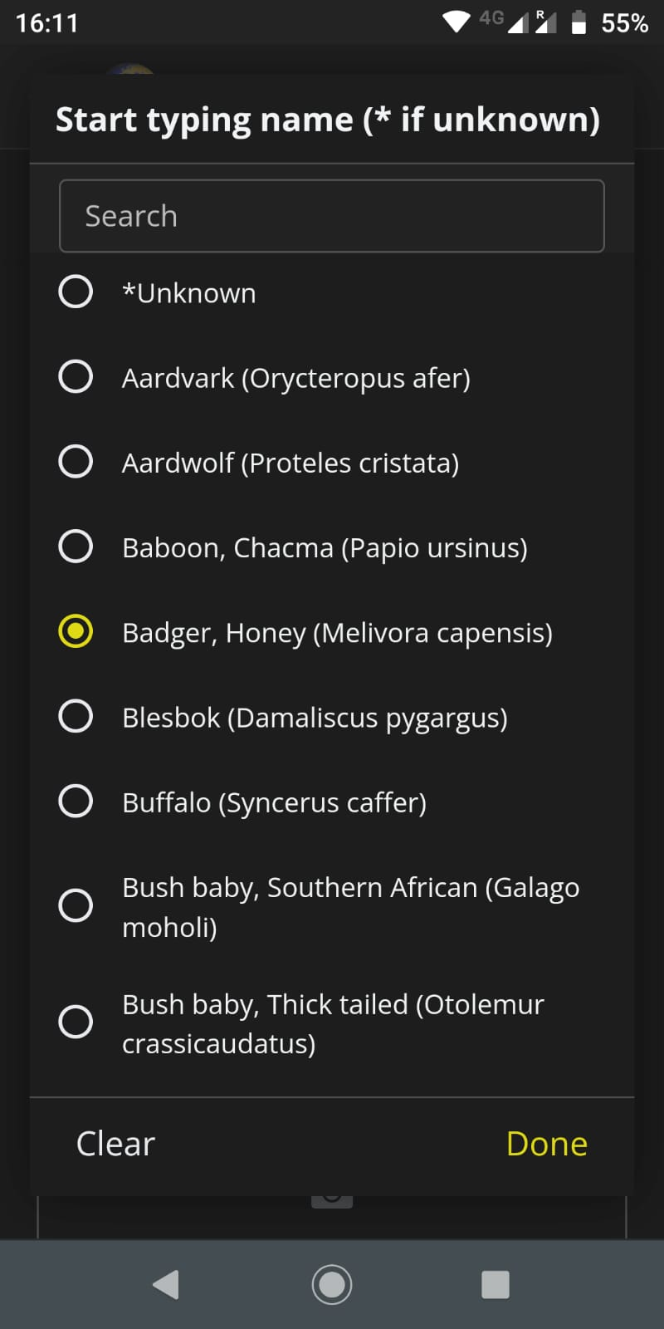
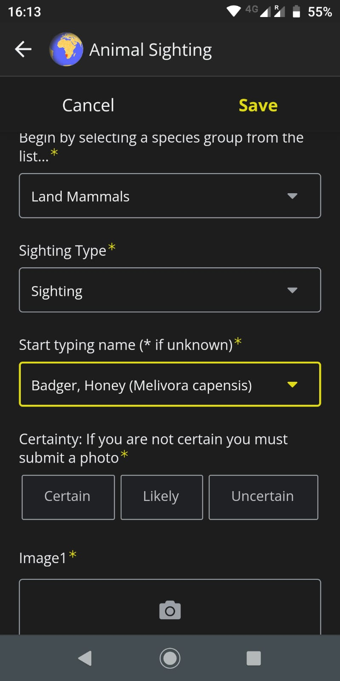
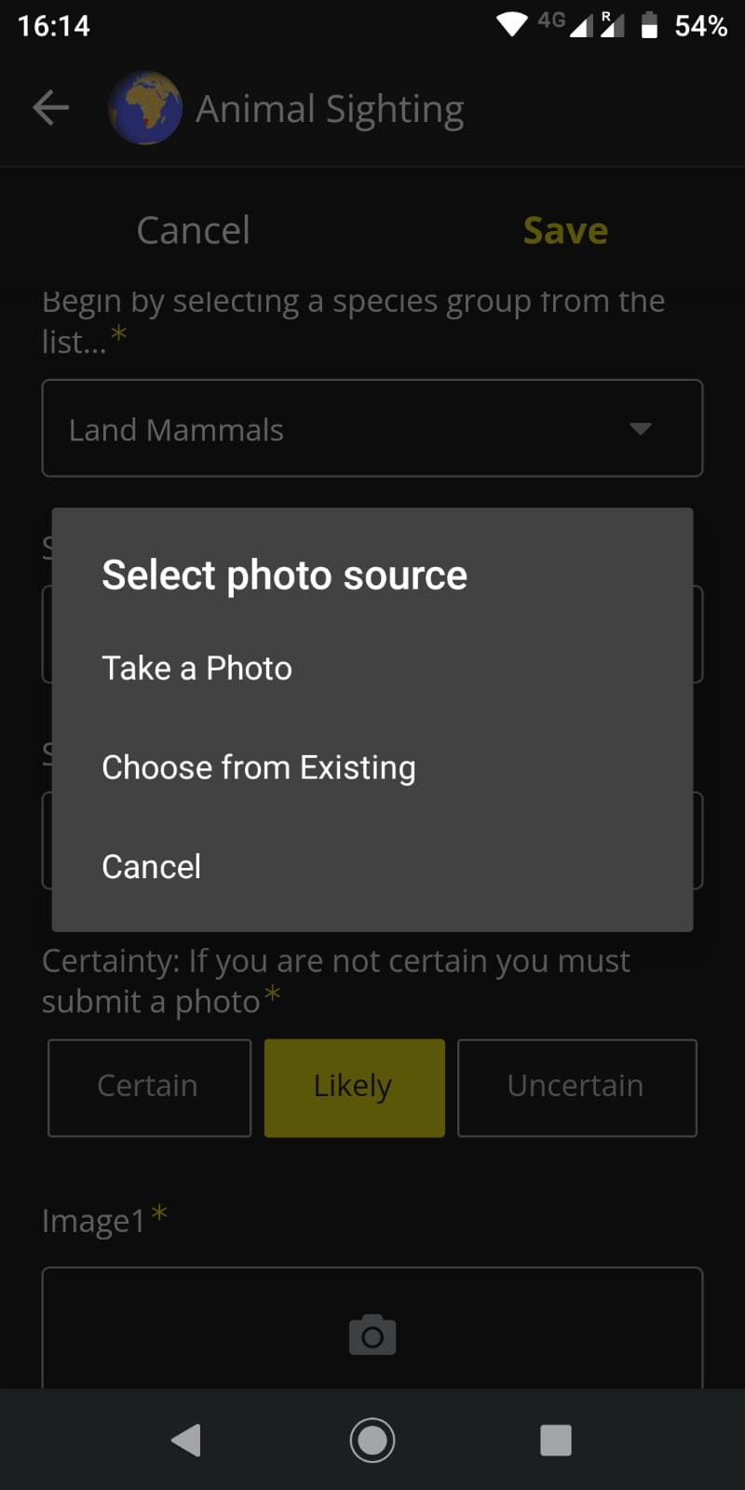

Slide 20
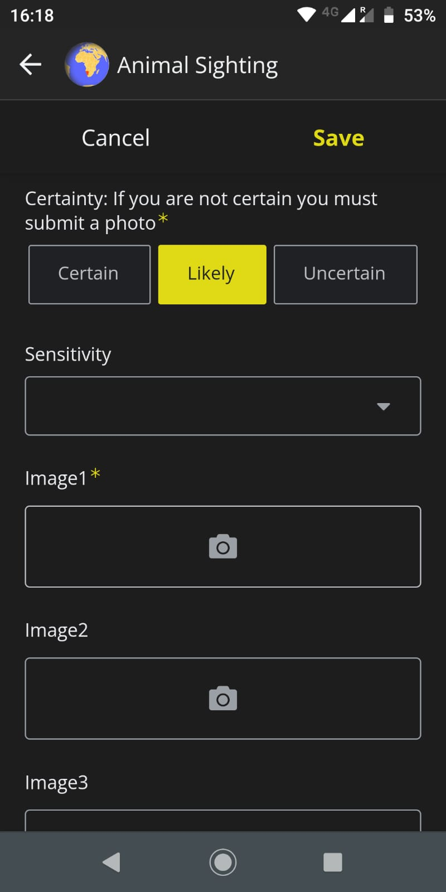
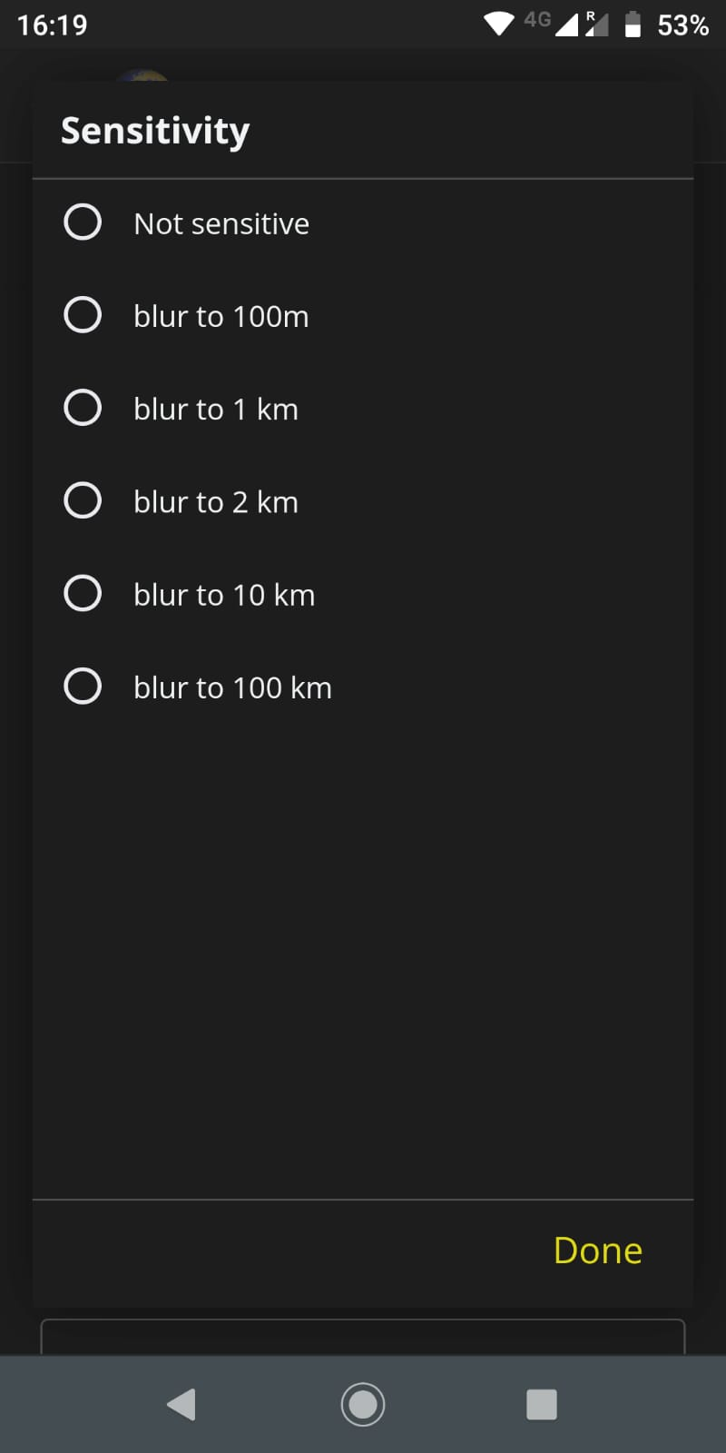
Take a photo or choose one from your gallery.
Add up to three photos.
For snakes, you can choose to ‘blur’ the display of the coordinates on the website.
This is automatic for 4 species of vulnerable snakes.
Rhino and pangolin locations are never shown on the website.

Slide 21
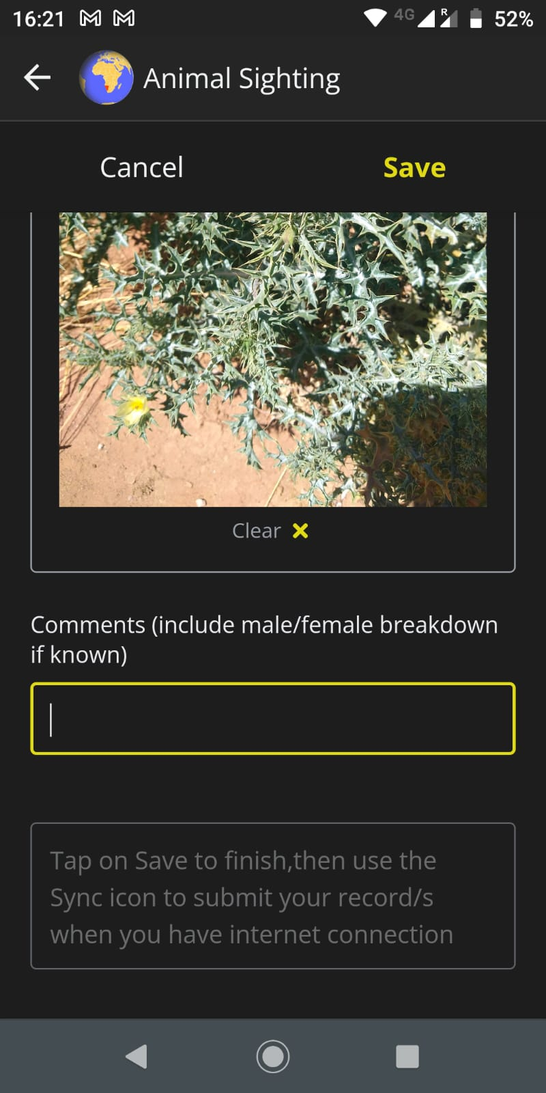
Add any comments on e.g. group size, habitat, behaviour, weather.
Click Save to finish the record.

Slide 22
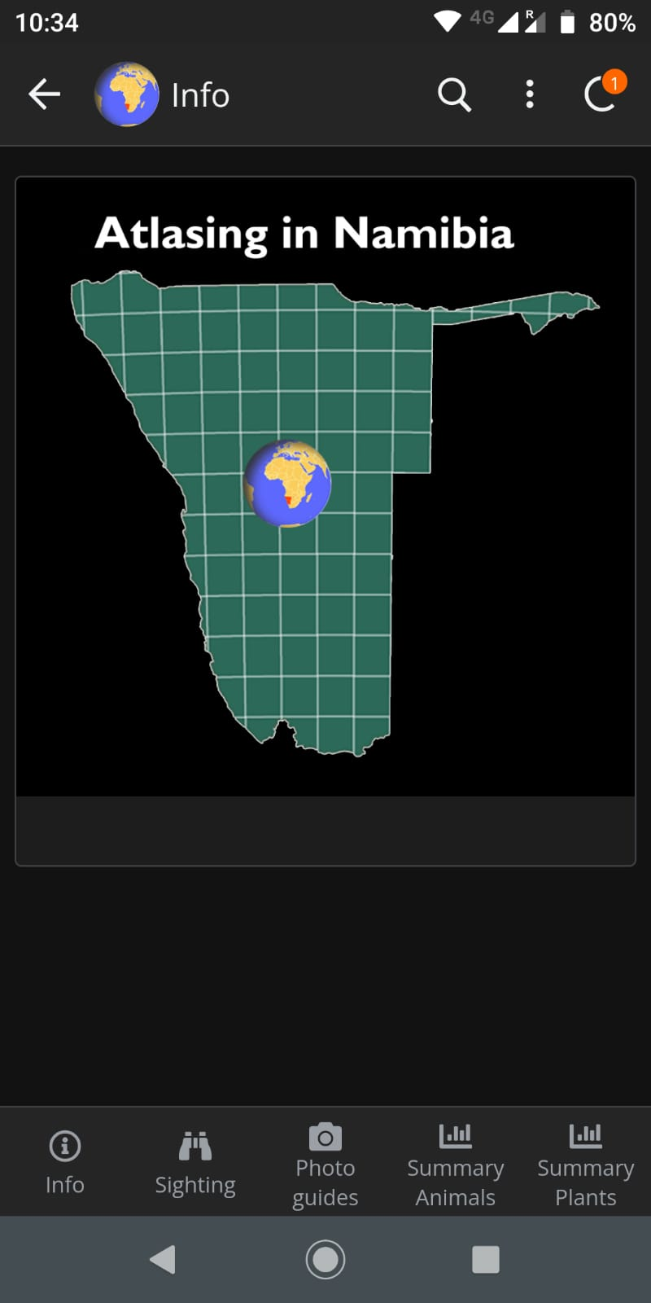
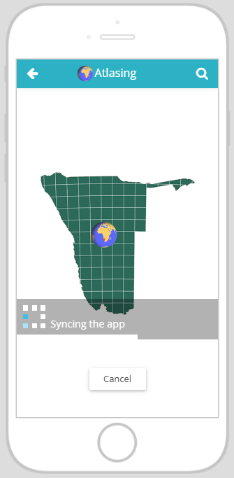
The number tells you how many records are stored on the app.
Note that your App records will not appear instantly on the website. They are uploaded regularly in batches.
Tap on “Sync” to synchronise when you have internet. This uploads your records and downloads any app upgrades.

Slide 23
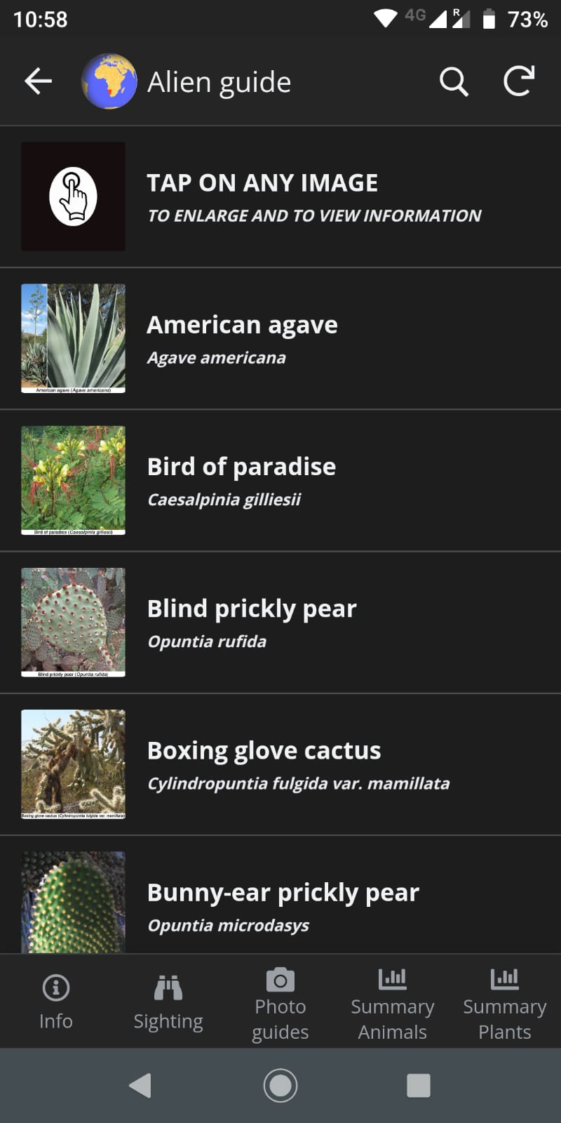
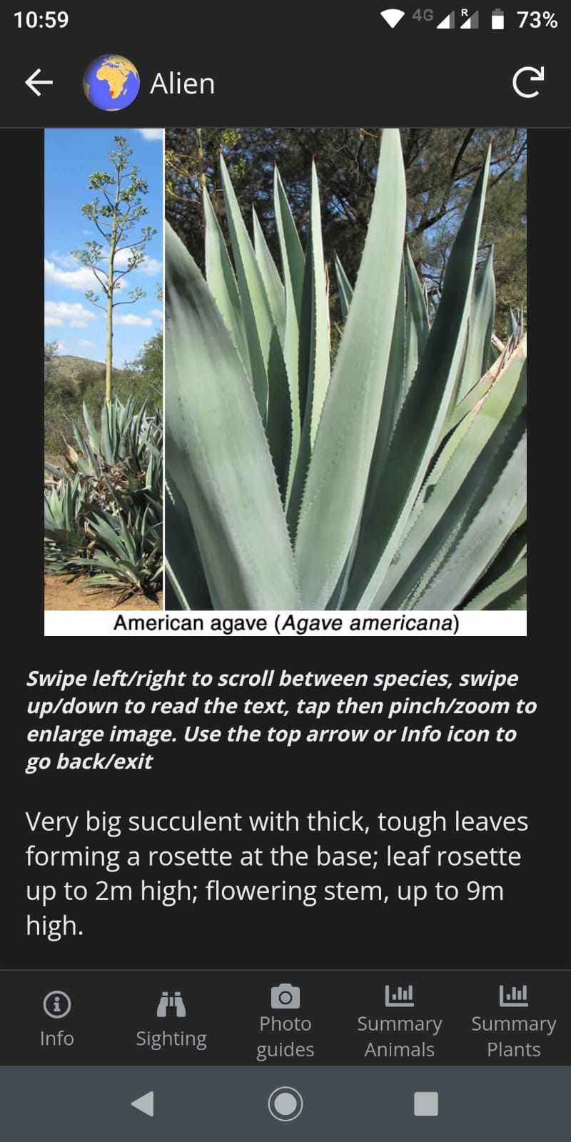
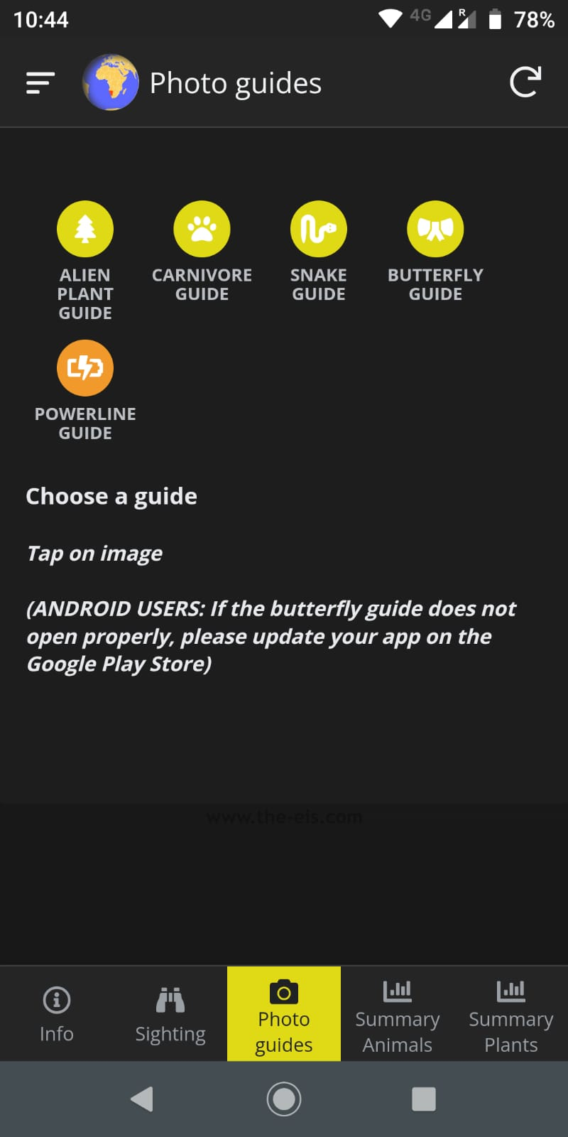

Slide 24
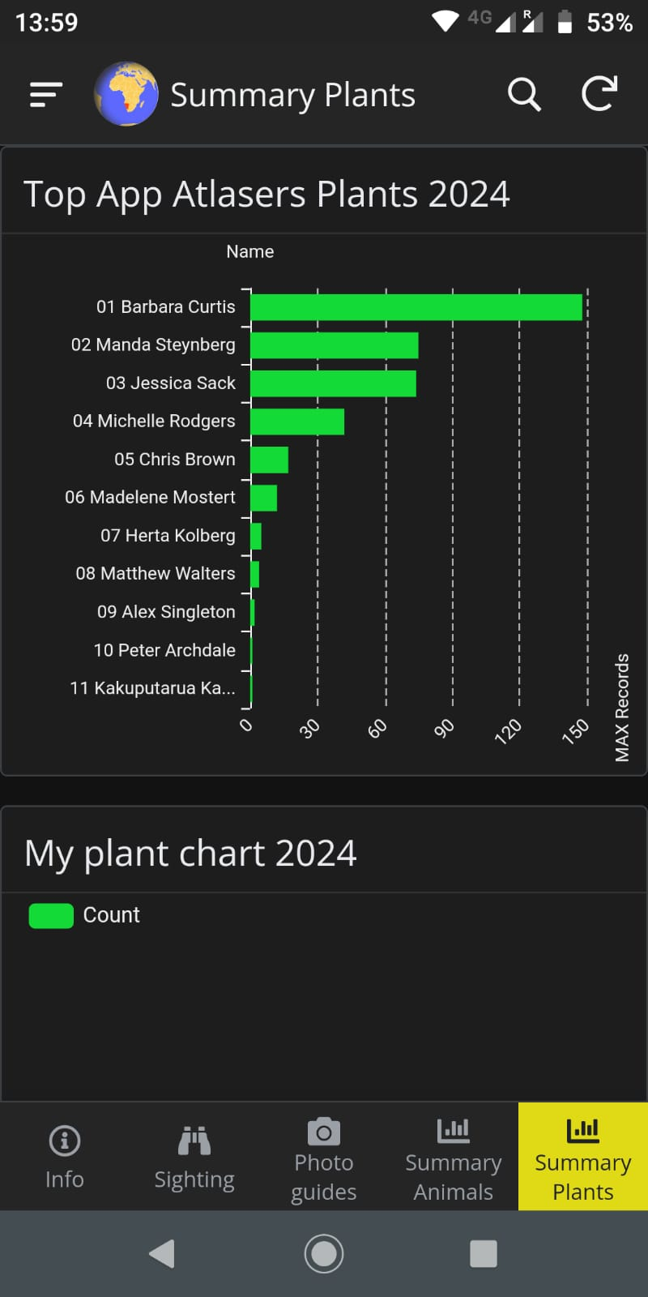
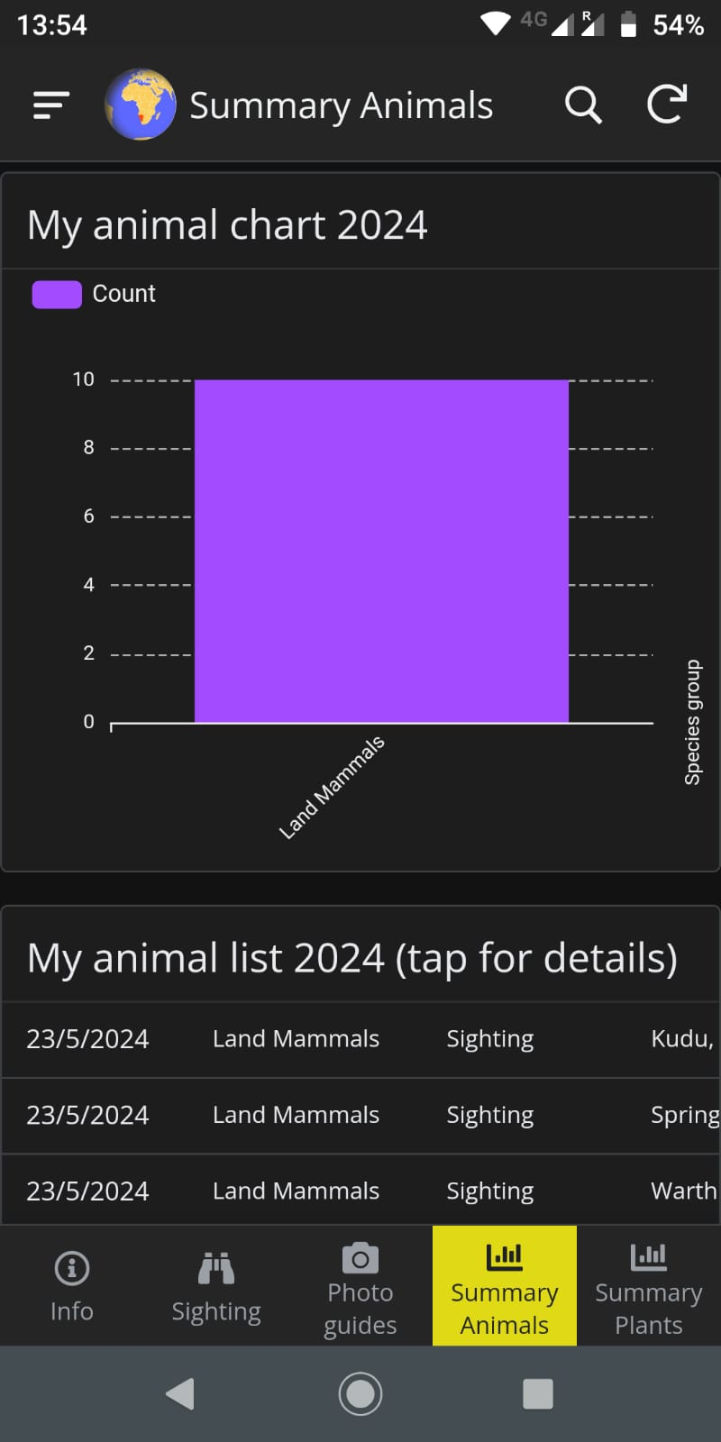
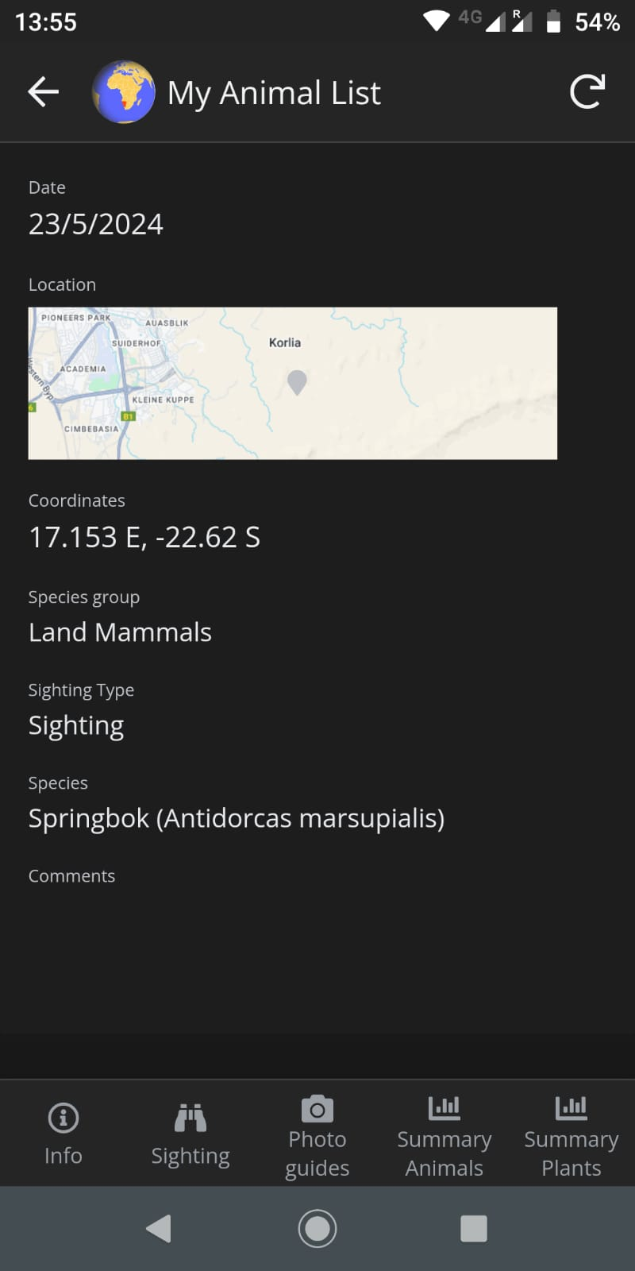
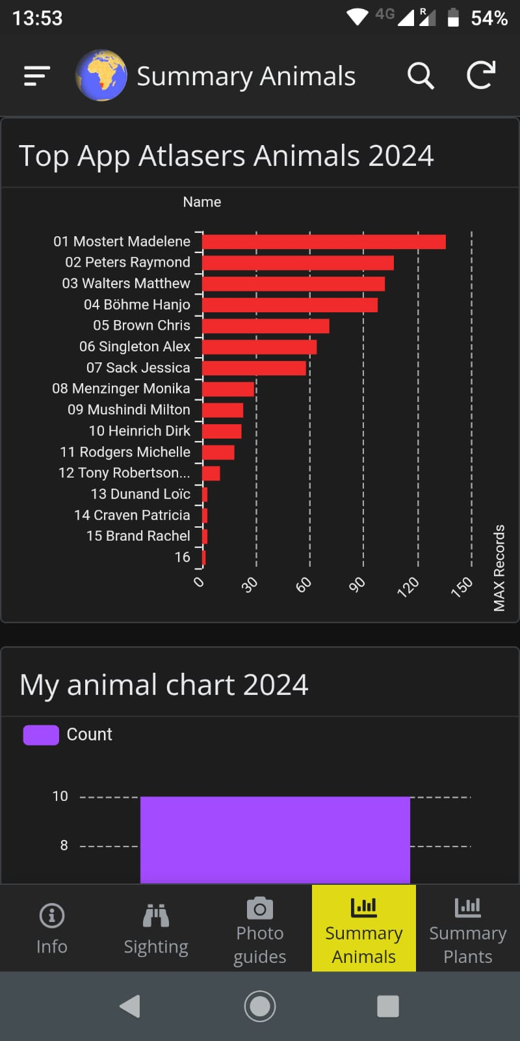

Slide 25
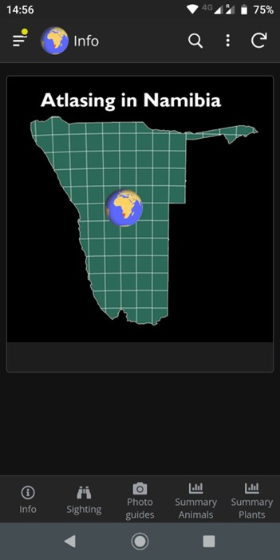
App or website?
Use the App when you are out and about and want your records to be submitted with your current location and the current date and time
Use the website:
To submit any records where you need to attribute a different date and time, or location
To view your records and to edit them if necessary

Slide 26
The Atlasing in Namibia App was designed and developed by Tony Robertson.
Credits
The EIS is currently supported by the Namibian Chamber of Environment.
EIS is hosted by Paratus Telecom.

Slide 27
Citizen Science: Atlasing in Namibia
www.the-eis.com/atlas
Thank you

